Slide 1



Interactive Visualization & Exploration of
Patient Progression in a Hospital Setting
  Innovative Applications of Data Visualization in Healthcare
  S38
Wathsala Nayomi
  School of Medicine, University of Utah
Scientific Computing and Imaging Institute, University of Utah.
Notes:
Hello, Good afternoon, Everyone.
My name is Wathsala and I am here to present a framework which allows interactive exploration of patient progression over time.
This work was carried out while I was working as a graduate intern for the school of medicine in University of Utah, and it was performed in collaboration with Lawrence Livermore national laboratory and Scientific Computing and Imaging Institute in University of Utah.

Slide 2
Electronic health records (EHRs) produce large volumes of clinical data.
Effectively understanding this data is of interest
One research direction is using visual analytics
Notes:
As healthcare systems increasingly adopt the use of EHRs, large volumes of clinical data are captured on a daily basis.
These data provide comprehensive details about patients.
As a result, they have the potential improve a wide range of application domains in healthcare such as patient outcome prediction and personalized medication.
So, physicians and clinical researchers are very much interested in finding effective methods to understand this abundance of data.
One research direction is using visual analytics.

Slide 3
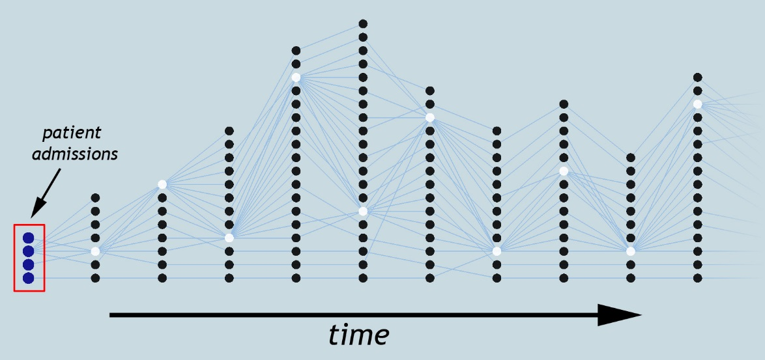
We allow interactive visualization & exploration of patient progression over time.
Due to large data sizes, analyzing patient progression is challenging.
Our approach…
  Patient group-based analysis
  Dynamic grouping
  Patient Progression via tracking graphs
  Interactive exploration
Notes:
In this work, we try to analyze the data within EHRs, to understand how patients progress over time.
Specifically, we present a visualization and analysis environment to understand the patient progression.
The main challenge we face when trying to analyze patient progression over time .. is the large data size
In our work, we tried to address this challenge in several manners.
First, since patient-based analysis is time consuming given the data sizes, instead of a per-patient analysis, we allow patient group-based analysis.
Second, in order provide the flexibility in defining the patient groups, we allow both the method of grouping and the level of grouping to be defined
Third, we make use of tracking graphs to visualize the patient progression in a concise manner.
This is a common representation used to visualize time-varying datasets. It provides a global overview of feature evolution over time and is amenable to quick simplifications.
Here is a example tracking graph showing the progression of patients over time.
Finally, we make use of optimized data structures and progressive visualization techniques to enable interactive exploration of data.
Combined, these provide the capability to explore large data sets in an interactive fashion.

Slide 4
I. Grouping patients within a time step
T₁
T₂
T₃
T_{n}
Notes:
Given a dataset, first, lets look at how patients are grouped within each time step.

Slide 5
I. Grouping patients within a time step
Hierarchical clustering encodes patients at multiple scales
User-defined similarity metric
(e.g. symptom-based, outcome-based)
Patient A
Patient B
Patient C
Patient D
Patient E
Patient F
Patient G
patient similarity
Patient Hierarchy

Slide 6
I. Grouping patients within a time step
Hierarchical clustering encodes patients at multiple scales
User-defined similarity metric
(e.g. symptom-based, outcome-based)
Store patient group-based attributes
(e.g. mean age, avg. heart rate)
Patient A
Patient B
Patient C
Patient D
Patient E
Patient F
Patient G
a_{1,} hr₁
a_{2,} hr₂
a_{3,} hr₃
patient similarity
a_{4,} hr₄
a_{5,} hr₅
Patient Hierarchy

Slide 7
I. Grouping patients within a time step
Hierarchical Representation
Grouping of patients
Store patient group-based attributes
This allows exploration of patient groups
for a range of patient similarity values
Patient A
Patient B
Patient C
Patient D
Patient E
Patient F
Patient G
a_{1,} hr₁
a_{2,} hr₂
a_{3,} hr₃
patient similarity
a_{4,} hr₄
a_{5,} hr₅
Patient Hierarchy

Slide 8
II. Correlating patient groups over time
T₁
T₂
T₃
T_{n}

Slide 9
II. Correlating patient groups over time
Correspondence metric enable patients to be tracked across time
User-defined correspondence metric
(e.g. similarity-based)
t
t + 1
t + 2

Slide 10
II. Correlating patient groups over time
Meta-graph structure
Correlations for a range of similarity values
Store correlation-based attributes
This allows exploration of
patient progression for
a range of patient similarity values.
t
t + 1
t + 2
W. Widanagamaachchi, C. Christensen, P.-T. Bremer, and V. Pascucci. Interactive exploration of large-scale time-varying data using dynamic tracking graphs. In IEEE Symposium on Large Data Analysis and Visualization (LDAV), 2012, pages 9–17, 2012.

Slide 11
II. Correlating patient groups over time
s
s
s
t
t + 1
t + 2
Time

Slide 12
III. Visualization & Exploration

Slide 13
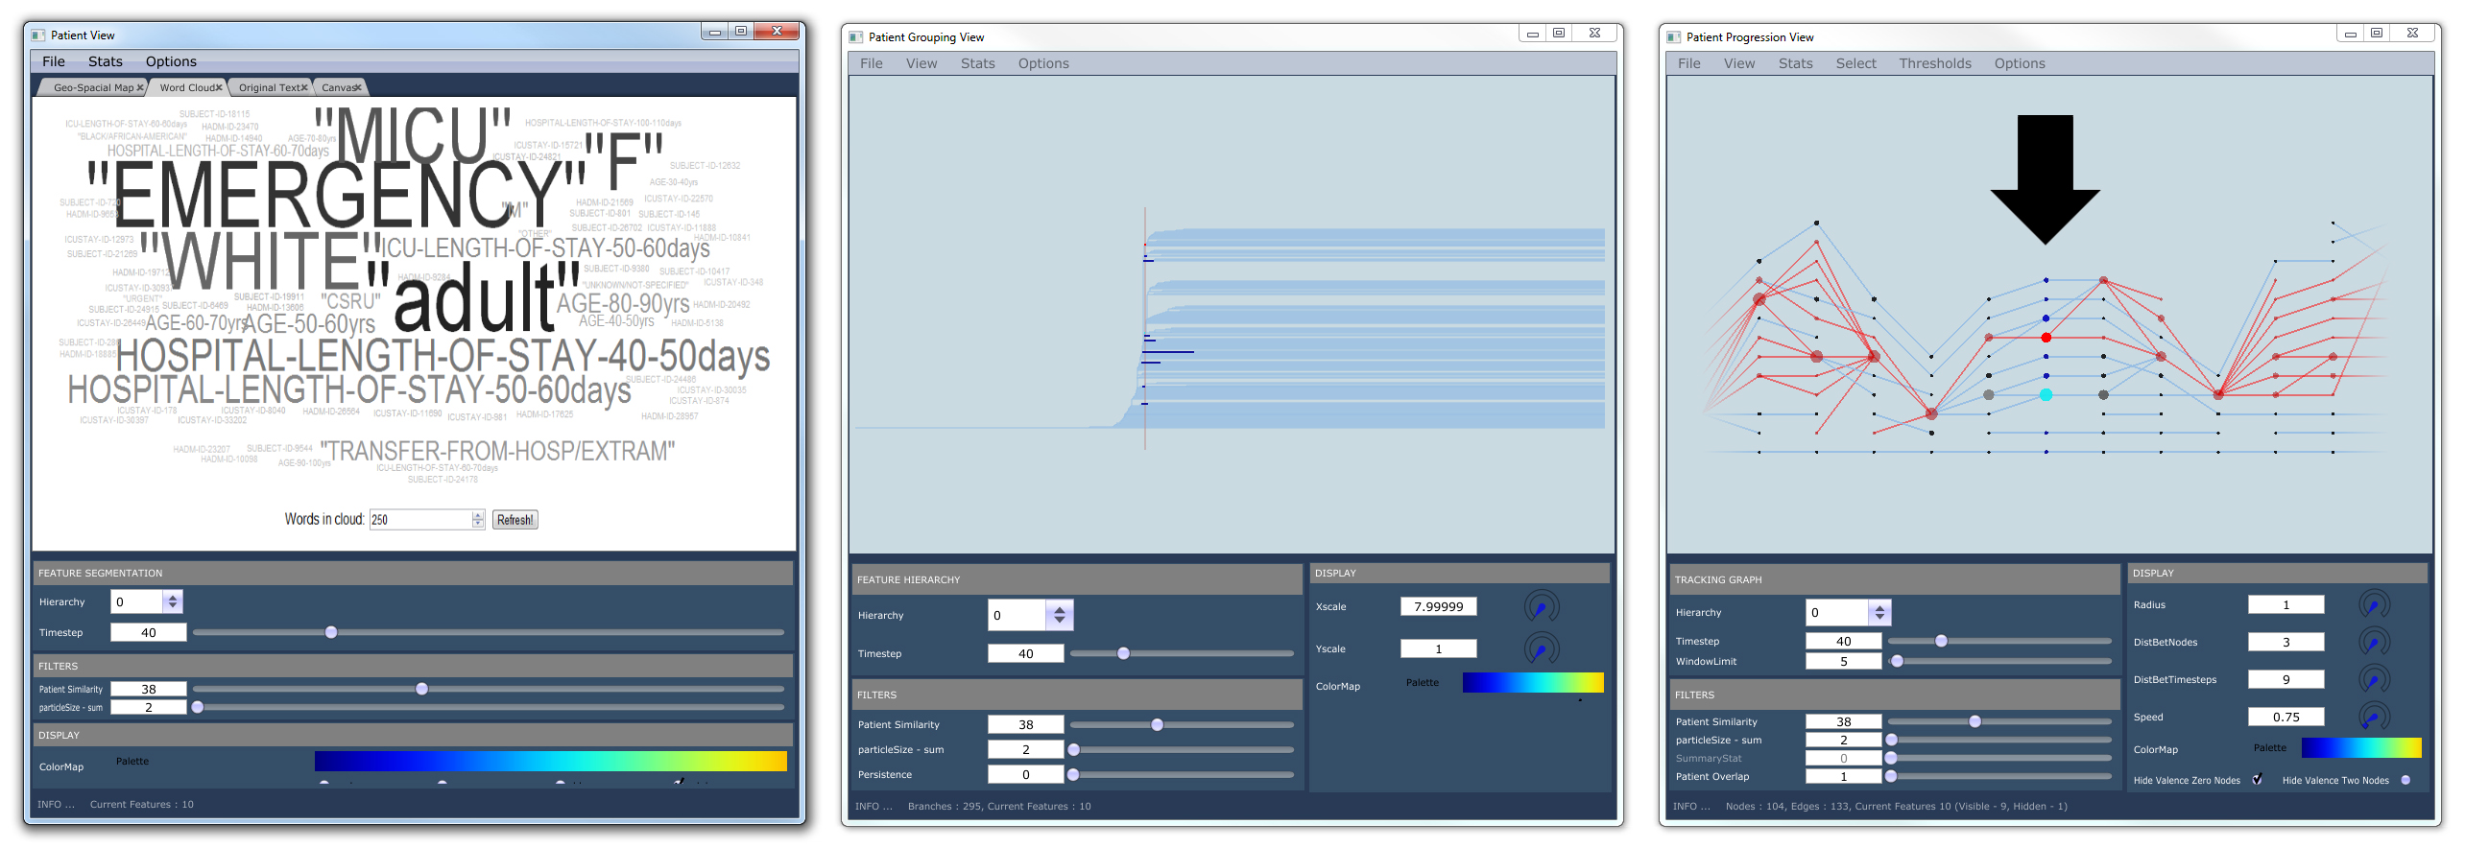
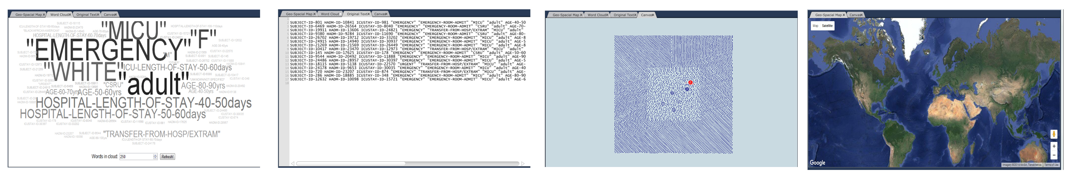
III. Visualization & Exploration
Patient View
Patient Grouping View
Patient Progression View
Word Cloud
Textual
Geometric Embedding
Geospatial

Slide 14
Results
MIMIC II clinical dataset
EHRs from ICUs
2001-2008 period
~27 GB
Extract information
for each day in a
patient’s hospital stay
Align data by admission date
Dataset after conversion
38291 patient admissions
174 days / time steps
~680MB
Similarity based on metric by Lee et al.
38291 patient admissions
from 32536 patients
Personalized mortality prediction driven by electronic medical data and a patient similarity metric. J. Lee, D. M. Maslove, and J. A. Dubin. PloS one, 10(5):e0127428, 2015.
Compute patient hierarchies
& meta-graph

Slide 15
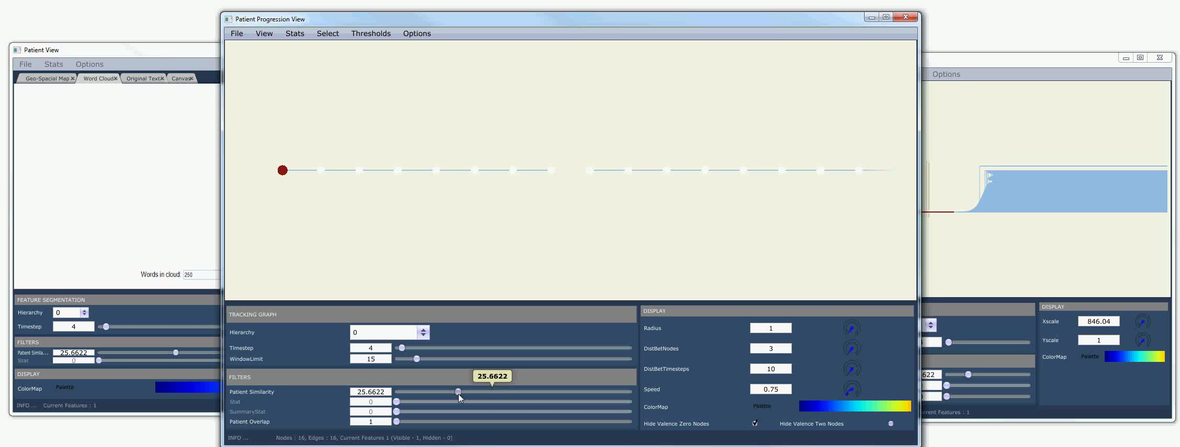
Results

Slide 16
Results
MIMIC II dataset Insights
  Appropriate similarity range is 30 – 38 for Lee et al. metric
  Only 6 have hospital lengths of stays greater than 90 days (i.e., 3 months)
Advantages
  Optimized data structures
  Progressive visualizations
  Interactive exploration
  Flexible grouping & correlations metrics

Slide 17
Summary
Understanding patient progression over time
Visualization & analysis environment
Future work
  Improved patient similarity metrics
  Additional healthcare datasets (with geospatial data)
  In a hospital setting

Slide 18
Thank you!
  Email me at: wathsy@sci.utah.edu

Slide 19
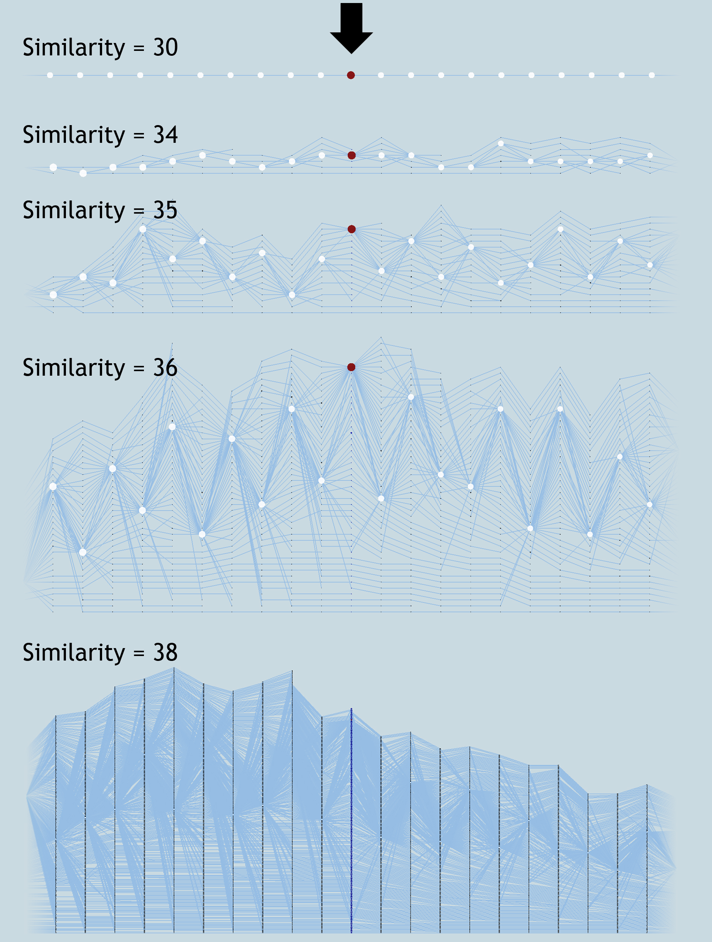

Slide 20
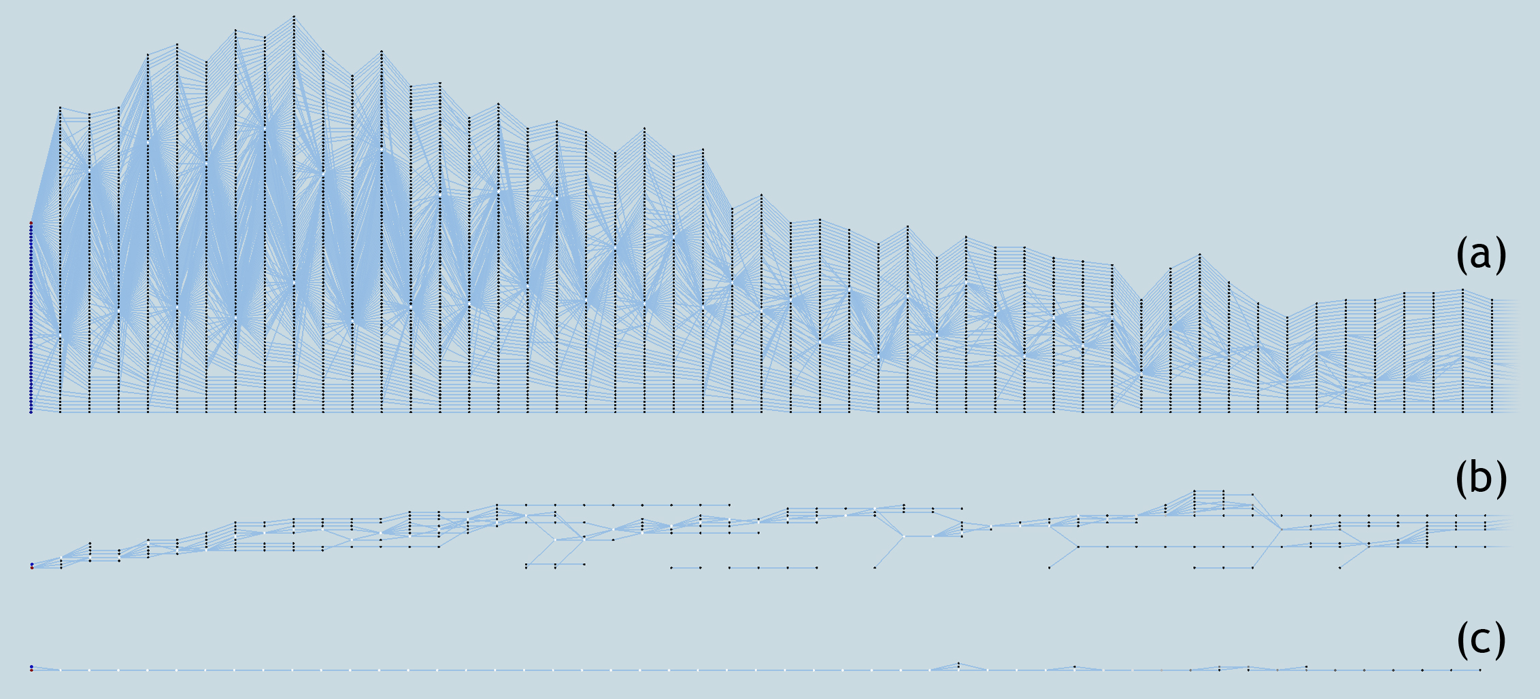

Slide 21
