Slide 1



Interactive Visualization & Exploration of
Patient Progression in a Hospital Setting
Wathsala Widanagamaachchi¹, Yarden Livnat¹, Peer-Timo Bremer², Scott Duvall³, Valerio Pascucci¹.
¹Scientific Computing and Imaging Institute, University of Utah.
²Lawrence Livermore National Laboratory.
³School of Medicine, University of Utah.

Slide 2
Electronic health records (EHRs) produce large volumes of clinical data.
Effectively understanding this data is of interest
Use of visual analytics

Slide 3
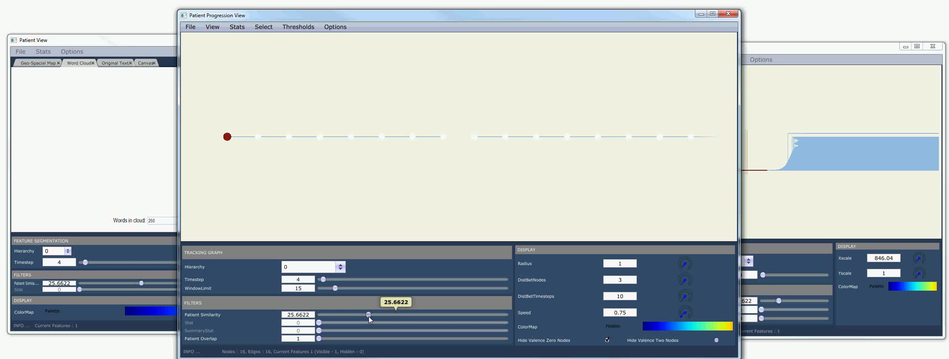
We allow interactive visualization & exploration of patient progression over time.

Slide 4
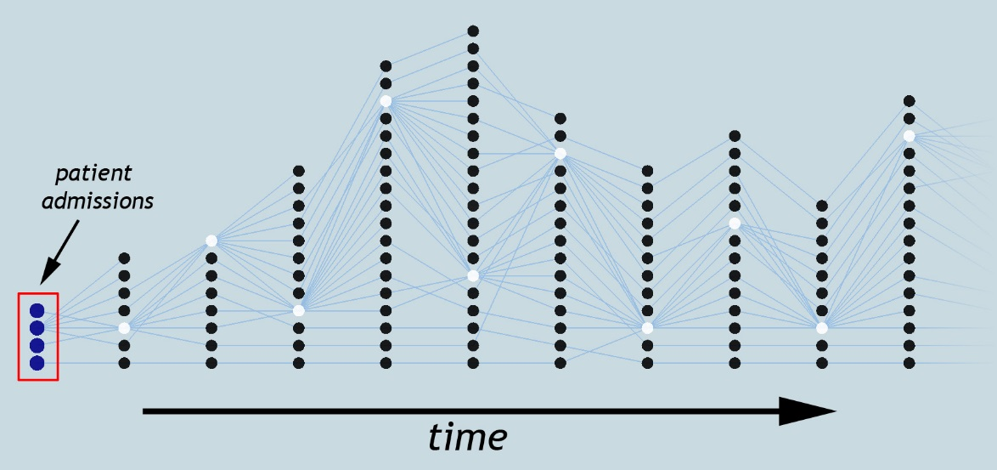
Patient Grouping
Due to large data sizes…
analyzing patient progression is challenging.
Patient Correlation
Visualization & Exploration
Our approach…
patient group-based analysis
allow dynamic grouping
progression via tracking graphs
interactive exploration

Slide 5
I. Grouping patients within a time step
Hierarchical clustering
User-defined similarity metric
Store patient group-based attributes
Patient 1
Patient 2
Patient 3
Patient Similarity
Patient
Group
Patient 1
Patient 1
Allows exploration of patient groups for a range of patient similarity values.
Patient 2
Patient 2
Patient 3
Patient 3

Slide 6
II. Correlating patient groups over time
Meta-graph structure
Correlations for a range of similarity values
Store correlation-based attributes
Tracking
individual patients
t
t + 1
t + 2
W. Widanagamaachchi, C. Christensen, P.-T. Bremer, and V. Pascucci. Interactive exploration of large-scale time-varying data using dynamic tracking graphs. In IEEE Symposium on Large Data Analysis and Visualization (LDAV), 2012, pages 9–17, 2012.

Slide 7
II. Correlating patient groups over time
Allows exploration of patient progression for a range of patient similarity values.
s
s
s
t
t + 1
t + 2

Slide 8
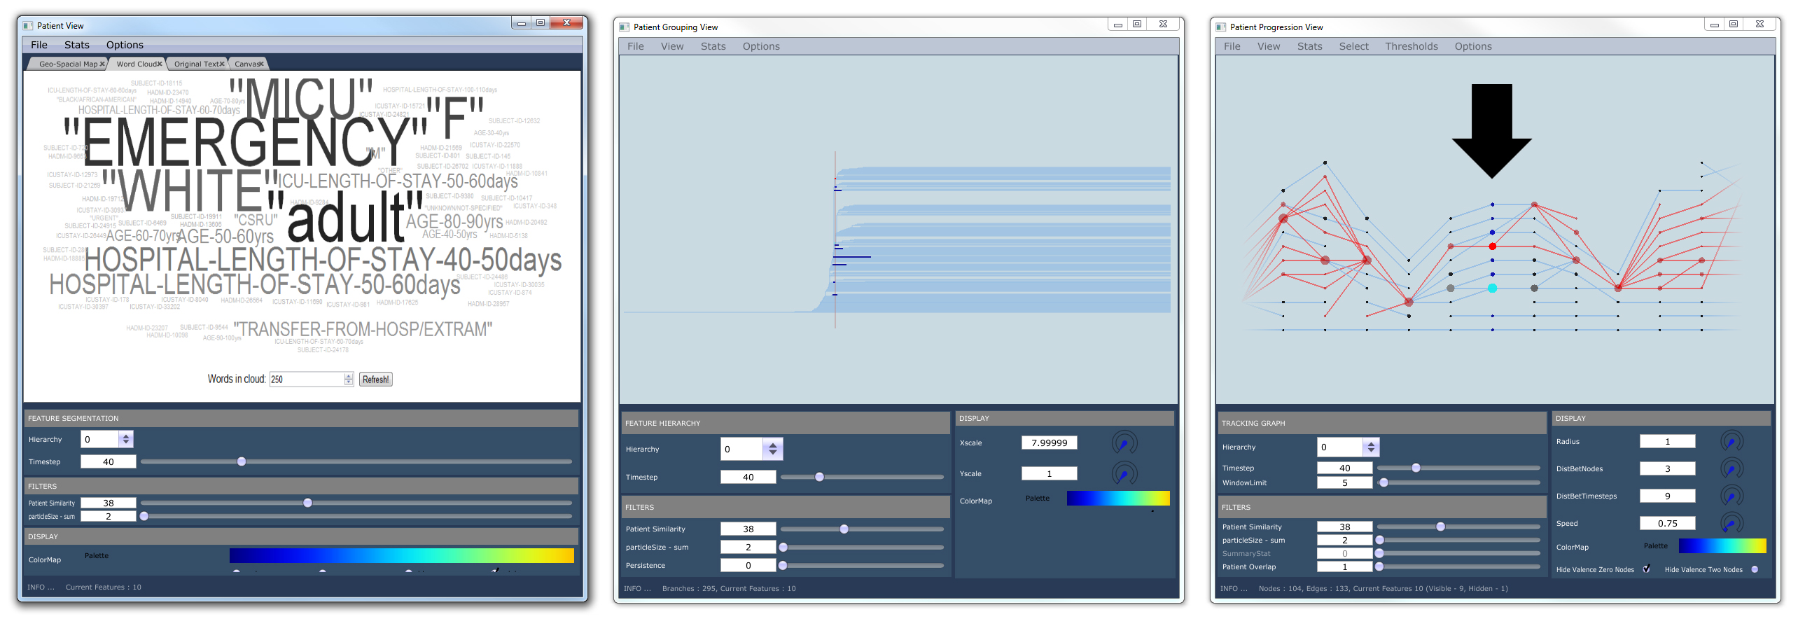
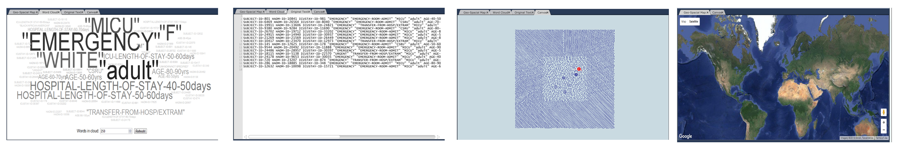
III. Visualization & exploration
Word Cloud
Textual
Geometric Embedding
Geospatial
Patient View
Patient Grouping View
Patient Tracking View

Slide 9
Results
Pre-processing step
Extract information
for each day in a
patient’s hospital stay
MIMIC II clinical dataset
EHRs from ICUs
2001-2008 period
~27 GB
Align data by admission date
Similarity based on metric by Lee et al.
Dataset after conversion
38291 patient admissions 174 days / time steps
~680MB
Personalized mortality prediction driven by electronic medical data and a patient similarity metric. J. Lee, D. M. Maslove, and J. A. Dubin. PloS one, 10(5):e0127428, 2015.
Compute patient hierarchies
& meta-graph

Slide 10
Results

Slide 11
Summary
Understanding patient progression over time
Visualization & analysis environment
Future work
Improved patient similarity metrics
Additional healthcare datasets
In a hospital setting

Slide 12
Thank You!!!

Slide 13
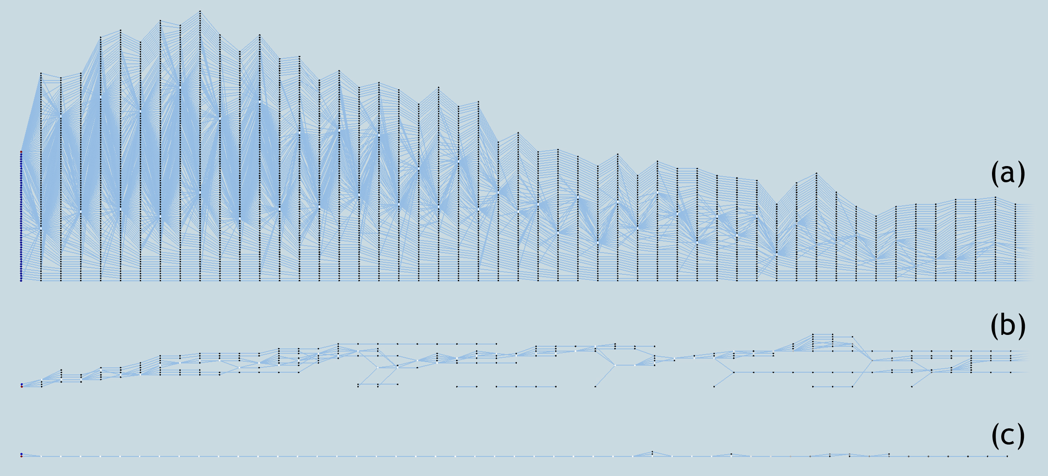
Results
Tracking graph simplification
Patient overlap ≥ 2
Patient group size ≥ 5

Slide 14
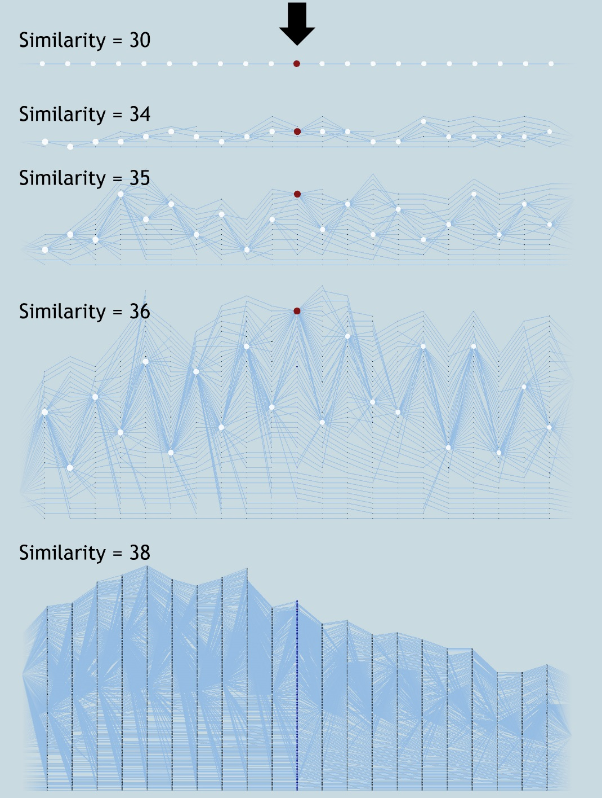
Results
Insights on similarity metric

