Slide 2
Ray Graphs … A Flexible Framework for Fusing Image Collections into Panoramas
Wathsala Widanagamaachchi
in collaboration with
Paul Rosen & Valerio Pascucci
SCI Institute, University of Utah, USA

Slide 3
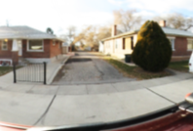
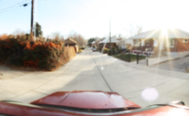
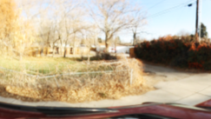
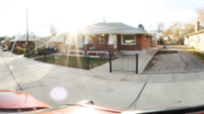
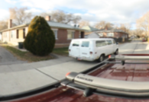
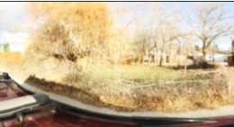
Managing, Displaying & Analyzing Large Image Datasets is Challenging
A surge of image & camera data is available
One promising approach is… Panoramas

Slide 4
What is a panorama?
A wide-area or wide-angle view of a physical space
More comprehensive than conventional image
360⁰ panorama
Street panorama

Slide 5
Motivation
Lack of a general technique which can assemble diverse variety of panoramas

Slide 6
Contributions
Ray Graph structure
Unifies panorama construction
Creation of arbitrary shaped panoramas
Two new forms of panoramas
Centipede panorama
Storytelling panorama
Semi-automatic panorama modification

Slide 7
System
Set of images + Camera parameters
Data Preprocessing
Optical Flow*
Pose Estimation
Ray Graph Construction
Image Generation
Panorama

Slide 8
Ray Graph
An implicit weighted graph structure
Defines coherency between all pairs of rays within a set of images
Ray Graph
Camera Rays
r₀
r₁
r₂
r₃
r₀
r₀
r₁
r₁
r₂
r₂
r₃
r₃
Edge strength
increases
C

Slide 9
Ray Graph – Edge tuple
Edge weight is a tuple.. { S_{D} , S_{P} , S_{T} }
Temporal Coherency
S_{T} (t₀, t₁) = t₁ – t₀
Directional Coherency
S_{D} (r₀, r₁) = 1 -$\frac{r0.r1}{\left|r0\right| \left|r1\right|}$
Positional Coherency
S_{P} (C₀, C₁) = |C₀ - C₁|

Slide 10
Panorama Construction
A path through the Ray Graph
Traversal algorithm is defined using a simple set of rules
Camera Rays
r₀₀
r₀₁
r₀₂
r₀₃
r₁₀
r₁₁
r₁₂
r₁₃
Ray Graph
r₀₀
r₀₀
r₀₁
r₀₂
r₀₃
r₁₀
r₁₁
r₁₂
r₁₃
C₀
C₁

Slide 11
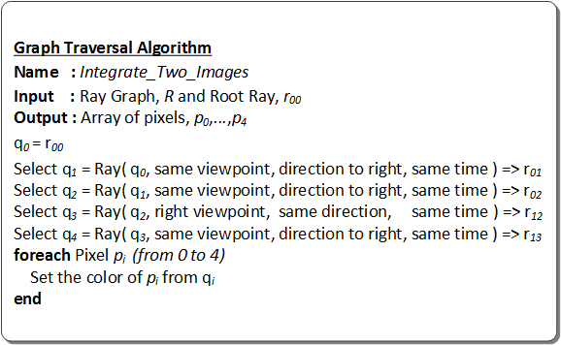
Camera Rays
r₀₀
r₀₁
r₀₂
r₀₃
r₁₀
r₁₁
r₁₂
r₁₃
Ray Graph
r₀₀
r₀₀
r₀₁
r₀₁
r₀₂
r₀₃
r₀₂
r₁₀
r₁₁
r₁₂
r₁₃
r₁₂
r₁₃
C₀
C₁

Slide 12
360⁰ Panorama
Constructor
r₀
r₀
r₁₀
r₁
Maintain directional coherency by varying the view direction
r₉
r₂
r₈
C
r₃
r₇
r₄
r₆
r₅

Slide 13
360⁰ Panorama

Slide 14
Street Panorama
Constructor
r₀₃
r₁₃
r₂₃
r₃₃
r₀₃
Maintain directional and spatial coherency by selecting rays in the same direction, from different viewpoints
C₀
C₁
C₂
C₃

Slide 15
Street Panorama

Slide 16
Centipede Panorama
Constructor
A
First new panorama
Integrates both wide-angle and wide-area views
Combines the advantages of both 360⁰ and street panoramas
C
D
B

Slide 17
Centipede Panorama
Constructor

Slide 18
Storytelling Panorama
Constructor
A
Present
B
Second new panorama
Fuses a set of images which vary over time
Time
Past

Slide 19
Storytelling Panorama
Present
Present
As the panorama moves deeper in time….
proportion of rays from the distant past is decreased.
Present
Time
Present
Time
Time
Time
Time
Constructor
Present
Past
Past
Past
Past

Slide 20
Panorama Modification
Stroke-based interface for repeated brushing of panoramic regions
Removes undesirable features in panoramas
Flags a set of rays & avoids them in re-generating the panorama

Slide 21
Panorama Modification

Slide 22
Limitations
Constructors are sensitive to the quality of input data
Temporal and spatial sparsity of data
Use of optical flow as a compensation
Ray Graph is sensitive to the quality of pose information

Slide 23
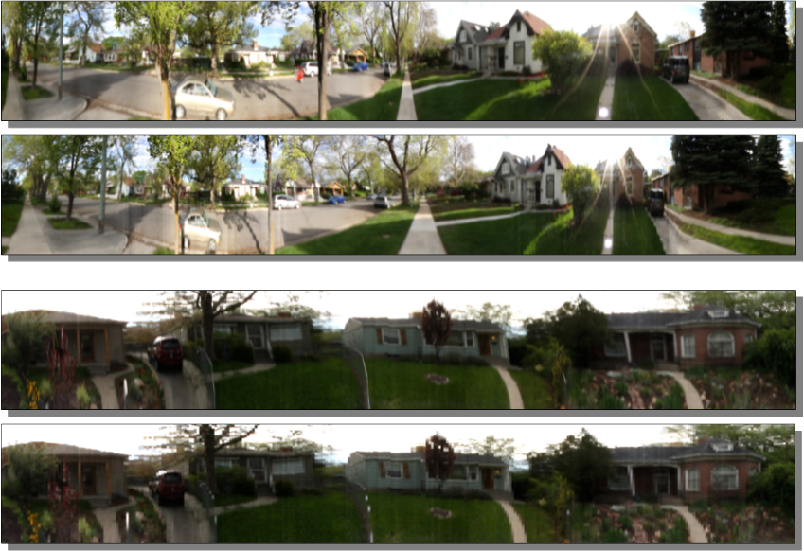
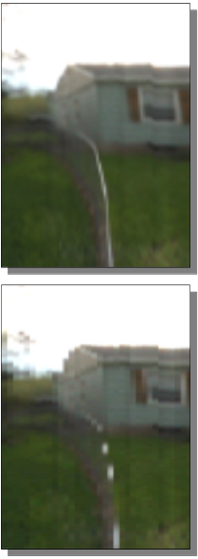
Limitations

Slide 24
Summary
Ray Graph, a system for unifying panorama construction
Two new panoramas : Centipede & Storytelling
Semi-automatic panorama modification method
Future Work
Possible iphone app
Additional coherency relationships ( e.g. depth )
Automatic panorama construction

Slide 25
Thank you…

Slide 26
Other Ray-based Representations
Light field & Lumigraph
capture multiple images into a dense set of rays
Concentric Mosaics
render novel views by combining rays
General Linear Cameras (GLCs)
partition an image plane into triangular images
These are a subset of the Ray Graph
Ray Graph is a more flexible representation

Slide 27
Results
3 Datasets
First 2 were collected using the 0-360 Panoramic Optic, a hyperbolic panoramic lens system, attached to a Canon Rebel XS DSLR camera
1 dataset : 1,300 panoramic images (25 GB and 5.45 billion rays) captured by attaching the system to a tripod and dolly.
2 dataset : 127 images (1.7 GB of data) captured using the same imaging system mounted on a vehicle.
3 dataset : Publicly available New College dataset, captured using a ladybug camera attached to a robot. 39,000 images (9.7 GB of data), only used a subset of 300

Slide 28
Performance
PC with a 3.2GHz Intel i7 CPU and 4.0GB of RAM
Data Preprocessing:
Optical flow : 90s to calculate and a few seconds to generate a new image.
Pose estimation :15-60s per image
Ray Graph:
Creation of the Ray Graph : 5-30s depending on the number of images
Speed depends on the complexity of analysis needed
Rendering Images: (All 4 types of panorama at 1280 X 720 output)
Cold cache : order of minutes
Warm cache : less than 1 frame per second or faster

Slide 29
Ray Graph – Edge tuple
Edge weight is a tuple.. { S_{D} , S_{P} , S_{T} }
Directional Coherency… S_{D} (r₀, r₁) = 1 -$\frac{r0.r1}{\left|r0\right| \left|r1\right|}$
Camera Rays
r₀₀
r₀₁
Ray Graph
r₀₀
r₀₁
r₀₂
r₀₃
r₁₀
r₁₁
r₁₂
r₁₃
Directional
r₀₀
r₀₁
r₀₂
r₀₃
r₁₀
r₁₁
r₁₂
r₁₃
Edge strength
increases
C₀
C₁

Slide 30
Ray Graph – Edge tuple
Edge weight is a tuple.. { S_{D} , S_{P} , S_{T} }
Positional Coherency... S_{P} (C₀, C₁) = |C₀ - C₁|
Camera Rays
r₀₀
r₀₁
Ray Graph
r₀₀
r₀₁
r₀₂
r₀₃
r₁₀
r₀₀
r₀₁
r₀₂
r₀₃
r₁₀
r₁₁
r₁₂
r₁₃
Positional
r₁₀
r₁₁
r₁₂
r₁₃
Edge strength
increases
C₀
C₁

Slide 31
Ray Graph – Edge tuple
Edge weight is a tuple.. { S_{D} , S_{P} , S_{T} }
Temporal Coherency… S_{T} (t₀, t₁) = t₁ – t₀

