Slide 1
Interactive Exploration of Large-Scale Time-Varying Data using Dynamic Tracking Graphs
Wathsala Widanagamaachchi*
in collaboration with
Cameron Christensen*,
Peer-Timo Bremer ⁺ and Valerio Pascucci*
* SCI Institute, University of Utah
⁺ Lawrence Livermore National Laboratory

Slide 2
Identifying and Tracking Features from Large Scientific Data is Challenging
Scientific simulations produce large datasets
Challenges when using large datasets…
Analyzing features
Understanding temporal evolution
Combustion simulations
TB size data sets
Several hundred timesteps
Burning of premixed hydrogen
100 timesteps & 400GB in size
Can we Identify & track the burning regions in time?

Slide 3
Identifying and Tracking Features from Large Scientific Data is Challenging
Scientific simulations produce large datasets
Challenges when using large datasets…
Analyzing features
Understanding temporal evolution
Combustion simulations
TB size data sets
Several hundred timesteps
Burning of premixed hydrogen
100 timesteps & 400GB in size
Can we Identify & track the burning regions in time?
Turbulent Combustion

Slide 4
We Enable Interactive Exploration of Massive Scientific Tracking Graphs
Abstract model showing the time evolution of features with interactive modification of their characterization

Slide 5
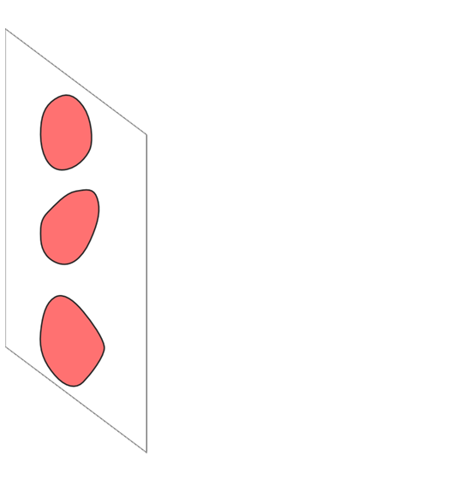
Tracking Graph Construction
t=0
Time

Slide 6
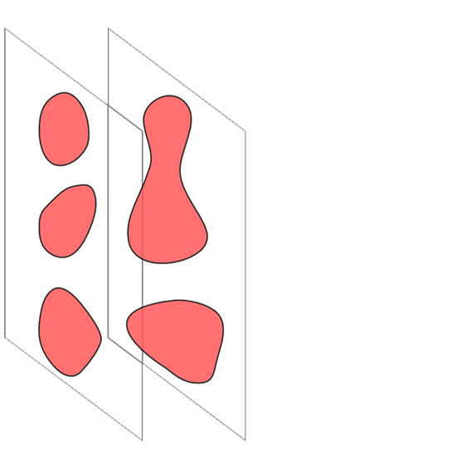
Tracking Graph Construction
t=0 t=1
Time

Slide 7
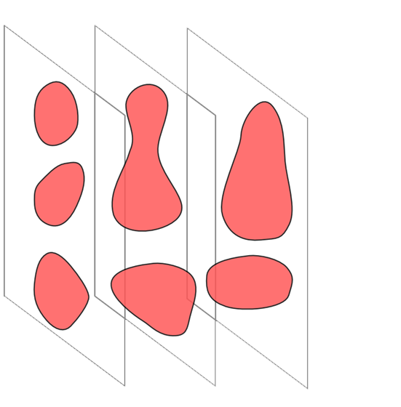
Tracking Graph Construction
t=0 t=1 t=2
Time

Slide 8
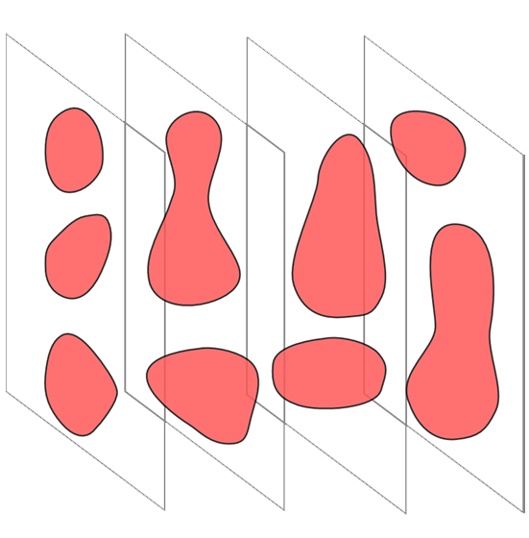
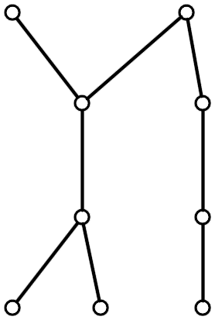
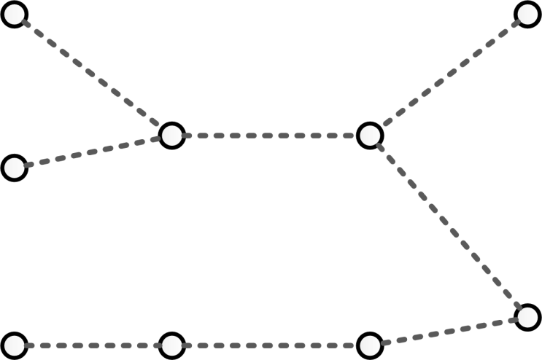
Tracking Graph Construction
t=0 t=1 t=2 t=3
Time

Slide 9
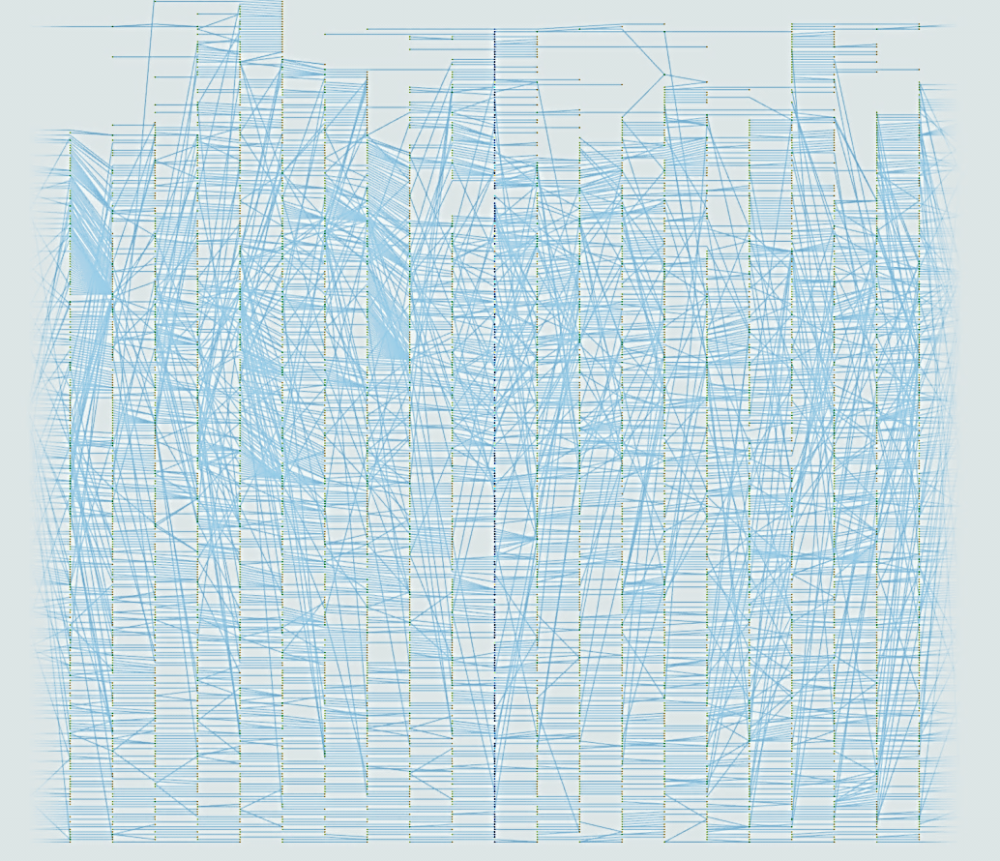
Tracking Graphs can be large
Computation is expensive
Layout creation is slow
Difficult to understand
Interactivity is needed to gain insight

Slide 10
Contribution
A system which allows..
Exploration of features
Progressive layouts
Modification of feature attributes & correlation criteria
Interactivity for TB size data
Mapping dynamics of the dataset with the visualization

Slide 11
System Components
When feature parameters & correlation criteria vary,
System interactively…
Select features
Generate tracking graphs
Layout & visualize tracking graphs

Slide 12
Topological Feature Families
Component 01 : Interactive Feature Selection
Use hierarchical merge trees
Encode all possible features for a wide range of feature parameters
References
Analyzing and tracking burning structures in lean premixed hydrogen flames, 2009.
Feature-based statistical analysis of combustion simulation data, 2011.
For the entire dataset, pre-compute features for a range of feature parameters

Slide 13
Merge Tree Construction
Component 01 : Interactive Feature Selection
Function
Value
y
z
x
Terrain Merge tree

Slide 14
Merge Tree Construction
Component 01 : Interactive Feature Selection
Function
Value
y
z
x
Terrain Merge tree

Slide 15
Merge Tree Construction
Component 01 : Interactive Feature Selection
Function
Value
y
z
x
Terrain Merge tree

Slide 16
Merge Tree Construction
Component 01 : Interactive Feature Selection
f
Function
Value
y
A feature
z
x
Terrain Merge tree

Slide 17
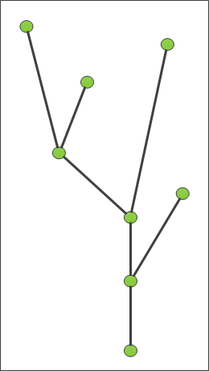
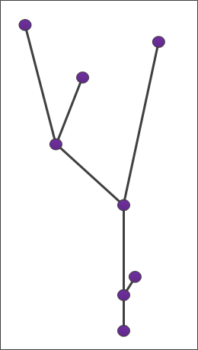
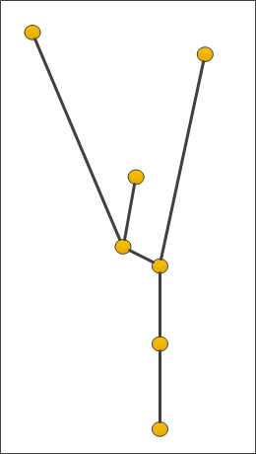
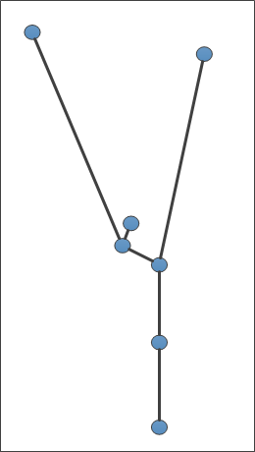
Component 02 : Interactive Tracking Graph Generation
Tracking Graph Construction
f₁
f₂
f₃
Function
Value
f₄
t=0 t=1 t=2 t=3

Slide 18
‘Meta-Graph’ – New Structure
Component 02 : Interactive Tracking Graph Generation
Meta-Graph
For all possible features in a particular time, encodes their correlation features in the consecutive timesteps.
Similar to the merge tree for features
Stores all possible tracking graphs & relevant attributes for a range of feature parameters
For the entire dataset, pre-compute tracking graphs for a range of feature parameters

Slide 19
Component 02 : Interactive Tracking Graph Generation
Meta-Graph Construction
f₁
f₂
f₃
Function
Value
f₄
t=0 t=1 t=2 t=3
Each edge stores…
Two end node details
Overlap amount

Slide 20
Extracting a Tracking Graph
Component 02 : Interactive Tracking Graph Generation
Given a meta-graph, feature families & a particular parameter setting…
Extract features & their edges
f₂
Function
Value
t=0 t=1 t=2 t=3

Slide 21
Extracting a Tracking Graph
Component 02 : Interactive Tracking Graph Generation
Dynamically update the graph, when parameters change
f₁
f₂
Function
Value
t=0 t=1 t=2 t=3

Slide 22
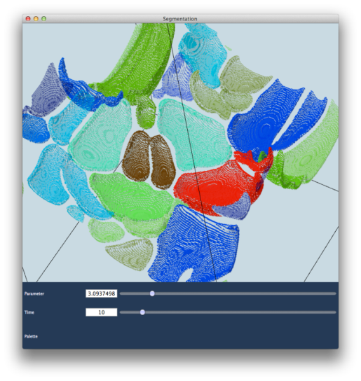
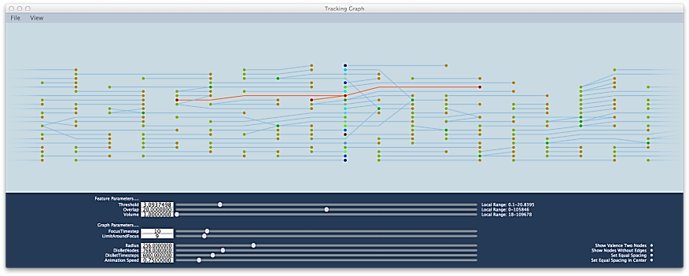
System Details
Selected Feature &
its tracking Graph
Two viewers
3D segmentation viewer
Tracking graph viewer
Focus timestep
User-defined window
Cross-linked selection
Visual effects
Animation
Fading & Blending
Feathering
Correlated color
mapping
Tracking graph
simplification
User-defined Window
Focus Timestep

Slide 23
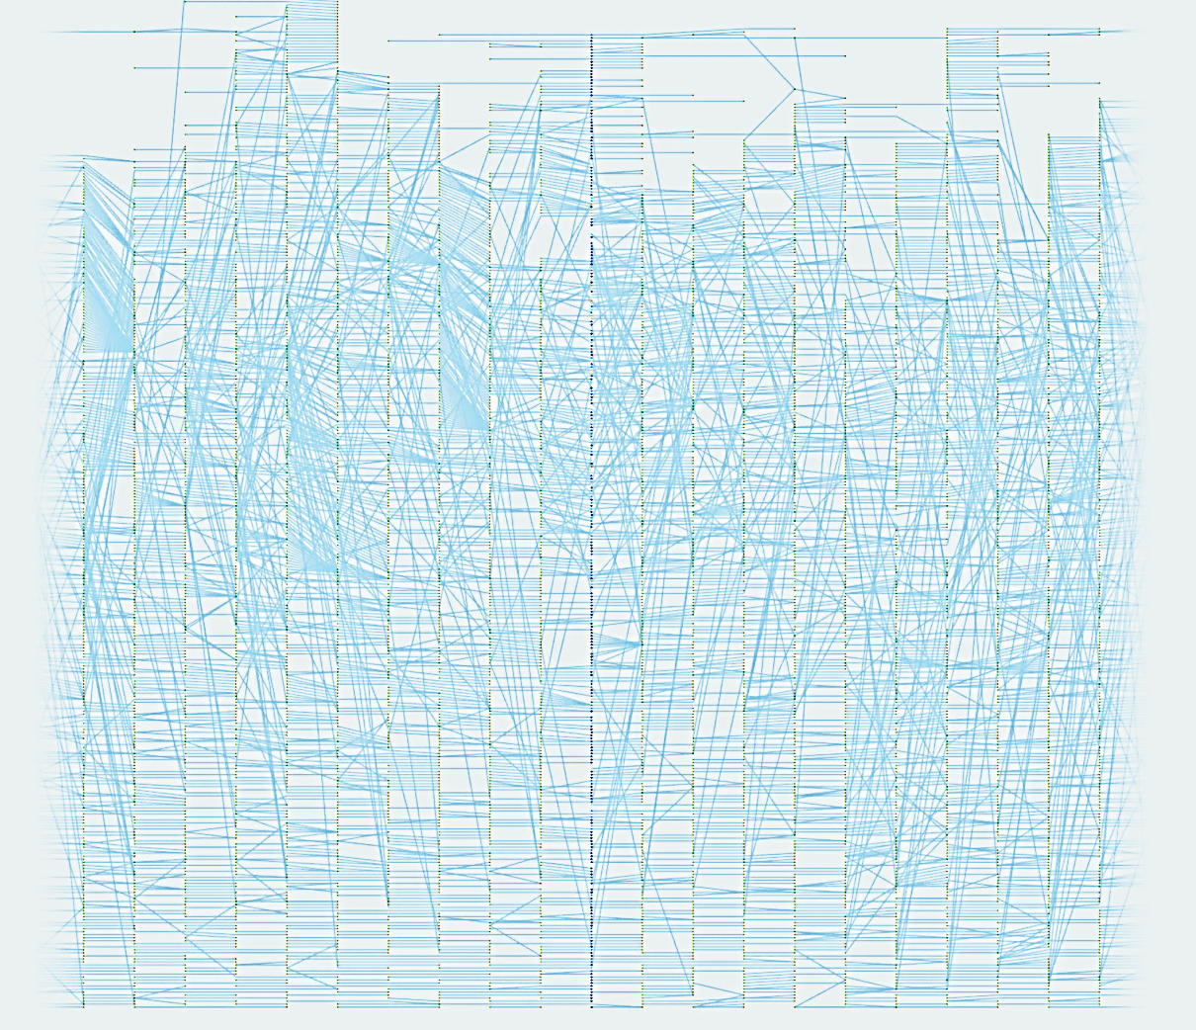
Interactive Graph Visualization
Component 03 : Interactive Graph Visualization
Use of
progressive graph layouts

Slide 24
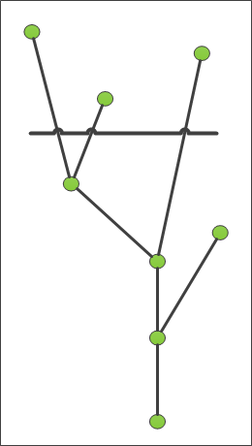
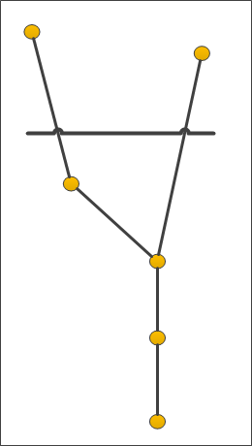
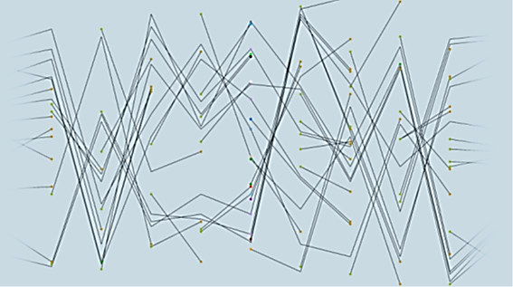
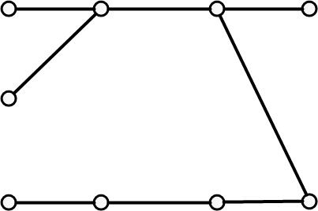
First Layout – Independent
Component 03 : Interactive Graph Visualization
f
f
Uses the depth-first ordering of features in merge trees
Computed ONCE at the start of system
Provides immediate feedback
Tracking Graph

Slide 25
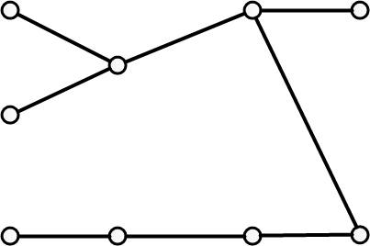
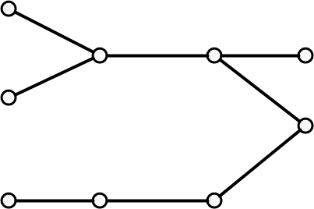
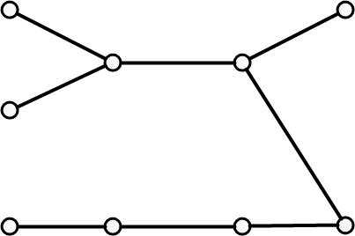
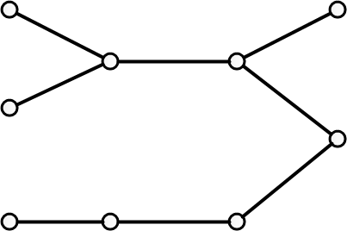
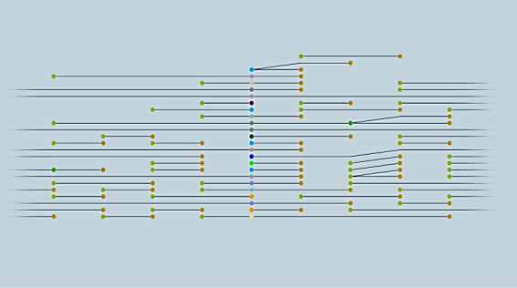
Second Layout - Greedy
Component 03 : Interactive Graph Visualization
Focus
Timestep
Layered optimization scheme
Median heuristic
Minimizes edge length &
reduce crossings

Slide 26
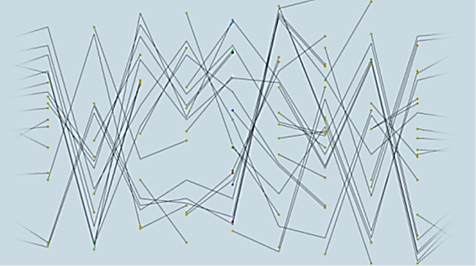
Layout Adaptation
Component 03 : Interactive Graph Visualization
First layout - Independent Second layout - Greedy
When parameters change,
adapt the current layout

Slide 27
Video

Slide 28
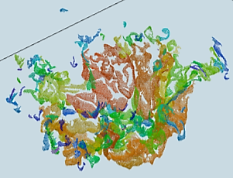
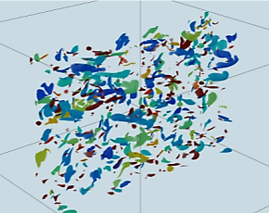
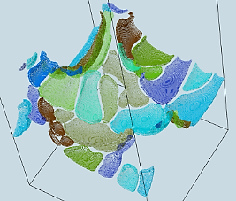
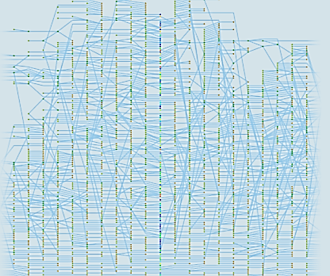
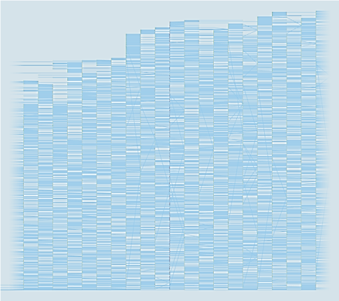
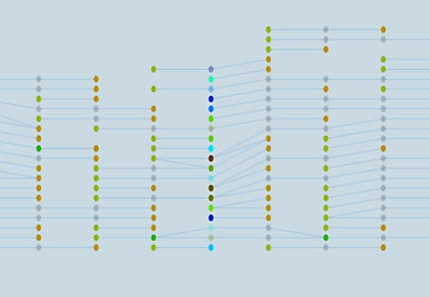
Results – Combustion Datasets
Burning of premixed low-swirl flame
331 timesteps
4TB data
Burning of premixed hydrogen flame
100 timesteps
400GB data
Burning of CO/H₂ jet flame
231 timesteps
1TB data

Slide 29
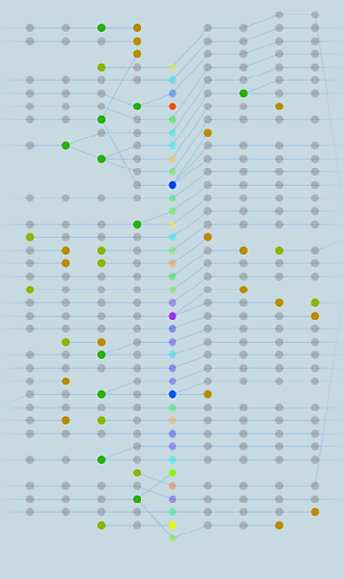
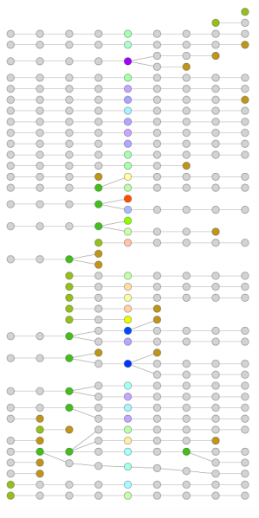
Greedy Layout vs Dot Layout
Interactive results
Compact layouts
Slow computation
High memory consumption

Slide 30
Summary
Interactive linked view system combining tracking graphs and feature displays
Progressive two-stage layout algorithm for displaying tracking graphs
Meta-Graph which can store all possible tracking graphs for a range of feature attributes
Progressive algorithm to extract, filter and simplify a tracking graph from a meta-graph

Slide 31
Future Work
Extend the scope of the framework
By using other datasets
(e.g. ocean data, cosmology data)
Improve analysis capabilities
By integrating more statistical views to features
Start with a compact view of data of the entire tracking graph and then refine it

Slide 32
Thank You…

Slide 33
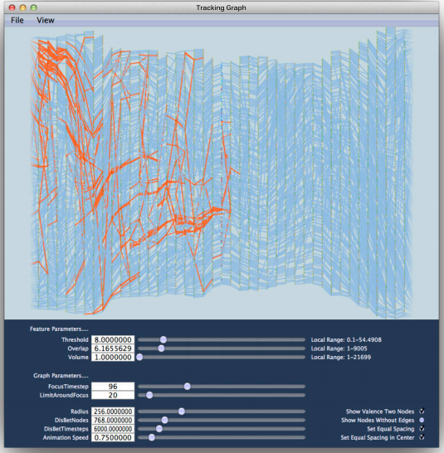
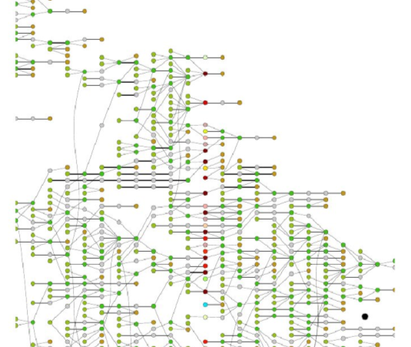
Greedy Layout vs Dot
Compact layout
Relatively few intersections
Fewer intersections
Extreme aspect ratios
Difficult to explore

