Slide 1
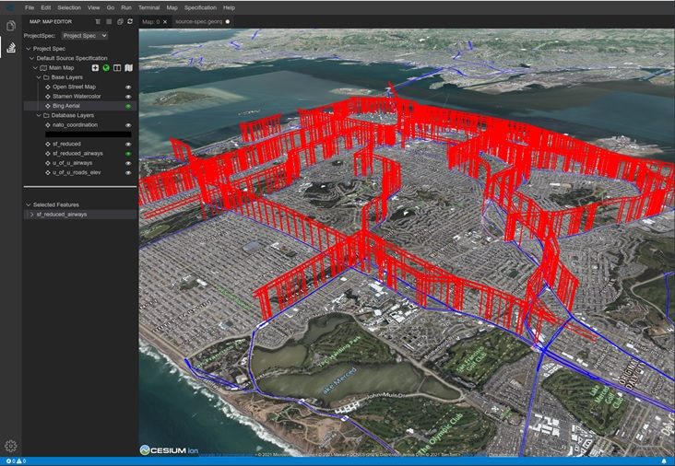
The Automation of Uncrewed Aircraft Systems Traffic Management Calibration Based on Experimental Platform Data
Thomas C. Henderson, David Sacharny,
William Raley, University of Utah
Chad Mello, US Air Force Academy
ICRA 2025
20 May 2025
Supported by AFWERX, USAFA &
Utah Dept of Transportation
Air Lanes over San Francisco

Slide 2
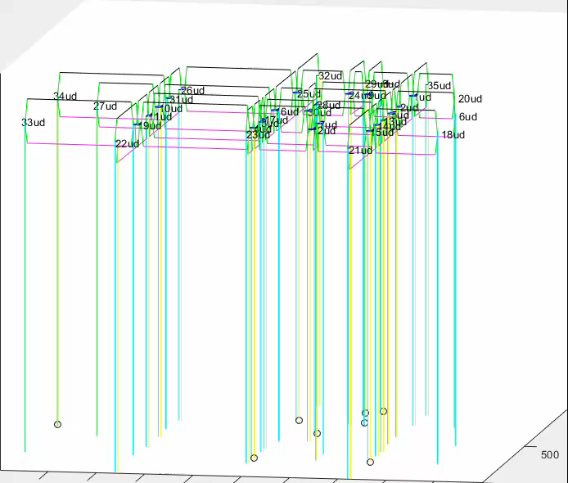
How to Manage 1000’s of Flights?
Our Proposal:
Lane-based
Strategic Deconfliction
(lanes derived from
SLC road network)

Slide 3
Example Lane Creation e.g., SLC (above roads)

Slide 4
Summary of Contributions
Lane-Based Approach
  Efficient Strategic Deconfliction
  Analytical Tools (Estimate Occupancy, Capacity, and Delay)
  Simulation Tools (Individual and System Behavior Prediction)
  Useful Abstraction for Urban Planning
    Has potential to impact UAM planning approach: Infrastructure Placement, Contingency Sites, Noise Estimation, Accessibility, etc.
Intelligent UAS Agents
Informed Traffic Management Policies

Slide 5
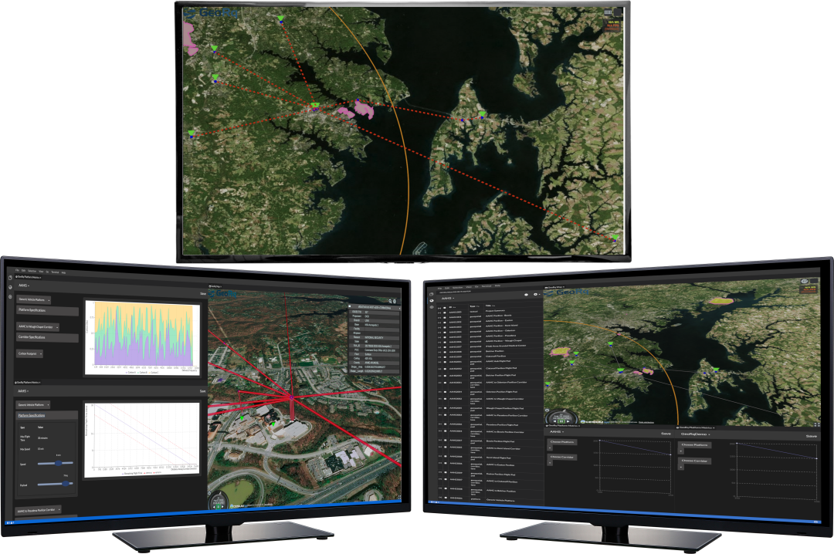
UAS Air Traffic Operations Center

Slide 6
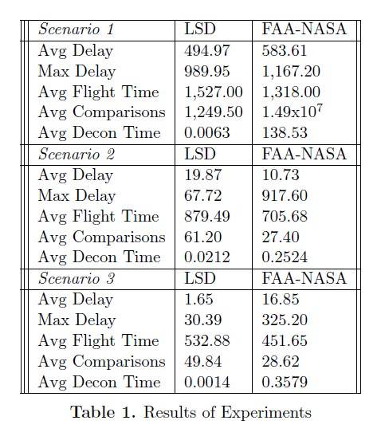
FNSD vs. LBSD
Results

Slide 7
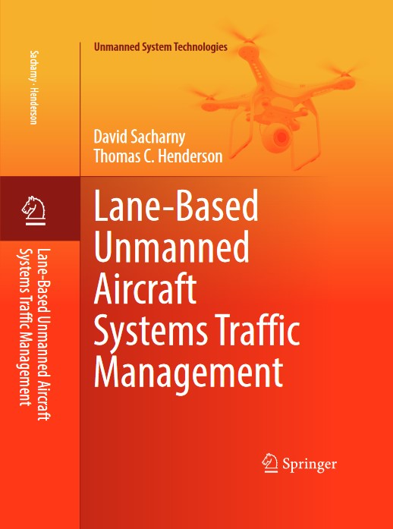
Lane-Based UAS Traffic Management
“Lane-Based Large-Scale UAS Traffic Management,”
D. Sacharny, T. Henderson and V. Marston,
IEEE Trans – Intelligent Transportation Systems
Lane-Based Unmanned Aircraft Systems Traffic Management,
David Sacharny and Thomas C. Henderson,
Springer-Verlag, Summer, 2022.
And several conference papers

Slide 8
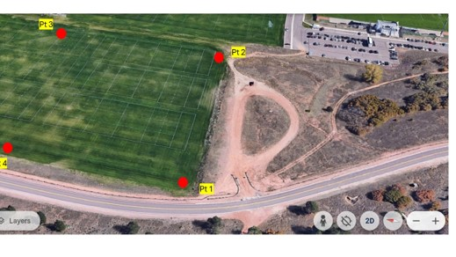
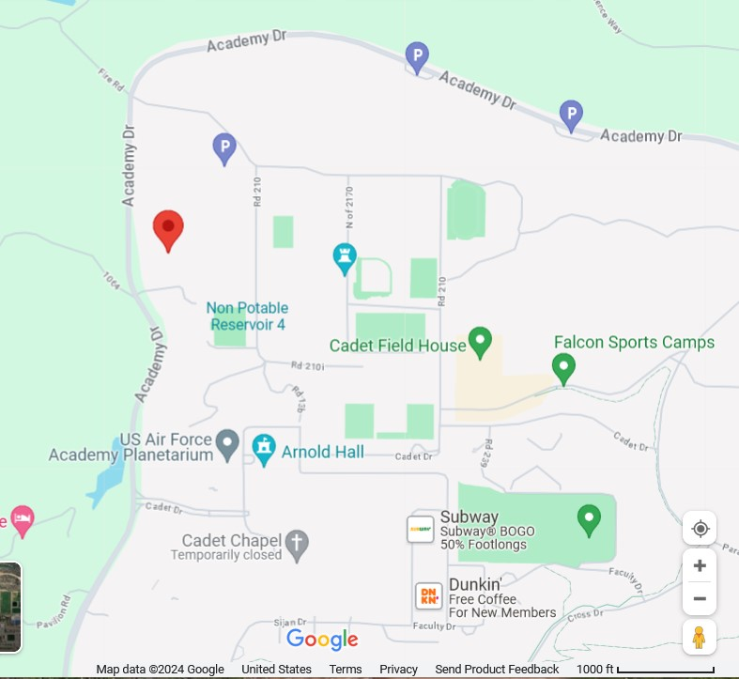
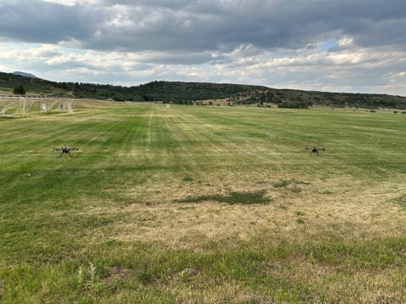
UTM Parameter Calibration Tests at US Air Force Academy

Slide 9
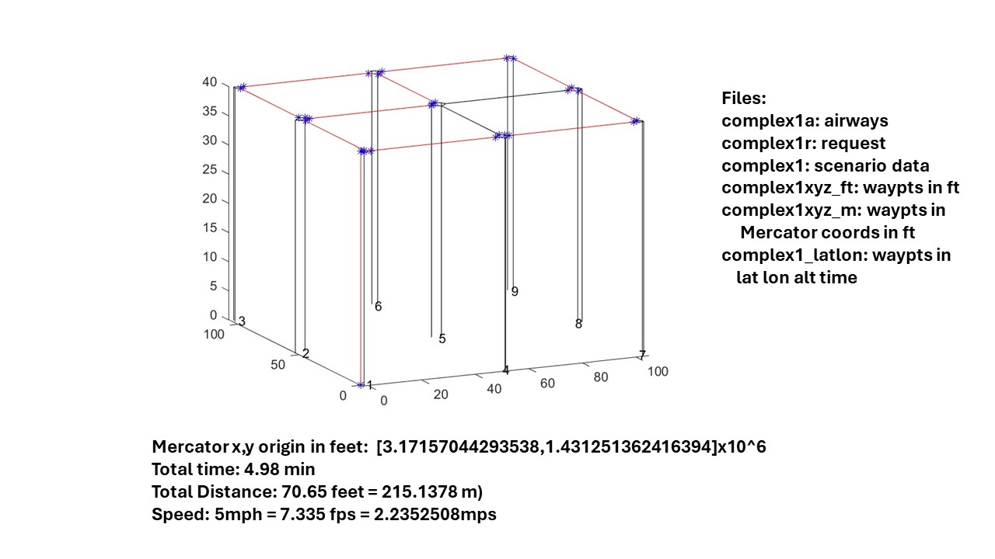
Validate Lane Network in Practice through Experiments
Complex Single UAS Tests
IMCOM 2024
SFFP

Slide 10
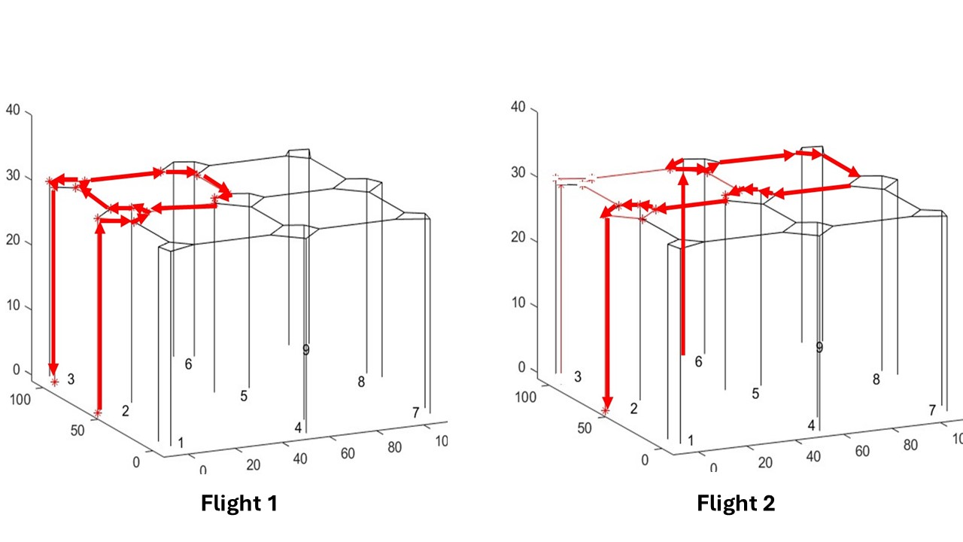
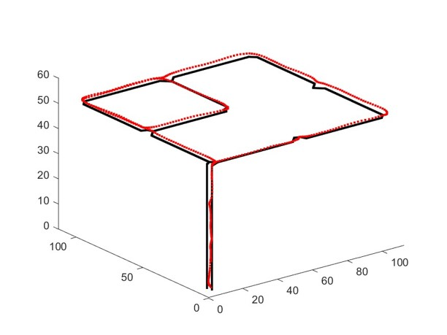
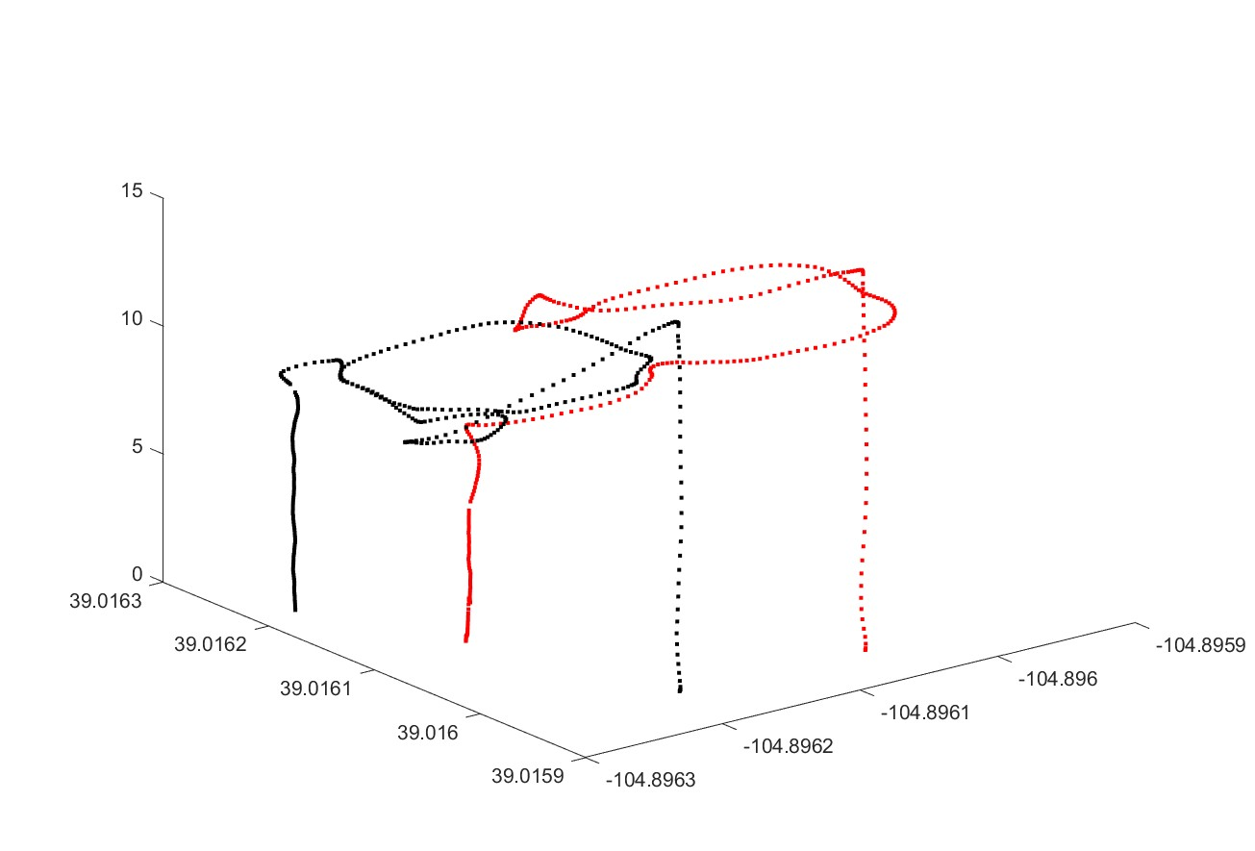
Single Flight Test
Two Flight Test

Slide 11
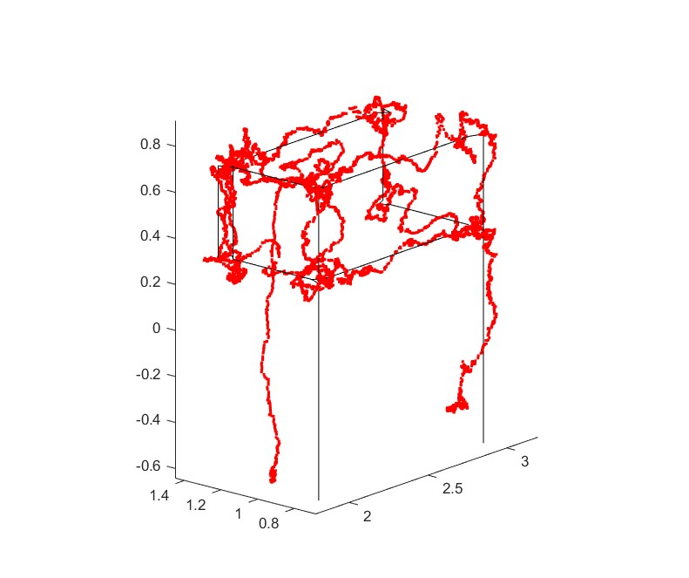
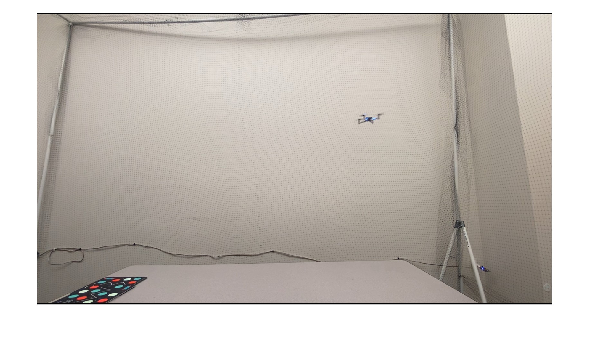
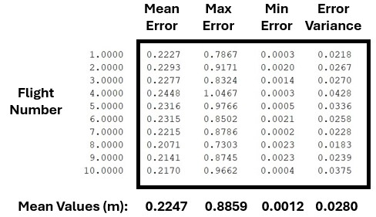
Crazyfly Calibration Results

Slide 12
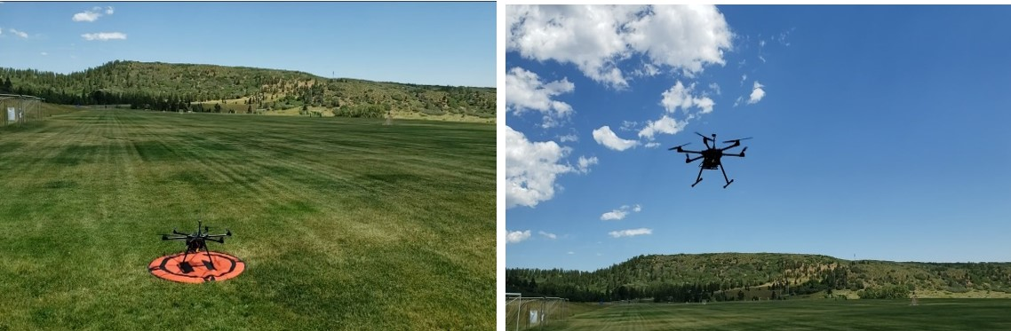
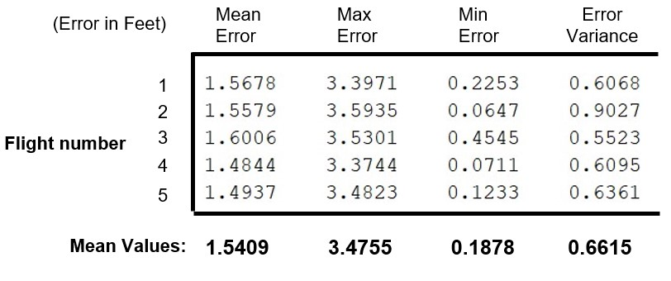
Tarot X6-based Hexacopter Calibration Results (1 Platform)
In this case a UTM
Administrator could
choose from 4 to 6 ft
as the safety headway.

Slide 13
Questions?

