Slide 1
Deep Learning in AI & Robotics

Slide 2
Deep Learning in AI & Robotics
Advisory Group: Tom Henderson (SoC) , Cathy Liu (CEE), Tolga Tasdizen (ECE), David Sacharny (Shield AI)
Faculty Associates:
SoC: Shandian Zhe, Vivek Srikumar, Tucker Hermanns,
Alan Kuntz
CEE: Carlos Oroza, Jianli Chen, Gaby Ou,
Nikola Markovic
University of Utah
30 October 2024

Slide 3
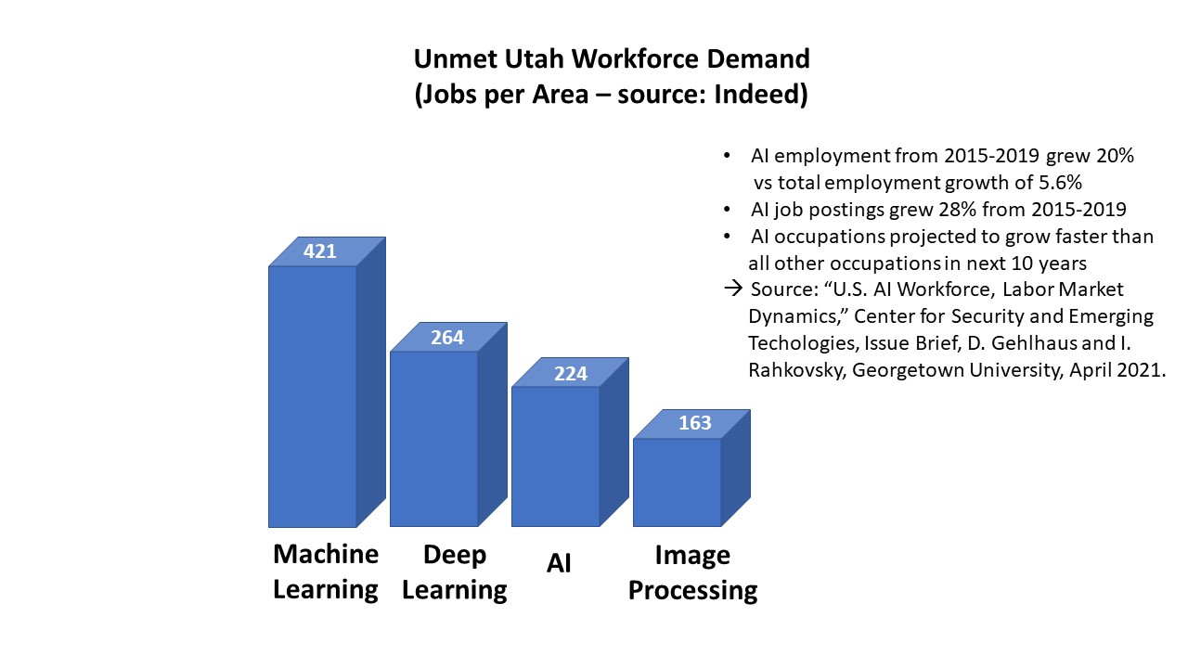
The Deep Learning Certificate Program will provide:
* working knowledge of the use of state-of-the-art deep learning technology
* internship projects with industry partners on image analysis, language
translation, autonomous systems, sensor data processing, database analytics,
fraud detection, etc., for classification/recognition/decision making
15 hrs total: 17 certificates awarded to date
Working Knowledge Courses:
Machine Learning
Artificial Intelligence
Probabilistic Machine Learning
-----------------------------------------
Robotics
Computer Vision
Image Processing
Transportation Operations
Traffic Network Modeling
-------------------------------------------
Deep Learning
At least 1
At least 1
Required
-------------------------------------------
Industry Capstone Project
Required

Slide 4
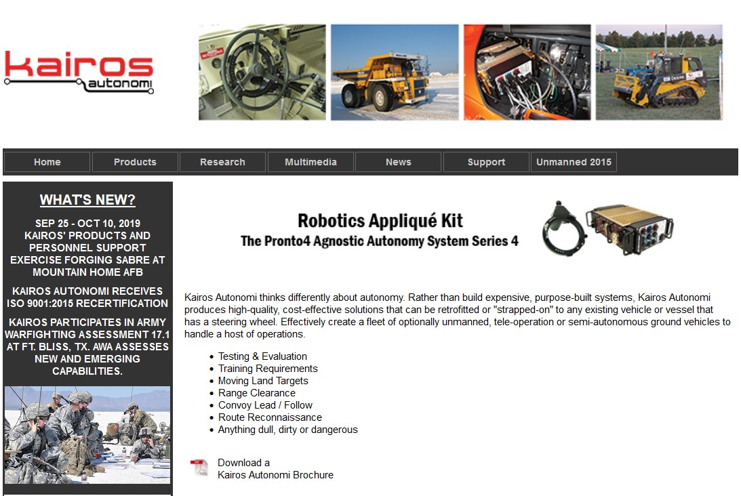
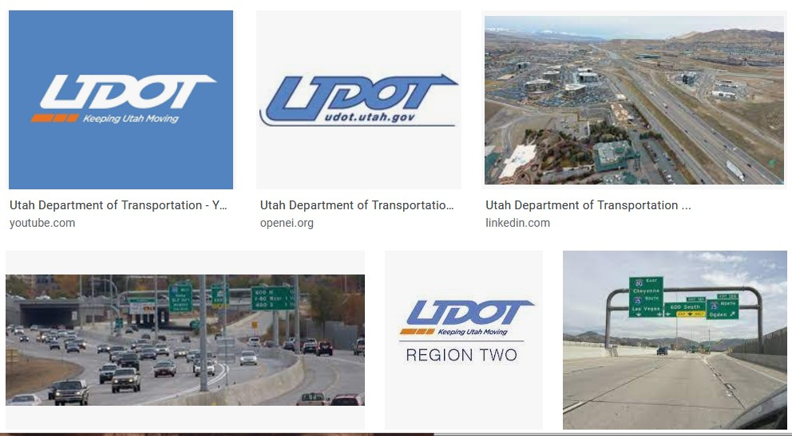
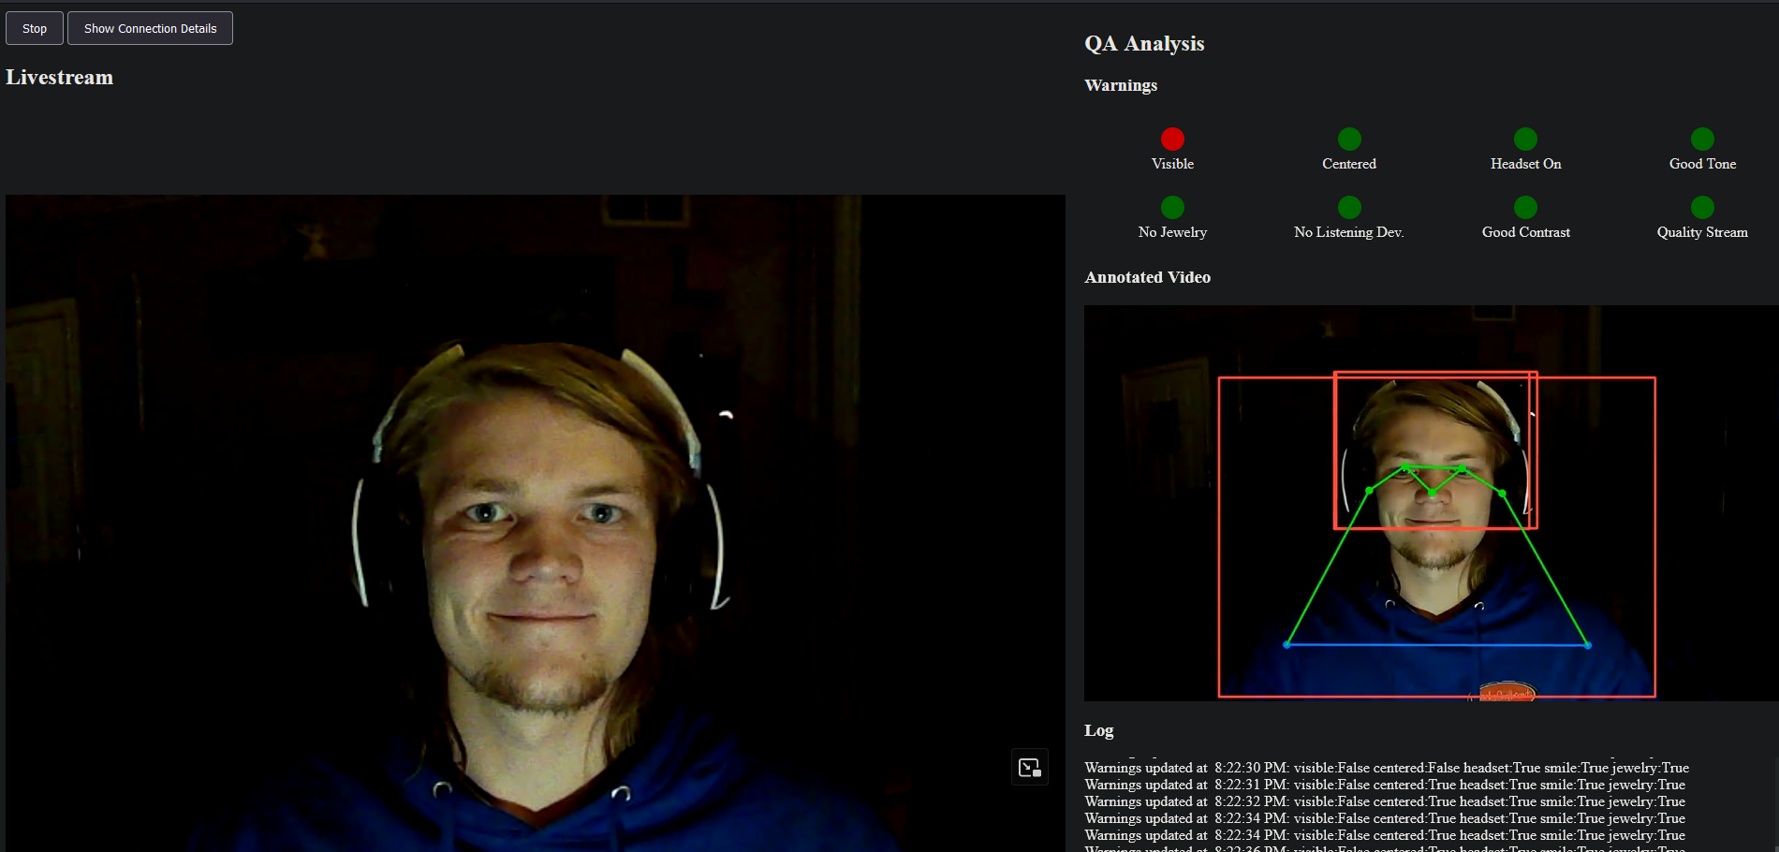
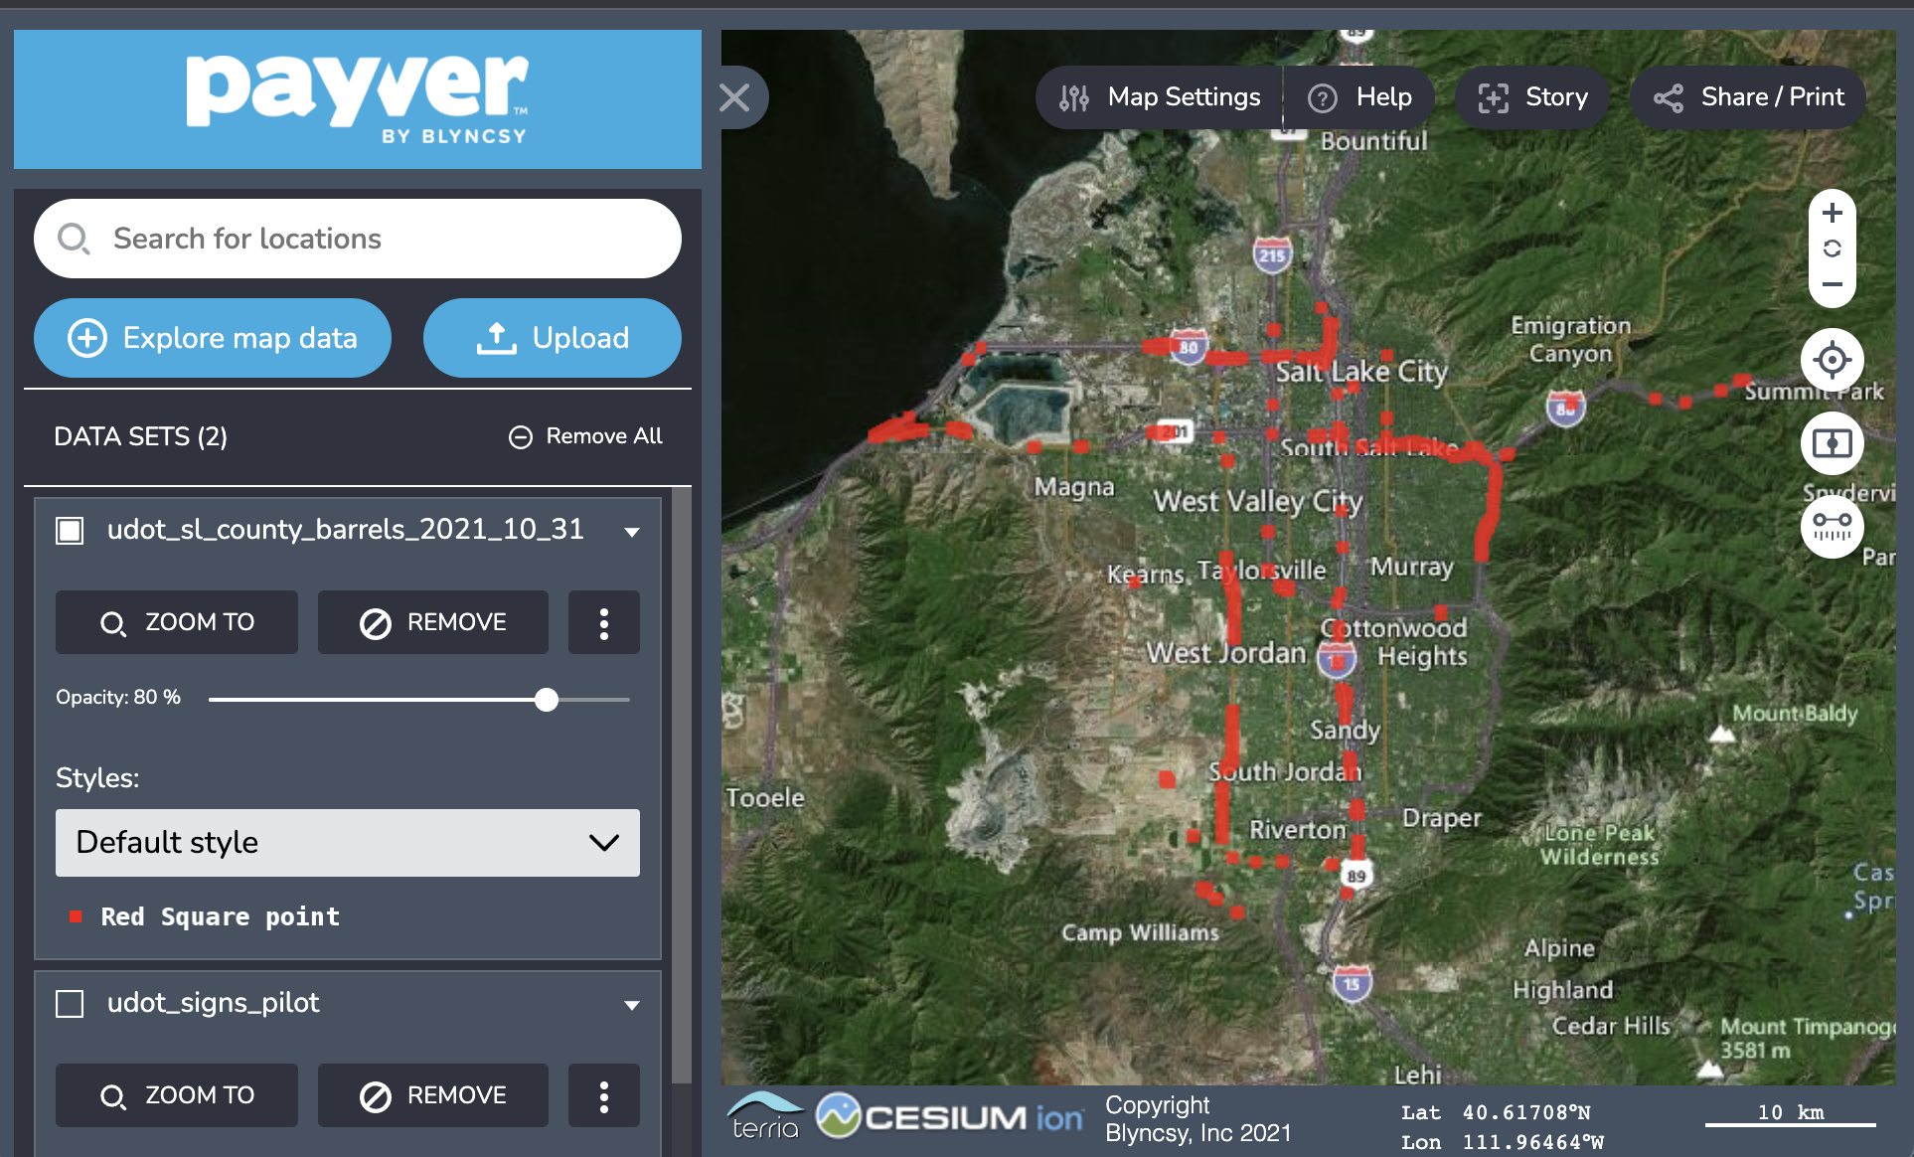
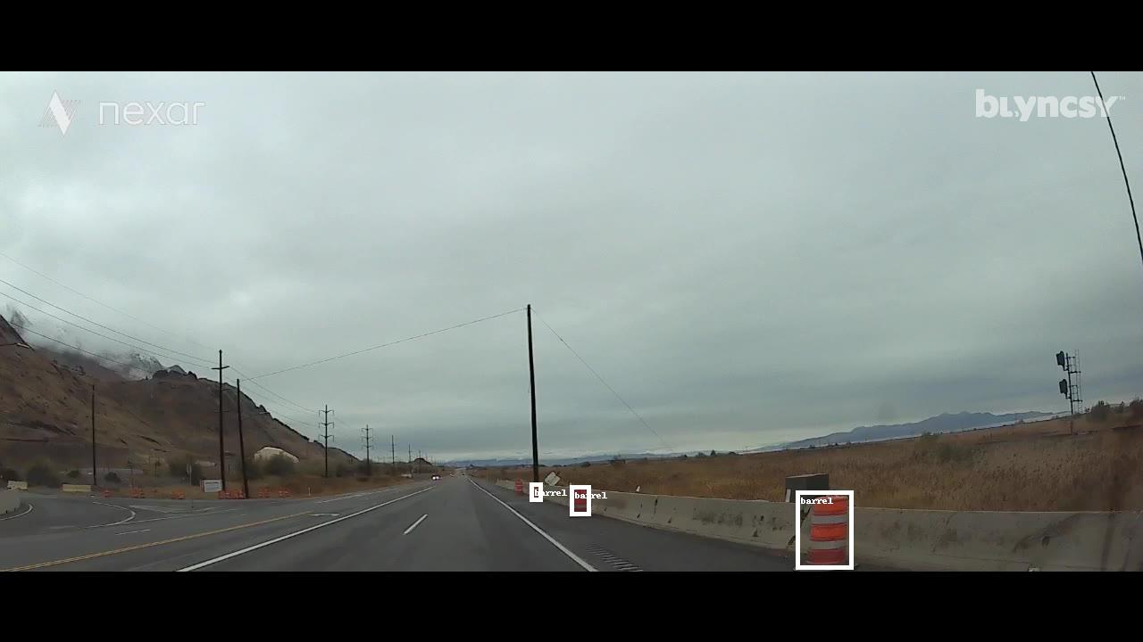
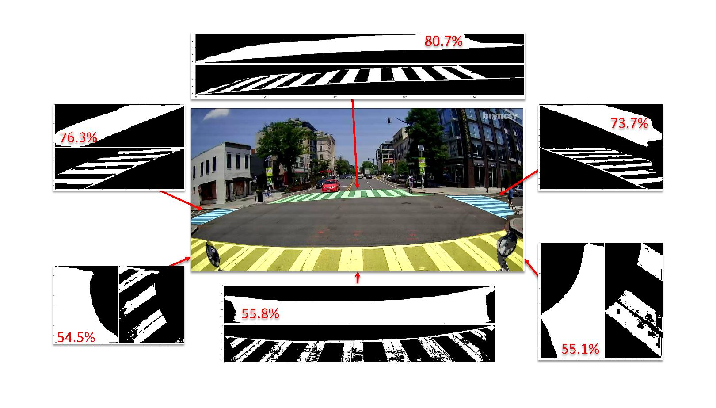
Industry Partners & the Future
Sign Language Video Quality
Where are the Traffic Cones ?
Crosswalk Quality

Slide 5
Industry Partners & the Future
Questions?
Contact: tch@cs.utah.edu
Apply Now!
Sign Language Video Quality
Where are the Traffic Cones ?
Crosswalk Quality

Slide 6
https://www.cs.utah.edu/graduate/graduate-certificate-in-deep-learning/

