Slide 1
CS6380 Weeks 7-8 18 Feb 2020

Slide 2
Intelligent Agents
Up to now, coded into algorithm and state variables
E.g., in-flight
What is the basis for intelligence?
Knowledge (facts, rules, etc.)
Inference (know new facts derived from old facts)
Characterize uncertainty in info
Know how to gather info
Situation awareness (includes recognition of problem, patterns, etc.)
Handle parallel activities (goals, reactive behavior, etc.)

Slide 3
Intelligent UAM Agents: USS
What does a USS do? What does it need to know?
GRS?
Other USS?
UAS?
UAM Domain (extent, grid, etc.)?
Flights?
Uses of Communication?
Emergencies?
Contingencies?
…

Slide 4
Intelligent UAM Agents: UAS
What does a UAS do? What does it need to know?
USS
Other UAS?
Flights?
UAM Domain (extent, grid, etc.)?
Uses of Communication?
Emergencies?
Contingencies?
…

Slide 5
Intelligent Agents
Knowledge Representation
Logic (Propositional Calculus)
Probability (Uncertainty of Knowledge)
Gain Knowledge from sensors
Reasoning over Knowledge
Proving Theorems
Resolution Theorem Proving
PSAT
PSSAT

Slide 6
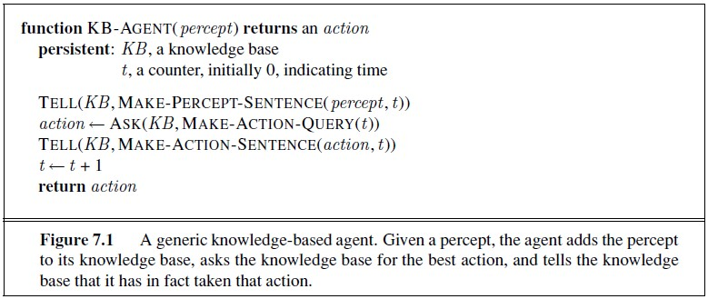
Knowledge-Based Agent
Logical sentences
Add knowledge (sentences) to KB
Infer new knowledge from KB
(prove a theorem)
Add new goal to KB

Slide 7
UAM World: Grid
1
2
3
4
y
Example Sentences:
IN_3_2
HIGH_WIND_3_4
CLOSED_2_2
Issues: no predicates
IN(3,2)
1
2
3
4
x

Slide 8
Propositional Calculus
Atom: Boolean variable; e.g., A, B, … → takes on True or False (1 or 0)
Literal: Atom or negation of an atom: A, ~A
Logical Operators: NOT, AND, OR, IMPLIES (~. ^, v, →)
Map: {0,1}^n → {0,1}
Well-formed Formula (WFF):
An atom is a wff
If f is a wff, then ~f is a wff
If f and g are wffs, then (f^g) is a formula, as is (fvg)
Any finite application of these rules is a wff

Slide 9
Semantic Proof: Truth Tables
A | B | ~A | AvB | A^B | A → B
0 0 1 0 0 1
0 1 1 1 0 1
1 0 0 1 0 0
1 1 0 1 1 1
e.g.: ~0 = 1; ~1 = 0; (0v1) = 1
View the operators as taking truth values and producing new ones
Also, we say (1,1) is a model for (A^B); i.e., (1,1) ϵ M((A^B))
For (AvB), M((AvB)) = {(0,1),(1,0),(1,1)}

Slide 10
Semantic Proof: Theorem Inference
A | B | (A^(A → B)) → B
0 0 0 1
0 1 0 1
1 0 0 0 1
1 1 11 1 1
Thus, for the KB to entail the theorem, the sentence must be true for all atom truth values.
You could also say: (A^(A → B)) |= B (semantically entail)
Note that 𝜶 |= 𝜷 iff M(𝜶) ⊆ M(𝜷)

Slide 11
Conjunctive Normal Form
Every wff can be expressed as:
A conjunction: $C_{1} ^ C_{2}$ ^ … ^ $C_{m}$
where each $C_{i}$ is a disjunction:
$C_{i}$= $D_{1}$v $D_{2}$ v … v $D_{n_{i}}$
and each $D_{j}$ is a literal
➔ We represent a KB in CNF

Slide 12
Consistent KB
A KB is consistent iff:
There is a truth assignment to all atoms so that each sentence (disjunction) in the KB is true.
Otherwise, the KB is inconsistent.

Slide 13
Example Inconsistent KB
KB = A ^ (~A)
Try it out:
A | A ^ (~A)
0 0 0
1 0 0 1

Slide 14
Syntactic Proofs: Symbol Manipulation
Can use re-write rules to start with given sentences and produce theorem by applying a sequence of appropriate rules. We say KB |- thm (the KB syntactically entails thm).
E.g., Modus Ponens:
1. A
2. ~A v B
}
can conclude: B

Slide 15
Core Problem (SAT): Satisfiability
SAT (Satisfiability) Problem:
Find a truth assignment to the atoms which makes the KB true (view as a logical sentence).
Solution: Try all $2^{n}$combinations.
First NP-Complete problem.

Slide 16
SAT Solver: Example
Sentence is in CNF, and 1 or all solutions are returned.
(Python code)

Slide 17
<~> thebes : cd $SAT
<2015/code/simple-sat-master/src> thebes : ls
BRECCIA run_tests.sh* satinstance.pyc solvers/ w44-008.in
fsm.py satinstance.py sat.py* tests/
<2015/code/simple-sat-master/src> thebes : ty w44-008.in
x1 x2 x3 x4
x2 x3 x4 x5
x3 x4 x5 x6
x4 x5 x6 x7
x5 x6 x7 x8
x1 x3 x5 x7
x2 x4 x6 x8
~x1 ~x2 ~x3 ~x4
~x2 ~x3 ~x4 ~x5
~x3 ~x4 ~x5 ~x6
~x4 ~x5 ~x6 ~x7
~x5 ~x6 ~x7 ~x8
~x1 ~x3 ~x5 ~x7
~x2 ~x4 ~x6 ~x8
<2015/code/simple-sat-master/src> thebes : sat.py < w44-008.in
~x1 ~x2 ~x3 x4 ~x5 ~x6 x7 ~x8
<2015/code/simple-sat-master/src> thebes :
CNF
Sentence
Truth Assignment →
Solution

Slide 18
<2015/code/simple-sat-master/src> thebes : sat.py < w44-008.in -a
~x1 ~x2 ~x3 x4 ~x5 ~x6 x7 ~x8
~x1 ~x2 ~x3 x4 ~x5 ~x6 x7 x8
~x1 ~x2 ~x3 x4 ~x5 x6 x7 ~x8
~x1 ~x2 ~x3 x4 ~x5 x6 x7 x8
~x1 ~x2 ~x3 x4 x5 ~x6 ~x7 ~x8
~x1 ~x2 ~x3 x4 x5 ~x6 ~x7 x8
~x1 ~x2 ~x3 x4 x5 ~x6 x7 ~x8
~x1 ~x2 ~x3 x4 x5 ~x6 x7 x8
~x1 ~x2 ~x3 x4 x5 x6 ~x7 ~x8
~x1 ~x2 ~x3 x4 x5 x6 ~x7 x8 of 132 solutions
~x1 ~x2 x3 ~x4 ~x5 ~x6 x7 x8
~x1 ~x2 x3 ~x4 ~x5 x6 ~x7 ~x8
~x1 ~x2 x3 ~x4 ~x5 x6 ~x7 x8
~x1 ~x2 x3 ~x4 ~x5 x6 x7 ~x8
~x1 ~x2 x3 ~x4 ~x5 x6 x7 x8
~x1 ~x2 x3 ~x4 x5 ~x6 ~x7 x8
~x1 ~x2 x3 ~x4 x5 ~x6 x7 x8
~x1 ~x2 x3 ~x4 x5 x6 ~x7 ~x8
~x1 ~x2 x3 ~x4 x5 x6 ~x7 x8
…

Slide 19
Models (Worlds) for Propositional Calculus
Let $S=\{C_{1},…,C_{m}\}$, be a set of $m$ logical sentences
→ which involve $n$ atoms
$Ω$ is the set of $2^{n}$ complete conjunctions formed from $n$ atoms as follows:
let the n-bit binary number $b_{1}b_{2}$…$b_{n−1}b_{n}$
represent the truth assignment:
truth($a_{i}$) = $b_{i}$
And let ${\text{ω}}_{k}$ be the conjunction whose $j^{th}$ atom has truth assignment ${\text{ω}}_{k,j}$

Slide 20
Complete Conjunction Example
Consider 2 atoms, A and B
Then the set of complete conjunctions is:
A=0 and B=0
A=0 and B=1 note there are $2^{n}$ of these
A=1 and B=0
A=1 and B=1

Slide 21
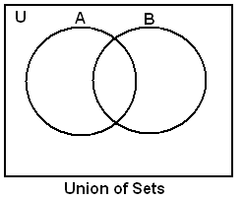
CC Example
U: Universe
→ unit hypercube
P(A): area of A
P(B): area of B
e.g.:
P(A) = P( ) + P( )
P(AvB) = P( ) + P( ) + P( )
A
$$∧$$
B
$$A∧¬B$$
$$¬A∧B$$
$$¬A∧¬B$$
$$A∧¬B$$
A $∧$ B
$$A∧¬B$$
A $∧$ B
$$¬A∧B$$

Slide 22
Inference
If an inference algorithm $i$ can derive from KB, we say:
KB ${\text{⊢}}_{i}$ α
An inference algorithm is:
sound: only derives entailed sentences
complete: can derive any entailed sentence

Slide 23
Types of Sentences
Tautologies: true for all models: A v ~A
(also called a valid sentence)
Contradictions: false for all models A ^ ~A
Contingencies: true for some, but not all models: A v B
For any sentences α and β, α |= β if and only if the sentence (α ⇒ β) is valid.

Slide 24
Proof by Contradiction (Reductio ad Absurdum)
α |= β if and only if the sentence (α ∧ ￢β) is unsatisfiable.
This idea forms the basis for our proof algorithm:
resolution theorem proving

Slide 25

Resolution Proof
The unit resolution inference rule:
where each $l$ is a literal, and $l_{i}$ and m are complementary literals

Slide 26
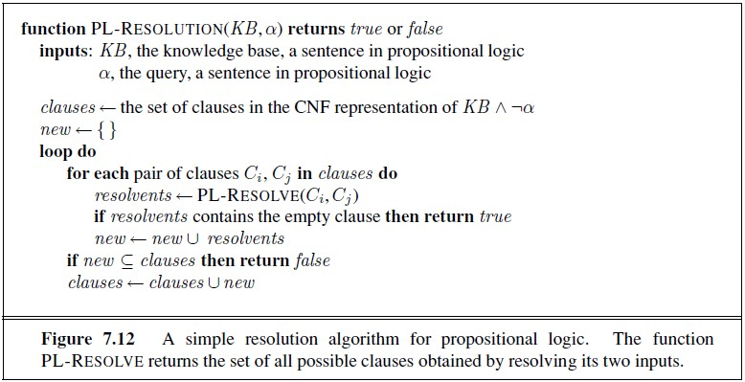
Resolution Algorithm

Slide 27
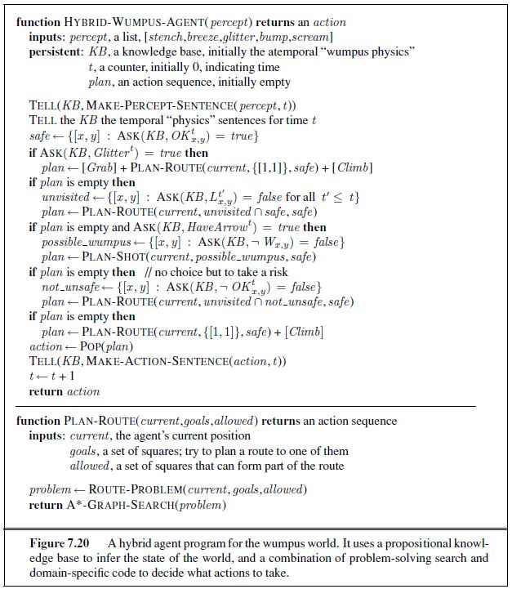
Logical KB Agent

Slide 28
Belief Desire Intention Agents
From Reasoning about Rational Agents
By Michael Wooldridge
Presented by Justin Blount

Slide 29
Rational Agents
Properties of Agents
Situated or embodied in some environment
Set of possible actions that modify environment
Autonomy -- makes independent decisions
Proactivness -- able to exhibit goal directed behavior
Reactivity -- responsive to changes in environment
Social Ability -- interact with other agents
(negotiation and cooperation)

Slide 30
BDI Model of rational agency
Beliefs -- information the agent has about world
Desires -- states of affairs that the agent, in an ideal world, would wish to be brought about
Intentions -- desires that the agent has committed to achieving

Slide 31
BDI Model
“The intuition is that the agent will not, in general, be able to achieve all its desires. Therefore an agent must fix upon some subset of its desires and commit resources to achieving them. These chosen desires are intentions.”
Developed by Michael Bratman
Intention based theory of practical reasoning

Slide 32
Reasoning in Humans
Practical reasoning is reasoning directed toward actions
the process of figuring out what to do
Theoretical reasoning is reasoning directed toward beliefs
Ex. All men are mortal AND Socrates is a man -> __
Practical reasoning has 2 activities
(Deliberation) Deciding what state of affairs we want to achieve
(Means end reasoning) Deciding how we want to achieve these state of affairs
Ex. When a person graduated from the university ….

Slide 33
Practical Reasoning A straight forward process?
Some complications
Deliberation and means end reasoning are computational processes
Resource bounds, time constraints
Two implications
Good performance requires efficient use of resources
Cannot deliberate indefinitely
Must commit to a state of affairs (called intention)

Slide 34
Intentions in practical reasoning
Use of the term in ordinary speech
Characterize actions (not accidental)
I might intentionally push someone under a train,
with the intention of killing them.
Characterize states of mind
I might have the intention this morning of pushing someone under a train this afternoon.
Future directed intentions are states of mind that are directed toward a future state of affairs

Slide 35
Intentions in practical reasoning
Intentions drive means end reasoning
A reasonable attempt to achieve is made
Involves deciding how to achieve
Basketball example
Intentions persist
I will not give up without good reason
Drop when its achieved, impossible or the reason for intention is no longer true.
Academic example

Slide 36
Intentions in practical reasoning
Constrain future practical reasoning
If I hold an intention I will not entertain options that are inconsistent with that intention
Influence beliefs upon which future practical reasoning is based
If I adopt an intention, then I can plan for the future on the assumption that I will achieve the intention. For if I intend to achieve some state of affairs while simultaneously believing that I will not achieve it, then I am being irrational

Slide 37
Agent control loop Version 1
While true
Observe the world
Update internal world model
Deliberate about what intention to achieve next
Use means end reasoning to get a plan for the
intention
Execute plan
End while

Slide 38
Observe-Think-Act loop[2]
1. observe the world;
2. interpret the observations (if needed):
diagnose (includes testing);
learn (includes testing);
3. select a goal;
4. plan;
5. execute part of the plan.

Slide 39
Plans
Plans are recipes for achieving intentions
A tuple of
Pre conditions -- circumstances under which it is applicable
Post condition -- defines what state of affairs the plan achieves
Body -- a sequence of actions

Slide 40
Agent control loop version 2
B := B0 // initial beliefs
While true do
get next precept p
B := brf(B, p) //belief revision function
I := deliberate(B)
Pi := plan(B,I)
execute(Pi)
End while

Slide 41
The Deliberation Process
Option generation
Agent generates a set of possible alternatives
Filtering
Agent chooses between competing alternatives, and commits to achieving them

Slide 42
Agent control loop 3
B := B0 // initial beliefs
I := I0 // initial intentions
While true do
get next precept p
B := brf(B, p)
D := options(B,I) // D - desires
I := filter(B) // I - intentions
Pi := plan(B,I)
execute(Pi)
End while

Slide 43
Commitment to intentions
An agent is committed to an intention
How committed should an agent be?
How long should it persist?
Under what conditions should a intention vanish?
Commitment strategy is used to determine when and how to drop to drop intentions

Slide 44
Commitment Strategies
Blind Commitment
Single minded
Open minded
Maintain
Until intention has been achieved
Until Intention achieved
or no longer possible
While believed possible

Slide 45
Agent control loop 4 -- introduce reactivity, replan
B := B0 I := I0 // initial beliefs and intentions
While true do
get next precept p
B := brf(B, p)
D := options(B,I)
I := filter(B)
Pi := plan(B,I)
While not empty(Pi) do
a := hd(Pi)
execute(a)
Pi = tail(Pi)
get next precept p
B := brf(B,p)
if not sound(Pi, I, B) then
Pi := plan(B,I)
end if
End while
End while

Slide 46
Agent Control loop 5 -- can drop intentions
B := B0 I := I0 // initial beliefs and intentions
While true do
get next precept p
B := brf(B, p)
D := options(B,I)
I := filter(B)
Pi := plan(B,I)
While not (empty(Pi) or succeeded(I,B) or impossible(I,B)) do
a := hd(Pi)
execute(a)
Pi = tail(Pi)
get next precept p
B := brf(B,p)
if not sound(Pi, I, B) then
Pi := plan(B,I)
end if
End while
End while

Slide 47
Commitment to means and ends
Intentions -- ends Plan -- means
Replan if plan is no longer sound given beliefs
Beliefs are updated after execution each action
Reconsiders plan after each iteration but does not reconsider intentions

Slide 48
Intention Reconsideration
Reconsiders when
Completely executed plan
Believes it has achieved current intentions
Believes current intentions are no longer possible
Does not allow agent to exploit serendipity
reconsideration of intention during the execution of the plan

Slide 49
Agent control loop 6 -- cautious
B := B0 I := I0 // initial beliefs and intentions
While true do
get next precept p
B := brf(B, p)
D := options(B,I)
I := filter(B)
Pi := plan(B,I)
While not (empty(Pi) or succeeded(I,B) or impossible(I,B)) do
a := hd(Pi)
execute(a)
Pi = tail(Pi)
get next precept p
B := brf(B,p)
D := options(B,I)
I := filter(B, D, I)
if not sound(Pi, I, B) then
Pi := plan(B,I) end if
End while
End while

Slide 50
Reconsideration of intentions
How often to recondsider your intentions?
How to charactarize situtations in which reconsideration would take plan?
Reconsideration requires resources
How fast is the environment changing?

Slide 51
Agent control loop 7 -- bold / cautious agent
B := B0 I := I0 // initial beliefs and intentions
While true do
get next precept p
B := brf(B, p)
D := options(B,I)
I := filter(B)
Pi := plan(B,I)
While not (empty(Pi) or succeeded(I,B) or impossible(I,B)) do
a := hd(Pi)
execute(a)
Pi = tail(Pi)
get next precept p
B := brf(B,p)
if reconsider(I,B) then
D := options(B,I)
I := filter(B, D, I) end if
if not sound(Pi, I, B) then
Pi := plan(B,I) end if
End while
End while

Slide 52
BDI model implementation
Procedural reasoning system (PRS)
Beliefs -- > prolog like facts
Desires and intentions are realized from plan library
Plans achieve some state of affairs
A plan has body and invocation condition
Invoked plans are desires
The agent picks one desires and puts it on execution stack
Execution stack are intentions

Slide 53
Bibliography
Wooldridge, 1999, Reasoning about Rational Agents
Balduccini, 2005,Answer set Base Design of Highly Autonomous, Rational Agents

Slide 54
plan
selection
Intention
Hierarchy
Plan
Library
filter
Options
BDI Architecture
Goal
Store
analyzer
Belief
Store
belief
revision
perceive
Percepts
Environment
execute
action

