Slide 1
Thread-Fair Memory Request Reordering
Kun Fang, Nick Iliev, Ehsan Noohi, Suyu Zhang, and Zhichun Zhu
Dept. of ECE, University of Illinois at Chicago

Slide 2
Outline
Background
Thread-Fair Memory Request Reordering
Result
Conclusion

Slide 3
SDRAM Organization (Device)
SDRAM device
Bank 0
Bank 7
Row decoder
Row decoder
…
Column
decoder
Column
decoder
Row buffer
Row buffer
addr
addr
addr
cmd
ACT
COL
PRE
data
8 bits

Slide 4
Request Reordering
B0 R0
R0 Rd
Act R0
Act R0
Act R0
Act R0
B0 R1
R0 Wr
Col
Col Rd
Col
Col Rd
B0 R0
R0 Rd
Pre R0
Col
Col Rd
Bus turn around
Act R1
Pre R0
Col Wr
Bus turn around
Col
Act R1
Col Wr
Pre R1
Col
T_WTR
Pre R0
Act R0
Pre R1
Col
Col Rd
Pre R0
Pre R0

Slide 5
Outline
Background
Thread-Fair Memory Request Reordering
  Observation
Result
Conclusion

Slide 6
Blocked By ROB Head
Mem Controller
ROB
B0 R1
B0 R1
B0 R0
B0 R0
B0 R0
B0 R0
B0 R0
B0 R0
B0 R0
B0 R0
B0 R0
B0 R0
B0 R0
B0 R0
B0 R0
B0 R0
B0 R0
B0 R1
No Reordering
Reorder

Slide 7
Outline
Background
Thread-Fair Memory Request Reordering
  Algorithm
Related Work
Conclusion

Slide 8
Thread-Fair Memory Request Reordering
Read First
Y
WQ > High WM
WQ < Low WM
Y
Write First
N
N
Issue Wr Hit?
Issue Rd Hit?
Y
N
Issue Rd FCFS?
N
Y
Issue ROB Head?
Y
N
Issue Rd FCFS?
N
Issue Rd Hit
Y
N
Y
Issue Wr Hit

Slide 9
Outline
Background
Thread-Fair Memory Request Reordering
  Implementation
Result
Conclusion

Slide 10
Scheduler Design
Bank n
Read Pending Queue
Index
1
4
6
Row Addr
Index
5
Row Addr
Write Pending Queue
Read Queue
Write Queue
1
6
Read Row Hit Queue
Write Row Hit Queue

Slide 11
Hardware Overhead
4 Channel, 2 Ranks/Channel, 8 Banks/Rank
  64 Banks
Read/Write Pending Queue (32-entry, 11KB)
  Index 6-bit (64-entry Read/Write Queue)
  Row Address 16-bit
Read/Write Request Hit Queue (32-entry, 3KB)
  Index 6-bit
Total 14KB

Slide 12
Outline
Background
Thread-Fair Memory Request Reordering
Result
Conclusion

Slide 13
Simulation Environment
USIMM 1.3
Workloads
  Single Process, Multi Process and Multi Thread
Configuration
  1, 2, 4, 8 and 16 core configuarion
  1 channel and 4 channel memory configuation

Slide 14
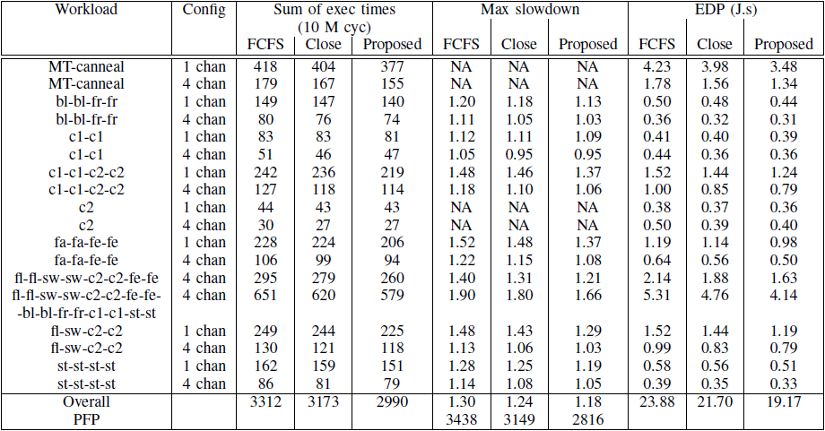
Result

Slide 15
Result
Fairness
  Improves from 3.1% to 13.6% (9.1 on average).
  Squared Diviation of all thread slowdown is less than 2% (except the 16-thread workload).
Performance
  Overall execution time improves by 9.7%
Power
  EDP 5.2% to 24.6% improvement (17.3% on average).

Slide 16
Outline
Background
Thread-Fair Memory Request Reordering
Result
Conclusion

Slide 17
Conclution
Mornitor the ROB head and give the request from it higher priority when opening rows.
Group Hit requests to reduce latency.
Read by pass Write
Can improve thread fairness, performance and EDP.

Slide 18
THANK YOU
Questions?

