Slide 1
The Compact Memory Scheduling Maximizing Row Buffer Locality
Young-Suk Moon, Yongkee Kwon, Hong-Sik Kim,
Dong-gun Kim, Hyungdong Hayden Lee, and Kunwoo Park

Slide 2
Introduction
The cost of read-to-write switching is high
The timing overhead of the row conflict is much higher than that of the read-to-write switching
Conventional draining policy does not utilize row locality
Effective draining policy considering row locality is proposed

Slide 3
EX1 :: Conventional Drain Policy
Activated Row
LO_WM
HI_WM
B0
R1
R7
drain starts
B1
R7
B2
R4
R8
WQ
W8
B0 R5
W7
B1 R2
W6
B0 B7
W5
B2 R8
W4
B3 R8
W3
B1 R7
W2
B0 R1
W1
B2 R4
W0
B3 R6
B3
R6
R8
switch to read drain
R11
B3 R9
R10
B1 R6
R9
B0 R1
R8
B1 R3
R7
B1 R4
R6
B2 R8
R5
B2 R4
R4
B3 R6
R3
B2 R7
R2
B3 R4
R1
B0 R5
R0
B1 R5
RQ
issued request
row hit chance is wasted during consecutive write drain
row hit request

Slide 4
EX1 :: Proposed Drain Policy
Activated Row
Row Hit in RQ, not in WQ
LO_WM
HI_WM
B0
R1
R5
drain starts
B1
R5
B2
R4
WQ
W8
B0 R5
W7
B1 R2
W6
B0 R7
W5
B2 R8
W4
B3 R8
W3
B1 R7
W2
B0 R1
W1
B2 R4
W0
B3 R6
B3
R6
switch to read drain
switch to write drain
R11
B3 R9
R10
B1 R6
R9
B0 R1
R8
B1 R3
R7
B1 R4
R6
B2 R8
R5
B2 R4
R4
B3 R6
R3
B2 R7
R2
B3 R4
R1
B0 R5
R0
B1 R5
RQ
Row Hit in WQ, not in RQ
issued request
* Row locality is successfully utilized
row hit request

Slide 5
EX2 :: Conventional Drain Policy
row hit write requests was not issued successfully
Activated Row
LO_WM
HI_WM
B0
R0
R5
drain starts
B1
R0
R5
B2
R0
WQ
W8
B0 R0
W7
B3 R0
W6
B2 R0
W5
B1 R0
W4
B0 R0
W3
B3 R0
W2
B2 R0
W1
B1 R0
W0
B0 R0
B3
R0
R4
switch to read drain
R11
B3 R9
R10
B1 R6
R9
B0 R1
R8
B1 R3
R7
B1 R4
R6
B2 R8
R5
B2 R4
R4
B3 R6
R3
B2 R7
R2
B3 R4
R1
B0 R5
R0
B1 R5
RQ
issued request
row hit request

Slide 6
EX2 :: Proposed Drain Policy
Activated Row
Row Hit in WQ, not in RQ
LO_WM
HI_WM
B0
R0
drain starts
B1
R0
B2
R0
WQ
W8
B0 R0
W7
B3 R0
W6
B2 R0
W5
B1 R0
W4
B0 R0
W3
B3 R0
W2
B2 R0
W1
B1 R0
W0
B0 R0
B3
R0
continue write drain
switch to read drain
R11
B3 R9
R10
B1 R6
R9
B0 R1
R8
B1 R3
R7
B1 R4
R6
B2 R8
R5
B2 R4
R4
B3 R6
R3
B2 R7
R2
B3 R4
R1
B0 R5
R0
B1 R5
RQ
issued request
* Row locality is successfully utilized
row hit request

Slide 7
Key Idea
By referencing row locality
Switch to read even if the # pending write requests in the write queue is bigger than “low watermark”
Drain write requests continuously even if the # pending write requests in the write queue reaches “low watermark”
The row locality can be fully utilized with RLDP(Row Locality based Drain Policy)

Slide 8
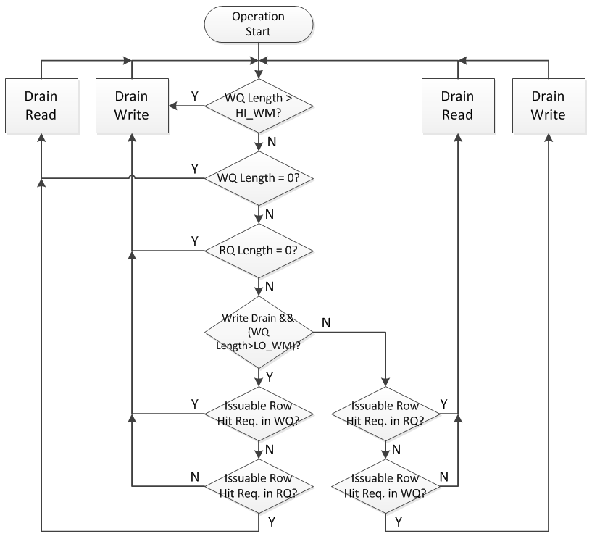
Flow Chart

Slide 9
Conventional Scheduling Algorithms
Delayed write drain[13] and delayed close policy[17] are combined to increase performance and utilize row buffer locality
Delayed write drain is applied adaptively based on historical request density
Per-bank delayed close policy is adaptively applied considering history counter
Read history counter is incremented when the read command is issued, and decremented when the active command is issued
Write history counter operates in the same manner

Slide 10
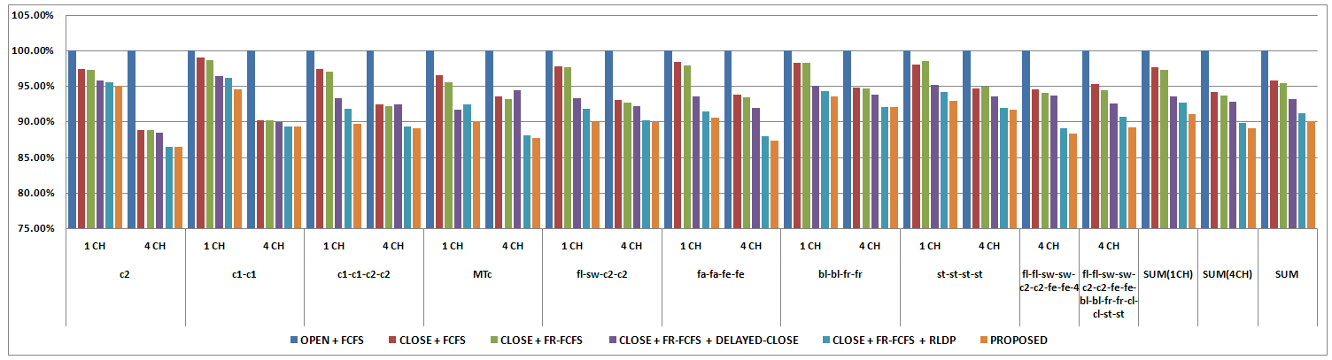
Total Execution Time
* DELAYED-CLOSE shows better result in 1-channel configuration than 4- channel configuration(3.74% in 1CH, 0.90% in 4CH)
** RLDP improves performance in both configuration (4.51% in 1CH, 3.86% in 4CH)
Compare to the CLOSE+FR-FCFS, the total execution time is reduced by
2.35% w/ DELAYED-CLOSE
4.37% w/ RLDP
5.64% w/ PROPOSED (9.99%, compare to FCFS)

Slide 11
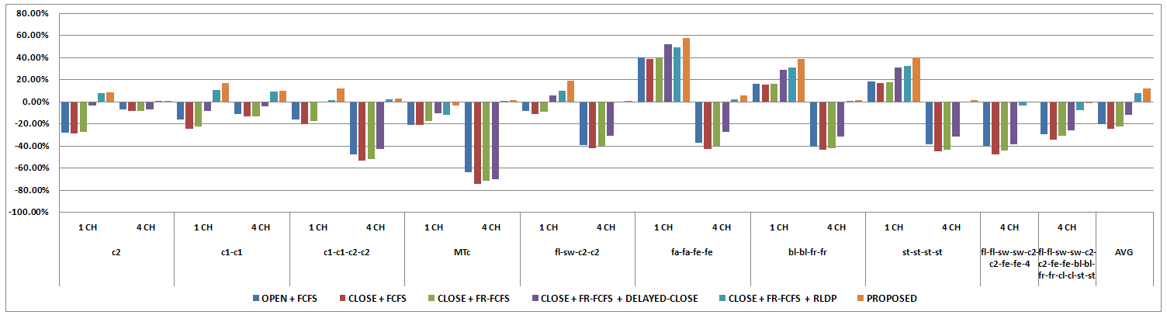
Row Hit Rate of Write Requests
Compare to the CLOSE+FR-FCFS, the row hit rate of write requests is increased by
10.64% w/ DELAYED-CLOSE
30.05% w/ RLDP
34.28% w/ PROPOSED
* Row Hit Rate = (# Write - #ActiveW)/ #Write
** RLDP shows improvement in terms of the row hit rate of write requests

Slide 12
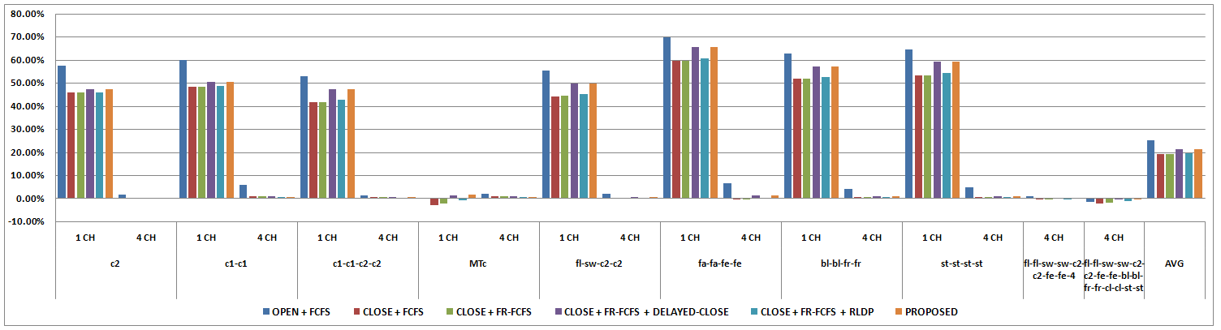
Row Hit Rate of Read Requests
Compare to the CLOSE+FR-FCFS, the row hit rate of write requests is increased by
2.20% w/ DELAYED-CLOSE
0.35% w/ RLDP
2.21% w/ PROPOSED
* DELAYED-CLOSE shows improvement in terms of the row hit rate of read requests, while RLDP shows slight improvement

Slide 13
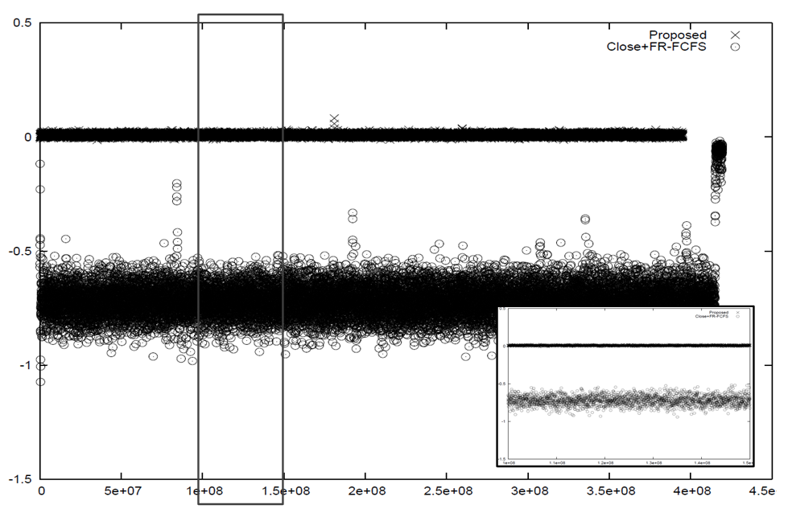
Row Hit Rate of Write Requests
* The row hit rate of write requests is improved greatly in all simulation period
* 4 channel configuration, MT-canneal

Slide 14
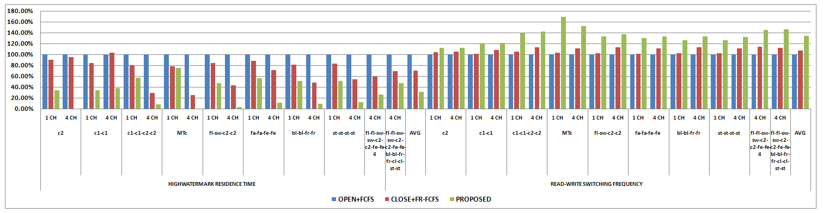
High Watermark Residence Time / Read-Write Switching Frequency
* Read to write switching is occurred more frequently
“HIGH WATERMARK RESIDENCE TIME” of the proposed algorithm is reduced by 69%
The “READ-WRITE SWITCHING FREQUENCY” of the proposed algorithm is increased by 33.78%

Slide 15
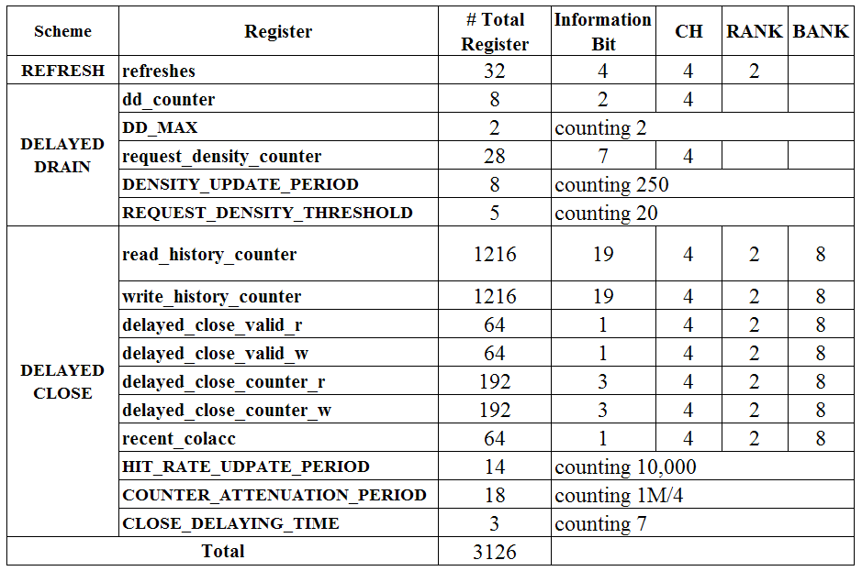
Hardware Overhead
The total register overhead is 0.4KB
Because RLDP only checks the row hit of the requests, logic complexity is low

Slide 16
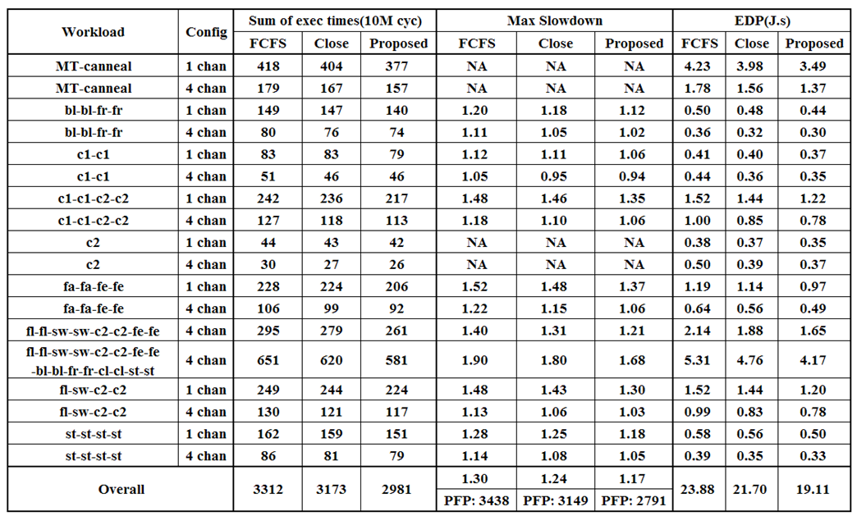
Comparison of Key Metrics
Compare to the close scheduling policy, the proposed algorithm reduces the system execution time by 6.86%(9.99%, compare to FCFS)
PFP is improved by 11.4%, and EDP is improved by 12%

Slide 17
Conclusion
RLDP(Row Locality based Drain Policy) is proposed to utilize the row buffer locality
The proposed scheduling algorithm improves the row hit rate of both write request and read request
The number of the active command is reduced so that the total execution time is improved by the amount of 6.86% compare to the CLOSE+FR-FCFS scheduling algorithm(9.99%, compare to FCFS)

Slide 18
Q & A

Slide 19
References
[1] B. Jacob, S. W. Ng, and D. T. Wang. Memory Systems - Cache, DRAM, Disk. Elsevier, Chapter 7, 2008
[2] JEDEC. JEDEC standard: DDR/DDR2/DDR3 STANDARD (JESD 79-1,2,3)
[3] Chang Joo Lee. DRAM-Aware Prefetching and Cache Management, HPS Technical Report, TR-HPS-2010-004, University of Texas, Austin, December, 2010.
[4] S. Rixner, W. J. Dally, U. J. Kapasi, P. Mattson, and J. D. Owens. Memory access scheduling. In Proceedings of ISCA, 2000.
[5] M. Awasthi, D. Nellans, K. Sudan, R. Balasubramonian, and A. Davis. Handling the Problems and Opportunities Posed by Multiple On-Chip Memory Controllers. In Proceedings of PACT, 2010.
[6] Y. Kim, M. Papamichael, O. Mutlu, and M. Harchol-Balter. Thread Cluster Memory Scheduling: Exploiting Differences in Memory Access Behavior. In Proceedings of MICRO, 2010.
[7] O. Mutlu and T. Moscibroda. Stall-Time Fair Memory Access Scheduling for Chip Multiprocessors. In Proceedings of MICRO, 2007.
[8] O. Mutlu and T. Moscibroda. Parallelism-Aware Batch Scheduling - Enhancing Both Performance and Fairness of Shared DRAM Systems. In Proceedings of ISCA, 2008.
[9] C. Lee, O. Mutlu, V. Nerasiman, and Y. N. Patt, ‘‘Prefetch-Aware DRAM Controllers,’’ In Proceedings of MICRO, 2008.

Slide 20
References
[10] I. Hur and C. Lin, Adaptive History-Based Memory Schedulers. In Proceedings of MICRO, 2004.
[11] D. Kaseridis, J. Stuecheli, and L. John. Minimalist Open-page: A DRAM Page-mode Scheduling Policy for the Many-core Era In Proceedings of MICRO, 2007.
[12] J. Stuecheli, D. Kaseridis, D. Daly, H. Hunter, and L. John. The Virtual Write Queue: Coordinating DRAM and LastLevel Cache Policies. In Proceedings of ISCA, 2010.
[13] C. Natarajan et al. A study of performance impact of memory controller features in multi-processor server environment. In Proceedings of WMPI, 2004.
[14] N. Chatterjee, N. Muralimanohar, R. Balasubramonian, A. Davis, and N. Jouppi. Staged Reads : Mitigating the Impact of DRAM Writes on DRAM Reads. In Proceedings of HPCA, 2012.
[15] B. Lee, E. Ipek, O. Mutlu, and D. Burger. Architecting
Phase Change Memory as a Scalable DRAM Alternative. In Proceedings of ISCA, 2009.
[16] N. Chatterjee and R. Balasubramonian and M. Shevgoor and S. Pugsley and A. Udipi and A. Shafiee and K. Sudan and M. Awasthi and Z. Chishti. USIMM: the Utah SImulated Memory Module. 2012.
[17] http://www.anandtech.com/show/3851/everything-you-always-wanted-to-know-about-sdram-memory-but-were-afraid-to-ask/6
[18] C. Bienia, S. Kumar, J. P. Singh, and K. Li. The PARSEC Benchmark Suite: Characterization and Architectural Implications. In Proceedings of PACT, 2008

Slide 21
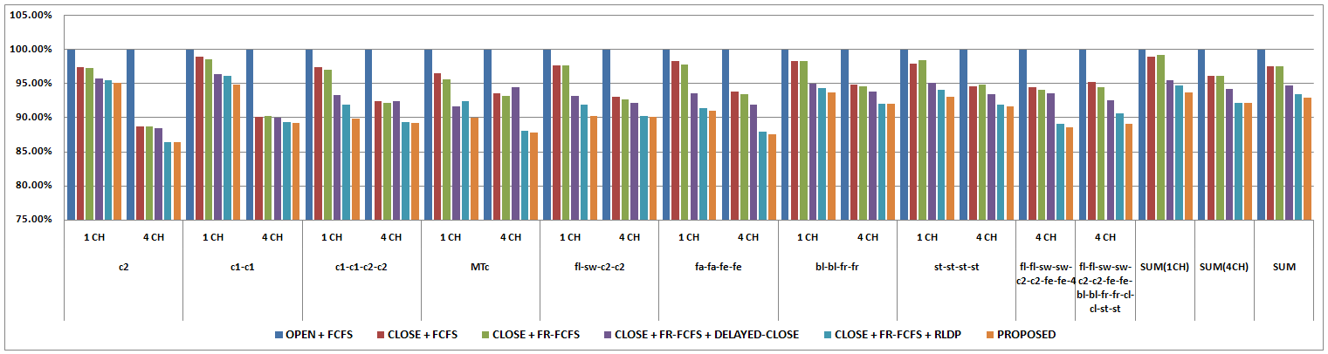
1-Rank Configuration
Compare to the CLOSE+FR-FCFS, the total execution time is reduced by
2.87 % w/ DELAYED-CLOSE
4.26% w/ RLDP
4.76% w/ PROPOSED (7.04%, compare to FCFS)
* Read to write switching overhead is larger than 2-rank configuration

