Slide 1

High Performance
Memory Access Scheduling
Using Compute-Phase Prediction and Writeback-Refresh Overlap
Yasuo Ishii, Kouhei Hosokawa, Mary Inaba, Kei Hiraki

Slide 2
Design Goal: High Performance Scheduler
Three Evaluation Metrics
  Execution Time (Performance)
  Energy-Delay Product
  Performance-Fairness Product
We found several trade-offs among these metrics
  The best execution time (performance) configuration does not show the best energy-delay product

Slide 3
Contribution
Proposals
  Compute-Phase Prediction
    Thread-priority control technique for multi-core processor
  Writeback-Refresh Overlap
    Mitigates refresh penalty on multi-rank memory system
Optimizations
  MLP-aware priority control
  Memory bus reservation
  Activate throttling

Slide 4
Outline
Proposals
  Compute-Phase Prediction
    Thread-priority control technique for multi-core processor
  Writeback-Refresh Overlap
    Mitigates refresh penalty on multi-rank memory system
Optimizations
  MLP-aware priority control
  Memory bus reservation
  Activate throttling

Slide 5
Thread-priority Control
Thread-priority control is beneficial for multi-core chips
  Network Fair Queuing[Nesbit+ 2006], Atlas[Kim+ 2010], Thread Cluster Memory Scheduling[Kim+ 2010]
  Typically, policies are updated periodically (Each epoch contains millions of cycles in TCM)
Core 0
high priority
Compute-Intensive
Priority requests
Memory-
Intensive
Memory
(DRAM)
priority status is not yet changed
Core 1
Non-priority requests
Memory-
Intensive
Compute-Intensive

Slide 6
Example: Memory Traffic of Blackscholes
One application contains both memory-intensive phases and compute-intensive phases

Slide 7
Phase-prediction result of TCM
Compute-phase
Memory-phase
We think this inaccurate classification is caused by the conventional periodically updating prediction strategy

Slide 8
Contribution 1: Compute-Phase Prediction
“Distance-based phase prediction” to realize fine-grain thread priority control scheme
Core
Memory
(DRAM)
Distance = # of committed instructions between 2 memory requests
Compute-phase
Memory-phase
Core
DRAM
Core
DRAM
Distance of req. exceed Θ_{interval}
Non-distant of req. continue Θ_{distant} times

Slide 9
Phase-prediction of Compute-Phase Prediction
Prediction result nearly matches the optimal classification
  Improves fairness and system throughput

Slide 10
Outline
Proposals
  Compute-Phase Prediction
    Thread-priority control technique for multi-core processor
  Writeback-Refresh Overlap
    Mitigates refresh penalty on multi-rank memory system
Optimizations
  MLP-aware priority control
  Memory bus reservation
  Activate throttling

Slide 11
DRAM refreshing penalty
tREFI
tRFC
Rank-0
Rank-1
Mem. Bus
Stall of read requests
Increases the threat of stall
DRAM refreshing increases the stall time of read requests
  Stall of read requests increases the execution time
  Shifting refresh timing cannot reduce the stall time
    This increases the threat of stall time for read requests

Slide 12
Contribution 2: Writeback-Refresh Overlap
Rank-0
Rank-1
Mem. Bus
R
W
R
W
R
W
R
W
R
W
R
W
R
W
R
Read requests stall
Typically, modern controllers divide read phases and write phases to reduce bus turnaround penalties
Overlaps refresh command with the write phase
  Avoid to increasing the stall time of read requests

Slide 13
Outline
Proposals
  Compute-Phase Prediction
    Thread-priority control technique for multi-core processor
  Writeback-Refresh Overlap
    Mitigates refresh penalty on multi-rank memory system
Optimizations
  MLP-aware priority control
  Memory bus reservation
  Activate throttling

Slide 14
Optimization 1: MLP-Aware Priority Control
Request Queue
Stall
Core 0
load(1)
Memory
(DDR3)
load(0)
load(1)
Stall
load(1)
Core 1
load (0)
load(1)
load(1)
load(1)
gives extra priority
Prioritizes Low-MLP requests to reduce the stall time.
  This priority is higher than the priority control of compute-phase predictions
  Minimalist [Kaseridis+ 2011] also uses MLP-aware scheduling

Slide 15
Optimization 2: Memory Bus Reservation
Reserves HW resources to reduce the latency of critical read requests
  Data bus for read and write (considering tRTR/tWTR penalty)
Additional penalty
tRAS
Command-Rank-0
ACT
RD
RD
BL
Command-Rank-1
RD
Memory bus
RD
RD
This method improves the system throughput and fairness

Slide 16
Optimization 3: Activate Throttling
Controls precharge / activation based on tFAW tracking
    Too early precharge command does not contribute to the latency reduction of following activate command
Memory clock
tFAW
tRP
Command-Rank-0
ACT
ACT
ACT
ACT
PRE
ACT
1
2
3
4
Row-conflict
Activate throttling increases the chance of row-hit access

Slide 17
Optimization: Other Techniques
Aggressive precharge
  Reduces row-conflict penalties
Force refreshing
  When tREFI timer has expired, the force refresh is issued
Adds extra priority to the timeout requests
  Promotes old read request to the higher priority
  Eliminates the starvation

Slide 18
Implementation: Optimized Memory Controller
Thread Priority
Control
Controller
State
Enhanced
Controller
State
Adds priority bit for each request
Extends controller state (2-bit)
Processor Core
Read Queue
DDR3
Devices
Write Queue
MUX
Refresh Timer
Refresh Queue
The optimized controller does not require large HW cost
  We mainly extend thread-priority control and controller state through our new scheduling technique

Slide 19
Implementation: Hardware Cost
Per-channel resource (341.25B)
  Compute-Phase Prediction (258B)
  Writeback-Refresh Overlap (2-bit)
  Other features (83B)
Per-request resource (3-bit)
  Priority bit, Row-hit bit, Timeout flag bit
Overall Hardware Cost: 2649B

Slide 20
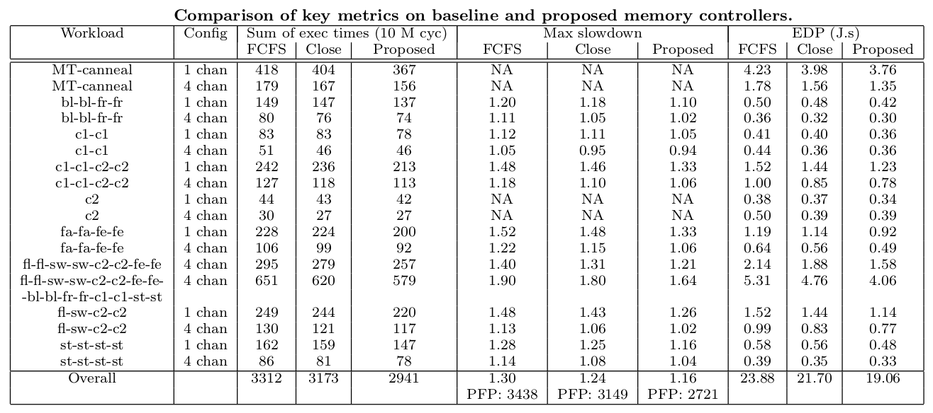
Evaluation Results
Performance
Improvement

Slide 21
Evaluation Results
Performance
Improvement
Exec time : 11.2%
PFP : 20.9%
EDP : 20.2%
Max Slowdown : 10.8%

Slide 22
Evaluation Results
Max : 12.9%
Max : 26.2%
Max : 14.9%
Performance
Improvement
Exec time : 11.2%
PFP : 20.9%
EDP : 20.2%
Max Slowdown : 10.8%

Slide 23
Evaluation Results

Slide 24
Evaluation Results

Slide 25
Evaluation Results

Slide 26
Evaluation Results
Max Slowdown
EDP

Slide 27
Optimization Breakdown
Proposals
  Compute-phase prediction
  Writeback-refresh overlap
Optimizations
  MLP-aware priority control
  Memory bus reservation
  Activate throttling
11.2% Performance improvement from FCFS consists of
  Close Page Policy: 4.2%
  Baseline Optimization: 4.9%
  Proposal Optimization: 1.9%
Baseline optimization accomplishes a 9.1% improvement
Proposed
Optimization
1.9%
Baseline
Optimization
4.9%
Close Page
  ・Timeout Detection
  ・Write Queue Spill Prevention
  ・Auto-Precharge
  ・Max Activate-Number Restriction
4.2%
FCFS(base)

Slide 28
Optimization Breakdown
11.2% Performance improvement from FCFS consists of
  Close Page Policy: 4.2%
  Baseline Optimization: 4.9%
  Proposal Optimization: 1.9%
Baseline optimization accomplishes a 9.1% improvement
Proposed
Optimization
1.9%
Baseline
Optimization
4.9%
Close Page
4.2%
FCFS(base)

Slide 29
Performance/EDP summary
(2975, 19.79)
(2981, 19.11)
(2987, 20.08)
Exec time
(2990, 19.17)
(3012, 19.71)
(3054, 20.25)
Optimization baseline
(3065, 20.58)
Close Page Policy
Y.Moon
T. Ikeda
Ours
K.Fang
L. Chen
K. kuroyanagi
C. Li
(3173, 21.7)
EDP

Slide 30
Performance/EDP summary
Final score
(2941, 19.06)
(2975, 19.79)
(2981, 19.11)
(2987, 20.08)
Exec time
(2990, 19.17)
(3012, 19.71)
(3054, 20.25)
Optimization baseline
(3065, 20.58)
Close Page Policy
Y.Moon
T. Ikeda
Ours
K.Fang
L. Chen
K. kuroyanagi
C. Li
EDP
(3173, 21.7)

Slide 31
Performance/EDP summary
Final score
(2941, 19.06)
(2975, 19.79)
(2981, 19.11)
(2987, 20.08)
Exec time
(2990, 19.17)
(3012, 19.71)
(3054, 20.25)
Optimization baseline
(3065, 20.58)
Close Page Policy
Y.Moon
T. Ikeda
Ours
K.Fang
L. Chen
K. kuroyanagi
C. Li
EDP
(3173, 21.7)

Slide 32
Optimization History
Final score
Y.Moon
(2941, 19.06)
K.Fang
K. kuroyanagi
Exec time
Ours
(2975, 19.79)
(2981, 19.11)
Optimization baseline
(2990, 19.17)
(3012, 19.71)
EDP

Slide 33
Optimization History
Final score
Y.Moon
(2941, 19.06)
K.Fang
K. kuroyanagi
Exec time
Ours
(2953, 18.75)
(2975, 19.79)
(2981, 19.11)
Optimization baseline
(2990, 19.17)
Opt 1: MLP-aware priority control
Opt 2: Mem bus resevation
Opt 3: ACT throttling
(3012, 19.71)
EDP

Slide 34
Optimization History
Final score
Y.Moon
(2941, 19.06)
K.Fang
Compute-phase prediction
Writeback-refresh overlap
K. kuroyanagi
Exec time
Ours
(2953, 18.75)
(2975, 19.79)
(2981, 19.11)
Optimization baseline
(2990, 19.17)
Opt 1: MLP-aware priority control
Opt 2: Mem bus resevation
Opt 3: ACT throttling
(3012, 19.71)
EDP

Slide 35
Optimization History
Final score
Y.Moon
(2941, 19.06)
K.Fang
Compute-phase prediction
Writeback-refresh overlap
K. kuroyanagi
Exec time
Ours
(2953, 18.75)
(2975, 19.79)
(2981, 19.11)
Optimization baseline
(2990, 19.17)
Opt 1: MLP-aware priority control
Opt 2: Mem bus resevation
Opt 3: ACT throttling
(3012, 19.71)
EDP

Slide 36
Conclusion
High Performance Memory Access Scheduling
  Proposals
    Novel thread-priority control method: Compute-phase prediction
    Cost-effective refreshing method: Writeback-refresh overlap
  Optimization strategies
    MLP-aware priority control, Memory bus reservation, Activate Throttling, Aggressive precharge, force refresh, timeout handling
The optimized scheduler reduces exec time by 11.2%
  Several trade-offs between performance and EDP
  Aggregating the various optimization strategies is
  most important for the DRAM system efficiency

Slide 37
Q&A

