Slide 1
Lecture: Systolic Arrays II
Topics: algorithms for addition/multiplication, solving a
system of linear equations, graph algorithms, sort
Schedule for next week:
Tuesday:
Thursday:

Slide 2
Motivation
How can accelerator computations be performed
efficiently?
Basic adds, multiplies, convolutions
While you may not directly use the algorithm as shown, it might
inspire other applications of the same technique
Broaden our knowledge beyond dot products
Last class: using arrays of simple processors (systolic
arrays) to perform sorting and matrix multiplication
This class: algorithms for addition and multiplication on
linear arrays/trees, solving a system of linear equations,
graph algorithms

Slide 3
Adding Two N-bit Numbers
Propagating the carry takes N steps – can we do better?
Recall the generate, propagate, and stop signals
a = 1010
b = 0011
c = 0010
psgp
s g p p g p s s p p s g p p p s
Carry =
Each carry depends on the leftmost non-p bit to the right

Slide 4
Using a Tree – Log(N)
Carry Lookahead
s
s s
s g s s
s p g s p s p s
s g p p g p s s p p s g p p p s
Propagate to the root: is the sub-tree generating a carry?
node = value of its leftmost non-p child
or p if both children are p

Slide 5
Using a Tree – Log(N)
Carry Lookahead
s
s s
s g s s
s p g s p s p s
s g p p g p s s p p s g p p p s
Leaves: remember the first non-p value you’re going to see
Remember: s g g s s s g s

Slide 6
Using a Tree – Log(N)
Carry Lookahead
s
s s
g g s s
p p s s s s s s
g g p p p p s s p p g g p p s s
As values are propagated to the root, copy the right
child to the left child
Remember: s g g s s s g s s

Slide 7
Using a Tree – Log(N)
Carry Lookahead
s
s s
g g s s
p p s s s s s s
g g p p p p s s p p g g p p s s
The root is the carry of the final sum. We’ll swap it out
with s (since there is no carry-in from the right
non-existent subtree)
Remember: s g g s s s g s s

Slide 8
Using a Tree – Log(N)
Carry Lookahead
s
s s
g g s s
p p s s s s s s
g g p p p p s s p p g g p p s s
Start pushing a node to its children. Note that leaves
are remembering the first non-p value they see.
Remember: s g g g g s s s s s s g s s s s

Slide 9
Adding N k-bit Numbers
Can build a tree of adders (DaDianNao); logN additions;
each addition is O(logk); therefore O(logN * logk)
Instead, we’ll do it in O(logN + logk) – called a Wallace
Tree – used in the SNN vs. ANN study (MICRO’15)
Based on the insight that adding 3 bits gives us 2 bits, i.e.,
we can add 3 numbers to produce two numbers.
A: 1 0 1 1 0 0 0 1
A’: 0 1 1 0 1 1 0 1
A’’: 1 0 1 0 0 1 0 0
D: 0 1 1 1 1 0 0 0
C: 1 0 1 0 0 1 0 1

Slide 10
Wallace Tree
Each level shrinks 3 inputs to 2 inputs in a single cycle;
log_{3/2}N levels; adding the last 2 numbers takes logk

Slide 11
Multiplication of Two N-bit Numbers
See typical multiplication example on next slide
Essentially, adding N 2N-bit numbers – we know that’s
do-able in O(logN) time, but requires more than O(N)
hardware (O(N²) work)
We’ll try to do it with O(N) hardware in O(N) time (4N-1 steps)

Slide 12
Multiplication Example
Multiplying 7x6 = 42
1 1 1
1 1 0
0 0 0
1 1 1
1 1 1
1 0 1 0 1 0
b₃ b₂ b₁
a₃ a₂ a₁
a₁b₃ a₁b₂ a₁b₁
a₂b₃ a₂b₂ a₂b₁
a₃b₃ a₃b₂ a₃b₁
p₆ p₅ p₄ p₃ p₂ p₁
This is the definition of a 1D conv.

Slide 13
1D Convolution
Need 2N processing elements to multiply 2 N-bit numbers
Inputs are fed from left and right with gaps (why gaps?)
Each processing element accumulates the corresponding
bit of the product
The generated carry has to also move leftward

Slide 14
Example
Convolution of
5 (101) and 7 (111)

Slide 15
Analysis
4N-1 steps because a 2N input has to go across 2N PEs
But every PE is idle in alternate cycles – can improve
efficiency by interleaving two multiplications or by
wrapping the linear array into two rows
This is also one approach for computing a 1D convolution;
extending to 2D and 3D convolutions is not straightforward

Slide 16

Solving Systems of Equations
Given an N x N lower triangular matrix A and an N-vector
b, solve for x, where Ax = b (assume solution exists)
a₁₁x₁ = b₁
a₂₁x₁ + a₂₂x₂ = b₂ , and so on…

Slide 17
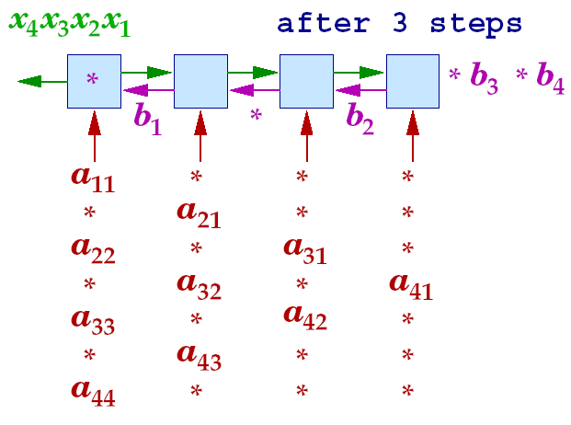
Equation Solver

Slide 18
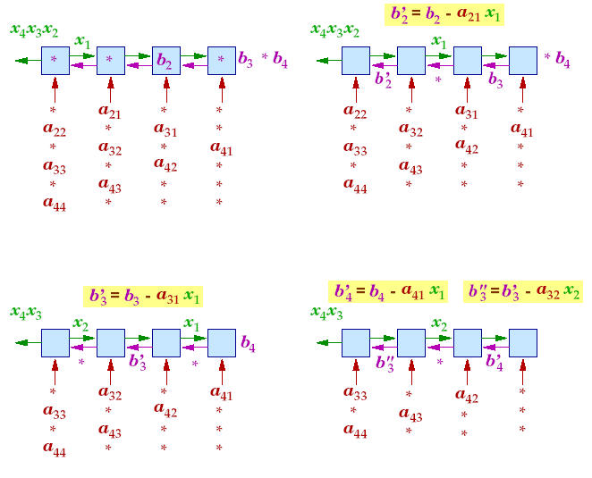
Equation Solver Example
When an x, b, and a meet at a cell, ax is subtracted from b
When b and a meet at cell 1, b is divided by a to become x

Slide 19
Complexity
Time steps = 2N – 1
Speedup = O(N), efficiency = O(1)
Note that half the processors are idle every time step –
can improve efficiency by solving two interleaved
equation systems simultaneously or by wrapping the
linear array

Slide 20
Inverting Triangular Matrices
Finding X, such that AX = I, where A is a lower triangular
matrix
For each row j, A x_{j} = e_{j} , where e_{j} is the jth unit vector
(0,…, 0, 1, 0,…, 0) and x_{j} is the jth row of matrix X
Simple extension of the earlier algorithm – it can be
applied to compute each row individually

Slide 21
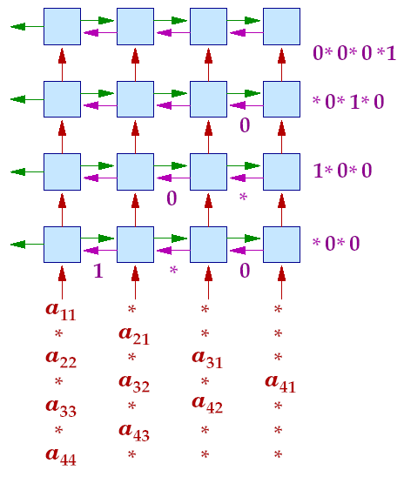
Inverting Triangular Matrices

Slide 22
Gaussian Elimination
Solving for x, where Ax=b and A is a nonsingular matrix
Note that A⁻¹Ax = A⁻¹b = x ; keep applying transformations
to A such that A becomes I ; the same transformations
applied to b will result in the solution for x
Sequential algorithm steps:
Pick a row where the first (i^{th}) element is non-zero and
normalize the row so that the first (i^{th}) element is 1
Subtract a multiple of this row from all other rows so
that their first (i^{th}) element is zero
Repeat for all i

Slide 23
Sequential Example
2 4 -7 x1 3
3 6 -10 x2 = 4
-1 3 -4 x3 6
1 2 -7/2 x1 3/2
3 6 -10 x2 = 4
-1 3 -4 x3 6
1 2 -7/2 x1 3/2
0 0 1/2 x2 = -1/2
-1 3 -4 x3 6
1 2 -7/2 x1 3/2
0 0 1/2 x2 = -1/2
0 5 -15/2 x3 15/2
1 2 -7/2 x1 3/2
0 5 -15/2 x2 = 15/2
0 0 1/2 x3 -1/2
1 2 -7/2 x1 3/2
0 1 -3/2 x2 = 3/2
0 0 1/2 x3 -1/2
1 0 -1/2 x1 -3/2
0 1 -3/2 x2 = 3/2
0 0 1/2 x3 -1/2
1 0 -1/2 x1 -3/2
0 1 -3/2 x2 = 3/2
0 0 1 x3 -1
1 0 0 x1 -2
0 1 0 x2 = 0
0 0 1 x3 -1

Slide 24
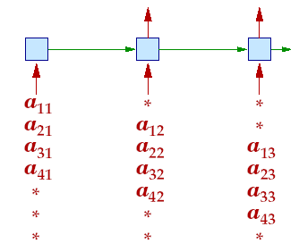
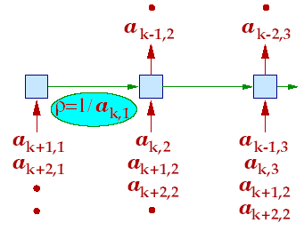
Algorithm Implementation
The matrix is input in staggered form
The first cell discards inputs until it finds
a non-zero element (the pivot row)
The inverse ρ of the non-zero
element is now sent rightward
ρ arrives at each cell at the same
time as the corresponding
element of the pivot row

Slide 25
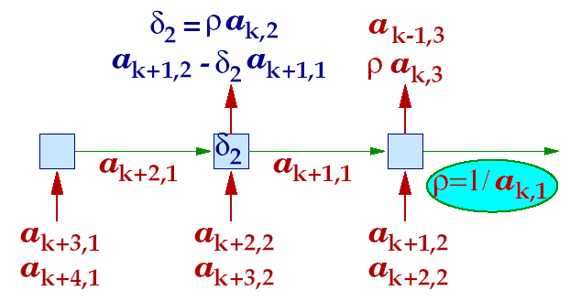
Algorithm Implementation
Each cell stores δ_{i} = ρ a_{k,I} – the value for the normalized pivot row
This value is used when subtracting a multiple of the pivot row from other rows
What is the multiple? It is a_{j,1}
How does each cell receive a_{j,1} ? It is passed rightward by the first cell
Each cell now outputs the new values for each row
The first cell only outputs zeroes and these outputs are no longer needed

Slide 26
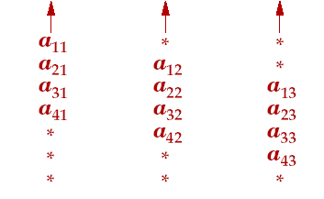
Algorithm Implementation
The outputs of all but the first cell must now go through the remaining
algorithm steps
A triangular matrix of processors efficiently implements the flow of data
Number of time steps?
Can be extended to compute the inverse of a matrix

Slide 27
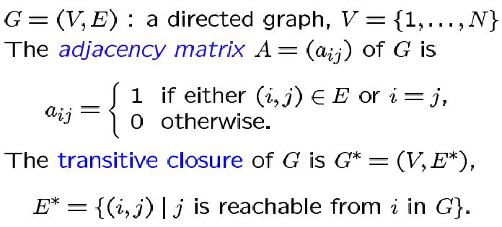
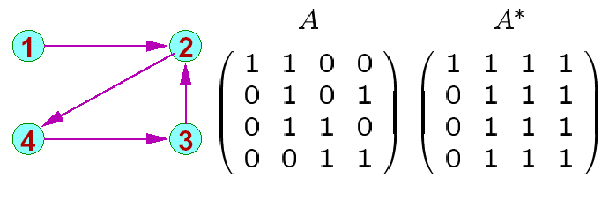
Graph Algorithms

Slide 28
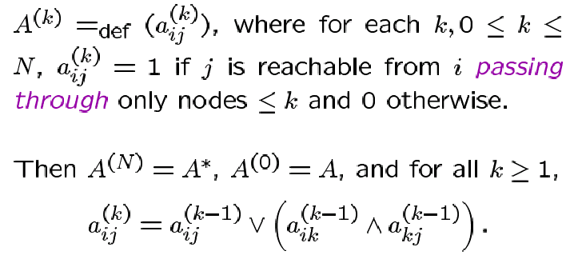
Floyd Warshall Algorithm

Slide 29
Implementation on 2d Processor Array
Row 3
Row 2
Row 1
Row 3
Row 2
Row 3
Row 1
Row 1/2
Row 1/3
Row 1
Row 2
Row 2/3
Row 2/1
Row 2
Row 3
Row 3/1
Row 3/2
Row 3
Row 1
Row 2
Row 1
Row 3
Row 2
Row 1

Slide 30
Algorithm Implementation
Diagonal elements of the processor array can broadcast
to the entire row in one time step (if this assumption is not
made, inputs will have to be staggered)
A row sifts down until it finds an empty row – it sifts down
again after all other rows have passed over it
When a row passes over the 1st row, the value of a_{i1} is
broadcast to the entire row – a_{ij} is set to 1 if a_{i1} = a_{1j} = 1
– in other words, the row is now the i^{th} row of A⁽¹⁾
By the time the k^{th} row finds its empty slot, it has already
become the k^{th} row of A^{(k-1)}

Slide 31
Algorithm Implementation
When the i^{th} row starts moving again, it travels over
rows a_{k} (k > i) and gets updated depending on
whether there is a path from i to j via vertices < k (and
including k)

Slide 32
Shortest Paths
Given a graph and edges with weights, compute the
weight of the shortest path between pairs of vertices
Can the transitive closure algorithm be applied here?

Slide 33
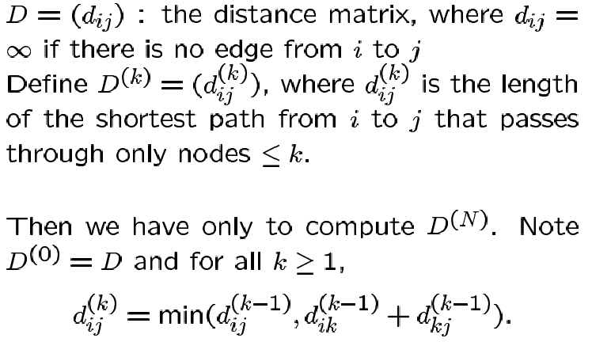
Shortest Paths Algorithm
The above equation is very similar to that in transitive closure

Slide 34
References
“Introduction to Parallel Algorithms and Architectures,” Leighton
Figure credits: Mitsu Ogihara

