Slide 1
Lecture: Analog Accelerator
Topics: memristor basics, ISAAC accelerator

Slide 2
Analog Acceleration
Many electronic phenomena correspond to
multiplication and addition
Analog phenomena are also noisy; perhaps, this is not
an issue when dealing with neural networks

Slide 3
Wires as ALUs
V1
G1
I1 =V1.G1
V2
G2
I2 =V2.G2
I = I1 + I2 =
V1.G1 + V2.G2

Slide 4
Crossbar for Vector-Matrix Multiplication
DAC
DAC
DAC
DAC
S&H
S&H
S&H
S&H
ADC

Slide 5
Physical View
Wordline
Memristor cell
Bitline
Driver circuits in silicon substrate
Physical view of a memristor crossbar array

Slide 6
Challenge
High ADC/DAC area/energy
You could stay in analog forever, but then you’d need expensive analog buffering and you’d introduce significant noise that accumulates across network layers
Unfortunately, some ADC overheads increase
exponentially with resolution
Resolution increases with computational density

Slide 7
1. Input One Bit at a Time
Need a trivial DAC
Must perform multiplication over 16 iterations
Results are aggregated with shift-and-adds

Slide 8
2. Spread the Weights
A single weight is spread across 8 2-bit cells in a row
The outputs of 8 columns have to be shifted and added
Low bits per cell is good for precision and for ADC efficiency

Slide 9
3. Few Rows Per Crossbar
Requires us to use many small crossbars
A neuron with many inputs is spread across multiple xbars
Must aggregate partial sums from many xbars

Slide 10
4. Weight Encoding
If the weights are large, store their “complements”
Reduces ADC resolution by 1 bit
Inputs are provided in 2’s complement form
The MSb represents -2¹⁵ -- need a shift-and-subtract
Irrelevant if we are using ReLU
Weights are stored with a bias: a bias of 2¹⁵ allows
unsigned integers to represent weights between
-2¹⁵ and 2¹⁵ - 1

Slide 11
Analog Accelerator Challenge
High ADC/DAC area/energy
1-bit input at a time (small v)
2-bit cells (small w)
Few rows per array (small R)
Encoding tricks to produce small numbers
Spread the computation across a single xbar, across
multiple xbars, and across time to reduce ADC size

Slide 12
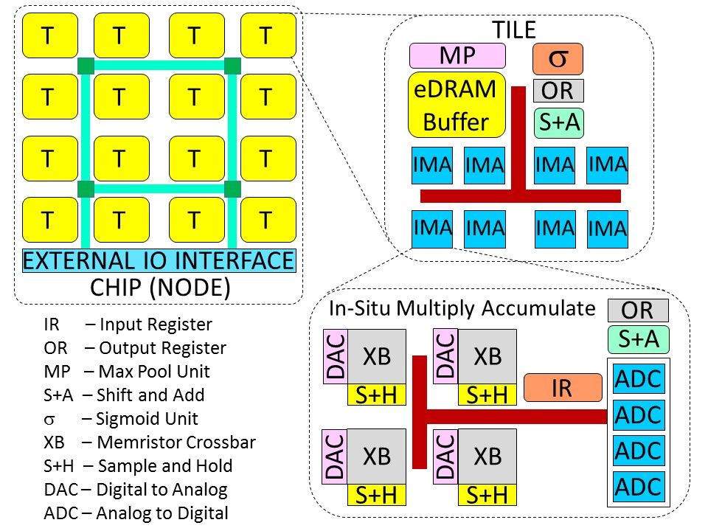
ISAAC Architecture

Slide 13
ISAAC Pipeline
(a) Example of different layers in action at the same time
B
B
B
B
Layer 2
Layer 3
Layer 4
Layer 5
Layer 1
(b) Example of one operation in layer i flowing through its pipeline
Cyc 1 2 3 4 … 17 18 19 20 21 22
eDRAM
Rd + IR
Xbar
1
Xbar
2
Xbar
3
Xbar
16
…
ADC
S+A
OR wr
S+A
OR wr
σ
eDRAM
Wr
Tile IMA IMA IMA IMA IMA IMA Tile Tile Tile

Slide 14
Pipeline Variants
Most digital accelerators use “temporal pipelines” – all
units work on 1 layer, then all work on the next layer, etc.
Good for low latency and cache locality
A spatial pipeline would give nearly the same throughput, but
higher latency per inference
Analog accelerators use “spatial pipelines” – parts of the
chip are hard-coded to execute specific layers
Required by design since weight updates are slow
Latency impact is small (no batching required and for the most
part, all layers work on the same image)

Slide 15
Replication in Early Layers

Slide 16
The ISAAC Pipeline
Pipelining within an IMA/tile/layer
Pipelining across layers
Network is mapped to avoid hazards; balanced replication
where possible to avoid storage/compute under-utilization
Design space exploration to identify the best use of chip
real estate

Slide 17
Power/Area Breakdowns

Slide 18
Power/Area Breakdowns

Slide 19
Design Space Exploration

Slide 20
Comparison to DaDianNao
7.5X higher computational density
14.8X higher throughput on CNN benchmarks
5.5X lower energy
The chip has a 3X higher power density

Slide 21
Throughput on CNNs

Slide 22
Other Analog Innovations
AN codes for reliability (Feinberg et al., HPCA’18)
Crossbars applied to scientific computing (Feinberg et al.,
ISCA’18)
More efficient ADCs (e.g., PipeLayer, HPCA’17)
Memristor-aided logic (Kvatinsky et al., IEEE Trans. On
Circuits and Systems, 2014) – activate two rows and
ground a third row to perform a NOR operation within the
crossbar

Slide 23
References
“ISAAC: A Convolutional Neural Network Accelerator with In-Situ
Analog Arithmetic in Crossbars”, A. Shafiee et al., Proceedings of
ISCA, 2016

