Slide 1
Lecture: Analog Accelerator
Topics: memristor basics, ISAAC accelerator

Slide 2
Analog Acceleration
Many electronic phenomena correspond to
multiplication and addition
Analog phenomena are also noisy; perhaps, this is not
an issue when dealing with neural networks
See the next slide as an example of how natural phenomena can be used to perform multiplication and addition (the exact operation we need for a dot-product). With three wires and 2 resistors, we are able to compute the dot-product. Each resistor injects a current that is the product of applied voltage (V1) and the conductance of the resistor (G1). By merging two such wires, we also perform addition of currents. Note that the dot-product is being performed in the analog domain – values are not represented as a stream of binary voltages (as is done in digital circuits), but as real-valued voltages, conductances, and currents.

Slide 3
Wires as ALUs
V1
G1
I1 =V1.G1
V2
G2
I2 =V2.G2
I = I1 + I2 =
V1.G1 + V2.G2

Slide 4
Crossbar for Vector-Matrix Multiplication
Here, this concept is extended further. We have a full grid of resistances and horizontal/vertical wires. The input voltages are provided on the horizontal wires (wordlines) and these voltages are seen by all the columns (bitlines). Each column represents a different neuron. Each column sees the same set of inputs, but computes a different dot-product based on the conductances in that column. It is expensive to take the analog current and send it over long distances, buffer it, do other operations on it, etc. So the analog current is immediately sent through an analog-to-digital converter (ADC). Similarly, at the input, we need a digital-to-analog converter (DAC). S&H is the sample-and-hold circuit that feeds signals sequentially to the ADC.
DAC
DAC
DAC
DAC
S&H
S&H
S&H
S&H
ADC

Slide 5
Physical View
Wordline
Memristor cell
Bitline
Driver circuits in silicon substrate
Physical view of a memristor crossbar array

Slide 6
Challenge
High ADC/DAC area/energy
You could stay in analog forever, but then you’d need expensive analog buffering and you’d introduce significant noise that accumulates across network layers
Unfortunately, some ADC overheads increase
exponentially with resolution
Resolution increases with computational density
It turns out that the ADC is a very expensive unit and its area/power grows almost exponentially with ADC resolution, i.e., how many bits of information can the ADC decipher. The number of bits coming out of a bitline is a function of the bits of info in the voltage (v), the bits of info in the weight (w), and the number of rows (R) being added (see equations below). To increase the parallelism and storage density, we want high v, w, and R – but then you’re demanding an expensive high-res ADC.

Slide 7
1. Input One Bit at a Time
Need a trivial DAC
Must perform multiplication over 16 iterations
Results are aggregated with shift-and-adds
The ISAAC architecture leverages these crossbars to perform dot-products for deep networks. It is therefore an example of an analog accelerator, or more precisely, a mixed-signal analog/digital accelerator. The grid of resistances is implemented with memristor cells that are sandwiched between the horizontal and vertical wires on two different metal layers. They key to an efficient design is the management of the high ADC overheads. This is done by spreading the dot-product in space and time. This helps bring down v, w, R, and consequently the ADC resolution. The first step is to spread in time. So instead of producing a 16-bit input with a very precise voltage, we’ll provide 16 1-bit inputs over 16 cycles. So every input is a single 0/1 value, i.e., a standard digital input and a complex DAC is not required. This helps bring v down to 1. For every bit provided, we perform a multiplication, and then aggregate the results with the appropriate shift. This is exactly like the multiplication algorithm in the digital space, but the multiplication and addition for each input bit is being performed with the crossbar.

Slide 8
2. Spread the Weights
A single weight is spread across 8 2-bit cells in a row
The outputs of 8 columns have to be shifted and added
Low bits per cell is good for precision and for ADC efficiency
Next, to reduce the value of w, we don’t encode the entire 16-bit value as a precise conductance in a cell. Instead, we spread the weight across 8 memristor cells in one row, i.e., each cell is only responsible for 2 bits. This makes it easier to program each individual cell and bring w down to 2. Therefore, the results from each column have to also be shifted and added.

Slide 9
3. Few Rows Per Crossbar
Requires us to use many small crossbars
A neuron with many inputs is spread across multiple xbars
Must aggregate partial sums from many xbars
To keep the value of R in check, we simply implement small crossbars of size 128x128. This means that if a neuron needs more than 128 inputs, it has to be spread across multiple crossbars. Again, we need to aggregate the partial sums from multiple crossbars to get the final neuron value. Thus, we have reduced v, w, and R by spreading the computation across multiple columns, across multiple crossbars, and across multiple cycles.

Slide 10
4. Weight Encoding
If the weights are large, store their “complements”
Reduces ADC resolution by 1 bit
Inputs are provided in 2’s complement form
The MSb represents -2¹⁵ -- need a shift-and-subtract
Irrelevant if we are using ReLU
Weights are stored with a bias: a bias of 2¹⁵ allows
unsigned integers to represent weights between
-2¹⁵ and 2¹⁵ - 1
As a final trick to keep A in check, we observe that in most cases, the dot-product is not a high value. If we assume 1-bit inputs at a time, 2-bit cells, and 128 rows, the maximum dot-product value is 384, requiring a 9-bit ADC. But in most cases, the dot-product value is less than 256, which means we can get away with an 8-bit ADC. If the dot-product threatens to be higher than 256, i.e., if the sum of all the weights is greater than 256, we store the bits in their flipped form, i.e., we store a 0 for a 3, a 1 for a 2, a 2 for a 1, and a 3 for a 0. While we’re creating an encoding, let’s also add support for negative weights and inputs. I won’t bother with the details here (see short synopsis above).

Slide 11
Analog Accelerator Challenge
High ADC/DAC area/energy
1-bit input at a time (small v)
2-bit cells (small w)
Few rows per array (small R)
Encoding tricks to produce small numbers
Spread the computation across a single xbar, across
multiple xbars, and across time to reduce ADC size

Slide 12
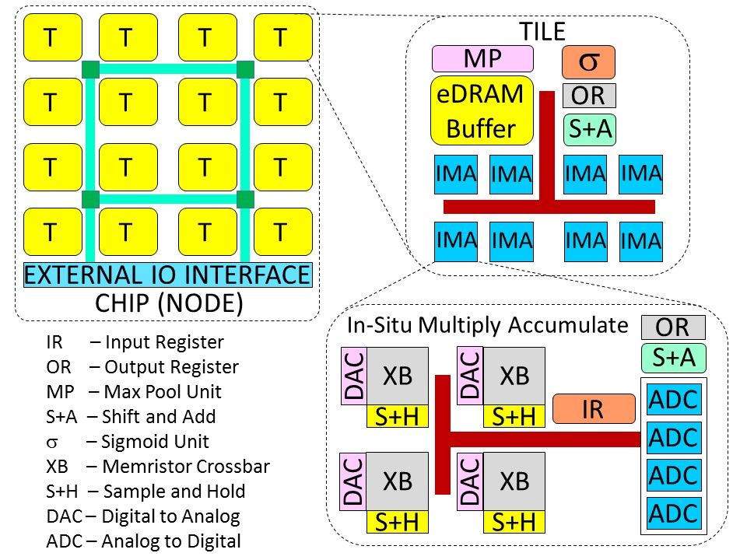
ISAAC Architecture

Slide 13
ISAAC Pipeline
(a) Example of different layers in action at the same time
B
B
B
B
Layer 2
Layer 3
Layer 4
Layer 5
Layer 1
(b) Example of one operation in layer i flowing through its pipeline
Cyc 1 2 3 4 … 17 18 19 20 21 22
eDRAM
Rd + IR
Xbar
1
Xbar
2
Xbar
3
Xbar
16
…
ADC
S+A
OR wr
S+A
OR wr
σ
eDRAM
Wr
Tile IMA IMA IMA IMA IMA IMA Tile Tile Tile

Slide 14
Pipeline Variants
Most digital accelerators use “temporal pipelines” – all
units work on 1 layer, then all work on the next layer, etc.
Good for low latency and cache locality
A spatial pipeline would give nearly the same throughput, but
higher latency per inference
Analog accelerators use “spatial pipelines” – parts of the
chip are hard-coded to execute specific layers
Required by design since weight updates are slow
Latency impact is small (no batching required and for the most
part, all layers work on the same image)

Slide 15
Replication in Early Layers

Slide 16
The ISAAC Pipeline
Pipelining within an IMA/tile/layer
Pipelining across layers
Network is mapped to avoid hazards; balanced replication
where possible to avoid storage/compute under-utilization
Design space exploration to identify the best use of chip
real estate

Slide 17
Power/Area Breakdowns

Slide 18
Power/Area Breakdowns

Slide 19
Design Space Exploration

Slide 20
Comparison to DaDianNao
7.5X higher computational density
14.8X higher throughput on CNN benchmarks
5.5X lower energy
The chip has a 3X higher power density

Slide 21
Throughput on CNNs

Slide 22
Other Analog Innovations
AN codes for reliability (Feinberg et al., HPCA’18)
Crossbars applied to scientific computing (Feinberg et al.,
ISCA’18)
More efficient ADCs (e.g., PipeLayer, HPCA’17)
Memristor-aided logic (Kvatinsky et al., IEEE Trans. On
Circuits and Systems, 2014) – activate two rows and
ground a third row to perform a NOR operation within the
crossbar

Slide 23
References
“ISAAC: A Convolutional Neural Network Accelerator with In-Situ
Analog Arithmetic in Crossbars”, A. Shafiee et al., Proceedings of
ISCA, 2016

