Slide 1
Lecture: Training Innovations
Topics: NVIDIA Volta, Intel NNP-T/I, ScaleDeep, vDNN
No class on Tuesday

Slide 2
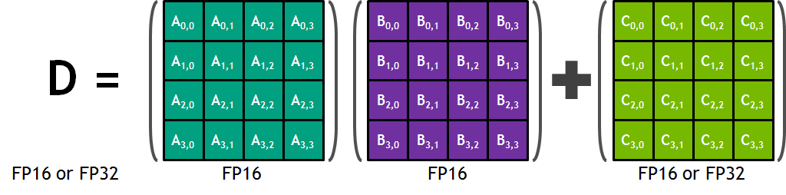
NVIDIA Volta GPU
640 tensor cores
Each tensor core performs a MAC on 4x4 tensors
Throughput: 128 FLOPs x 640 x 1.5 GHz = 125 Tflops
FP16 multiply operations
12x better than Pascal on training and 6x better on inference
Basic matrix multiply unit – 32 inputs being fed to 64 parallel multipliers; 64 parallel add operations
Reference: http://images.nvidia.com/content/volta-architecture/pdf/volta-architecture-whitepaper.pdf

Slide 3
Intel NNP-T
Image Source: Intel presentation HotChips’19

Slide 4
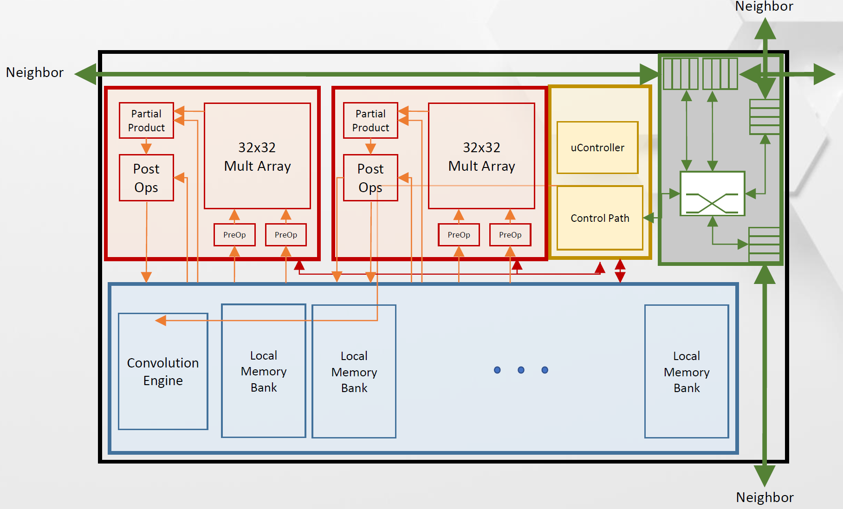
Intel NNP-T
Each Tensor Processing Cluster (TPC) has two 32x32 MAC grids
supporting bfloat16 (appears similar to TPU)
Conv engine to marshall data before each step
60MB on-chip SRAM (2.5MB scratchpad per TPC)
Communication is key: grid network among TPCs, 64 SerDes
lanes (3.6 Tb/s) for inter-chip communication, 4 HBMs
Relatively low utilization for GeMM (< 60%) and Conv (59-87%)
Image Source: Intel presentation HotChips’19

Slide 5
Intel NNP-I
12 Inference Compute Engines (ICE) that can work together or
independently; 24MB central cache and 4MB per ICE
Each ICE has 4K 8b MAC unit
10W, 48 TOPs, 3600 inf/s
Image Source: Intel presentation HotChips’19

Slide 6
Training Take-Homes
Create a mini-batch which is a random set of training inputs; apply the
fwd pass; compute error; backprop the errors (while using a transpose
of weights); compute the deltas for all the weights (using the Xs of
previous layer); aggregate the deltas and update the weights at the
end of the mini-batch; keep creating mini-batches until you run out of
training samples; this is one epoch.
On the fwd pass, we use inputs X and weights W to compute output Y
On the bwd pass, we use dY and weights W to compute dX;
we also use dX and X to compute dW
X
X,W
Y
dX
dY,W,X
dY
dW

Slide 7
ScaleDeep Intro
Pays attention to training (network, storage)
Introduces heterogeneity
Uses a spatial pipeline
(instead of time-multiplexed execution)
Heavy use of batching for efficiency
Novel interconnect structure (for a 1.4 KW server) that
helps with batching and training

Slide 8
Layer Breakdown
High weight reuse;
Large feature maps
High neuron reuse;
Many feature maps;
80% of all computations
Large memory;
High bytes/flop
Note: FP, BP, WG

Slide 9
CompHeavy Tile
Kernels enter from top and down
Can do two small kernels or 1
large kernel
Inputs enter from left memory
Accumulation happens on right
Scratchpad used for partial sums
Multiple lanes in each PE (can
handle different kernels)

Slide 10
MemHeavy Tile
Intra-chip heterogeneity
Mainly used for data storage.
Can compute activations and
pooling.

Slide 11
ScaleDeep Chip
3 Comp tiles per Mem tile
(for FP, BP, and WG)
Tiles are dedicated for
specific layers (like ISAAC)
Latency/thruput trade-off

Slide 12
Chip Heterogeneity
Tailored for
FC layer

Slide 13
ScaleDeep Node
Each ConvChip works
on a different image.
The outputs converge on
the FC chip (spokes) so
it can use batching.
The wheel arcs are used
for weight updates and
for very large convs.
The FC layer is split
across multiple FCchips;
increases batching,
reduces memory,
low network bw

Slide 14
Results Summary
Both chips have about 50 MB capacity
Convchip consumes 58 W, FCchip consumes 15 W
Inference is 3x faster than training
One chip-cluster (320 W, comparable to a GPU) has
5-11x speedup over the GPU
5x speedup over DaDianNao at iso-power

Slide 15
Training on GPUs
GPUs have limited memory capacity (max 12 GB)
When training, in addition to storing weights, we must
store all the activations as they are required during
backprop; plus the weight deltas
In convolution layers, the activations consume way more
memory than the weights; convolution activations also
have longer reuse distance than classifier weights
vDNN is a runtime that automatically moves activations to
CPU memory and back, so the network fits in GPU memory
(avoids constrained network, multi GPUs, small batches, slower algos)

Slide 16
Motivation I

Slide 17
Motivation II

Slide 18
Motivation III
Can use frequency-domain FFT algorithms that are faster, but need additional workspace

Slide 19
vDNN Proposal
Runtime system that, during fwd pass, initiates an off-load of a layer’s X
while it is computing on X (no races because X is read-only)
The layer waits if the offload hasn’t finished; trying to optimize memory
capacity
During back-prop, initiate a prefetch of X for previous layer; must wait if
prefetch hasn’t finished

Slide 20
System Parameters
Baseline: NVIDIA Titan X; 7 TFLOP/s; 336 GB/s GDDR5
memory bandwidth, 12 GB, 16 GB/s PCIe link
for GPU←→ CPU memory transfers
Baseline with performance features (more memory reqd)
vDNNall: all layers perform an offload/prefetch (least memory)
vDNNconv: only convolutional layers perform offload/prefetch
vDNNdyn: explores many configs to identify the few layers
that need to be offloaded/prefetched, and the few
layers that can use the faster algos; exploration
isn’t expensive and uses a greedy algorithm

Slide 21
Memory Interference
Early layers need the most offloading and will interfere
the most with GDDR access; but early layers also have
the least memory accesses for weights; at most, the
interference will be 16/336 = 5%

Slide 22
Performance Results
The largest benchmark has 18% perf loss; others are near zero
Dynamic scheme gives best perf while fitting in memory
Power increase of 1-7%

Slide 23
References
“Neural Networks and Deep Learning,” (Chapter 2) Michael Nielsen
“SCALEDEEP: A Scalable Compute Architecture for Learning and
Evaluating Deep Networks,” S. Venkataramani et al., ISCA 2017
“vDNN: Virtualized Deep Neural Networks for Scalable, Memory-
Efficient Neural Network Design,” M. Rhu et al., MICRO 2016

