Slide 1
Lecture: DianNao and DaDianNao
Topics: Diannao wrap-up and DaDianNao

Slide 2
DianNao

Slide 3
Fixed Point Arithmetic
DianNao uses 16b fixed-point arithmetic; much more efficient
than 32b floating-point arithmetic, and little impact on accuracy

Slide 4
Fixed Point Error Rates

Slide 5
Precision Analysis for DNNs
Min bits required per layer for accuracy within 1%
Source: Proteus, Judd et al., WAPCO’16

Slide 6
Implementation Details/Results
Cycle time of 1.02ns, area of 3mm², 485mW power
The NFU is composed of 8 pipeline stages
Peak activity is nearly 500 GOP/s
44KB of RAM capacity
Buffers are about 60% of area/power, while NFU is ~30%
Energy is 21x better than a SIMD baseline; this is limited
because of the high cost of memory accesses
Big performance boosts as well: higher computational
density, tiling, prefetching

Slide 7
DianNao Conclusions
Tiling to reduce memory traffic
Efficient NFU and buffers to reduce energy/op and prefetch
Even with these innovations, memory is the bottleneck,
especially in a small accelerator with few pins
For example, each classifier layer step needs 256 new
synaptic weights (512 bytes), while 4 memory channels
can only bring in 64 bytes per cycle
Energy consumed by the DianNao pipeline per cycle = 500pJ
Energy per cycle for fetching 64 bytes from memory = 35nJ
(70 pJ/b for DDR3 at 100% utilization, Malladi et al., ISCA’12)
It’s all about the memory bandwidth/energy !!!

Slide 8
The GPU Option
Modest (but adequate) memory capacities (a few giga-bytes)
High memory bandwidth, e.g., 208 GB/s (NVIDIA K20M)
But, high compute-to-cache ratio on the chip
Therefore, average GPU power of ~75 W, plus expensive
memory accesses ➔ GPU card TDP of ~225W
A GPU out-performs DianNao by ~2X

Slide 9
DaDianNao Philosophy
Need giga-bytes of storage for weights and accessing these
weights is the clear bottleneck
Can’t store giga-bytes on 1 chip, but can store giga-bytes
on many chips on a board
Surround a DianNao circuit with a large eDRAM (dense)
structure to replace main memory (high storage-to-compute)
Every operation is spread across several “tiles” to maximize
parallelism

Slide 10
DaDianNao Philosophy II
Synapses stay in place and neuron values move around
(since synapses are so much larger)
Use eDRAM instead of SRAM (about 2.85x higher density)
Can get high internal bandwidth by having many banks
for eDRAM storage (they use 4)
Implement many tiles on a chip – each tile has 4 eDRAM
banks for weights, and all tiles share 2 eDRAM banks
for input/output
They allow 32-bit operations because it is useful for training

Slide 11
DaDianNao Layouts
Each eDRAM bank size is 512 KB (3 cyc); central eDRAM bank is
2MB (10 cyc); total node storage is 36 MB; HT bw is 6.4 x 4 GB/s (80ns).

Slide 12
Other Details
606 MHz clock (because of the eDRAM)
5.58 Tera ops/second
16 W node (chip), 68 mm²
Area breakdown: 45% tiles; 26% HT; 12% central eDRAM;
9% central wiring
Half the chip is eDRAM storage
Power breakdown: 39% in tiles, 50% HT; eDRAM power
is 38%; combinational circuits are 38%, 19% is registers

Slide 13
Speedup over GPU

Slide 14
Energy Reductions

Slide 15
Benchmarks

Slide 16
DaDianNao Summary
Memory bandwidth is the key bottleneck, especially
when handling the fully-connected classifier layers
DaDianNao manages this by distributing weights across
eDRAM banks in many chips
A layer is executed in parallel across several NFUs/chips;
outputs are moved around; the next layer then executes
(no memory accesses for weights)

Slide 17
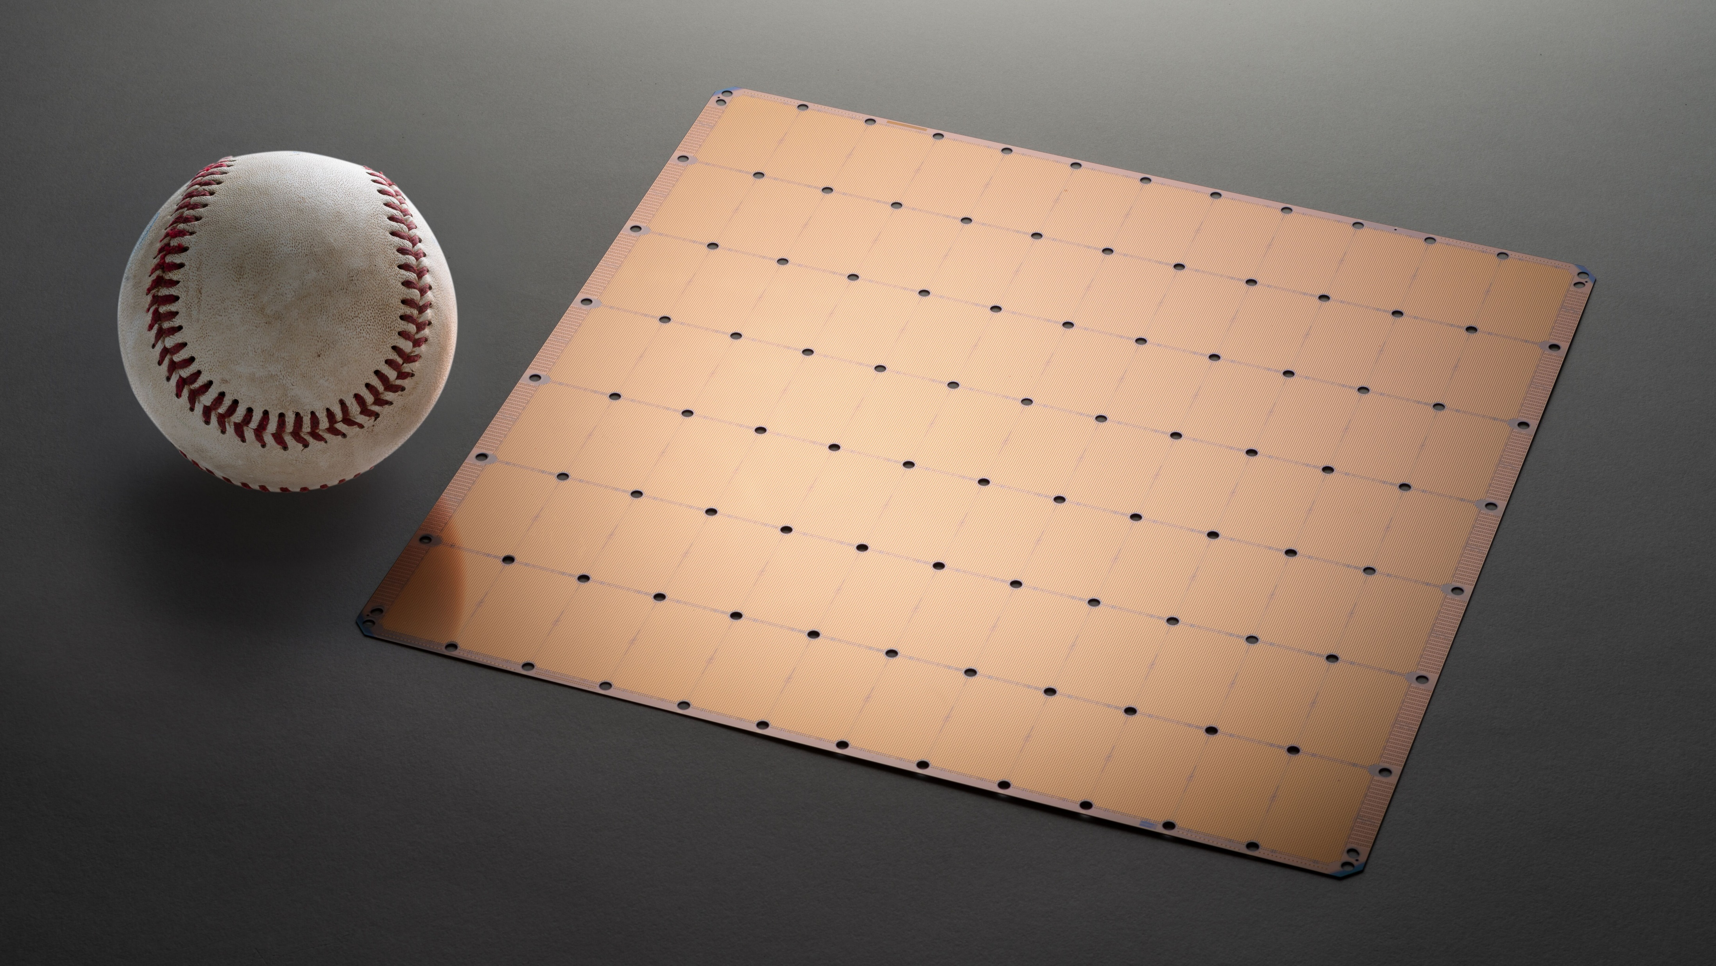
Cerebras Wafer Scale Integration
Trillion transistors
18 GB SRAM
15-50 KW power
100 Pb/s internal bandwidth
Source: Cerebras.net

Slide 18
References
“DianNao: A Small-Footprint High-Throughput Accelerator for Ubiquitous
Machine Learning”, T. Chen et al., Proceedings of ASPLOS, 2014
“DaDianNao: A Machine-Learning Supercomputer”,
Y. Chen et al., Proceedings of MICRO, 2014
https://www.cerebras.net/wp-content/uploads/2019/08/Cerebras-Wafer-Scale-Engine-Whitepaper.pdf
https://www.sigarch.org/the-first-trillion-transistor-chip-a-new-design-space

