Slide 1
CS 7960 Neuromorphic Architectures
Rajeev Balasubramonian
School of Computing, University of Utah
http://www.cs.utah.edu/~rajeev/cs7960

Slide 2
Lecture: Introduction
Topics: landscape, terminology, motivation
Logistics: lectures, project, exams, grading, canvas

Slide 3
Hardware Trends
Why the emphasis on accelerators?

Slide 4
Hardware Trends
Why the emphasis on accelerators?
Stagnant single- and multi-thread performance with general-purpose cores
Dark silicon (emphasis on power-efficient throughput)
End of scaling
No low-hanging fruit
Emergence of machine learning

Slide 5



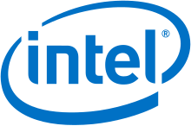


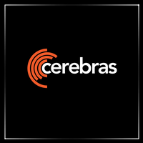
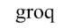



Commercial Hardware for ML
Google TPU (inference and training)
Recent NVIDIA chips (Volta)
Microsoft Brainwave and Catapult
Intel Loihi and Nervana
Cambricon
Graphcore (training)
Cerebras (training)
Groq (inference)
ARM
Western Digital
Tesla (FSD)

Slide 6
Neuromorphic Hardware
The holy grail: emulating the brain
Low power – the brain consumes only 20 W
Fault tolerant – the brain loses neurons all the time
No programming required – the brain learns by itself
Significant efforts in Europe, US, China (Human Brain Project, DARPA SyNAPSE)
Implementations: SpiNNaker, Spikey, TrueNorth

Slide 7
Taxonomy
ANN vs. SNN: ML vs. Neuroscience, training via back-prop or via biological processes
Analog vs. Digital architectures
Chips for inference vs. training
Systolic vs. Tensors

Slide 8
ANN vs. SNN
x₁
w₁
f (x₁w₁ + x₂w₂ + x₃w₃ + b)
x₂
w₂
x₃
w₃
Source: Nere et al., HPCA’13

Slide 9
ANN vs. SNN
Perceptron (ANN): well-understood, high accuracy
Spiking neural network: infant technology
(relatively), potential for low-energy computations
and low-energy communication, potential for high
information content
Potential convergence: brain-inspired ideas being
injected into machine learning (RNNs, few bits per
value), and machine learning techniques (back-prop)
being used to train brain models

Slide 10
Analog vs. Digital
A single analog device can perform multiple multi-bit operations
But, analog has challenges, e.g. noise/precision
Cognitive applications amenable to analog because of their noise tolerance

Slide 11
Gartner Hype Curve

Slide 12
NN Hype Curve
From O. Temam keynote, ISCA’10

Slide 13
Older Commercial Examples
Analog
Digital
Ref: “Artificial Neural Networks: A Review of Commercial Hardware”, Dias et al., Elsevier, 2004.

Slide 14
Early Bust
Commercial NN chips fell out of favor in the early 2000s
SVMs overtook ANNs
General-purpose processors were getting faster every
year and quickly overtaking ASICs
Limited market for machine learning
Note that none of the above is applicable today

Slide 15
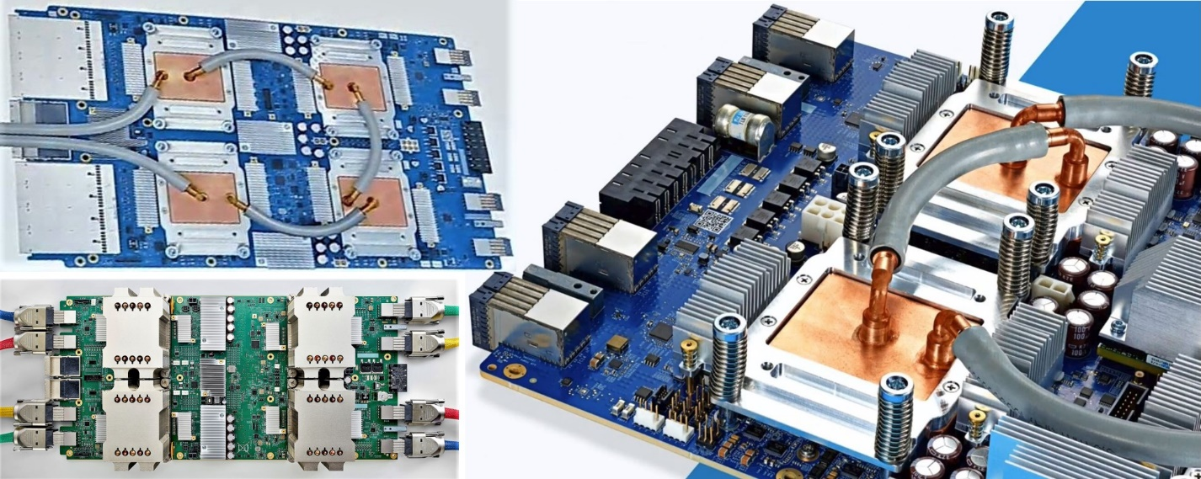
Google TPU
Version 1: 15-month effort, basic design, only for inference, 92 TOPs peak, 15x faster than GPU, 40 W 28nm 300 mm² chip
Version 2: designed for training, a pod is a collection of v2 chips connected with a torus topology
Version 3: 8x higher throughput, liquid cooled
Ref: Google

Slide 16
References
“Neuromorphic Computing: The Machine of a New Soul”,
The Economist, August 2013
“Artificial Neural Networks: A Review of Commercial Hardware”,
Dias et al., Elsevier, 2004.
“The Rebirth of Neural Networks”, Olivier Temam, Keynote at ISCA’10
Chapter 1 of Nielsen’s book:
http://neuralnetworksanddeeplearning.com/chap1.html

