Slide 1
Lecture: Accelerators
Topics: GPU basics, accelerators for machine learning
Wednesday: review session
Next Monday 12/13, 1pm – 3pm: Final exam

Slide 2
SIMD Processors
Single instruction, multiple data
Such processors offer energy efficiency because a single
instruction fetch can trigger many data operations
Such data parallelism may be useful for many
image/sound and numerical applications

Slide 3
GPUs
Initially developed as graphics accelerators; now viewed
as one of the densest compute engines available
Many on-going efforts to run non-graphics workloads on
GPUs, i.e., use them as general-purpose GPUs or GPGPUs
C/C++ based programming platforms enable wider use
of GPGPUs – CUDA from NVidia and OpenCL from an
industry consortium
A heterogeneous system has a regular host CPU and a
GPU that handles (say) CUDA code (they can both be
on the same chip)

Slide 4
The GPU Architecture
SIMT – single instruction, multiple thread; a GPU has
many SIMT cores
A large data-parallel operation is partitioned into many
thread blocks (one per SIMT core); a thread block is
partitioned into many warps (one warp running at a
time in the SIMT core); a warp is partitioned across many
in-order pipelines (each is called a SIMD lane)
A SIMT core can have multiple active warps at a time,
i.e., the SIMT core stores the registers for each warp;
warps can be context-switched at low cost; a warp
scheduler keeps track of runnable warps and schedules
a new warp if the currently running warp stalls

Slide 5
The GPU Architecture

Slide 6
Architecture Features
Simple in-order pipelines that rely on thread-level parallelism
to hide long latencies
Many registers (~1K) per in-order pipeline (lane) to support
many active warps
When a branch is encountered, some of the lanes proceed
along the “then” case depending on their data values;
later, the other lanes evaluate the “else” case; a branch
cuts the data-level parallelism by half (branch divergence)
When a load/store is encountered, the requests from all
lanes are coalesced into a few 128B cache line requests;
each request may return at a different time (mem divergence)

Slide 7
GPU Memory Hierarchy
Each SIMT core has a private L1 cache (shared by the
warps on that core)
A large L2 is shared by all SIMT cores; each L2 bank
services a subset of all addresses
Each L2 partition is connected to its own memory
controller and memory channel
The GDDR5 memory system runs at higher frequencies,
and uses chips with more banks, wide IO, and better
power delivery networks

Slide 8
Hardware Trends
Why the recent emphasis on accelerators?
  Stagnant single- and multi-thread performance with general-purpose cores
    Dark silicon (emphasis on power-efficient throughput)
    End of scaling
    No low-hanging fruit
  Emergence of deep neural networks

Slide 9









Commercial Hardware
Machine Learning accelerators
Google TPU (inference and training)
Recent NVIDIA chips (Volta, NVDLA)
Microsoft Brainwave, Catapult
Intel Loihi and Nervana
Cambricon
Graphcore (training)
Cerebras (training)
Groq (inference)
Tesla FSD (inference)

Slide 10
Machine Learning Workloads
Dominated by dot-product computations
Deep neural networks: convolutional and fully-connected layers
Convolutions exhibit high data reuse
Fully-connected layers have high memory-to-compute ratio

Slide 11
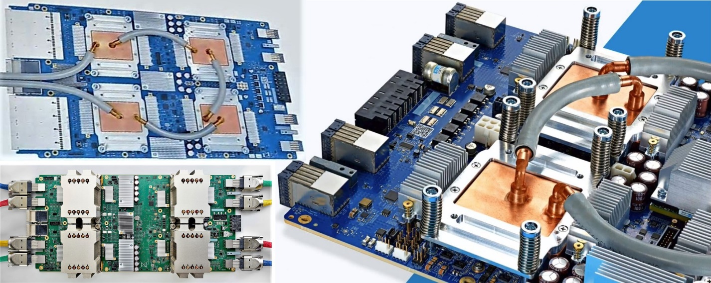
Google TPU
Version 1: 15-month effort, basic design, only for inference, 92 TOPs peak, 15x faster than GPU, 40 W 28nm 300 mm² chip
Version 2: designed for training, a pod is a collection of v2 chips connected with a torus topology
Version 3: 8x higher throughput, liquid cooled
Ref: Google

Slide 12
TPU Architecture
8 GB
256 KB
24 MB
Weights are pre-loaded during previous
phase and inputs flow left to right.

Slide 13
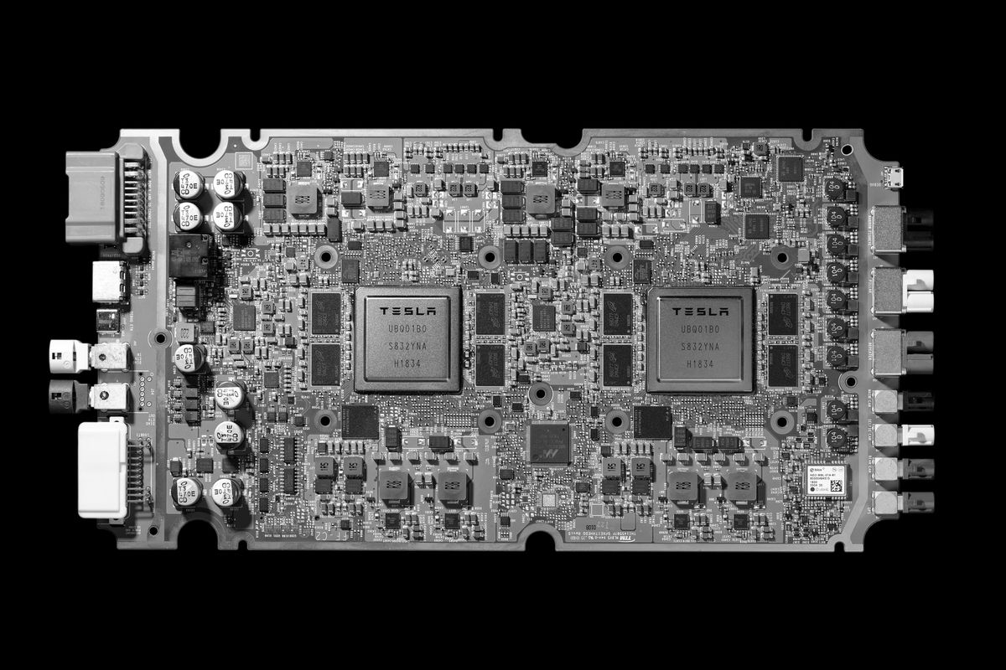
Tesla FSD
Tesla’s custom accelerator chip, shipping in cars since April 2019
FSD sits behind the glovebox, consumes 72W
18 months for first design, next generation out in 2 years
Image Source: Tesla

Slide 14
NN Accelerator Chip (NNA)
Goals: under 100 W (2% impact on driving range, cooling, etc.), 50 TOPs, batch size of 1 for low latency, GPU support as well, security/safety.
Security: all code must be attested by Tesla
Safety: two completely independent systems on the board that verify every output
The FSD 2.5 design (GPU based) consumes 57 W, the 3.0 design consumes 72 W, but is 21x faster (72 TOPs)
20% saving in cost by designing their own chip

Slide 15
Self Driving Car Pipeline
Image Source: Lin et al., ASPLOS 2018
Detection and tracking are two of the heavy-hitters and are DNN based

Slide 16
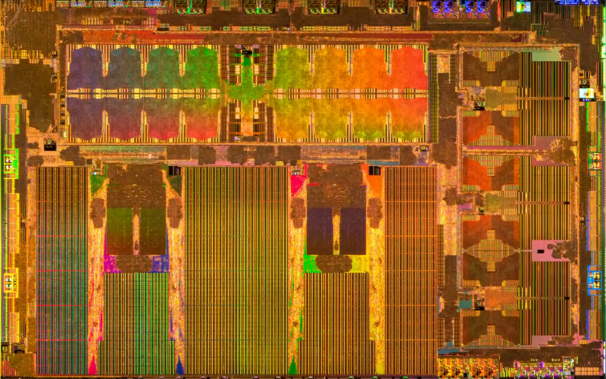
NNA Pipeline
On-chip network moves inputs to LPDDR4: 128b@4.2 Gb/s = 68GB/s
Includes: video encoder, image signal processor, 600 Gflop GPU, and 12-core 2.2 GHz CPU, hardware for ReLU and pooling layers
Most importantly: 2 NN accelerator cores, each with 96x96 grid of MACs and 32MB SRAM, 2 GHz, 36 TOPs per core
Image Source: Tesla

Slide 17
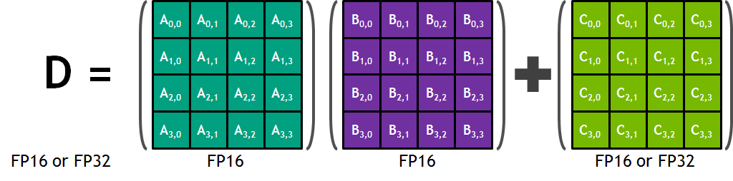
NVIDIA Volta GPU
640 tensor cores
Each tensor core performs a MAC on 4x4 tensors
Throughput: 128 FLOPs x 640 x 1.5 GHz = 125 Tflops
FP16 multiply operations
12x better than Pascal on training and 6x better on inference
Basic matrix multiply unit – 32 inputs being fed to 64 parallel multipliers; 64 parallel add operations
Reference: http://images.nvidia.com/content/volta-architecture/pdf/volta-architecture-whitepaper.pdf

