Slide 1
Lecture 7: Examples, MARS
Today’s topics:
  Procedures wrap-up
  More examples
  MARS intro

Slide 2
Storage Management on a Call/Return
A new procedure must create space for all its variables on the stack
Before/after executing the jal, the caller/callee must save relevant
values in $s0-$s7, $a0-$a3, $ra, $fp, temps into the stack space
Arguments are copied into $a0-$a3; the jal is executed
After the callee creates stack space, it updates the value of $sp
Once the callee finishes, it copies the return value into $v0, frees
up stack space, and $sp is incremented
On return, the caller/callee brings in stack values, ra, temps into registers
The responsibility for copies between stack and registers may fall
upon either the caller or the callee

Slide 3
Registers
The 32 MIPS registers are partitioned as follows:
  Register 0 : $zero always stores the constant 0
  Regs 2-3 : $v0, $v1 return values of a procedure
  Regs 4-7 : $a0-$a3 input arguments to a procedure
  Regs 8-15 : $t0-$t7 temporaries
  Regs 16-23: $s0-$s7 variables
  Regs 24-25: $t8-$t9 more temporaries
  Reg 28 : $gp global pointer
  Reg 29 : $sp stack pointer
  Reg 30 : $fp frame pointer
  Reg 31 : $ra return address

Slide 4
Example 1 (pg. 98)
int leaf_example (int g, int h, int i, int j)
{
int f ;
f = (g + h) – (i + j);
return f;
}
leaf_example:
addi $sp, $sp, -12
sw $t1, 8($sp)
sw $t0, 4($sp)
sw $s0, 0($sp)
add $t0, $a0, $a1
add $t1, $a2, $a3
sub $s0, $t0, $t1
add $v0, $s0, $zero
lw $s0, 0($sp)
lw $t0, 4($sp)
lw $t1, 8($sp)
addi $sp, $sp, 12
jr $ra
Notes:
In this example, the callee took care of
saving the registers it needs.
The caller took care of saving its $ra and
$a0-$a3.
Could have avoided using the stack altogether.

Slide 5
Saving Conventions
Caller saved: Temp registers $t0-$t9 (the callee won’t
bother saving these, so save them if you care), $ra (it’s
about to get over-written), $a0-$a3 (so you can put in
new arguments), $fp (if being used by the caller)
Callee saved: $s0-$s7 (these typically contain “valuable”
data)
Read the Notes on the class webpage on this topic

Slide 6
slti
if ($a0 < 1)
then …
else …
slti $t0, $a0, 1 # if $a0 < 1, set $t0 = 1, else $t0 = 0
beq $t0, $zero, else
then:
…
else:
Easier to implement with pseudo-instructions like blt, bge.

Slide 7
Example 2 (pg. 101)
int fact (int n)
{
if (n < 1) return (1);
else return (n * fact(n-1));
}
fact:
slti $t0, $a0, 1
beq $t0, $zero, L1
addi $v0, $zero, 1
jr $ra
L1:
addi $sp, $sp, -8
sw $ra, 4($sp)
sw $a0, 0($sp)
addi $a0, $a0, -1
jal fact
lw $a0, 0($sp)
lw $ra, 4($sp)
addi $sp, $sp, 8
mul $v0, $a0, $v0
jr $ra
Notes:
The caller saves $a0 and $ra
in its stack space.
Temp register $t0 is never saved.

Slide 8
Example 2 (pg. 101)
int fact (int n)
{
if (n < 1) return (1);
else return (n * fact(n-1));
}
fact:
slti $t0, $a0, 1
beq $t0, $zero, L1
addi $v0, $zero, 1
jr $ra
L1:
addi $sp, $sp, -8
sw $ra, 4($sp)
sw $a0, 0($sp)
addi $a0, $a0, -1
jal fact
lw $a0, 0($sp)
lw $ra, 4($sp)
addi $sp, $sp, 8
mul $v0, $a0, $v0
jr $ra
$t0 = (n < 1)
if false, jump
else, return 1
Notes:
The caller saves $a0 and $ra
in its stack space.
Temp register $t0 is never saved.

Slide 9
Example 2 (pg. 101)
int fact (int n)
{
if (n < 1) return (1);
else return (n * fact(n-1));
}
fact:
slti $t0, $a0, 1
beq $t0, $zero, L1
addi $v0, $zero, 1
jr $ra
L1:
addi $sp, $sp, -8
sw $ra, 4($sp)
sw $a0, 0($sp)
addi $a0, $a0, -1
jal fact
lw $a0, 0($sp)
lw $ra, 4($sp)
addi $sp, $sp, 8
mul $v0, $a0, $v0
jr $ra
Notes:
The caller saves $a0 and $ra
in its stack space.
Temp register $t0 is never saved.
fact(n-1)
return(n*fact(n-1))

Slide 10
Example 2 (pg. 101)
int fact (int n)
{
if (n < 1) return (1);
else return (n * fact(n-1));
}
fact:
slti $t0, $a0, 1
beq $t0, $zero, L1
addi $v0, $zero, 1
jr $ra
L1:
addi $sp, $sp, -8
sw $ra, 4($sp)
sw $a0, 0($sp)
addi $a0, $a0, -1
jal fact
lw $a0, 0($sp)
lw $ra, 4($sp)
addi $sp, $sp, 8
mul $v0, $a0, $v0
jr $ra
Saving on
the stack
Notes:
The caller saves $a0 and $ra
in its stack space.
Temp register $t0 is never saved.
Restoring
from the stack

Slide 11
Dealing with Characters
Instructions are also provided to deal with byte-sized
and half-word quantities: lb (load-byte), sb, lh, sh
These data types are most useful when dealing with
characters, pixel values, etc.
C employs ASCII formats to represent characters – each
character is represented with 8 bits and a string ends in
the null character (corresponding to the 8-bit number 0);
A is 65, a is 97

Slide 12
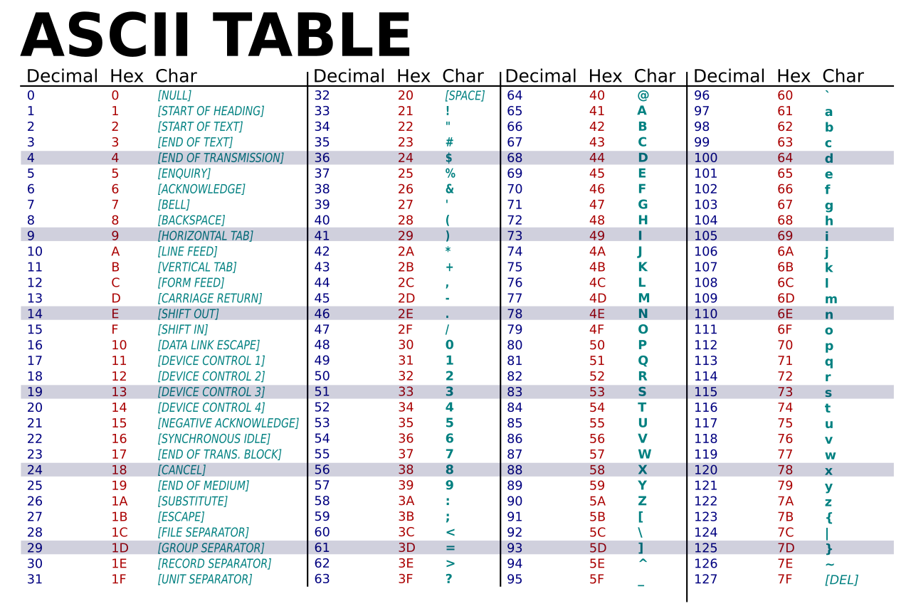

Slide 13
Example 3 (pg. 108)
Convert to assembly:
void strcpy (char x[], char y[])
{
int i;
i=0;
while ((x[i] = y[i]) != `\0’)
i += 1;
}
strcpy:
addi $sp, $sp, -4
sw $s0, 0($sp)
add $s0, $zero, $zero
L1: add $t1, $s0, $a1
lb $t2, 0($t1)
add $t3, $s0, $a0
sb $t2, 0($t3)
beq $t2, $zero, L2
addi $s0, $s0, 1
j L1
L2: lw $s0, 0($sp)
addi $sp, $sp, 4
jr $ra
Notes:
Temp registers not saved.

Slide 14
Full Example – Sort in C (pg. 133)
void sort (int v[ ], int n)
{
int i, j;
for (i=0; i<n; i+=1) {
for (j=i-1; j>=0 && v[j] > v[j+1]; j-=1) {
swap (v,j);
}
}
}
void swap (int v[ ], int k)
{
int temp;
temp = v[k];
v[k] = v[k+1];
v[k+1] = temp;
}
Allocate registers to program variables
Produce code for the program body
Preserve registers across procedure invocations

Slide 15
The swap Procedure
Register allocation: $a0 and $a1 for the two arguments, $t0 for the
temp variable – no need for saves and restores as we’re not using
$s0-$s7 and this is a leaf procedure (won’t need to re-use $a0 and $a1)
swap: sll $t1, $a1, 2
add $t1, $a0, $t1
lw $t0, 0($t1)
lw $t2, 4($t1)
sw $t2, 0($t1)
sw $t0, 4($t1)
jr $ra
void swap (int v[], int k)
{
int temp;
temp = v[k];
v[k] = v[k+1];
v[k+1] = temp;
}
First focus on the swap procedure. Simple swap instructions. sll and add to calculate the address of v[k], similar to the earlier example. Being frugal with registers to avoid saves-restores. See next slide for more comments.

Slide 16

The swap Procedure
Register allocation: $a0 and $a1 for the two arguments, $t0 for the
temp variable – no need for saves and restores as we’re not using
$s0-$s7 and this is a leaf procedure (won’t need to re-use $a0 and $a1)
swap: sll $t1, $a1, 2
add $t1, $a0, $t1
lw $t0, 0($t1)
lw $t2, 4($t1)
sw $t2, 0($t1)
sw $t0, 4($t1)
jr $ra
calculating
address of v[k]
$t0 = v[k]
$t2 = v[k+1]
v[k] = $t2
v[k+1]= $t0
return
void swap (int v[], int k)
{
int temp;
temp = v[k];
v[k] = v[k+1];
v[k+1] = temp;
}

Slide 17
The sort Procedure
Register allocation: arguments v and n use $a0 and $a1, i and j use
$s0 and $s1; must save $a0 and $a1 before calling the leaf procedure
The outer for loop looks like this: (note the use of pseudo-instrs)
move $s0, $zero # initialize the loop
loopbody1: bge $s0, $a1, exit1 # will eventually use slt and beq
… inner loop …
addi $s0, $s0, 1
j loopbody1
exit1:
for (i=0; i<n; i+=1) {
for (j=i-1; j>=0 && v[j] > v[j+1]; j-=1) {
swap (v,j);
}
}

Slide 18
The sort Procedure
The inner for loop looks like this:
addi $s1, $s0, -1 # initialize the loop
loopbody2: blt $s1, $zero, exit2 # will eventually use slt and beq
sll $t1, $s1, 2
add $t2, $a0, $t1
lw $t3, 0($t2)
lw $t4, 4($t2)
ble $t3, $t4, exit2
… body of inner loop …
addi $s1, $s1, -1
j loopbody2
exit2:
Again, some effort to calculate the address of v[j]
for (i=0; i<n; i+=1) {
for (j=i-1; j>=0 && v[j] > v[j+1]; j-=1) {
swap (v,j);
}
}

Slide 19
Saves and Restores
Since we repeatedly call “swap” with $a0 and $a1, we begin
“sort” by copying its arguments into $s2 and $s3 – must update
the rest of the code in “sort” to use $s2 and $s3 instead of
$a0 and $a1
Must save $ra at the start of “sort” because it will get
over-written when we call “swap”
Must also save $s0-$s3 so we don’t overwrite something that
belongs to the procedure that called “sort”
First two bullets for efficiency and easy-to-read code. Last bullet to comply with save-restore conventions.

Slide 20
Saves and Restores
sort: addi $sp, $sp, -20
sw $ra, 16($sp)
sw $s3, 12($sp)
sw $s2, 8($sp)
sw $s1, 4($sp)
sw $s0, 0($sp)
move $s2, $a0
move $s3, $a1
…
move $a0, $s2 # the inner loop body starts here
move $a1, $s1
jal swap
…
exit1: lw $s0, 0($sp)
…
addi $sp, $sp, 20
jr $ra
9 lines of C code → 35 lines of assembly
Adds the save-restores for sort.
Adds the inner loop body to call swap.

Slide 21
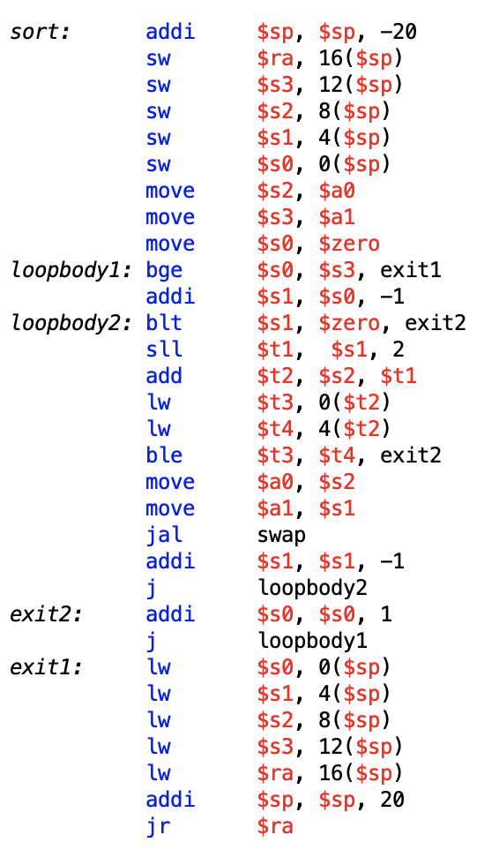
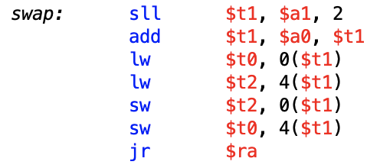
Completed Sort Procedure
Take a closer look at these
slides later if you'd like

Slide 22
MARS
MARS is a simulator that reads in an assembly program
and models its behavior on a MIPS processor
Note that a “MIPS add instruction” will eventually be
converted to an add instruction for the host computer’s
architecture – this translation happens under the hood
To simplify the programmer’s task, it accepts
pseudo-instructions, large constants, constants in
decimal/hex formats, labels, etc.
The simulator allows us to inspect register/memory
values to confirm that our program is behaving correctly

Slide 23
Pseudo Instructions
Convenient Pseudo Instructions
blt- Branch on Less Than
bgt - Branch on Greater Than
ble - Branch on Less Than Equal
bge - Branch on Greater Than or Equal
li - Load Immediate
subi - Subtract Immediate
move - Move

Slide 24
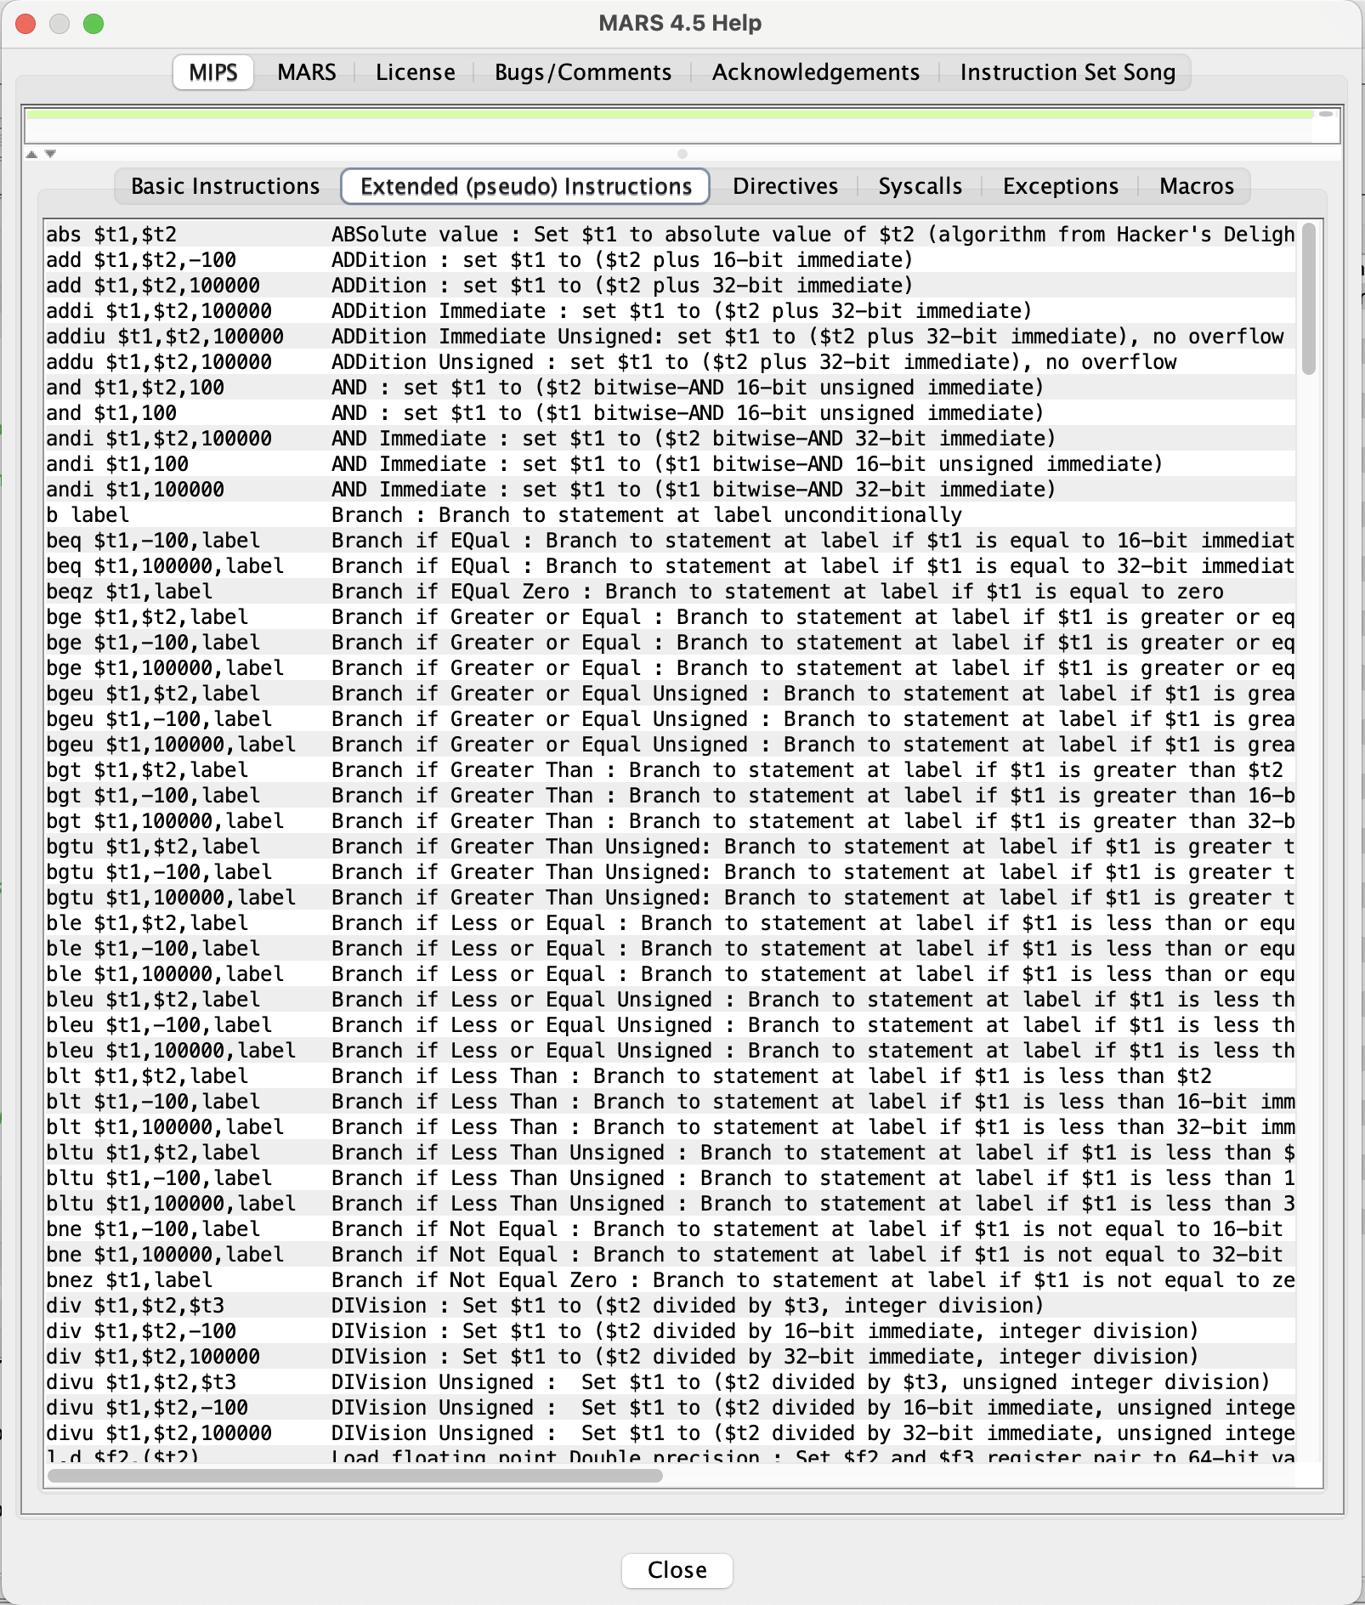
Pseudo Instructions
Check MARS documentation/help for more information on pseudo instructions

Slide 25
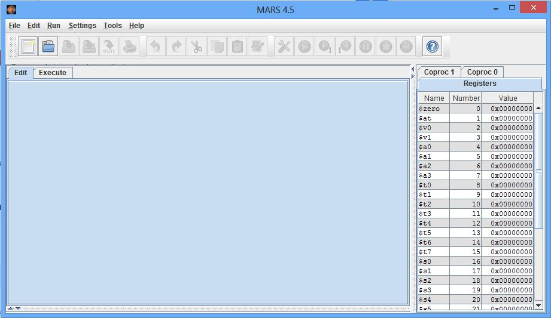
MARS Intro – Tool Bar
Directives, labels, global pointers, system calls

Slide 26
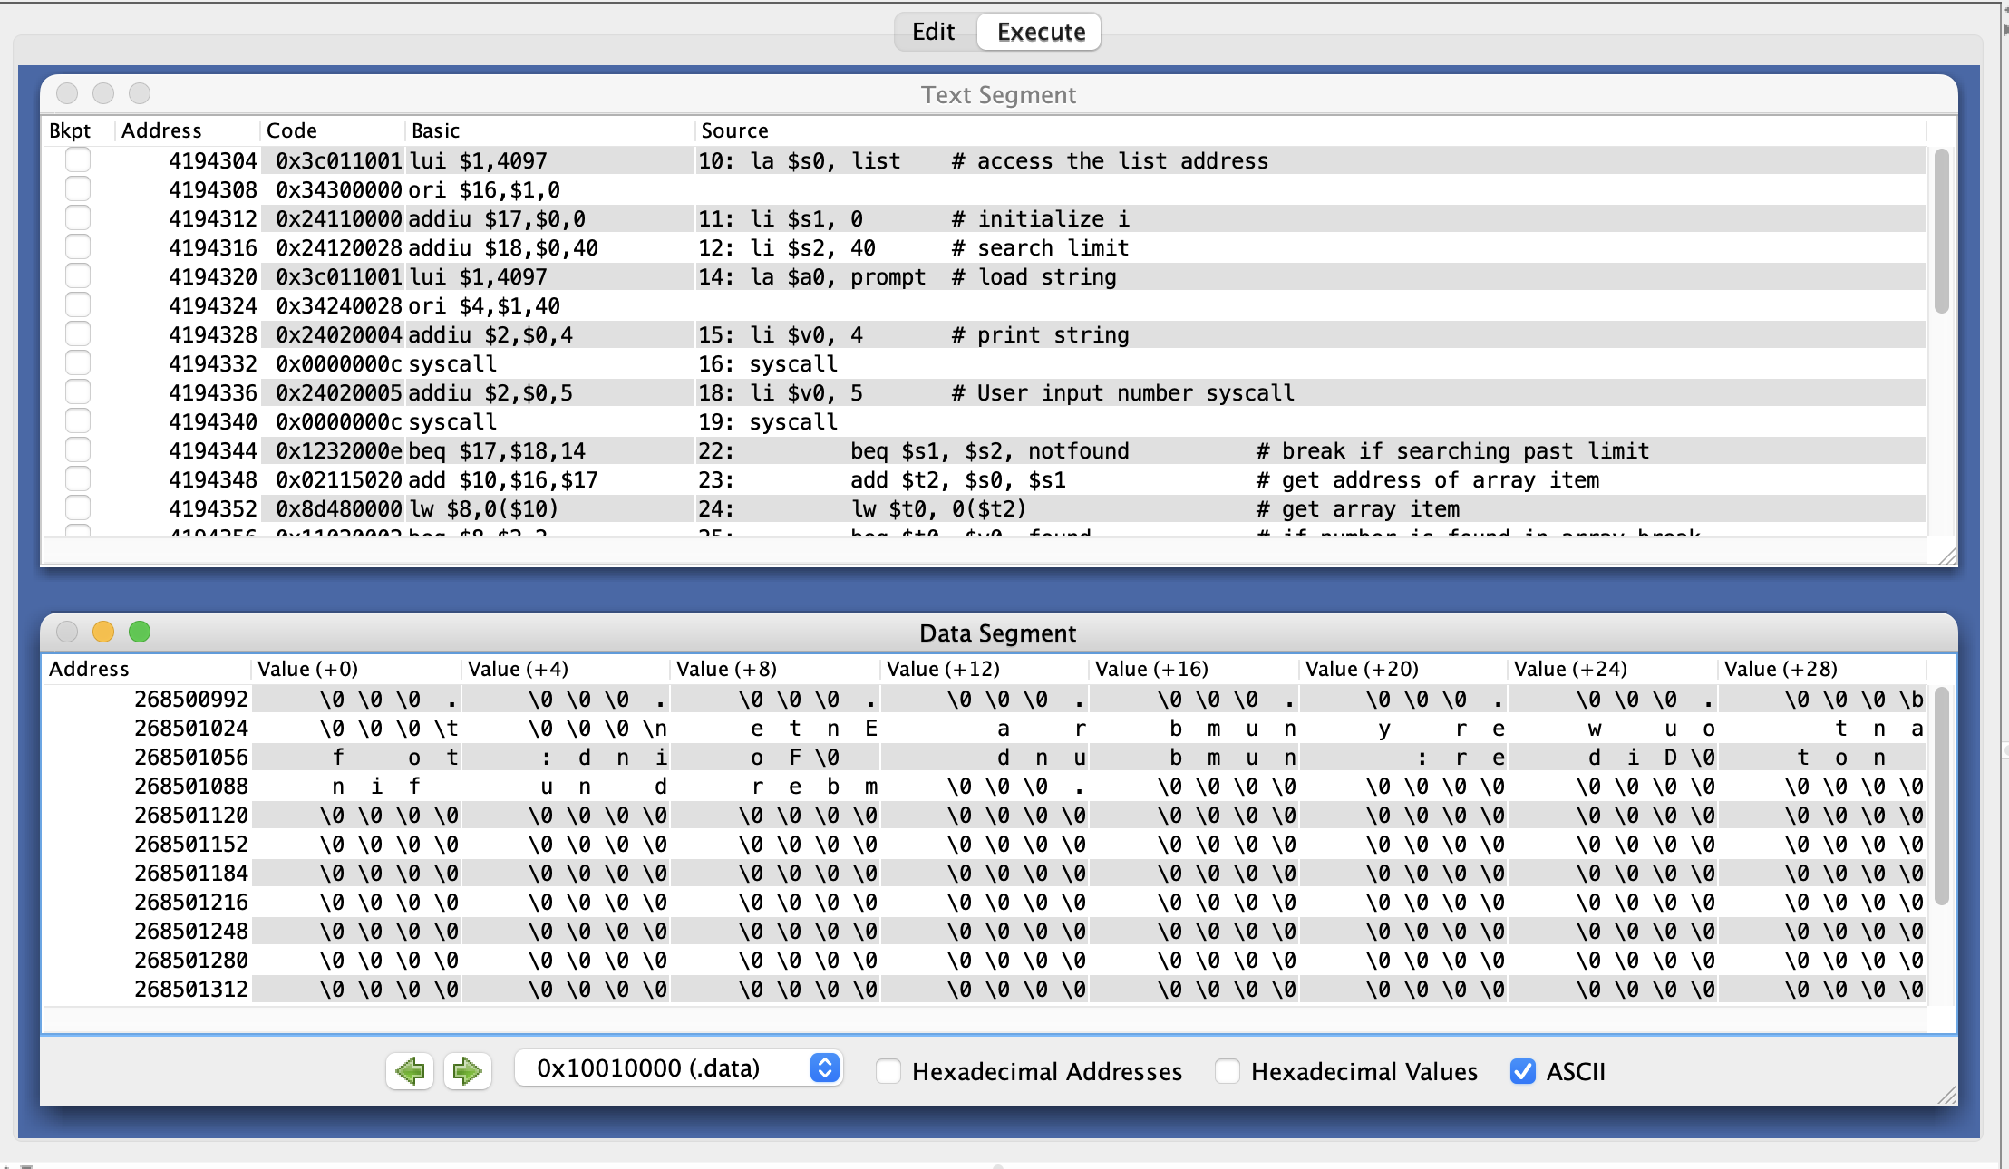
MARS Intro – Execute Information

Slide 27
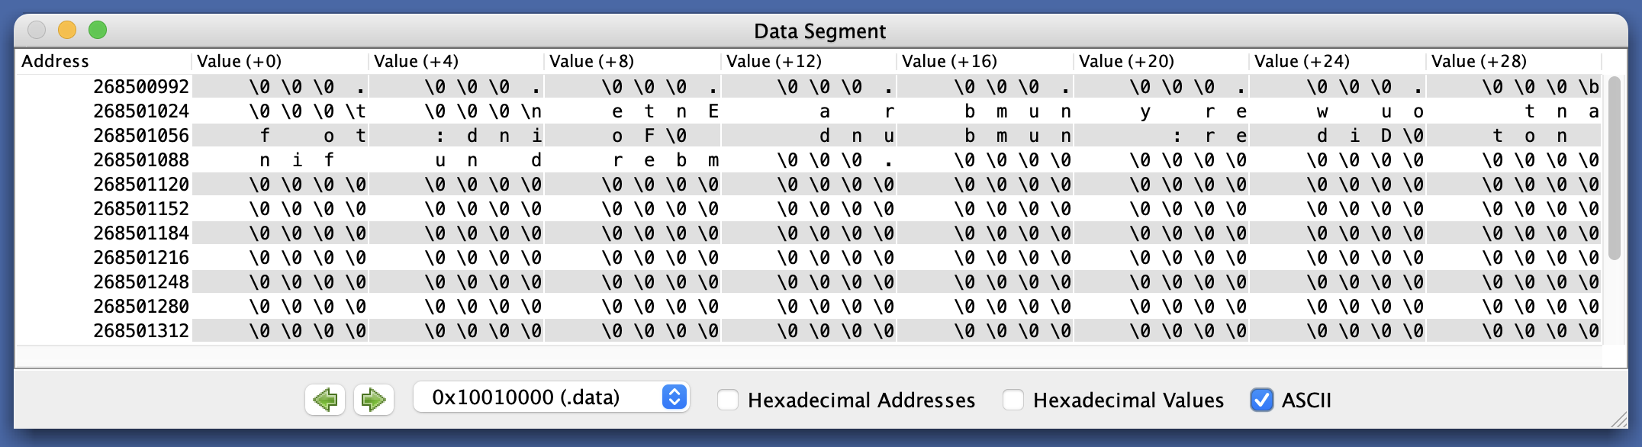
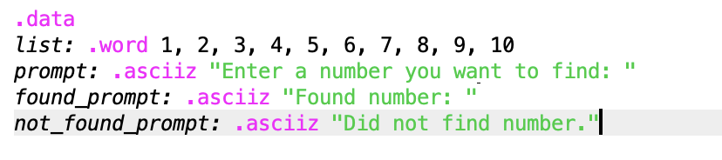
MARS Intro – Data/Memory Information

Slide 28
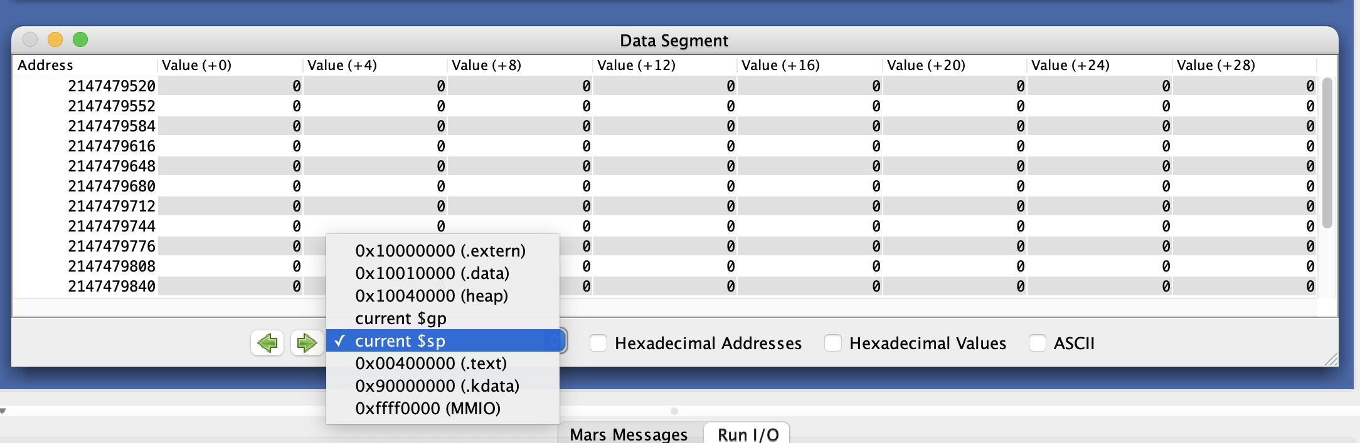
MARS Intro – Data/Memory Information
Debugging with memory values is very useful!

Slide 29
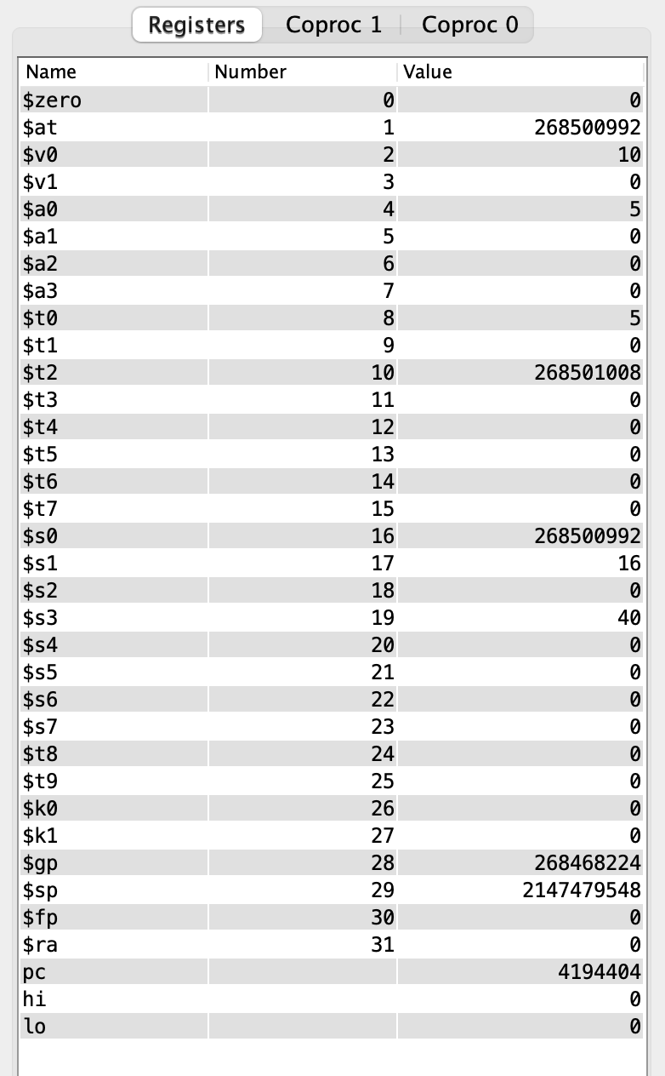
MARS Intro – Register Information
5 in $t0
Address in $s0
10 in $v0
Incremented address in $t2
Read the google doc on the class webpage for details!

Slide 30
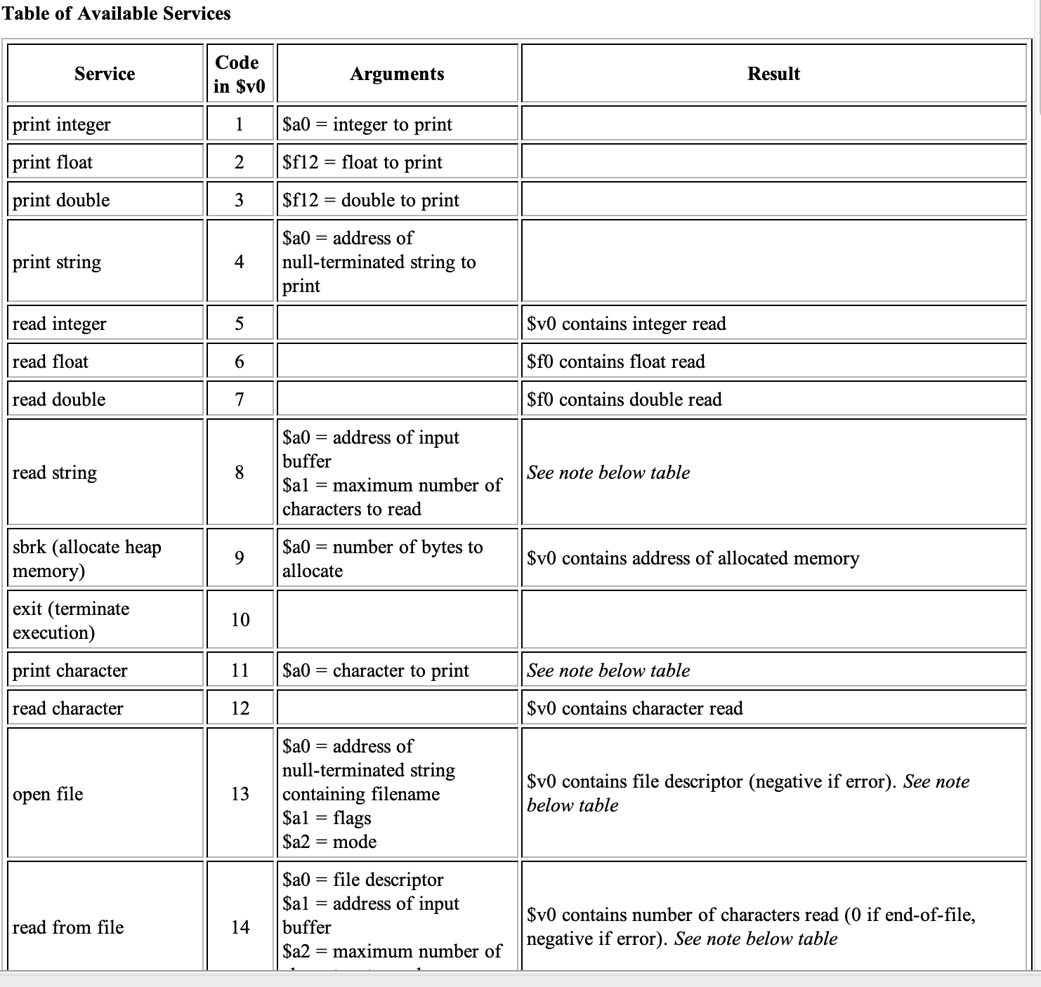
System Calls
Print Integer
- move $a0, $t0
- li $v0, 1
- syscall
Print String
- la $a0, prompt
- li $v0, 4
- syscall
Exit Program
- li $v0, 10
- syscall

Slide 31
Example Print Routine
.data
str: .asciiz “the answer is ”
.text
li $v0, 4 # load immediate; 4 is the code for print_string
la $a0, str # the print_string syscall expects the string
# address as the argument; la is the instruction
# to load the address of the operand (str)
syscall # MARS will now invoke syscall-4
li $v0, 1 # syscall-1 corresponds to print_int
li $a0, 5 # print_int expects the integer as its argument
syscall # MARS will now invoke syscall-1

Slide 32
Example
Write an assembly program to prompt the user for two
numbers and print the sum of the two numbers

Slide 33
Example
.data
str1: .asciiz “Enter 2 numbers:”
.text str2: .asciiz “The sum is ”
li $v0, 4
la $a0, str1
syscall
li $v0, 5
syscall
add $t0, $v0, $zero
li $v0, 5
syscall
add $t1, $v0, $zero
li $v0, 4
la $a0, str2
syscall
li $v0, 1
add $a0, $t1, $t0
syscall

