Slide 1
Lecture 27: Review Session
Disk, reliability wrap-up
Review Session
Exam reminders / Thursday
Class evals, TAs

Slide 2
Role of Disks
Activities external to the CPU/memory are typically
orders of magnitude slower
Example: while CPU performance has improved by 50%
per year, disk latencies have improved by 10% every year
Typical strategy on I/O: switch contexts and work on
something else
Other metrics, such as bandwidth, reliability, availability,
and capacity, often receive more attention than performance

Slide 3
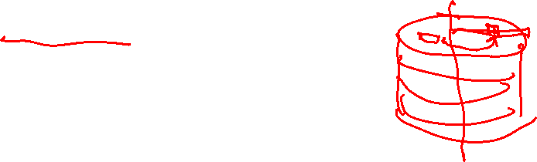
Magnetic Disks
A magnetic disk consists of 1-12 platters (metal or glass
disk covered with magnetic recording material on both
sides), with diameters between 1-3.5 inches
Each platter is comprised of concentric tracks (5-30K) and
each track is divided into sectors (100 – 500 per track,
each about 512 bytes)
A movable arm holds the read/write heads for each disk
surface and moves them all in tandem – a cylinder of data
is accessible at a time

Slide 4

Disk Latency
To read/write data, the arm has to be placed on the
correct track – this seek time usually takes 5 to 12 ms
on average – can take less if there is spatial locality
Rotational latency is the time taken to rotate the correct
sector under the head – average is typically more than
2 ms (15,000 RPM)
Transfer time is the time taken to transfer a block of bits
out of the disk and is typically 3 – 65 MB/second
A disk controller maintains a disk cache (spatial locality
can be exploited) and sets up the transfer on the bus
(controller overhead)

Slide 5
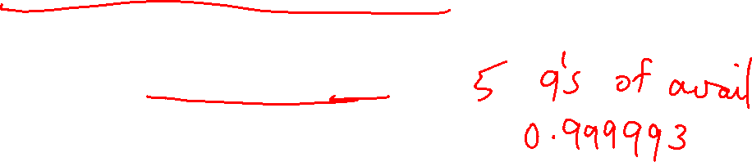
Defining Reliability and Availability
A system toggles between
  Service accomplishment: service matches specifications
  Service interruption: service deviates from specs
The toggle is caused by failures and restorations
Reliability measures continuous service accomplishment
and is usually expressed as mean time to failure (MTTF)
Availability measures fraction of time that service matches
specifications, expressed as MTTF / (MTTF + MTTR)

Slide 6
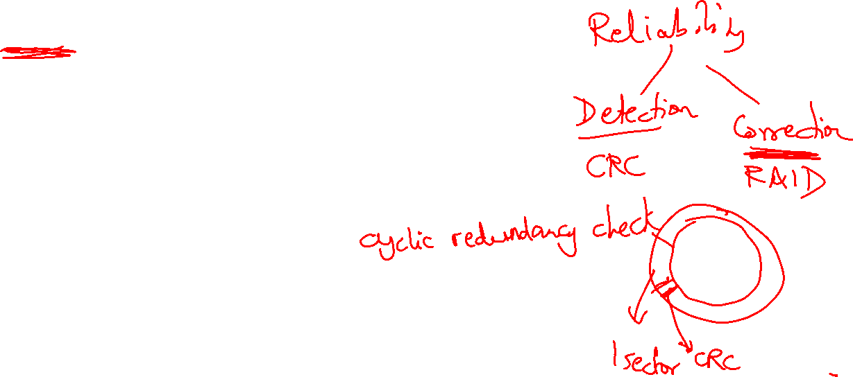
RAID
Reliability and availability are important metrics for disks
RAID: redundant array of inexpensive (independent) disks
Redundancy can deal with one or more failures
Each sector of a disk records check information (CRC) that allows
it to determine if the disk has an error or not (in other words,
redundancy already exists within a disk)
When the disk read flags an error, we turn elsewhere for
correct data

Slide 7
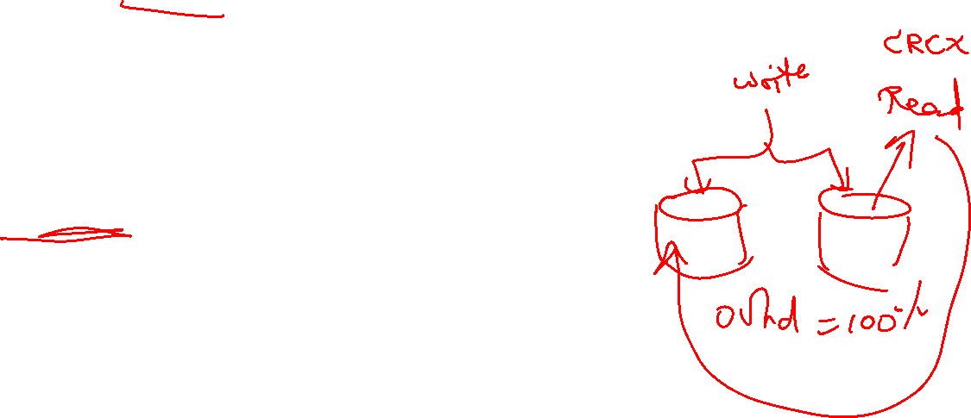
RAID 0 and RAID 1
RAID 0 has no additional redundancy (misnomer) – it
uses an array of disks and stripes (interleaves) data
across the arrays to improve parallelism and throughput
RAID 1 mirrors or shadows every disk – every write
happens to two disks
Reads to the mirror may happen only when the primary
disk fails – or, you may try to read both together and the
quicker response is accepted
Expensive solution: high reliability at twice the cost

Slide 8
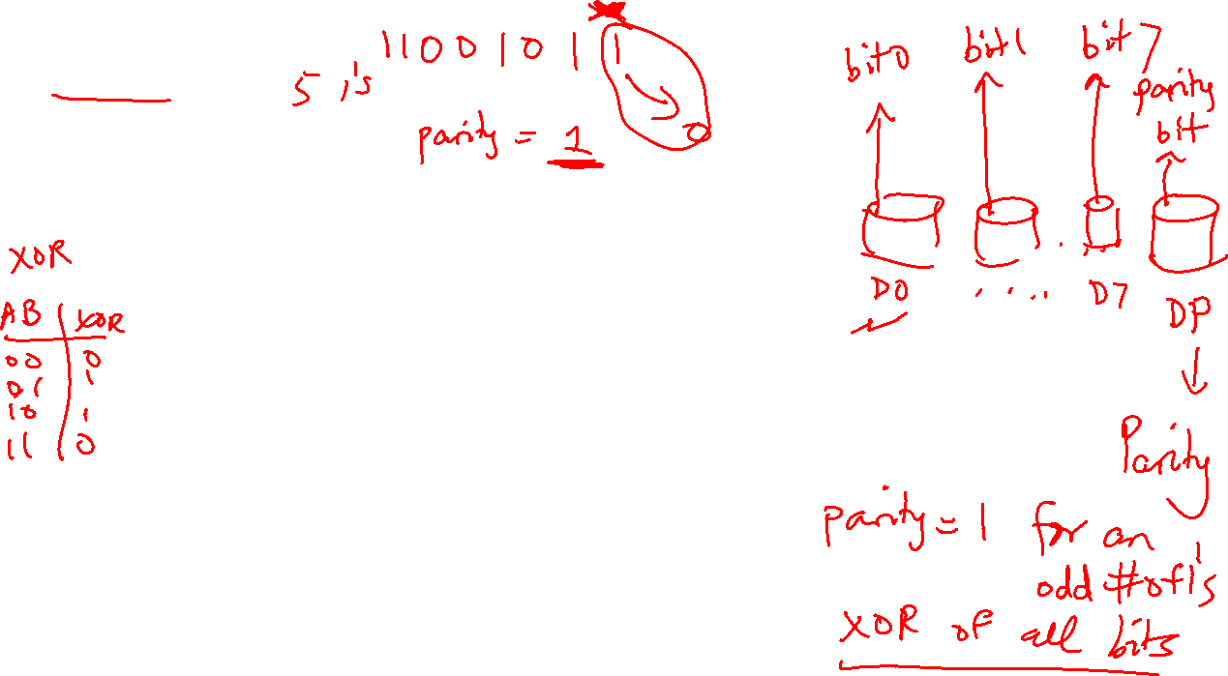
RAID 3
Data is bit-interleaved across several disks and a separate
disk maintains parity information for a set of bits
For example: with 8 disks, bit 0 is in disk-0, bit 1 is in disk-1,
…, bit 7 is in disk-7; disk-8 maintains parity for all 8 bits
For any read, 8 disks must be accessed (as we usually
read more than a byte at a time) and for any write, 9 disks
must be accessed as parity has to be re-calculated
High throughput for a single request, low cost for
redundancy (overhead: 12.5%), low task-level parallelism

Slide 9
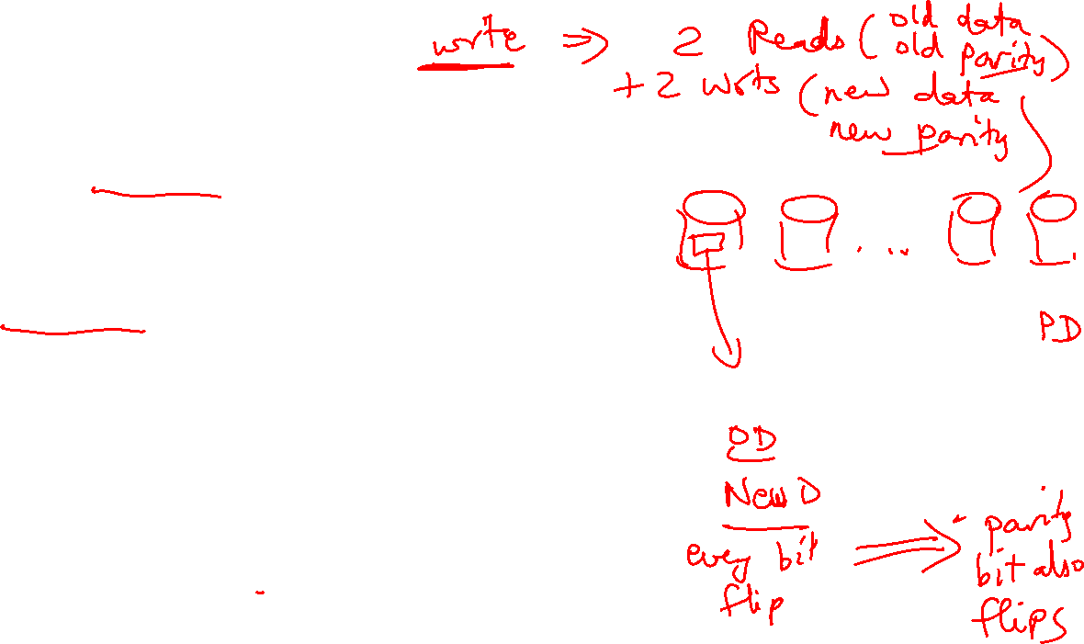
RAID 4 and RAID 5
Data is block interleaved – this allows us to get all our
data from a single disk on a read – in case of a disk error,
read all 9 disks
Block interleaving reduces thruput for a single request (as
only a single disk drive is servicing the request), but
improves task-level parallelism as other disk drives are
free to service other requests
On a write, we access the disk that stores the data and the
parity disk – parity information can be updated simply by
checking if the new data differs from the old data

Slide 10
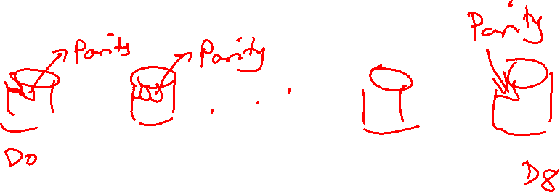
RAID 5
If we have a single disk for parity, multiple writes can not
happen in parallel (as all writes must update parity info)
RAID 5 distributes the parity block to allow simultaneous writes

Slide 11
RAID Summary
RAID 1-5 can tolerate a single fault – mirroring (RAID 1)
has a 100% overhead, while parity (RAID 3, 4, 5) has
modest overhead
Can tolerate multiple faults by having multiple check
functions – each additional check can cost an additional
disk (RAID 6)
RAID 6 and RAID 2 (memory-style ECC) are not
commercially employed

Slide 12

Memory Protection
Most common approach: SECDED – single error correction,
double error detection – an 8-bit code for every 64-bit word
-- can correct a single error in any 64-bit word – also used
in caches
Extends a 64-bit memory channel to a 72-bit channel and
requires ECC DIMMs (e.g., a word is fetched from 9 chips
instead of 8)
Chipkill is a form of error protection where failures in an
entire memory chip can be corrected

Slide 13

Computation Errors
Errors in ALUs and cores are typically handled by
performing the computation n times and voting for the
correct answer
n=3 is common and is referred to as triple modular
redundancy

Slide 14
3810 Review Session
Spring 2025

Slide 15
Modern Trends
Historical contributions to performance:
  Better processes (faster devices) ~20%
  Better circuits/pipelines ~15%
  Better organization/architecture ~15%
Today, annual improvement is closer to 20%; this is primarily
because of slowly increasing transistor count and more cores.
Need multi-thread parallelism and accelerators to boost
performance every year.

Slide 16
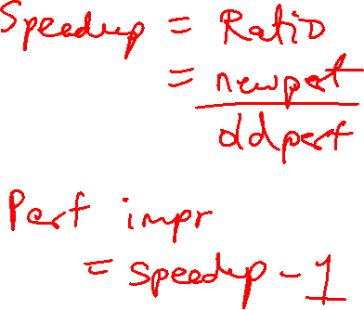
Performance Measures
Performance = 1 / execution time
Speedup = ratio of performance
Performance improvement = speedup -1
Execution time = clock cycle time x CPI x number of instrs
Program takes 100 seconds on ProcA and 150 seconds on ProcB
Speedup of A over B = 150/100 = 1.5
Performance improvement of A over B = 1.5 – 1 = 0.5 = 50%
Speedup of B over A = 100/150 = 0.66 (speedup less than 1 means
performance went down)
Performance improvement of B over A = 0.66 – 1 = -0.33 = -33%
or Performance degradation of B, relative to A = 33%
If multiple programs are executed, the execution times are combined
into a single number using AM, weighted AM, or GM

Slide 17
Performance Equations
CPU execution time = CPU clock cycles x Clock cycle time
CPU clock cycles = number of instrs x avg clock cycles
per instruction (CPI)
Substituting in previous equation,
Execution time = clock cycle time x number of instrs x avg CPI
If a 2 GHz processor graduates an instruction every third cycle,
how many instructions are there in a program that runs for
10 seconds?

Slide 18
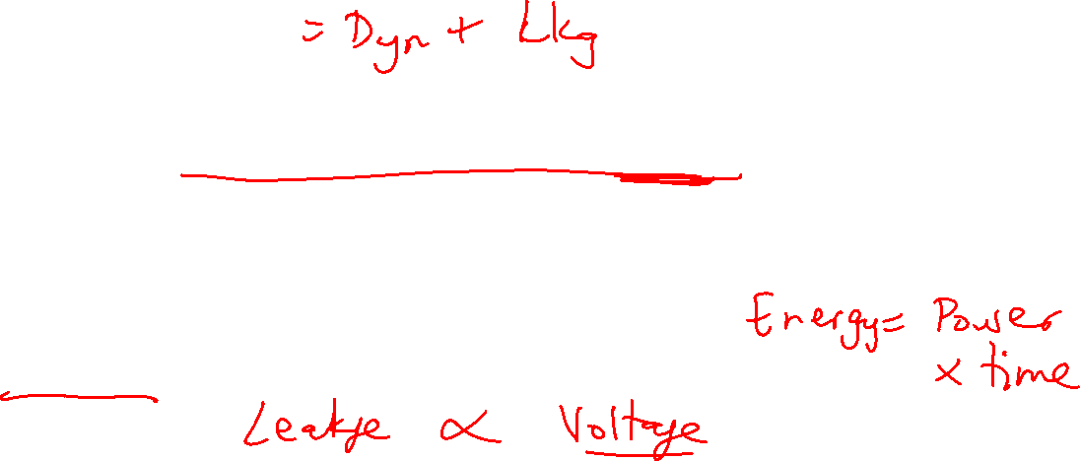
Power Consumption
Dyn power α activity x capacitance x voltage² x frequency
Capacitance per transistor and voltage are decreasing,
but number of transistors and frequency are increasing at
a faster rate
Leakage power is also rising and will soon match dynamic
power
Power consumption is already around 100W in
some high-performance processors today

Slide 19

Example Problem
A 1 GHz processor takes 100 seconds to execute a CPU-bound
program, while consuming 70 W of dynamic power and 30 W of
leakage power. Does the program consume less energy in
Turbo boost mode when the frequency is increased to 1.2 GHz?
Normal mode energy = 100 W x 100 s = 10,000 J
Turbo mode energy = (70 x 1.2 + 30) x 100/1.2 = 9,500 J
Note:
Frequency only impacts dynamic power, not leakage power.
We assume that the program’s CPI is unchanged when
frequency is changed, i.e., exec time varies linearly
with cycle time for CPU-bound programs.

Slide 20
Basic MIPS Instructions
lw $t1, 16($t2)
add $t3, $t1, $t2
addi $t3, $t3, 16
sw $t3, 16($t2)
beq $t1, $t2, 16
blt is implemented as slt and bne
j 64
jr $t1
sll $t1, $t1, 2
Loop: sll $t1, $s3, 2
add $t1, $t1, $s6
lw $t0, 0($t1)
bne $t0, $s5, Exit
addi $s3, $s3, 1
j Loop
Exit:
Convert to assembly:
while (save[i] == k)
i += 1;
i and k are in $s3 and $s5 and
base of array save[] is in $s6

Slide 21
Registers
The 32 MIPS registers are partitioned as follows:
  Register 0 : $zero always stores the constant 0
  Regs 2-3 : $v0, $v1 return values of a procedure
  Regs 4-7 : $a0-$a3 input arguments to a procedure
  Regs 8-15 : $t0-$t7 temporaries
  Regs 16-23: $s0-$s7 variables
  Regs 24-25: $t8-$t9 more temporaries
  Reg 28 : $gp global pointer
  Reg 29 : $sp stack pointer
  Reg 30 : $fp frame pointer
  Reg 31 : $ra return address

Slide 22
Memory Organization
High address
Stack
Dynamic data (heap)
Proc A’s values
Proc B’s values
Static data (globals)
$fp
$gp
Proc C’s values
Text (instructions)
…
$sp
Stack grows
this way
Low address

Slide 23
Procedure Calls/Returns
procA (int i)
{
int j;
j = …;
i = call procB(j);
… = i;
}
procB (int j)
{
int k;
… = j;
k = …;
return k;
}
procA:
$s0 = … # value of j
$t0 = … # some tempval
$a0 = $s0 # the argument
…
jal procB
…
… = $v0
procB:
$t0 = … # some tempval
… = $a0 # using the argument
$s0 = … # value of k
$v0 = $s0;
jr $ra

Slide 24
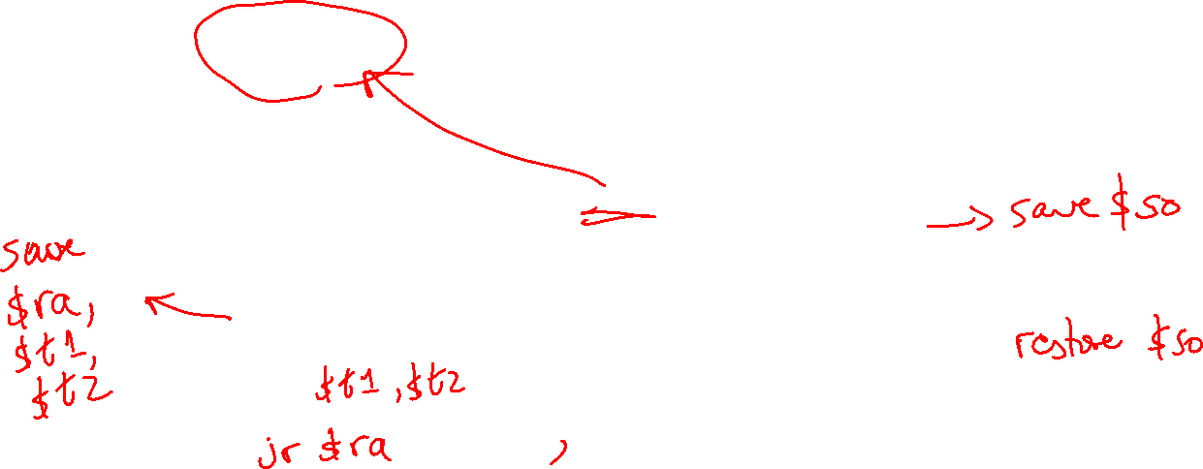
Saves and Restores
Caller saves:
  $ra, $a0, $t0, $fp (if reqd)
Callee saves:
  $s0
As every element is saved on stack,
the stack pointer is decremented
procA:
$s0 = … # value of j
$t0 = … # some tempval
$a0 = $s0 # the argument
…
jal procB
…
… = $v0
procB:
$t0 = … # some tempval
… = $a0 # using the argument
$s0 = … # value of k
$v0 = $s0;
jr $ra

Slide 25
Example 2
int fact (int n)
{
if (n < 1) return (1);
else return (n * fact(n-1));
}
fact:
addi $sp, $sp, -8
sw $ra, 4($sp)
sw $a0, 0($sp)
slti $t0, $a0, 1
beq $t0, $zero, L1
addi $v0, $zero, 1
addi $sp, $sp, 8
jr $ra
L1:
addi $a0, $a0, -1
jal fact
lw $a0, 0($sp)
lw $ra, 4($sp)
addi $sp, $sp, 8
mul $v0, $a0, $v0
jr $ra
Notes:
The caller saves $a0 and $ra
in its stack space.
Temps are never saved.

Slide 26
Recap – Numeric Representations
Decimal 35₁₀ = 3 x 10¹ + 5 x 10⁰
Binary 00100011₂ = 1 x 2⁵ + 1 x 2¹ + 1 x 2⁰
Hexadecimal (compact representation)
0x 23 or 23_{hex} = 2 x 16¹ + 3 x 16⁰
0-15 (decimal) → 0-9, a-f (hex)
Dec Binary Hex
0 0000 00
1 0001 01
2 0010 02
3 0011 03
Dec Binary Hex
4 0100 04
5 0101 05
6 0110 06
7 0111 07
Dec Binary Hex
8 1000 08
9 1001 09
10 1010 0a
11 1011 0b
Dec Binary Hex
12 1100 0c
13 1101 0d
14 1110 0e
15 1111 0f

Slide 27
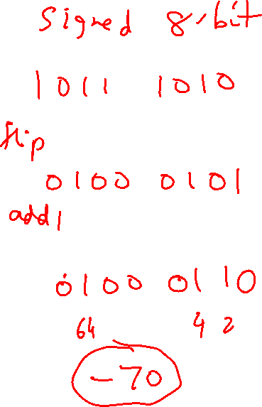
2’s Complement
0000 0000 0000 0000 0000 0000 0000 0000_{two} = 0_{ten}
0000 0000 0000 0000 0000 0000 0000 0001_{two} = 1_{ten}
…
0111 1111 1111 1111 1111 1111 1111 1111_{two} = 2³¹-1
1000 0000 0000 0000 0000 0000 0000 0000_{two} = -2³¹
1000 0000 0000 0000 0000 0000 0000 0001_{two} = -(2³¹ – 1)
1000 0000 0000 0000 0000 0000 0000 0010_{two} = -(2³¹ – 2)
…
1111 1111 1111 1111 1111 1111 1111 1110_{two} = -2
1111 1111 1111 1111 1111 1111 1111 1111_{two} = -1
Note that the sum of a number x and its inverted representation x’ always
equals a string of 1s (-1).
x + x’ = -1
x’ + 1 = -x … hence, can compute the negative of a number by
-x = x’ + 1 inverting all bits and adding 1
This format can directly undergo addition without any conversions!
Each number represents the quantity
x₃₁ -2³¹ + x₃₀ 2³⁰ + x₂₉ 2²⁹ + … + x₁ 2¹ + x₀ 2⁰

Slide 28
Multiplication Example
Multiplicand 1000_{ten}
Multiplier x 1001_{ten}
---------------
1000
0000
0000
1000
----------------
Product 1001000_{ten}
In every step
  multiplicand is shifted
  next bit of multiplier is examined (also a shifting step)
  if this bit is 1, shifted multiplicand is added to the product

Slide 29
Division
1001_{ten} Quotient
Divisor 1000_{ten} | 1001010_{ten} Dividend
-1000
10
101
1010
-1000
10_{ten} Remainder
At every step,
  shift divisor right and compare it with current dividend
  if divisor is larger, shift 0 as the next bit of the quotient
  if divisor is smaller, subtract to get new dividend and shift 1
  as the next bit of the quotient

Slide 30
Division
1001_{ten} Quotient
Divisor 1000_{ten} | 1001010_{ten} Dividend
0001001010 0001001010 0000001010 0000001010
100000000000 → 0001000000→ 0000100000→0000001000
Quo: 0 000001 0000010 000001001
At every step,
  shift divisor right and compare it with current dividend
  if divisor is larger, shift 0 as the next bit of the quotient
  if divisor is smaller, subtract to get new dividend and shift 1
  as the next bit of the quotient

Slide 31
Binary FP Numbers
20.45 decimal = ? Binary
20 decimal = 10100 binary
0.45 x 2 = 0.9 (not greater than 1, first bit after binary point is 0)
0.90 x 2 = 1.8 (greater than 1, second bit is 1, subtract 1 from 1.8)
0.80 x 2 = 1.6 (greater than 1, third bit is 1, subtract 1 from 1.6)
0.60 x 2 = 1.2 (greater than 1, fourth bit is 1, subtract 1 from 1.2)
0.20 x 2 = 0.4 (less than 1, fifth bit is 0)
0.40 x 2 = 0.8 (less than 1, sixth bit is 0)
0.80 x 2 = 1.6 (greater than 1, seventh bit is 1, subtract 1 from 1.6)
… and the pattern repeats
10100.011100110011001100…
Normalized form = 1.0100011100110011… x 2⁴

Slide 32
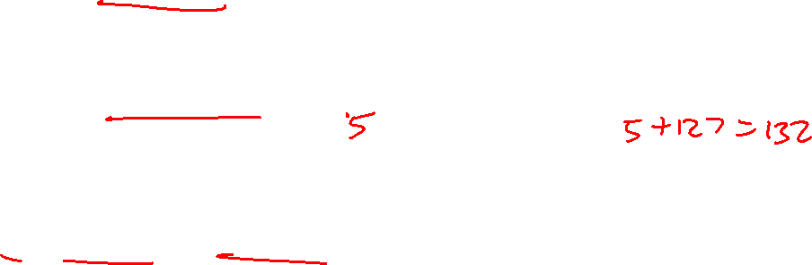
Examples
Final representation: (-1)^{S} x (1 + Fraction) x 2^{(Exponent – Bias)}
Represent -0.75_{ten} in single and double-precision formats
Single: (1 + 8 + 23)
Double: (1 + 11 + 52)
What decimal number is represented by the following
single-precision number?
1 1000 0001 01000…0000
Remember:
True exponent Exponent in register
+127
-127

Slide 33
Examples
Final representation: (-1)^{S} x (1 + Fraction) x 2^{(Exponent – Bias)}
Represent -0.75_{ten} in single and double-precision formats
Single: (1 + 8 + 23)
1 0111 1110 1000…000
Double: (1 + 11 + 52)
1 0111 1111 110 1000…000
What decimal number is represented by the following
single-precision number?
1 1000 0001 01000…0000
-5.0

Slide 34
Example 2
Final representation: (-1)^{S} x (1 + Fraction) x 2^{(Exponent – Bias)}
Represent 36.90625_{ten} in single-precision format
36 / 2 = 18 rem 0
18 / 2 = 9 rem 0
9 / 2 = 4 rem 1
4 / 2 = 2 rem 0
2 / 2 = 1 rem 0
1 / 2 = 0 rem 1
0.90625 x 2 = 1.81250
0.8125 x 2 = 1.6250
0.625 x 2 = 1.250
0.25 x 2 = 0.50
0.5 x 2 = 1.00
0.0 x 2 = 0.0
36 is 100100
0.90625 is 0.1110100…0

Slide 35

Example 2
Final representation: (-1)^{S} x (1 + Fraction) x 2^{(Exponent – Bias)}
We’ve calculated that 36.90625_{ten} = 100100.1110100…0 in binary
Normalized form = 1.001001110100…0 x 2⁵
(had to shift 5 places to get only one bit left of the point)
The sign bit is 0 (positive number)
The fraction field is 001001110100…0 (the 23 bits after the point)
The exponent field is 5 + 127 (have to add the bias) = 132,
which in binary is 10000100
The IEEE 754 format is 0 10000100 001001110100…..0
sign exponent 23 fraction bits

Slide 36
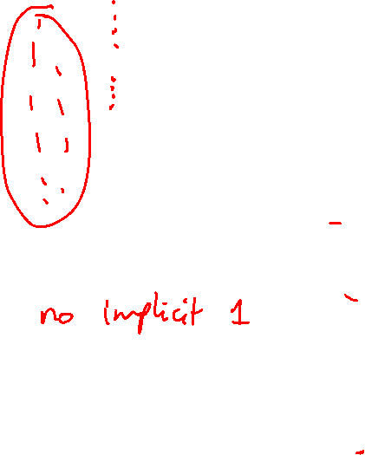
Value inf
Value NAN
Highest value ~2 x 2¹²⁷
2 special cases up top that use the
reserved exponent field of 255
0 255 00…0
0 255 xx….x
0 254 11….1
Value 1
0 127 00…0
Exponent field < 127, i.e., after
subtracting bias, they are negative
exponents, representing numbers < 1
Smallest Norm ~2 x 2⁻¹²⁶
Largest Denorm ~1 x 2⁻¹²⁶
Smallest Denorm ~2⁻¹⁴⁹
0 0..01 00…0
0 0..00 11…1
0 0..00 00…1
Special case with exponent field 0, used to
represent denorms, that help us gradually approach 0
Value 0
0 00..0 00…0
Same rules as above, but the sign bit is 1
Same magnitudes as above, but negative numbers

Slide 37
FP Addition – Binary Example
Consider the following binary example
1.010 x 2¹ + 1.100 x 2³
Convert to the larger exponent:
0.0101 x 2³ + 1.1000 x 2³
Add
1.1101 x 2³
Normalize
1.1101 x 2³
Check for overflow/underflow
Round
Re-normalize
IEEE 754 format: 0 10000010 11010000000000000000000

Slide 38
Boolean Algebra
A + B = A . B
A . B = A + B
Any truth table can be expressed
as a sum of products
A B C E
0 0 0 0
0 0 1 0
0 1 0 0
0 1 1 1
1 0 0 0
1 0 1 1
1 1 0 1
1 1 1 0
(A . B . C) + (A . C . B) + (C . B . A)
Can also use “product of sums”
Any equation can be implemented
with an array of ANDs, followed by
an array of ORs

Slide 39
Adder Implementations
Ripple-Carry adder – each 1-bit adder feeds its carry-out to next stage –
simple design, but we must wait for the carry to propagate thru all bits
Carry-Lookahead adder – each bit can be represented by an equation
that only involves input bits (a_{i}, b_{i}) and initial carry-in (c₀) -- this is a
complex equation, so it’s broken into sub-parts
For bits a_{i}, b_{i,}, and c_{i}, a carry is generated if a_{i}.b_{i} = 1 and a carry is
propagated if a_{i} + b_{i} = 1
C_{i+1} = g_{i} + p_{i} . C_{i}
Similarly, compute these values for a block of 4 bits, then for a block
of 16 bits, then for a block of 64 bits….Finally, the carry-out for the
64th bit is represented by an equation such as this:
C₄ = G₃+ G₂.P₃ + G₁.P₂.P₃ + G₀.P₁.P₂.P₃ + C₀.P₀.P₁.P₂.P₃
Each of the sub-terms is also a similar expression

Slide 40

Trade-Off Curve
Truth table
sum-of-products adder, (2, 2⁶⁴)
Performance
#inputs to each gate
# sequential gates
gp adder (3, 33)
Carry Lookahead GP adder (7, 5)
Ripple-Carry
adder (64, 2)
# sequential gates

Slide 41
32-bit ALU
Source: H&P textbook

Slide 42
Control Lines
What are the values
of the control lines
and what operations
do they correspond to?
Ai Bn Op
AND 0 0 00
OR 0 0 01
Add 0 0 10
Sub 0 1 10
NOR 1 1 00
NAND 1 1 01
SLT 0 1 11
BEQ 0 1 10 (xx)
Source: H&P textbook

Slide 43
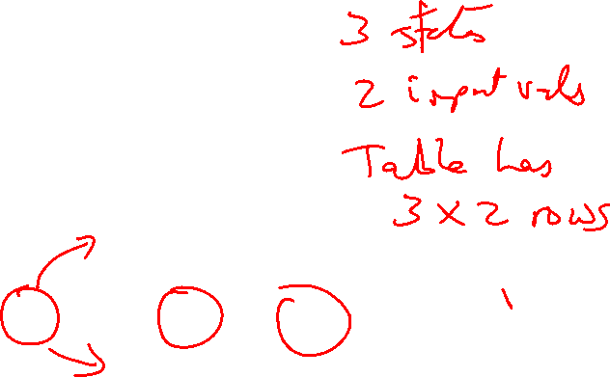
Tackling FSM Problems
Three questions worth asking:
  What are the possible output states? Draw a
  bubble for each.
  What are inputs? What values can those inputs take?
  For each state, what do I do for each possible
  input value? Draw an arc out of every bubble for
  every input value.

Slide 44
Example – Residential Thermostat
Two temp sensors: internal and external
If internal temp is within 1 degree of desired, don’t
change setting
If internal temp is > 1 degree higher than desired, turn
AC on; if internal temp is < 1 degree lower than
desired, turn heater on
If external temp and desired temp are within 5
degrees, disregard the internal temp, and turn both AC
and heater off

Slide 45
Finite State Machine Table

Slide 46
Finite State Diagram
HEAT
U-H
COOL
U-C,
U-G
U-H,
U-G
U-C
D-C,
D-G,
D-H
U-C
U-H
D-C,
D-G,
D-H
OFF
Int temp settings:
C – cold
G – goldilocks
H – hot
Ext temp settings:
D – desired zone
U – undesired zone
D-C, D-G, D-H, U-G

Slide 47
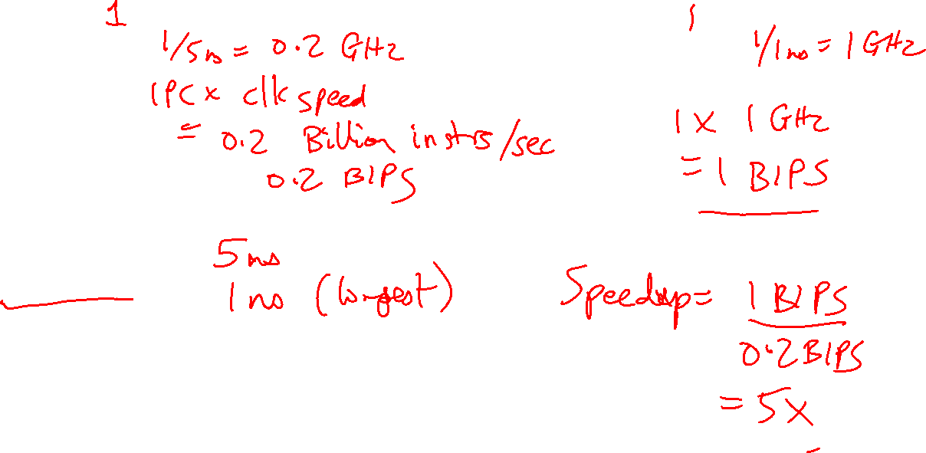
Unpipelined processor
CPI:
Clock speed:
Throughput:
Pipelined processor
CPI:
Clock speed:
Throughput:
Circuit Assumptions
Length of full circuit:
Length of each stage:
No hazards
Pipeline Performance

Slide 48

No Bypassing
(for the 5-stage pipeline)
Point of production: always RW middle
Point of consumption: always D/R middle
Bypassing
Point of production:
add, sub, etc.: end of ALU
lw: end of DM
Point of consumption:
add, sub, lw: start of ALU
sw $1, 8($2): start of ALU for $2,
start of DM for $1
* PoP
I1 add: IF DR AL DM RW
I2 add: IF DR DR DR AL DM RW
* PoC
* PoP
I1 add: IF DR AL DM RW
I2 add: IF DR AL DM RW
* PoC
Data Hazards

Slide 49
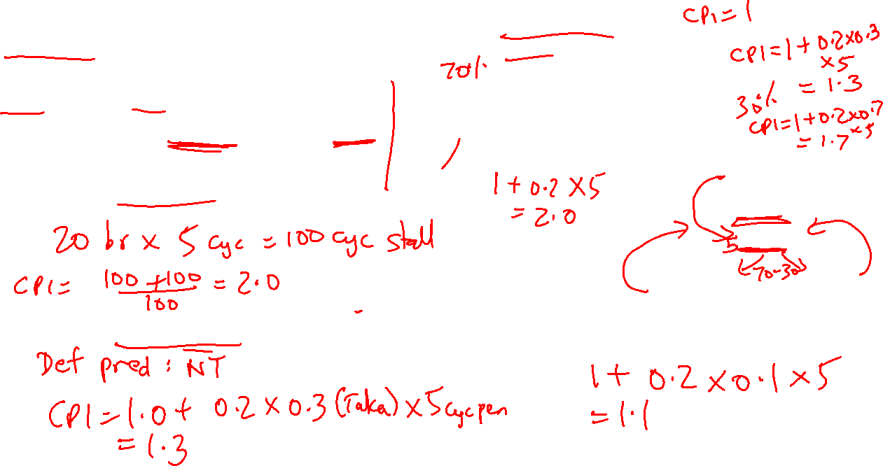
Assumptions
100 instructions
20 branches
14 Not-Taken, 6 Taken
Branch resolved in 6th cycle (penalty of 5)
Approach 3: Branch Delay Slot
Option A: always useful
Option B: useful when the branch
goes along common fork
Option C: useful when the branch
goes along uncommon fork
Option D: no-op, always non-useful
Approach 1: Panic and wait
Option A
Branch
Slot
NTaken Taken
Option B Option C
Approach 2: Fetch-next-instr
Approach 4: Branch predictor
Accuracy of 90%
Control Hazards

Slide 50
Reorder Buffer (ROB)
Branch prediction
and instr fetch
Instr 1
Instr 2
Instr 3
Instr 4
Instr 5
Instr 6
T1
T2
T3
T4
T5
T6
Register File
R1-R32
R1 ← R1+R2
R2 ← R1+R3
BEQZ R2
R3 ← R1+R2
R1 ← R3+R2
Decode &
Rename
T1 ← R1+R2
T2 ← T1+R3
BEQZ T2
T4 ← T1+T2
T5 ← T4+T2
ALU
ALU
ALU
Instr Fetch Queue
Results written to
ROB and tags
broadcast to IQ
Issue Queue (IQ)
Out of Order Processor

Slide 51
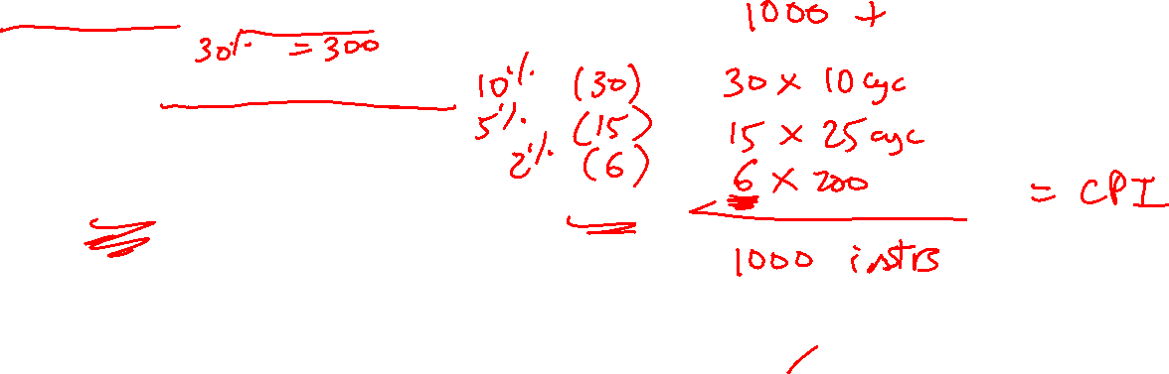
Assumptions
1000 instructions, 1000 cycles, no stalls with L1 hits
# loads/stores:
% of loads/stores that show up at L2:
% of loads/stores that show up at L3:
% of loads/stores that show up at mem:
L2 acc = 10 cyc, L3 acc = 25 cyc, mem acc = 200 cyc
Cache Latency

Slide 52
Assumptions
512KB cache, 8-way set-associative, 64-byte blocks, 32-bit addresses
Data array size = #sets x #ways x blocksize
Tag array size = #sets x #ways x tagsize
Offset bits = log(blocksize)
Index bits = log(#sets)
Tag bits + index bits + offset bits = addresswidth
Cache Size

Slide 53
Assumptions
16 sets, 1 way, 32-byte blocks
Access pattern: 4 40 400 480 512 520 1032 1540
Offset = address % 32 (address modulo 32, extract last 5)
Index = address/32 % 16 (shift right by 5, extract last 4)
Tag = address/512 (shift address right by 9)
32-bit address
23 bits tag 4 bits index 5 bits offset H/M Evicted address
4: 0 0 4 M Inv
40: 0 1 8 M Inv
400: 0 12 16 M Inv
480: 0 15 0 M Inv
512: 1 0 0 M 0
520: 1 0 8 H -
1032: 2 0 8 M 512
1540: 3 0 4 M 1024
Cache Hits/Misses

Slide 54
Example 0b
Show how the following addresses map to the cache and yield hits or misses.
The cache is direct-mapped, has 16 sets, and a 64-byte block size.
Addresses: 8, 96, 32, 480, 976, 1040, 1096
Offset = address % 64 (address modulo 64, extract last 6)
Index = address/64 % 16 (shift right by 6, extract last 4)
Tag = address/1024 (shift address right by 10)
32-bit address
22 bits tag 4 bits index 6 bits offset
8: 0 0 8 M
96: 0 1 32 M
32: 0 0 32 H
480: 0 7 32 M
976: 0 15 16 M
1040: 1 0 16 M
1096: 1 1 8 M
.
.
.

Slide 55
Consider a 3-processor multiprocessor connected with a shared bus that has the following properties:
centralized shared memory accessible with the bus, (ii) snooping-based MSI cache coherence protocol, (iii) write-invalidate policy. Also assume that the caches have a writeback policy. Initially, the caches all have invalid data. The processors issue the following three requests, one after the other. Similar to slide 17 of lecture 25, fill in the following table to indicate what happens for every request. Also indicate if/when memory writeback is performed. (8 points)
P2: Read X
P1: Read X
P2: Write X
P3: Read X
Request | Cache Hit/Miss | Request on the bus | Who responds | State in Cache 1 | State in Cache 2 | State in Cache 3 | State in Cache 4
 |  |  |  | Inv | Inv | Inv | Inv
P2: Rd X
P1: Rd X
P2: Wr X
P3: Rd X

Slide 56
Questions to ask yourself:
How does Meltdown work?
How does Spectre work?
How can you force a footprint? (the relevant code sequence)
How can you examine footprints? (exploiting the side channel)
How can you defend against these attacks?
Security

Slide 57
Questions to ask yourself:
What does the programmer/compiler deal with?
What does the OS deal with?
How is translation done efficiently?
Virtual Memory

Slide 58
Questions to ask yourself:
Why do multiprocs need to deal with prog. models, coherence, synchronization, consistency?
What are race conditions?
What is an example synchronization primitive and how is it implemented?
What consistency model is assumed by a programmer?
Why is it slow?
How do I make life easier for the programmer and provide high performance?
Synchronization, Consistency

Slide 59
Questions to ask yourself:
What are the central philosophies in a GPU?
In what ways does the GPU design differ from a CPU?
What are the different ways that disks provide high reliability?
Can you explain how parity is used to recover lost data?
GPUs, Disks

Slide 60
Disk Basics
Disk access remains very slow – mechanical head that has to move to the correct “ring” of data – order of milli-seconds – high enough that a context-switch is best
Focus on other metrics, especially reliability
A sector on the disk is associated with a cyclic redundancy code (CRC) – a hash that tells us if the read data is correct or not – it is simply an error detector, not an error corrector
To correct the error, RAID is commonly used
Reliability measures continuous service accomplishment and is usually expressed as mean time to failure (MTTF)
Availability is measured as MTTF/(MTTF+MTTRecovery)

Slide 61
RAID
RAID 0: no redundancy
RAID 1: mirroring
RAID 2 and 6: memory-style ECC and rarely deployed
RAID 3: bit-interleaved, lower cost, but no query-level parallelism
RAID 4: block-interleaved, lower cost, query-level parallelism, but write bottleneck
RAID 5: block-interleaved, lower cost, query-level parallelism, write parallelism
Parity and XOR!

