Slide 1
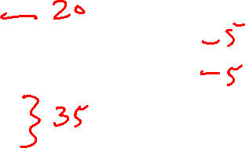
Lecture 26: Pot-Pourri
Today’s topics:
  Virtual Memory
  Shared memory vs message-passing
  Simultaneous multi-threading (SMT)
  GPUs
  Accelerators
  Disks and reliability

Slide 2
Virtual Memory
Processes deal with virtual memory – they have the
illusion that a very large address space is available to
them
There is only a limited amount of physical memory that is
shared by all processes – a process places part of its
virtual memory in this physical memory and the rest is
stored on disk (called swap space)
Thanks to locality, disk access is likely to be uncommon
The hardware ensures that one process cannot access
the memory of a different process

Slide 3
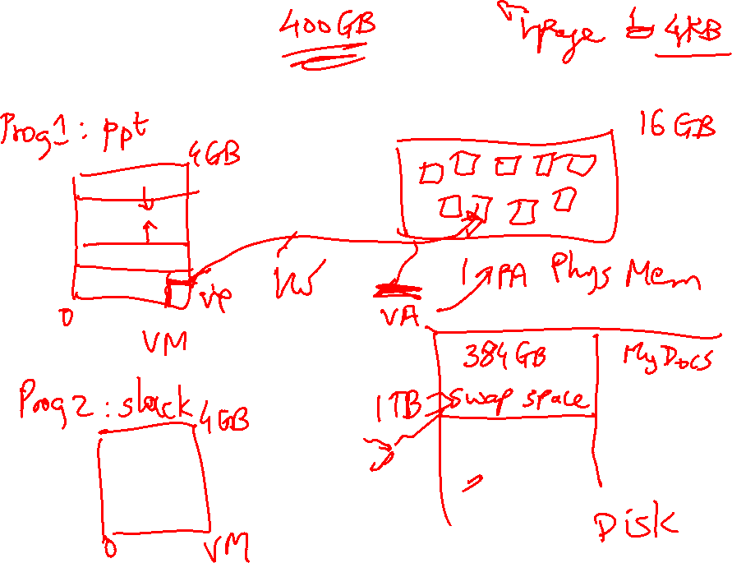
Virtual Memory

Slide 4
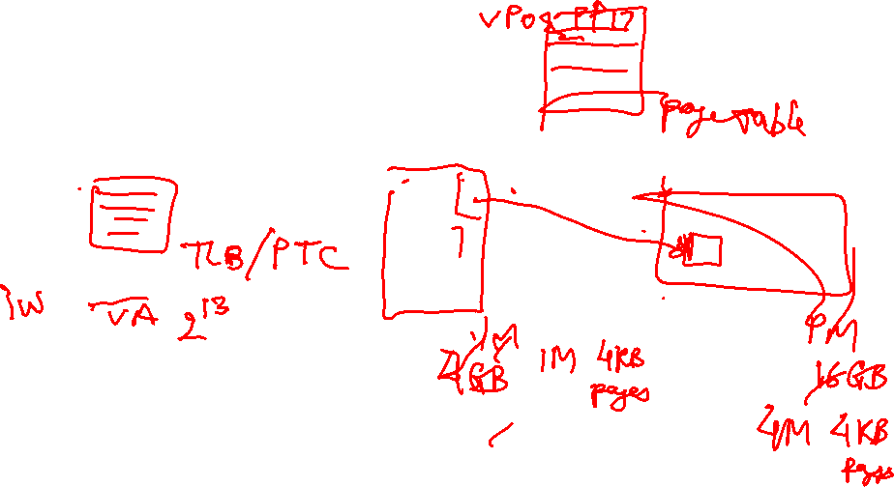
Address Translation
The virtual and physical memory are broken up into pages
8KB page size
Virtual address
13
virtual page
number
page offset
Translated to physical
page number
Physical address

Slide 5
Memory Hierarchy Properties
A virtual memory page can be placed anywhere in physical
memory (fully-associative)
Replacement is usually LRU (since the miss penalty is
huge, we can invest some effort to minimize misses)
A page table (indexed by virtual page number) is used for
translating virtual to physical page number
The page table is itself in memory

Slide 6
TLB
Since the number of pages is very high, the page table
capacity is too large to fit on chip
A translation lookaside buffer (TLB) caches the virtual
to physical page number translation for recent accesses
A TLB miss requires us to access the page table, which
may not even be found in the cache – two expensive
memory look-ups to access one word of data!
A large page size can increase the coverage of the TLB
and reduce the capacity of the page table, but also
increases memory waste

Slide 7
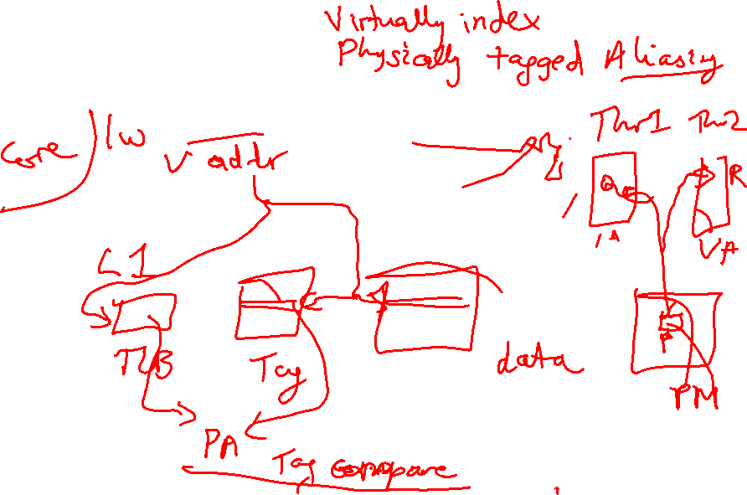
TLB and Cache Access

Slide 8
TLB and Cache
Is the cache indexed with virtual or physical address?
  To index with a physical address, we will have to first
  look up the TLB, then the cache → longer access time
  Multiple virtual addresses can map to the same
  physical address – must ensure that these
  different virtual addresses will map to the same
  location in cache – else, there will be two different
  copies of the same physical memory word
Does the tag array store virtual or physical addresses?
  Since multiple virtual addresses can map to the same
  physical address, a virtual tag comparison can flag a
  miss even if the correct physical memory word is present

Slide 9
Cache and TLB Pipeline
Virtual address
Offset
Virtual page number
Virtual
index
TLB
Tag array
Data array
Physical page number
Physical tag
Physical tag comparion
Virtually Indexed; Physically Tagged Cache

Slide 10
Bad Events
Consider the longest latency possible for a load instruction:
  TLB miss: must look up page table to find translation for v.page P
  Calculate the virtual memory address for the page table entry
  that has the translation for page P – let’s say, this is v.page Q
  TLB miss for v.page Q: will require navigation of a hierarchical
  page table (let’s ignore this case for now and assume we have
  succeeded in finding the physical memory location (R) for page Q)
  Access memory location R (find this either in L1, L2, or memory)
  We now have the translation for v.page P – put this into the TLB
  We now have a TLB hit and know the physical page number – this
  allows us to do tag comparison and check the L1 cache for a hit
  If there’s a miss in L1, check L2 – if that misses, check in memory
  At any point, if the page table entry claims that the page is on disk,
  flag a page fault – the OS then copies the page from disk to memory
  and the hardware resumes what it was doing before the page fault
  … phew!

Slide 11
Shared-Memory Vs. Message-Passing
Shared-memory:
Well-understood programming model
Communication is implicit and hardware handles protection
Hardware-controlled caching
Message-passing:
No cache coherence → simpler hardware
Explicit communication → easier for the programmer to
restructure code
Software-controlled caching
Sender can initiate data transfer

Slide 12

Ocean Kernel
.
Procedure Solve(A)
begin
diff = done = 0;
while (!done) do
diff = 0;
for i ← 1 to n do
for j ← 1 to n do
temp = A[i,j];
A[i,j] ← 0.2 * (A[i,j] + neighbors);
diff += abs(A[i,j] – temp);
end for
end for
if (diff < TOL) then done = 1;
end while
end procedure
Row 1
.
Row k
Row 2k
Row 3k
…

Slide 13
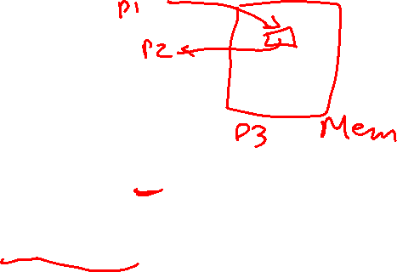
Shared Address Space Model
procedure Solve(A)
int i, j, pid, done=0;
float temp, mydiff=0;
int mymin = 1 + (pid * n/procs);
int mymax = mymin + n/nprocs -1;
while (!done) do
mydiff = diff = 0;
BARRIER(bar1,nprocs);
for i ← mymin to mymax
for j ← 1 to n do
…
endfor
endfor
LOCK(diff_lock);
diff += mydiff;
UNLOCK(diff_lock);
BARRIER (bar1, nprocs);
if (diff < TOL) then done = 1;
BARRIER (bar1, nprocs);
endwhile
int n, nprocs;
float **A, diff;
LOCKDEC(diff_lock);
BARDEC(bar1);
main()
begin
read(n); read(nprocs);
A ← G_MALLOC();
initialize (A);
CREATE (nprocs,Solve,A);
WAIT_FOR_END (nprocs);
end main

Slide 14
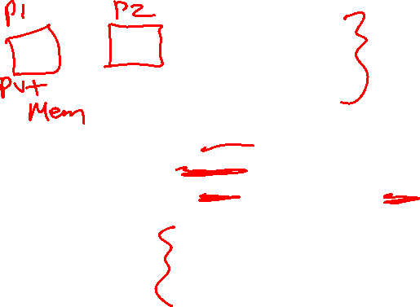
Message Passing Model
main()
read(n); read(nprocs);
CREATE (nprocs-1, Solve);
Solve();
WAIT_FOR_END (nprocs-1);
procedure Solve()
int i, j, pid, nn = n/nprocs, done=0;
float temp, tempdiff, mydiff = 0;
myA ← malloc(…)
initialize(myA);
while (!done) do
mydiff = 0;
if (pid != 0)
SEND(&myA[1,0], n, pid-1, ROW);
if (pid != nprocs-1)
SEND(&myA[nn,0], n, pid+1, ROW);
if (pid != 0)
RECEIVE(&myA[0,0], n, pid-1, ROW);
if (pid != nprocs-1)
RECEIVE(&myA[nn+1,0], n, pid+1, ROW);
for i ← 1 to nn do
for j ← 1 to n do
…
endfor
endfor
if (pid != 0)
SEND(mydiff, 1, 0, DIFF);
RECEIVE(done, 1, 0, DONE);
else
for i ← 1 to nprocs-1 do
RECEIVE(tempdiff, 1, *, DIFF);
mydiff += tempdiff;
endfor
if (mydiff < TOL) done = 1;
for i ← 1 to nprocs-1 do
SEND(done, 1, I, DONE);
endfor
endif
endwhile

Slide 15
Multithreading Within a Processor
Until now, we have executed multiple threads of an
application on different processors – can multiple
threads execute concurrently on the same processor?
Why is this desireable?
  inexpensive – one CPU, no external interconnects
  no remote or coherence misses (more capacity misses)
Why does this make sense?
  most processors can’t find enough work – peak IPC
  is 6, average IPC is 1.5!
  threads can share resources → we can increase
  threads without a corresponding linear increase in area

Slide 16
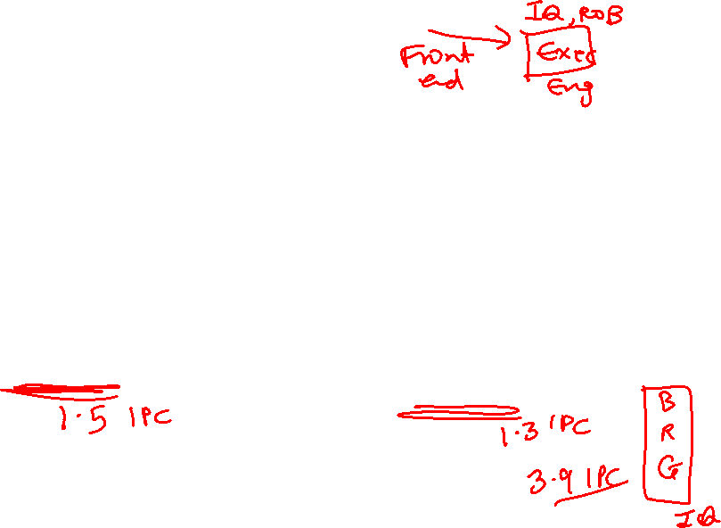
How are Resources Shared?
Each box represents an issue slot for a functional unit. Peak thruput is 4 IPC.
Thread 1
Thread 2
Thread 3
Cycles
Thread 4
Idle
Superscalar
Fine-Grained
Multithreading
Simultaneous
Multithreading
Superscalar processor has high under-utilization – not enough work every
cycle, especially when there is a cache miss
Fine-grained multithreading can only issue instructions from a single thread
in a cycle – can not find max work every cycle, but cache misses can be tolerated
Simultaneous multithreading can issue instructions from any thread every
cycle – has the highest probability of finding work for every issue slot

Slide 17
Performance Implications of SMT
Single thread performance is likely to go down (caches,
branch predictors, registers, etc. are shared) – this effect
can be mitigated by trying to prioritize one thread
With eight threads in a processor with many resources,
SMT yields throughput improvements of roughly 2-4

Slide 18
SIMD Processors
Single instruction, multiple data
Such processors offer energy efficiency because a single
instruction fetch can trigger many data operations
Such data parallelism may be useful for many
image/sound and numerical applications

Slide 19

GPUs
Initially developed as graphics accelerators; now viewed
as one of the densest compute engines available
Many on-going efforts to run non-graphics workloads on
GPUs, i.e., use them as general-purpose GPUs or GPGPUs
C/C++ based programming platforms enable wider use
of GPGPUs – CUDA from NVidia and OpenCL from an
industry consortium
A heterogeneous system has a regular host CPU and a
GPU that handles (say) CUDA code (they can both be
on the same chip)

Slide 20
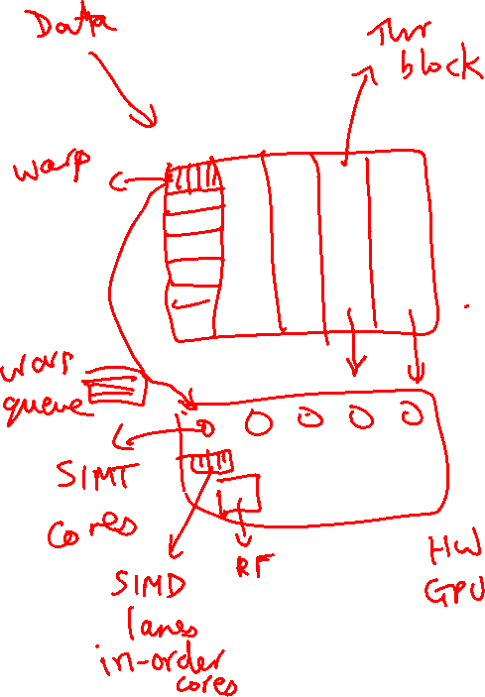
GPUs

Slide 21
The GPU Architecture
SIMT – single instruction, multiple thread; a GPU has
many SIMT cores
A large data-parallel operation is partitioned into many
thread blocks (one per SIMT core); a thread block is
partitioned into many warps (one warp running at a
time in the SIMT core); a warp is partitioned across many
in-order pipelines (each is called a SIMD lane)
A SIMT core can have multiple active warps at a time,
i.e., the SIMT core stores the registers for each warp;
warps can be context-switched at low cost; a warp
scheduler keeps track of runnable warps and schedules
a new warp if the currently running warp stalls

Slide 22

The GPU Architecture

Slide 23

Architecture Features
Simple in-order pipelines that rely on thread-level parallelism
to hide long latencies
Many registers (~1K) per in-order pipeline (lane) to support
many active warps
When a branch is encountered, some of the lanes proceed
along the “then” case depending on their data values;
later, the other lanes evaluate the “else” case; a branch
cuts the data-level parallelism by half (branch divergence)
When a load/store is encountered, the requests from all
lanes are coalesced into a few 128B cache line requests;
each request may return at a different time (mem divergence)

Slide 24
GPU Memory Hierarchy
Each SIMT core has a private L1 cache (shared by the
warps on that core)
A large L2 is shared by all SIMT cores; each L2 bank
services a subset of all addresses
Each L2 partition is connected to its own memory
controller and memory channel
The GDDR5 memory system runs at higher frequencies,
and uses chips with more banks, wide IO, and better
power delivery networks
A portion of GDDR5 memory is private to the GPU and the
rest is accessible to the host CPU (the GPU performs copies)

Slide 25
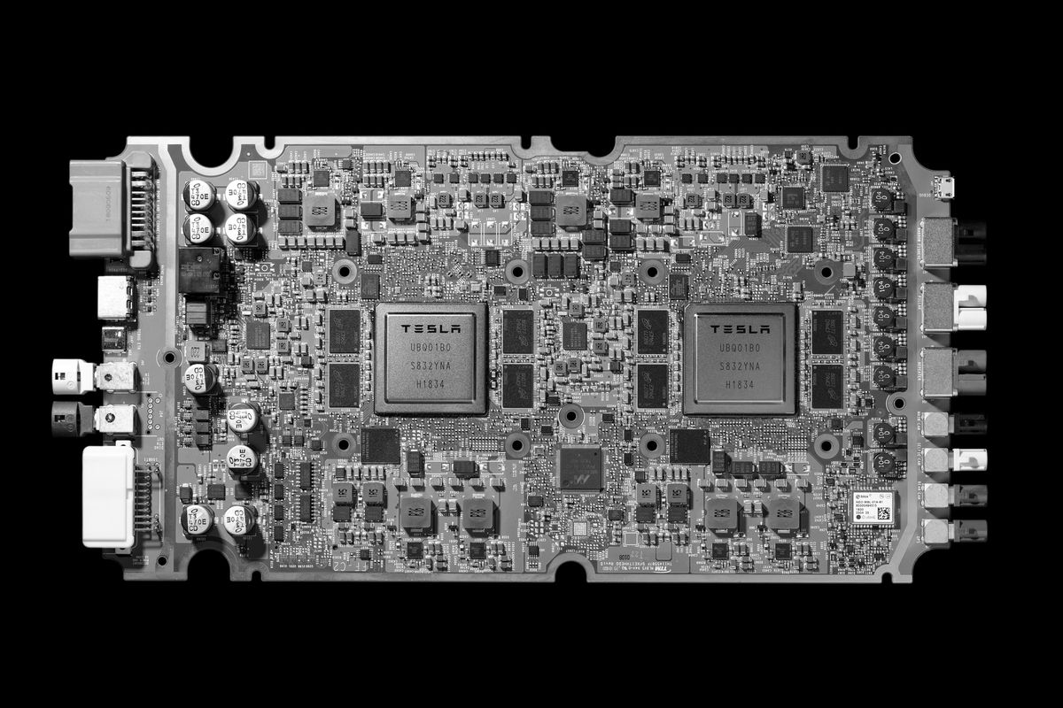
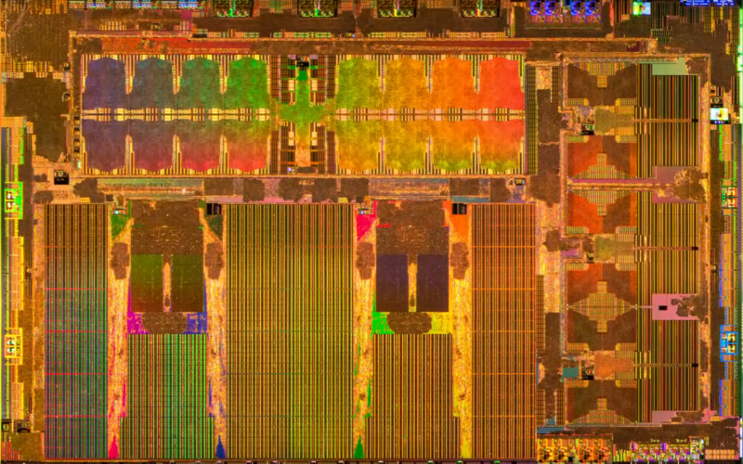
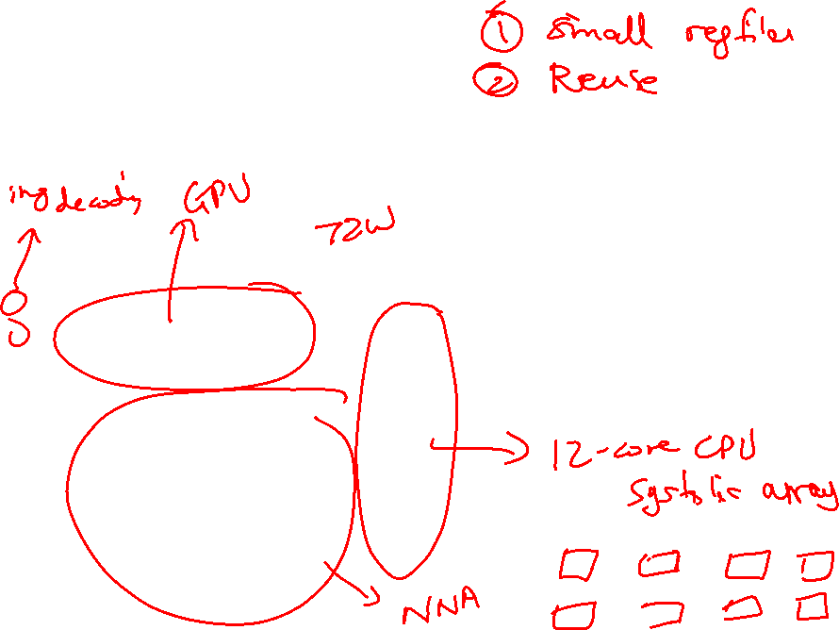
Accelerators - Tesla FSD
Image Source: Tesla

Slide 26
Accelerators
General-purpose processors add overheads in terms of
instruction fetch, register read/write, etc.
If the workload is well-known, computational units can be
wired up to avoid many of these overheads
Many AI accelerators today (Google, Tesla, Amazon, … )
These AI accelerators are primarily designed for efficient
matrix multiplications
Large systolic arrays are an example of how dot-products
can be calculated without involving large register files
and with data reuse (improving energy efficiency, parallelism)

Slide 27
Role of Disks
Activities external to the CPU/memory are typically
orders of magnitude slower
Example: while CPU performance has improved by 50%
per year, disk latencies have improved by 10% every year
Typical strategy on I/O: switch contexts and work on
something else
Other metrics, such as bandwidth, reliability, availability,
and capacity, often receive more attention than performance

Slide 28
Magnetic Disks
A magnetic disk consists of 1-12 platters (metal or glass
disk covered with magnetic recording material on both
sides), with diameters between 1-3.5 inches
Each platter is comprised of concentric tracks (5-30K) and
each track is divided into sectors (100 – 500 per track,
each about 512 bytes)
A movable arm holds the read/write heads for each disk
surface and moves them all in tandem – a cylinder of data
is accessible at a time

Slide 29
Disk Latency
To read/write data, the arm has to be placed on the
correct track – this seek time usually takes 5 to 12 ms
on average – can take less if there is spatial locality
Rotational latency is the time taken to rotate the correct
sector under the head – average is typically more than
2 ms (15,000 RPM)
Transfer time is the time taken to transfer a block of bits
out of the disk and is typically 3 – 65 MB/second
A disk controller maintains a disk cache (spatial locality
can be exploited) and sets up the transfer on the bus
(controller overhead)

Slide 30
Defining Reliability and Availability
A system toggles between
  Service accomplishment: service matches specifications
  Service interruption: service deviates from specs
The toggle is caused by failures and restorations
Reliability measures continuous service accomplishment
and is usually expressed as mean time to failure (MTTF)
Availability measures fraction of time that service matches
specifications, expressed as MTTF / (MTTF + MTTR)

Slide 31
RAID
Reliability and availability are important metrics for disks
RAID: redundant array of inexpensive (independent) disks
Redundancy can deal with one or more failures
Each sector of a disk records check information that allows
it to determine if the disk has an error or not (in other words,
redundancy already exists within a disk)
When the disk read flags an error, we turn elsewhere for
correct data

Slide 32
RAID 0 and RAID 1
RAID 0 has no additional redundancy (misnomer) – it
uses an array of disks and stripes (interleaves) data
across the arrays to improve parallelism and throughput
RAID 1 mirrors or shadows every disk – every write
happens to two disks
Reads to the mirror may happen only when the primary
disk fails – or, you may try to read both together and the
quicker response is accepted
Expensive solution: high reliability at twice the cost

Slide 33
RAID 3
Data is bit-interleaved across several disks and a separate
disk maintains parity information for a set of bits
For example: with 8 disks, bit 0 is in disk-0, bit 1 is in disk-1,
…, bit 7 is in disk-7; disk-8 maintains parity for all 8 bits
For any read, 8 disks must be accessed (as we usually
read more than a byte at a time) and for any write, 9 disks
must be accessed as parity has to be re-calculated
High throughput for a single request, low cost for
redundancy (overhead: 12.5%), low task-level parallelism

Slide 34
RAID 4 and RAID 5
Data is block interleaved – this allows us to get all our
data from a single disk on a read – in case of a disk error,
read all 9 disks
Block interleaving reduces thruput for a single request (as
only a single disk drive is servicing the request), but
improves task-level parallelism as other disk drives are
free to service other requests
On a write, we access the disk that stores the data and the
parity disk – parity information can be updated simply by
checking if the new data differs from the old data

Slide 35
RAID 5
If we have a single disk for parity, multiple writes can not
happen in parallel (as all writes must update parity info)
RAID 5 distributes the parity block to allow simultaneous
writes

Slide 36
RAID Summary
RAID 1-5 can tolerate a single fault – mirroring (RAID 1)
has a 100% overhead, while parity (RAID 3, 4, 5) has
modest overhead
Can tolerate multiple faults by having multiple check
functions – each additional check can cost an additional
disk (RAID 6)
RAID 6 and RAID 2 (memory-style ECC) are not
commercially employed

Slide 37
Memory Protection
Most common approach: SECDED – single error correction,
double error detection – an 8-bit code for every 64-bit word
-- can correct a single error in any 64-bit word – also used
in caches
Extends a 64-bit memory channel to a 72-bit channel and
requires ECC DIMMs (e.g., a word is fetched from 9 chips
instead of 8)
Chipkill is a form of error protection where failures in an
entire memory chip can be corrected

Slide 38
Computation Errors – TMR
Errors in ALUs and cores are typically handled by
performing the computation n times and voting for the
correct answer
n=3 is common and is referred to as triple modular
redundancy

