Slide 1

Lecture 24: Security, Multiprocessors
Today’s topics:
  Security
  Cache coherence in multiprocessors

Slide 2
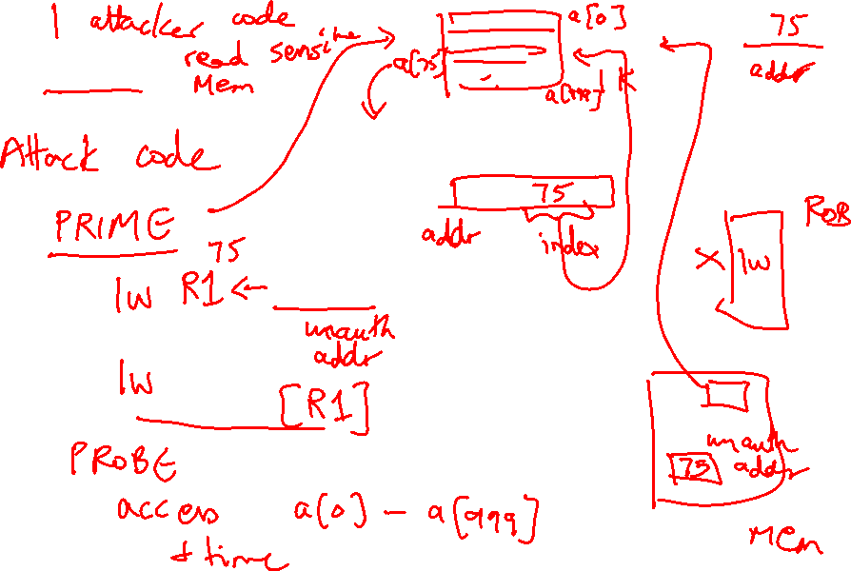
Meltdown

Slide 3
Spectre: Variant 1
if (x < array1_size)
y = array2[ array1[x] ];

Slide 4
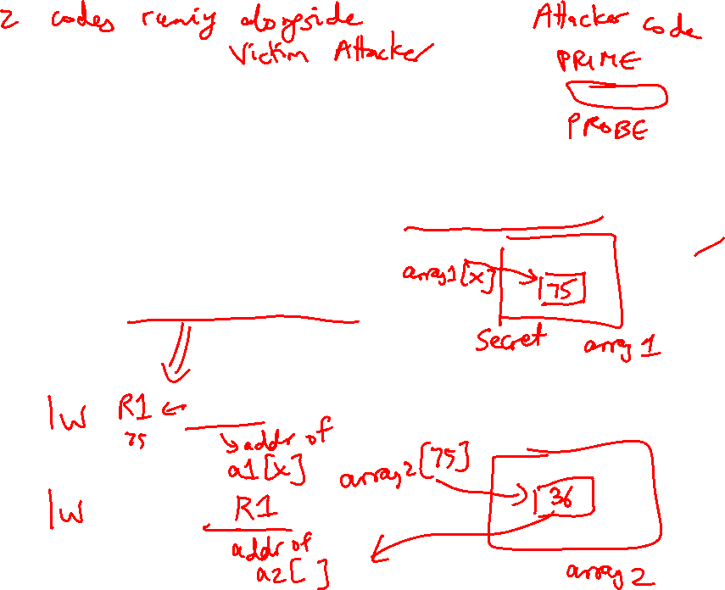
Spectre: Variant 1
x is controlled by attacker
Thanks to bpred, x can be anything
array1[ ] is the secret
Victim Code
if (x < array1_size)
y = array2[ array1[x] ];
Access pattern of array2[ ] betrays the secret

Slide 5

Spectre: Variant 2
Victim code
R1 ← (from attacker)
R2 ← some secret
Label0: if (…)
Attacker code
Label0: if (1)
Label1: …
…
…
Victim code
Label1:
lw [R2]

Slide 6
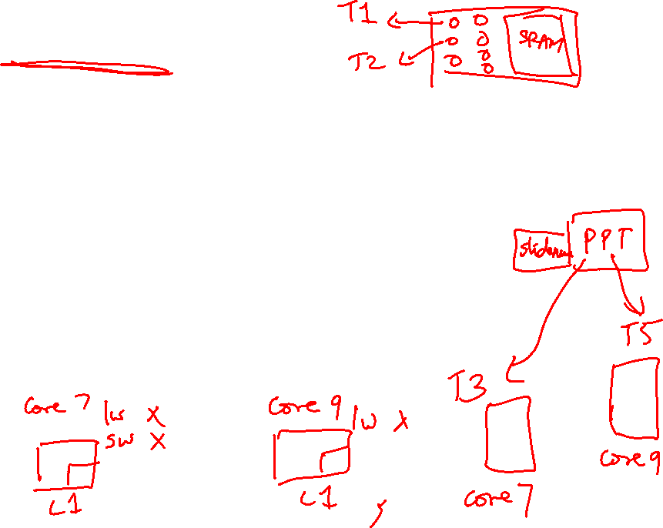
Multiprocessor Taxonomy
SISD: single instruction and single data stream: uniprocessor
MISD: no commercial multiprocessor: imagine data going
through a pipeline of execution engines
SIMD: vector architectures: lower flexibility
MIMD: most multiprocessors today: easy to construct with
off-the-shelf computers, most flexibility

Slide 7
Memory Organization - I
Centralized shared-memory multiprocessor or
Symmetric shared-memory multiprocessor (SMP)
Multiple processors connected to a single centralized
memory – since all processors see the same memory
organization → uniform memory access (UMA)
Shared-memory because all processors can access the
entire memory address space
Can centralized memory emerge as a bandwidth
bottleneck? – not if you have large caches and employ
fewer than a dozen processors

Slide 8
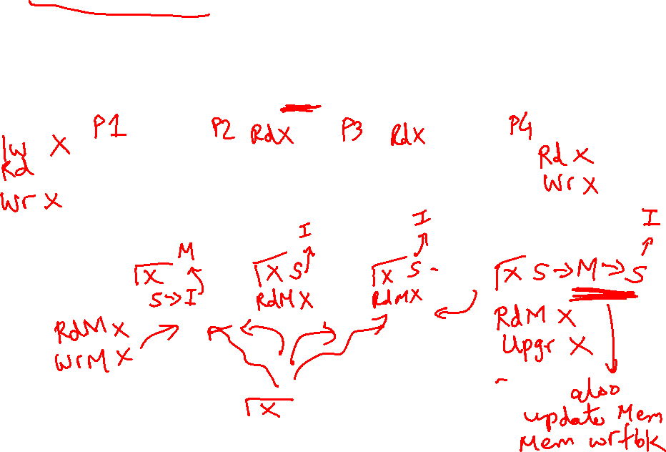
Snooping-Based Protocols
Three states for a block: invalid, shared, modified
A write is placed on the bus and sharers invalidate themselves
The protocols are referred to as MSI, MESI, etc.
Processor
Processor
Processor
Processor
Caches
Caches
Caches
Caches
Main Memory
I/O System

Slide 9
Snooping-Based Protocols
Three states for a block: invalid, shared, modified
A write is placed on the bus and sharers invalidate themselves
The protocols are referred to as MSI, MESI, etc.
Processor
Processor
Processor
Processor
Caches
Caches
Caches
Caches
Main Memory
I/O System

Slide 10
Example
P1 reads X: not found in cache-1, request sent on bus, memory responds,
X is placed in cache-1 in shared state
P2 reads X: not found in cache-2, request sent on bus, everyone snoops
this request, cache-1does nothing because this is just a read request,
memory responds, X is placed in cache-2 in shared state
P1
P2
P1 writes X: cache-1 has data in shared
state (shared only provides read perms),
request sent on bus, cache-2 snoops and
then invalidates its copy of X, cache-1
moves its state to modified
P2 reads X: cache-2 has data in invalid
state, request sent on bus, cache-1 snoops
and realizes it has the only valid copy, so it
downgrades itself to shared state and
responds with data, X is placed in cache-2
in shared state, memory is also updated
Cache-1
Cache-2
Main Memory

Slide 11
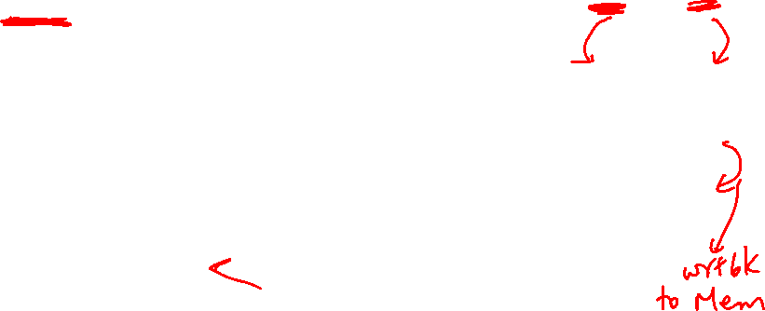
Example
Request | Cache Hit/Miss | Request on the bus | Who responds | State in Cache 1 | State in Cache 2 | State in Cache 3 | State in Cache 4
 |  |  |  | Inv | Inv | Inv | Inv
P1: Rd X | Rd Miss | Rd X | Memory | S | Inv | Inv | Inv
P2: Rd X | Rd Miss | Rd X | Memory | S | S | Inv | Inv
P2: Wr X | Perms Miss | Upgrade X | No response. Other caches invalidate. | Inv | M | Inv | Inv
P3: Wr X | Wr Miss | Wr X | P2 responds | Inv | Inv | M | Inv
P3: Rd X | Rd Hit | - | - | Inv | Inv | M | Inv
P4: Rd X | Rd Miss | Rd X | P3 responds. Mem wrtbk | Inv | Inv | S | S

Slide 12
Cache Coherence Protocols
Directory-based: A single location (directory) keeps track
of the sharing status of a block of memory
Snooping: Every cache block is accompanied by the sharing
status of that block – all cache controllers monitor the
shared bus so they can update the sharing status of the
block, if necessary
Write-invalidate: a processor gains exclusive access of
a block before writing by invalidating all other copies
Write-update: when a processor writes, it updates other
shared copies of that block

Slide 13
Constructing Locks
Applications have phases (consisting of many instructions)
that must be executed atomically, without other parallel
processes modifying the data
A lock surrounding the data/code ensures that only one
program can be in a critical section at a time
The hardware must provide some basic primitives that
allow us to construct locks with different properties
Bank balance
$1000
Parallel (unlocked) banking transactions
Rd $1000
Add $100
Wr $1100
Rd $1000
Add $200
Wr $1200

Slide 14
Synchronization
The simplest hardware primitive that greatly facilitates
synchronization implementations (locks, barriers, etc.)
is an atomic read-modify-write
Atomic exchange: swap contents of register and memory
Special case of atomic exchange: test & set: transfer
memory location into register and write 1 into memory
(if memory has 0, lock is free)
lock: t&s register, location
bnz register, lock
CS
st location, #0
When multiple parallel threads
execute this code, only one
will be able to enter CS

Slide 15
Coherence Vs. Consistency
Coherence guarantees (i) write propagation
(a write will eventually be seen by other processors), and
(ii) write serialization (all processors see writes to the
same location in the same order)
The consistency model defines the ordering of writes and
reads to different memory locations – the hardware
guarantees a certain consistency model and the
programmer attempts to write correct programs with
those assumptions

Slide 16
Consistency Example
Consider a multiprocessor with bus-based snooping cache
coherence
Initially A = B = 0
P1 P2
A ← 1 B ← 1
… …
if (B == 0) if (A == 0)
Crit.Section Crit.Section

Slide 17
Consistency Example
Consider a multiprocessor with bus-based snooping cache
coherence
Initially A = B = 0
P1 P2
A ← 1 B ← 1
… …
if (B == 0) if (A == 0)
Crit.Section Crit.Section
The programmer expected the
above code to implement a
lock – because of ooo, both processors
can enter the critical section
The consistency model lets the programmer know what assumptions
they can make about the hardware’s reordering capabilities

