Slide 1
Lecture 22: Cache Examples
Today’s topics:
  Cache access
  Example problems in cache design

Slide 2
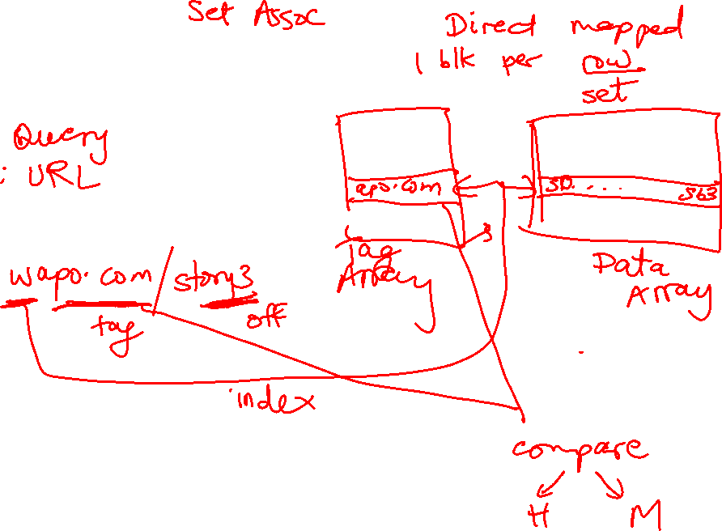
Accessing the Cache

Slide 3
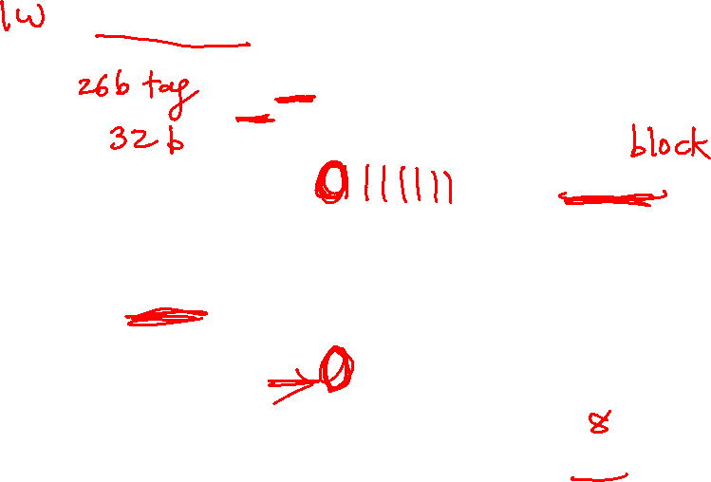
Accessing the Cache
Byte address
101000
Offset
8-byte words
8 words: 3 index bits
Direct-mapped cache:
each address maps to
a unique location in cache
Sets
Data array

Slide 4
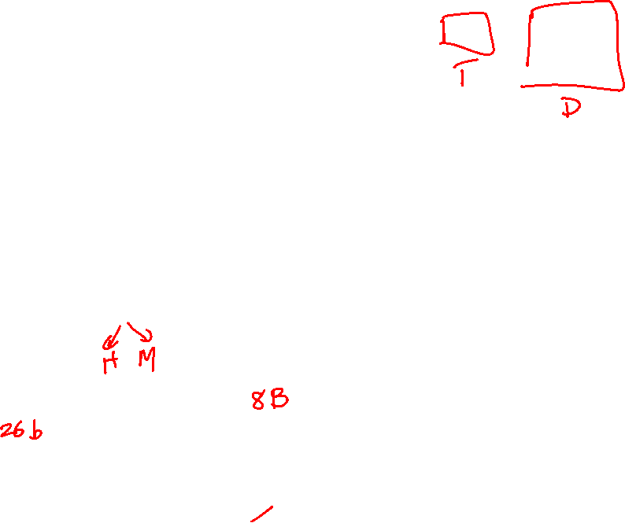
The Tag Array
Byte address
101000
Tag
8-byte words
Compare
Direct-mapped cache:
each address maps to
a unique address
Tag array
Data array

Slide 5
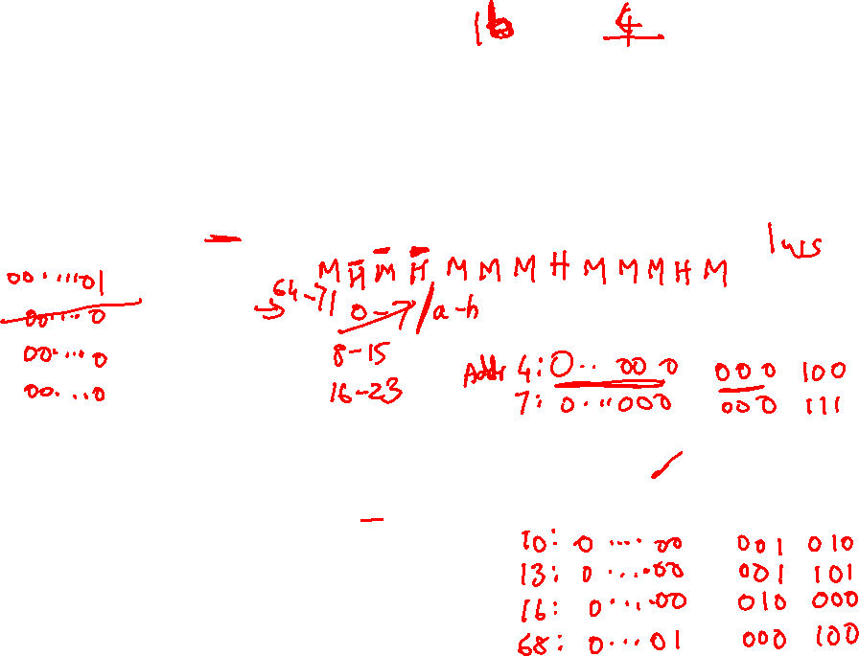
Example Access Pattern
Byte address
Assume that addresses are 8 bits long
How many of the following address requests
are hits/misses?
4, 7, 10, 13, 16, 68, 73, 78, 83, 88, 4, 7, 10…
101000
Tag
8-byte words
Compare
Direct-mapped cache:
each address maps to
a unique address
Tag array
Data array

Slide 6
Increasing Line Size
Byte address
A large cache line size → smaller tag array,
fewer misses because of spatial locality
10100000
32-byte cache
line size or
block size
Tag
Offset
Tag array
Data array

Slide 7
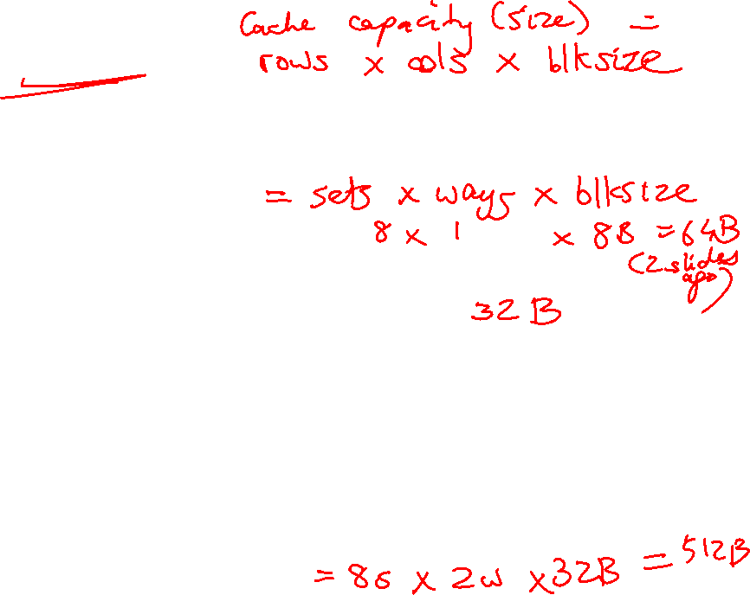
Associativity
Byte address
Set associativity → fewer conflicts; wasted power
because multiple data and tags are read
10100000
Tag
Way-1
Way-2
Tag array
Data array
Compare

Slide 8
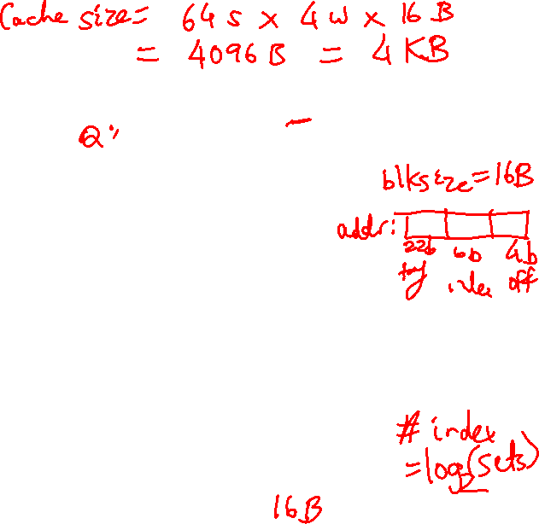
Associativity
How many offset/index/tag bits if the cache has
64 sets,
each set has 64 bytes,
4 ways
Byte address
10100000
Tag
Way-1
Way-2
Tag array
Data array
Compare

Slide 9
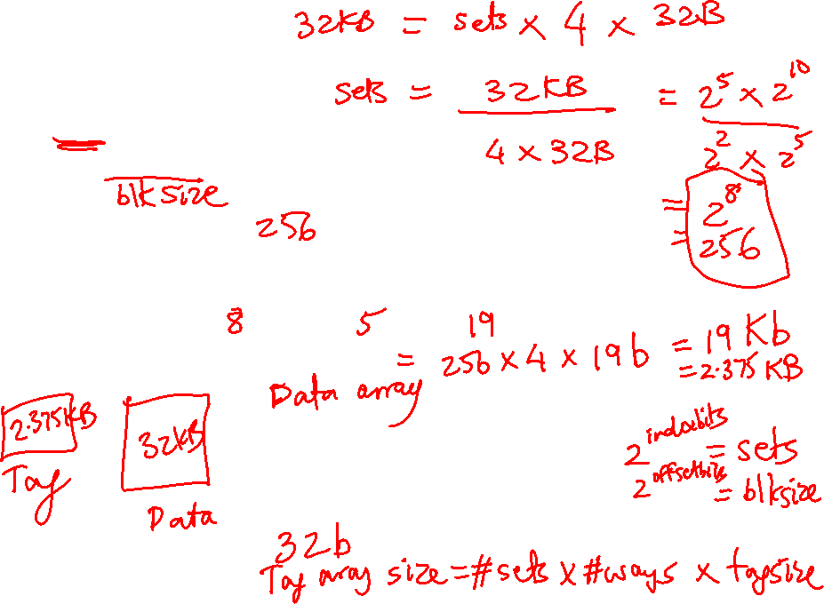
Example 1
32 KB 4-way set-associative data cache array with 32
byte line sizes
How many sets?
How many index bits, offset bits, tag bits?
How large is the tag array?
Cache size = #sets x #ways x blocksize
Index bits = log₂(sets)
Offset bits = log₂(blocksize)
Addr width = tag + index + offset

Slide 10
Example 1
32 KB 4-way set-associative data cache array with 32
byte line sizes
cache size = #sets x #ways x block size
How many sets? 256
How many index bits, offset bits, tag bits?
8 5 19
log₂(sets) log₂(blksize) addrsize-index-offset
How large is the tag array?
tag array size = #sets x #ways x tag size
= 19 Kb = 2.375 KB

Slide 11
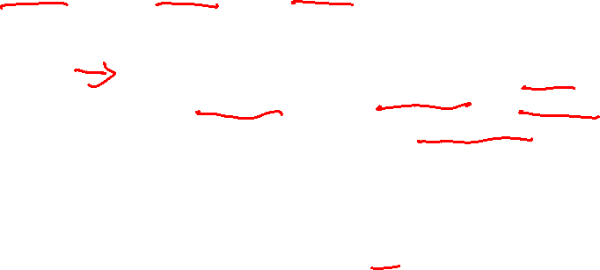
Example 2
Show how the following addresses map to the cache and yield hits or misses.
The cache is direct-mapped, has 16 sets, and a 64-byte block size.
Addresses: 8, 96, 32, 480, 976, 1040, 1096
Offset = address % 64 (address modulo 64, extract last 6)
Index = address/64 % 16 (shift right by 6, extract last 4)
Tag = address/1024 (shift address right by 10)
32-bit address
22 bits tag 4 bits index 6 bits offset
8: 0 0 8 M
96: 0 1 32 M
32: 0 0 32 H
480: 0 7 32 M
976: 0 15 16 M
1040: 1 0 16 M
1096: 1 1 8 M
.
.
.

Slide 12
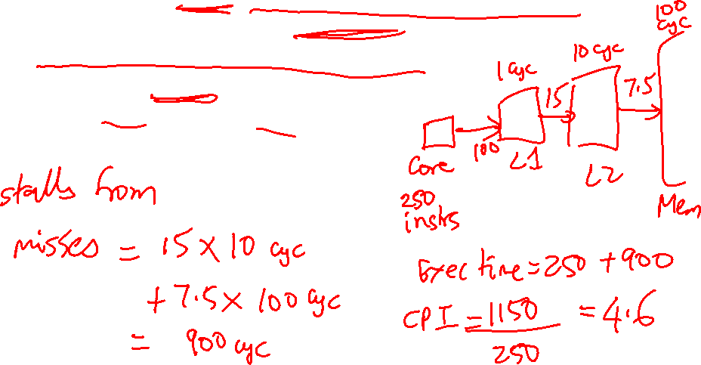
Example 3
A pipeline has CPI 1 if all loads/stores are L1 cache hits
40% of all instructions are loads/stores
85% of all loads/stores hit in 1-cycle L1
50% of all (10-cycle) L2 accesses are misses
Memory access takes 100 cycles
What is the CPI?

Slide 13
Example 3
A pipeline has CPI 1 if all loads/stores are L1 cache hits
40% of all instructions are loads/stores
85% of all loads/stores hit in 1-cycle L1
50% of all (10-cycle) L2 accesses are misses
Memory access takes 100 cycles
What is the CPI?
Start with 1000 instructions
1000 cycles (includes all 400 L1 accesses)
+ 400 (ld/st) x 15% x 10 cycles (the L2 accesses)
+ 400 x 15% x 50% x 100 cycles (the mem accesses)
= 4,600 cycles
CPI = 4.6

Slide 14
Example 4
Assume that addresses are 8 bits long
How many of the following address requests
are hits/misses?
4, 7, 10, 13, 16, 24, 36, 4, 48, 64, 4, 36, 64, 4
Byte address
00010000
Tag
Way-1
Way-2
8-byte blocks
Tag array
Data array

Slide 15
Example 4
Assume that addresses are 8 bits long
How many of the following address requests
are hits/misses?
4, 7, 10, 13, 16, 24, 36, 4, 48, 64, 4, 36, 64, 4
M H M H M M M H M M H M M M
Byte address
00010000
Tag
Way-1
Way-2
8-byte blocks
Tag array
Data array

