Slide 1
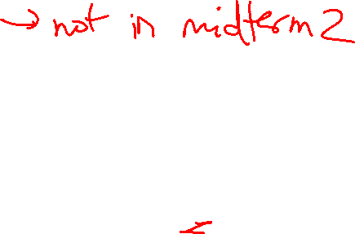
Lecture 21: Out-of-Order, Cache Hierarchies
Today’s topics:
  Out of order processors wrap-up
  Cache access intro and details

Slide 2
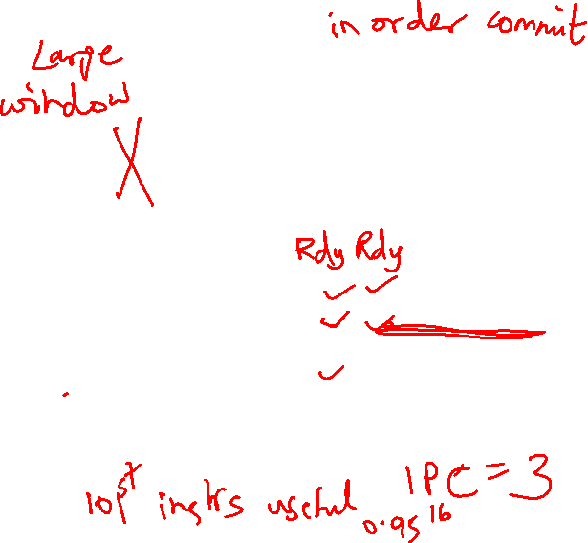
An Out-of-Order Processor Implementation
Reorder Buffer (ROB)
Branch prediction
and instr fetch
Instr 1
Instr 2
Instr 3
Instr 4
Instr 5
Instr 6
T1
T2
T3
T4
T5
T6
Register File
R1-R32
R1 ← R1+R2
R2 ← R1+R3
BEQZ R2
R3 ← R1+R2
R1 ← R3+R2
Decode &
Rename
T1 ← R1+R2
T2 ← T1+R3
BEQZ T2
T4 ← T1+T2
T5 ← T4+T2
ALU
ALU
ALU
Instr Fetch Queue
Results written to
ROB and tags
broadcast to IQ
Branches
Speculation/power
Width/Window
“Threads”
Issue Queue (IQ)

Slide 3
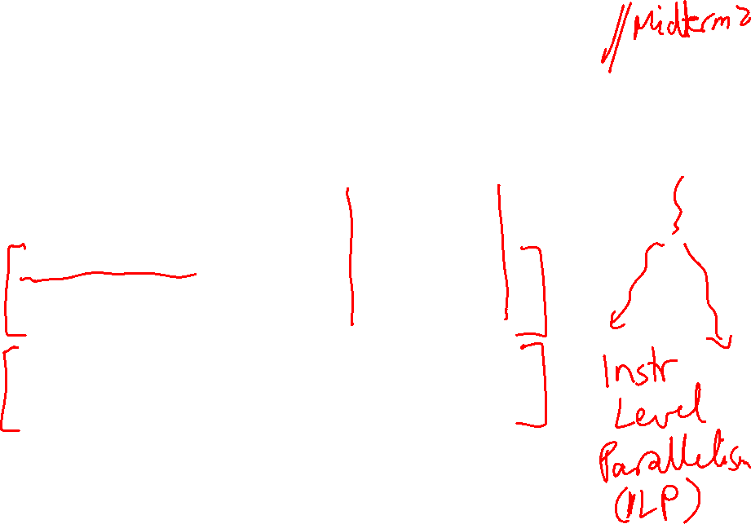
Example Code
Completion times with in-order with ooo
ADD R1, R2, R3 5 5
ADD R4, R1, R2 6 6
LW R5, 8(R4) 7 7
ADD R7, R6, R5 9 9
ADD R8, R7, R5 10 10
LW R9, 16(R4) 11 7
ADD R10, R6, R9 13 9
ADD R11, R10, R9 14 10

Slide 4
Cache Hierarchies
Data and instructions are stored on DRAM chips – DRAM
is a technology that has high bit density, but relatively poor
latency – an access to data in memory can take as many
as 300 cycles today!
Hence, some data is stored on the processor in a structure
called the cache – caches employ SRAM technology, which
is faster, but has lower bit density
Internet browsers also cache web pages – same concept

Slide 5
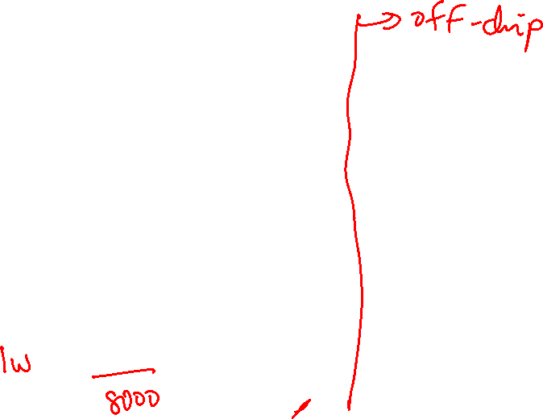
Memory Hierarchy
As you go further, capacity and latency increase
Disk
1 TB
10M cycles
Memory
16GB
300 cycles
L2 cache
2MB
15 cycles
L1 data or
instruction
Cache
32KB
2 cycles
Registers
1KB
1 cycle

Slide 6
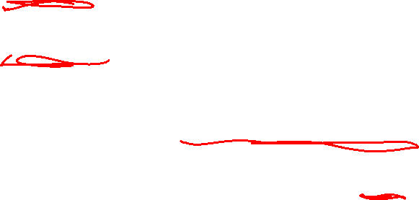
Locality
Why do caches work?
  Temporal locality: if you used some data recently, you
  will likely use it again
  Spatial locality: if you used some data recently, you
  will likely access its neighbors
No hierarchy: average access time for data = 300 cycles
32KB 1-cycle L1 cache that has a hit rate of 95%:
average access time = 0.95 x 1 + 0.05 x (301)
= 16 cycles

Slide 7
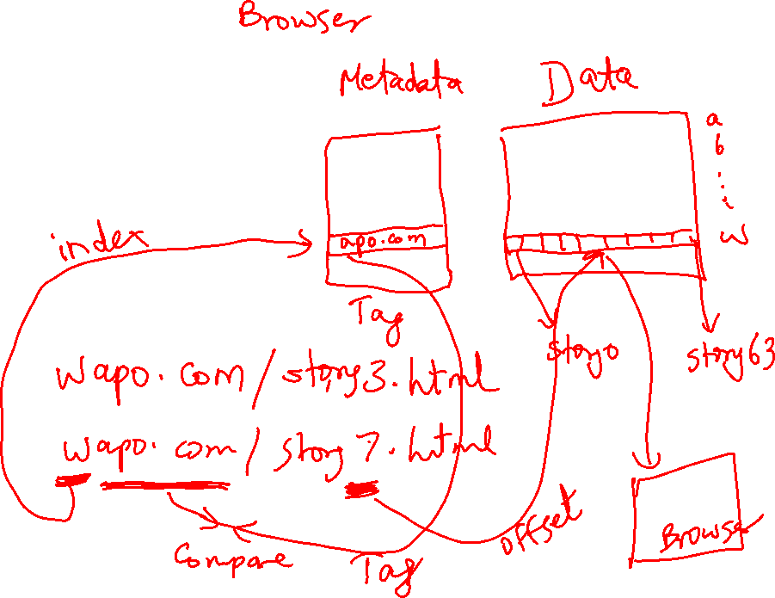
Accessing the Cache

Slide 8
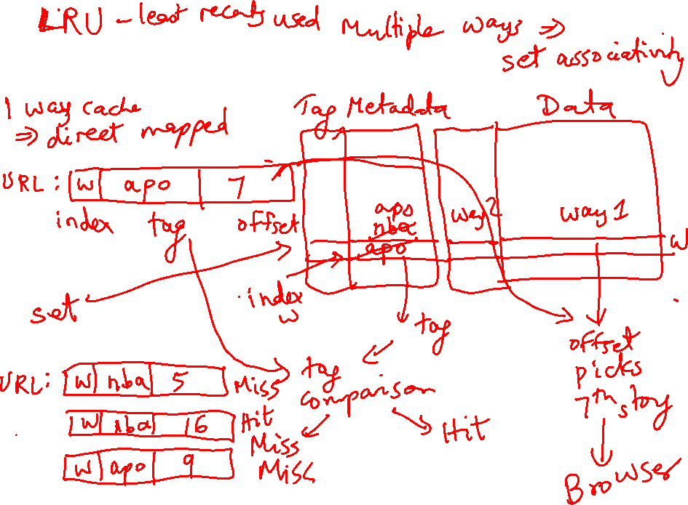
Accessing the Cache

Slide 9
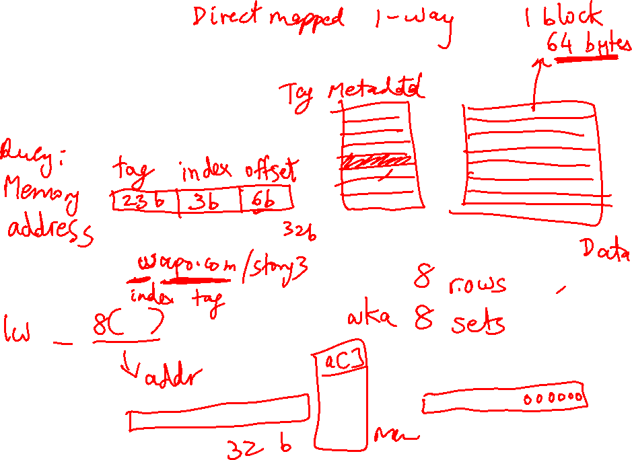
Accessing the Cache

Slide 10
Accessing the Cache
Byte address
101000
Offset
8-byte words
8 words: 3 index bits
Direct-mapped cache:
each address maps to
a unique location in cache
Sets
Data array

Slide 11
The Tag Array
Byte address
101000
Tag
8-byte words
Compare
Direct-mapped cache:
each address maps to
a unique address
Tag array
Data array

Slide 12
Example Access Pattern
Byte address
Assume that addresses are 8 bits long
How many of the following address requests
are hits/misses?
4, 7, 10, 13, 16, 68, 73, 78, 83, 88, 4, 7, 10…
101000
Tag
8-byte words
Compare
Direct-mapped cache:
each address maps to
a unique address
Tag array
Data array

