Slide 1
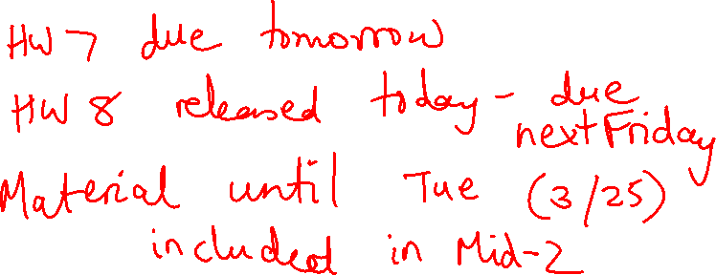
Lecture 19: Branches
Today’s topics:
  Branch prediction
  (Also see class notes on pipelining, hazards, etc.)

Slide 2

PoP/PoC Summary
Without bypassing:
PoP is typically whenever the register file write is completed
PoC is typically at the start of register file read
With bypassing:
PoP is when the value to be written to the register is available
For an Add, right after the ALU stage
For a Load, right after the DM stage
For an FP-Add, right after all the FP-Add stages have finished
PoC is right before one of the compute units needs its input
For an Add, right before the ALU stage
For a Load, right before the ALU stage
For a store, one operand is needed right before ALU stage
one operand is needed right before DM stage

Slide 3
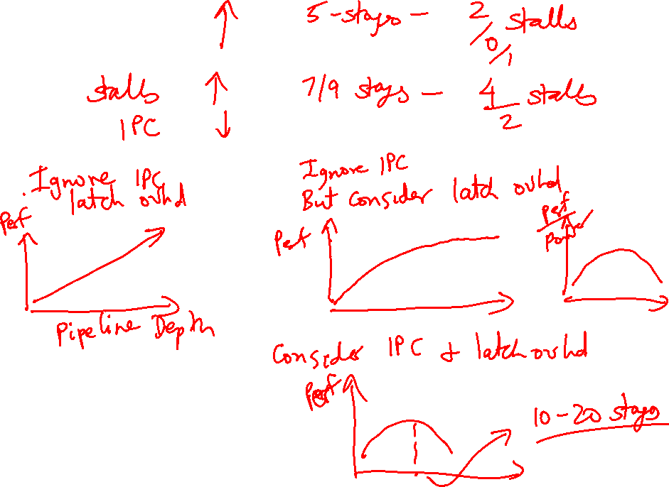
Pipeline Depth

Slide 4
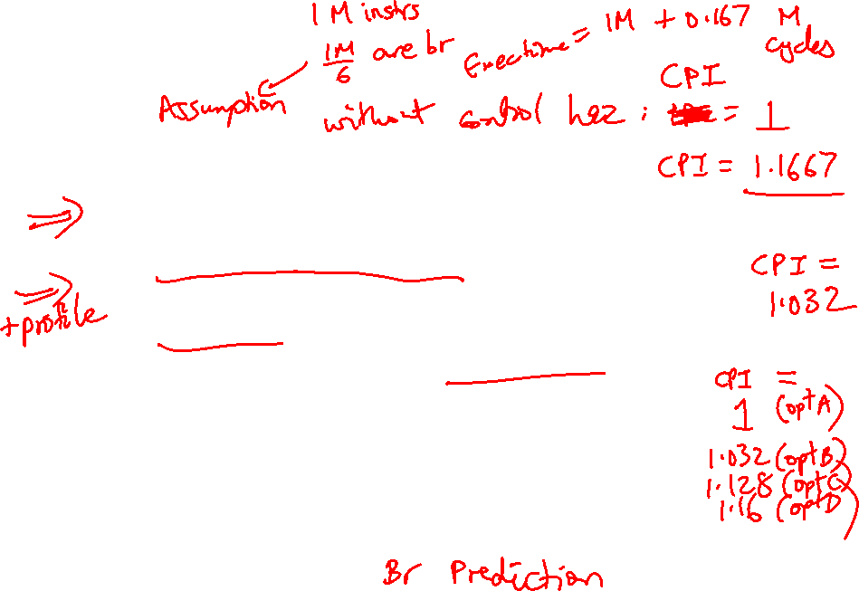
Control Hazards
Simple techniques to handle control hazard stalls:
  for every branch, introduce a stall cycle (note: every
  6th instruction is a branch!)
  assume the branch is not taken and start fetching the
  next instruction – if the branch is taken, need hardware
  to cancel the effect of the wrong-path instruction
  fetch the next instruction (branch delay slot) and
  execute it anyway – if the instruction turns out to be
  on the correct path, useful work was done – if the
  instruction turns out to be on the wrong path,
  hopefully program state is not lost
  make a smarter guess and fetch instructions from the
  expected target

Slide 5
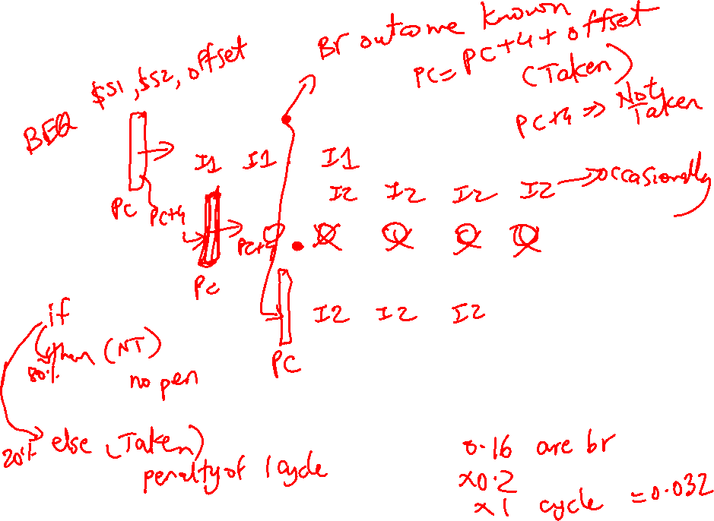
Control Hazards
IF
D/R
ALU
DM
RW
IF
D/R
ALU
DM
RW
IF
D/R
ALU
DM
RW
IF
D/R
ALU
DM
RW

Slide 6
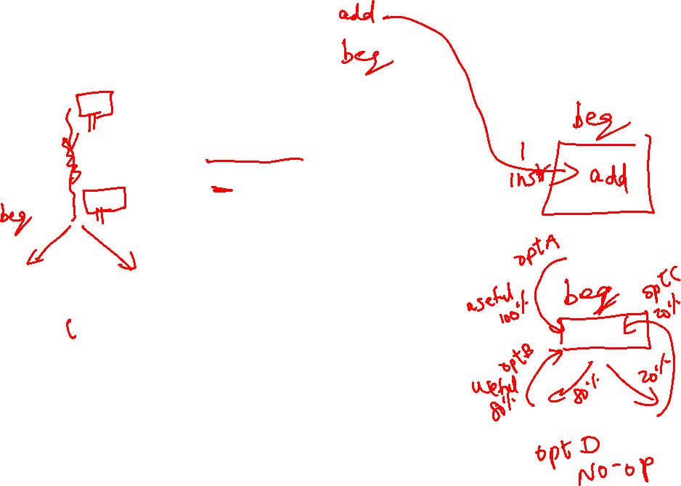
Branch Delay Slots
Source: H&P textbook

Slide 7
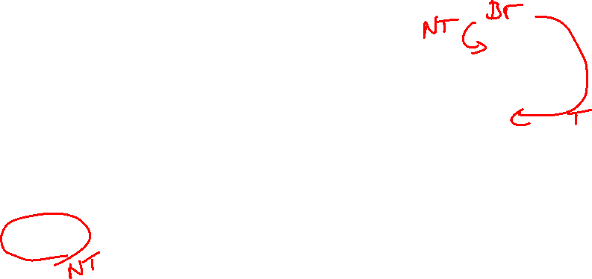
Pipeline without Branch Predictor
PC
IF (br)
Reg Read
Compare
Br-target
PC + 4

Slide 8
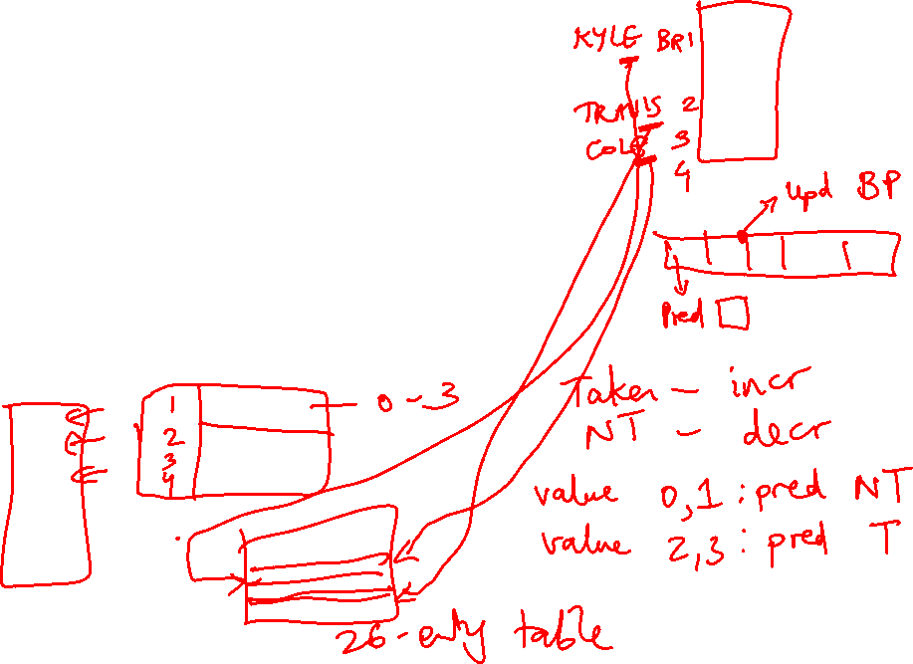
Pipeline with Branch Predictor
PC
IF (br)
Reg Read
Compare
Br-target
Branch
Predictor

Slide 9
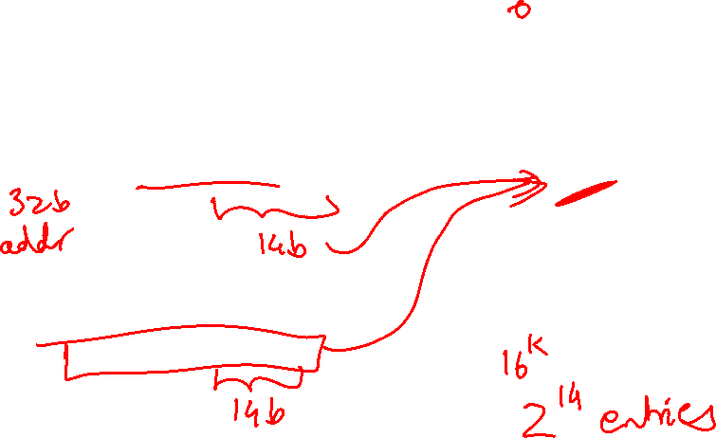
Bimodal Predictor
Table of
16K entries
of 2-bit
saturating
counters
14 bits
Branch PC

Slide 10
2-Bit Prediction
For each branch, maintain a 2-bit saturating counter:
if the branch is taken: counter = min(3,counter+1)
if the branch is not taken: counter = max(0,counter-1)
… sound familiar?
If (counter >= 2), predict taken, else predict not taken
The counter attempts to capture the common case for
each branch
Indexing functions
Multiple branch predictors
History, trade-offs

Slide 11
Slowdowns from Stalls
Perfect pipelining with no hazards → an instruction
completes every cycle (total cycles ~ num instructions)
→ speedup = increase in clock speed = num pipeline stages
With hazards and stalls, some cycles (= stall time) go by
during which no instruction completes, and then the stalled
instruction completes
Total cycles = number of instructions + stall cycles

Slide 12
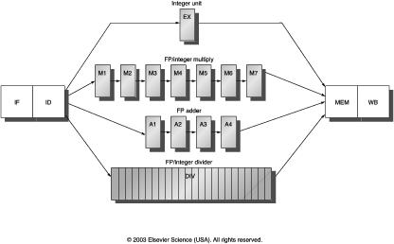
Multicycle Instructions
Multiple parallel pipelines – each pipeline can have a different
number of stages
Instructions can now complete out of order – must make sure
that writes to a register happen in the correct order

