Slide 1
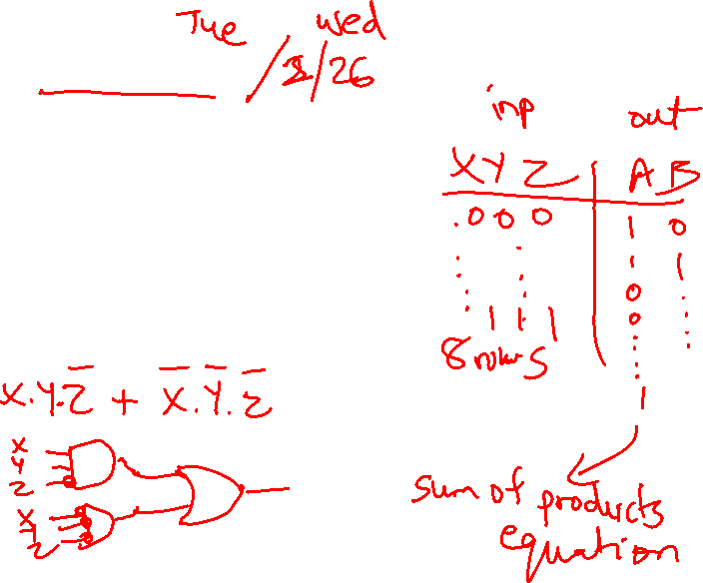
Lecture 13: ALUs, Adders
HW 5 due 2/25
Today’s topics:
  ALU
  Carry-lookahead adder

Slide 2
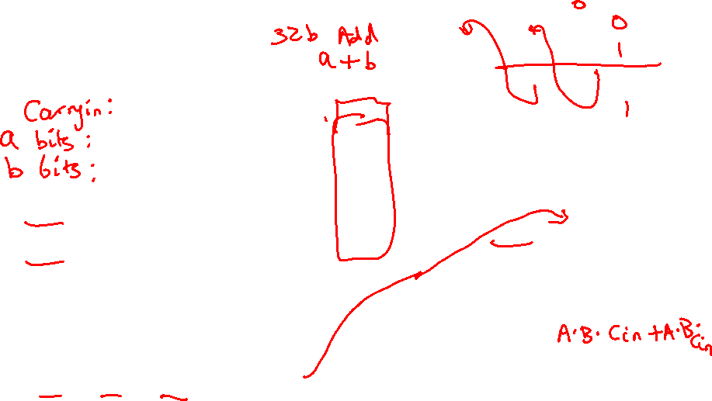
Adder Algorithm
1 0 0 1
0 1 0 1
Sum 1 1 1 0
Carry 0 0 0 1
Equations:
Sum = Cin . A . B +
B . Cin . A +
A . Cin . B +
A . B . Cin
Cout = A . B . Cin +
A . B . Cin +
A . Cin . B +
B . Cin . A
= A . B +
A . Cin +
B . Cin
Truth Table for the above operations:
A B Cin Sum Cout
0 0 0 0 0
0 0 1 1 0
0 1 0 1 0
0 1 1 0 1
1 0 0 1 0
1 0 1 0 1
1 1 0 0 1
1 1 1 1 1

Slide 3
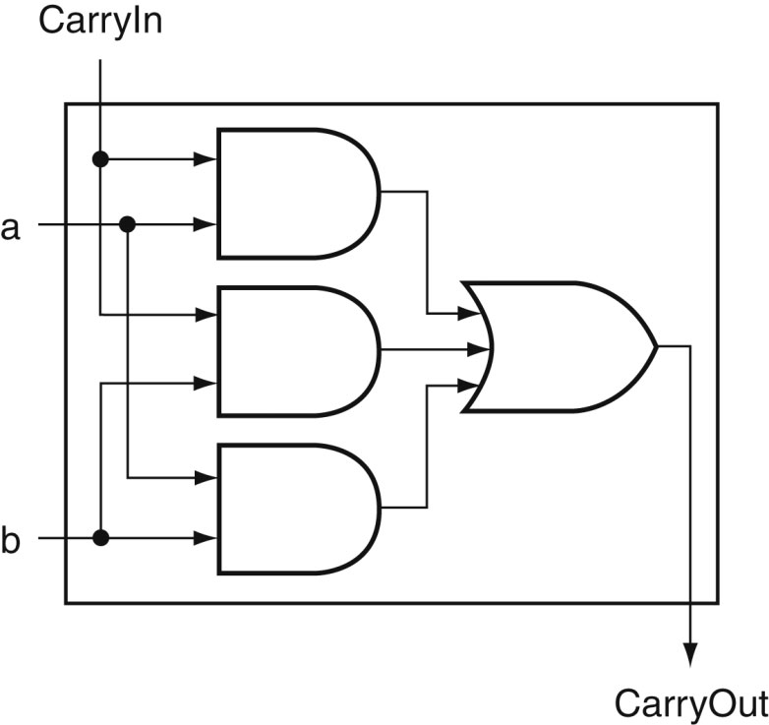
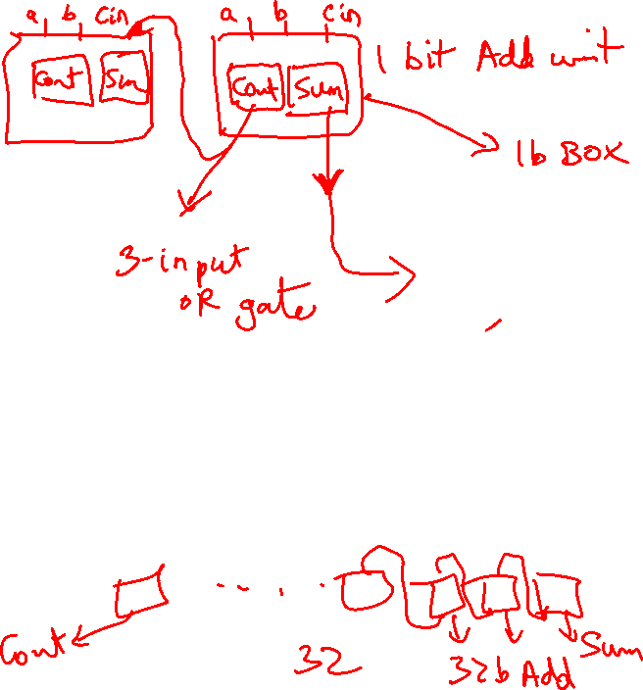
Carry Out Logic
Equations:
Sum = Cin . A . B +
B . Cin . A +
A . Cin . B +
A . B . Cin
Cout = A . B . Cin +
A . B . Cin +
A . Cin . B +
B . Cin . A
= A . B +
A . Cin +
B . Cin
Source: H&P textbook

Slide 4
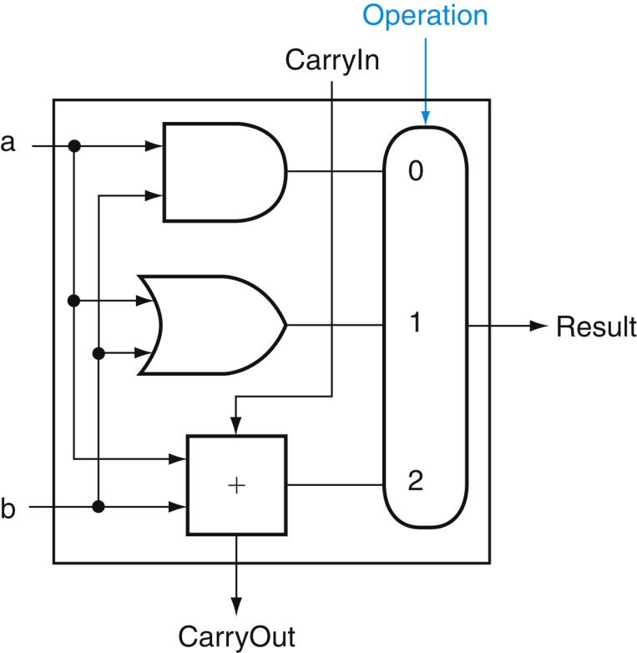
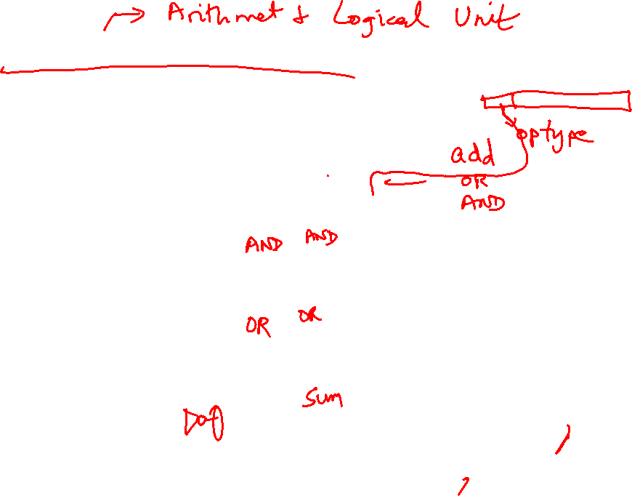
1-Bit ALU with Add, Or, And
Multiplexor selects between Add, Or, And operations
Source: H&P textbook

Slide 5
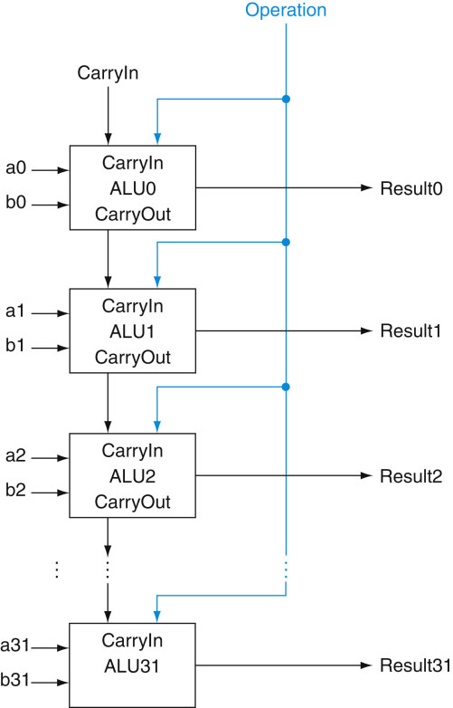
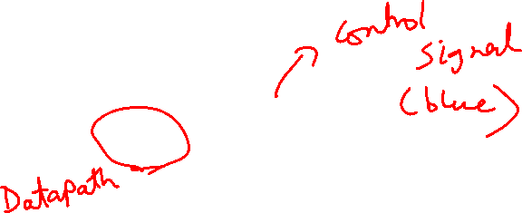
32-bit Ripple Carry Adder
1-bit ALUs are connected
“in series” with the
carry-out of 1 box
going into the carry-in
of the next box
Source: H&P textbook

Slide 6
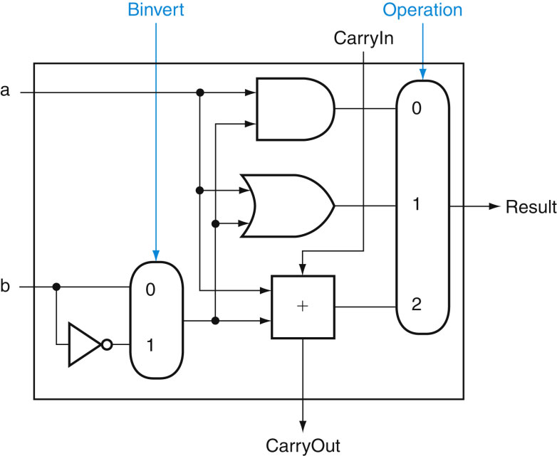
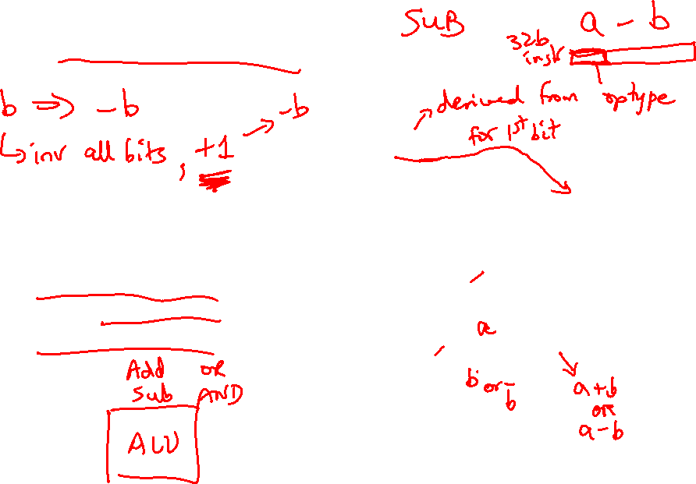
Incorporating Subtraction
Must invert bits of B and add a 1
  Include an inverter
  CarryIn for the first bit is 1
  The CarryIn signal (for the
  first bit) can be the same
  as the Binvert signal
Source: H&P textbook

Slide 7
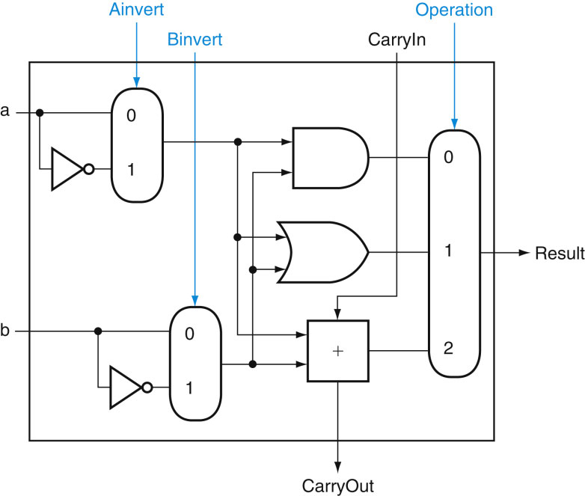
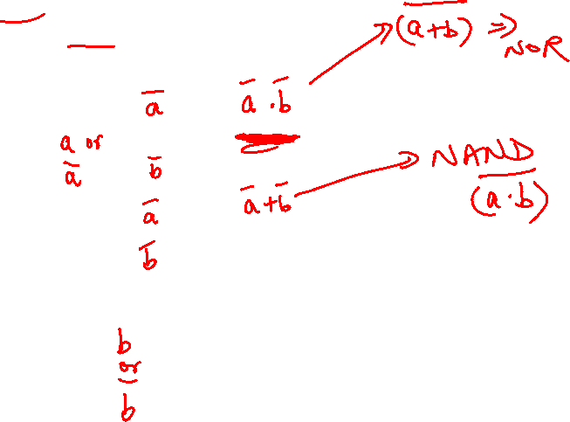
Incorporating NOR and NAND
Source: H&P textbook

Slide 8

Control Lines
What are the values
of the control lines
and what operations
do they correspond to?
Ai Bn Op
AND 0 0 00
OR 0 0 01
Add 0 0 10
Sub 0 1 10
NAND 1 1 01
NOR 1 1 00
Source: H&P textbook

Slide 9
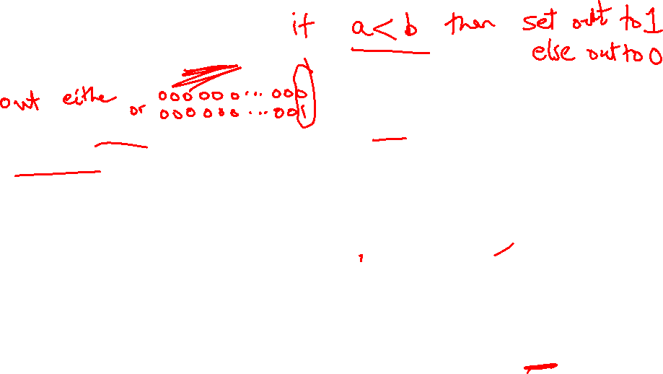
Incorporating slt
Perform a – b and check
the sign
New signal (Less) that
is zero for ALU boxes
1-31
The 31st box has a unit
to detect overflow and
sign – the sign bit
serves as the Less
signal for the 0th box
Source: H&P textbook

Slide 10
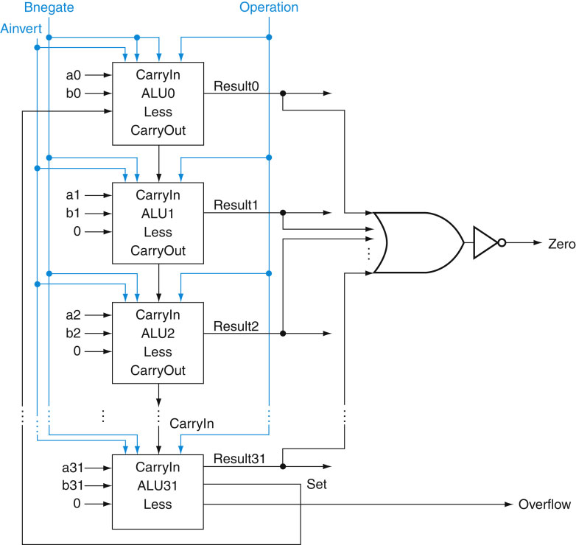

Incorporating beq
Perform a – b and
confirm that the
result is all zero’s
Source: H&P textbook

Slide 11
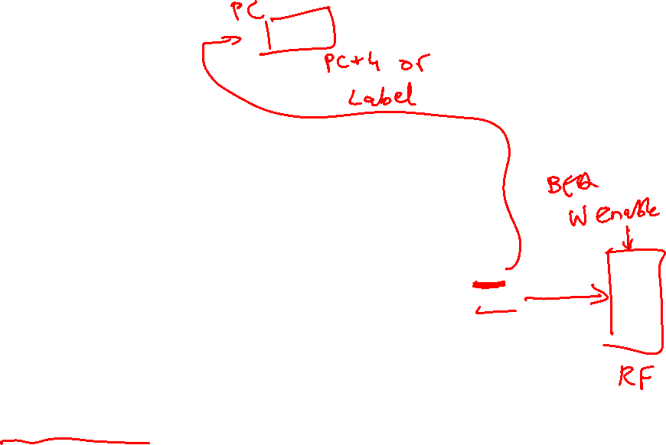
Control Lines
What are the values
of the control lines
and what operations
do they correspond to?
Ai Bn Op
AND 0 0 00
OR 0 0 01
Add 0 0 10
Sub 0 1 10
NOR 1 1 00
NAND 1 1 01
SLT 0 1 11
BEQ 0 1 10
Source: H&P textbook

Slide 12
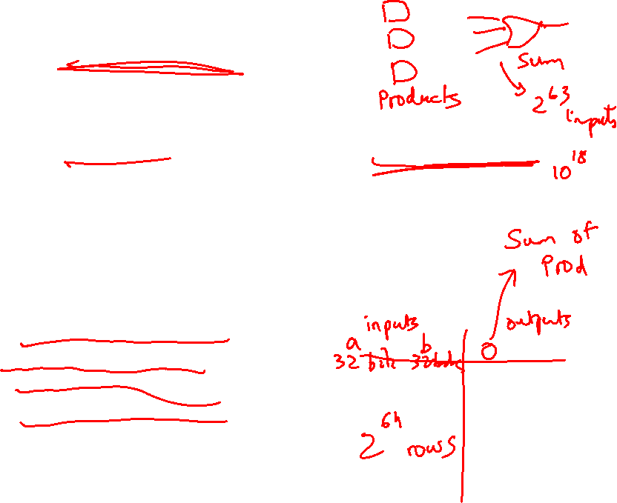
Speed of Ripple Carry
The carry propagates thru every 1-bit box: each 1-bit box sequentially
implements AND and OR – total delay is the time to go through 64 gates!
We’ve already seen that any logic equation can be expressed as the
sum of products – so it should be possible to compute the result by
going through only 2 gates!
Caveat: need many parallel gates and each gate may have a very
large number of inputs – it is difficult to efficiently build such large
gates, so we’ll find a compromise:
  moderate number of gates
  moderate number of inputs to each gate
  moderate number of sequential gates traversed

Slide 13
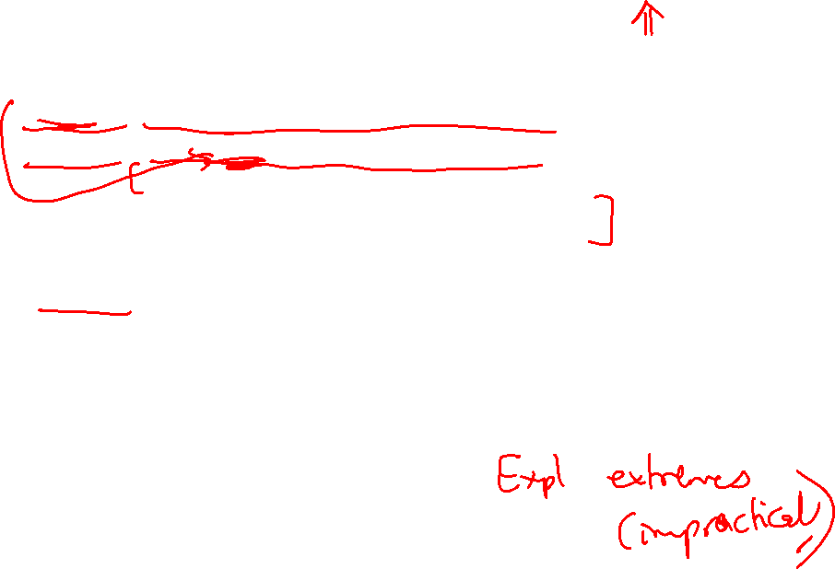
Computing CarryOut
Cout = A . B + A . Cin + B . Cin
CarryIn1 = b0.CarryIn0 + a0.CarryIn0 + a0.b0
CarryIn2 = b1.CarryIn1 + a1.CarryIn1 + a1.b1
= b1.b0.c0 + b1.a0.c0 + b1.a0.b0 +
a1.b0.c0 + a1.a0.c0 + a1.a0.b0 + a1.b1
…
CarryIn32 = a really large sum of really large products
Potentially fast implementation as the result is computed
by going thru just 2 levels of logic – unfortunately, each
gate is enormous and slow

Slide 14
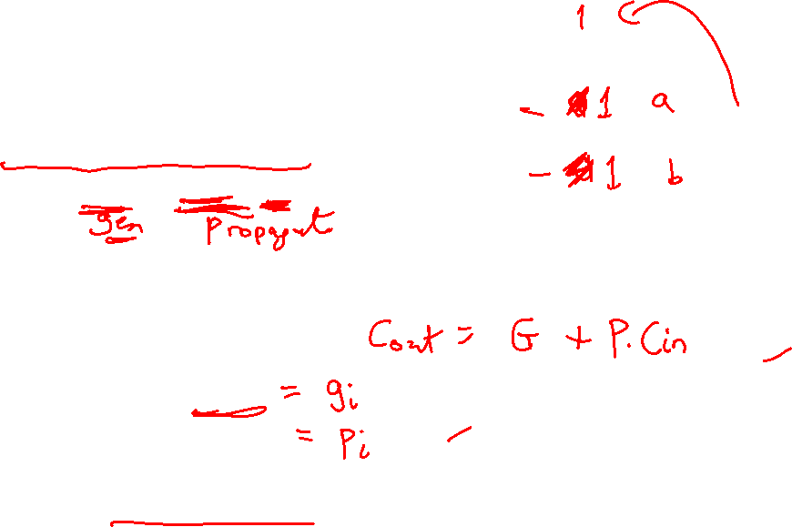
Generate and Propagate
Equation re-phrased:
Ci+1 = ai.bi + ai.Ci + bi.Ci
= (ai.bi) + (ai + bi).Ci
Stated verbally, the current pair of bits will generate a carry
if they are both 1 and the current pair of bits will propagate
a carry if either is 1
Generate signal = ai.bi
Propagate signal = ai + bi
Therefore, Ci+1 = Gi + Pi . Ci

Slide 15
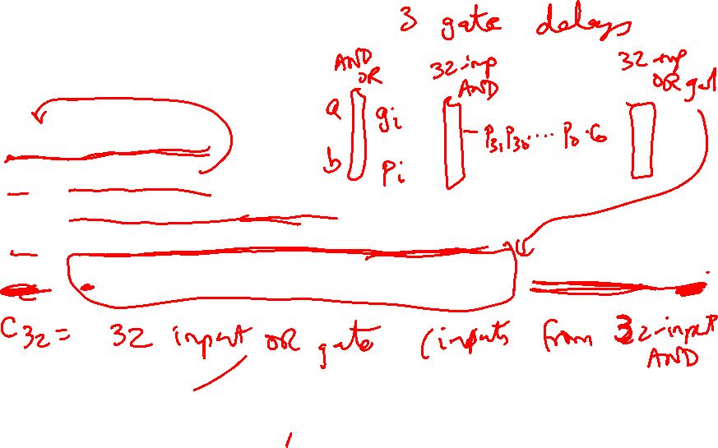
Generate and Propagate
c1 = g0 + p0.c0
c2 = g1 + p1.c1
= g1 + p1.g0 + p1.p0.c0
c3 = g2 + p2.g1 + p2.p1.g0 + p2.p1.p0.c0
c4 = g3 + p3.g2 + p3.p2.g1 + p3.p2.p1.g0 + p3.p2.p1.p0.c0
Either,
a carry was just generated, or
a carry was generated in the last step and was propagated, or
a carry was generated two steps back and was propagated by both
the next two stages, or
a carry was generated N steps back and was propagated by every
single one of the N next stages

Slide 16
Divide and Conquer
The equations on the previous slide are still difficult to implement
as logic functions – for the 32nd bit, we must AND every single
propagate bit to determine what becomes of c0 (among other
things)
Hence, the bits are broken into groups (of 4) and each group
computes its group-generate and group-propagate
For example, to add 32 numbers, you can partition the task as
a tree
.
. . . .
. . . . . . . . . . . . . . . .

Slide 17
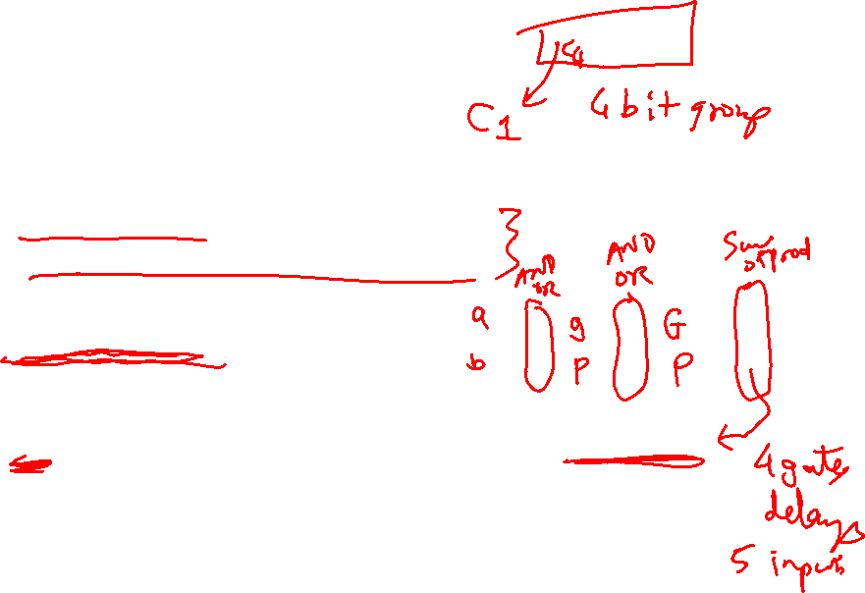
P and G for 4-bit Blocks
Compute P0 and G0 (super-propagate and super-generate) for the
first group of 4 bits (and similarly for other groups of 4 bits)
P0 = p0.p1.p2.p3
G0 = g3 + g2.p3 + g1.p2.p3 + g0.p1.p2.p3
Carry out of the first group of 4 bits is
C1 = G0 + P0.c0
C2 = G1 + P1.G0 + P1.P0.c0
C3 = G2 + (P2.G1) + (P2.P1.G0) + (P2.P1.P0.c0)
C4 = G3 + (P3.G2) + (P3.P2.G1) + (P3.P2.P1.G0) + (P3.P2.P1.P0.c0)
By having a tree of sub-computations, each AND, OR gate has few
inputs and logic signals have to travel through a modest set of
gates (equal to the height of the tree)

Slide 18
Example
Add A 0001 1010 0011 0011
B 1110 0101 1110 1011
g 0000 0000 0010 0011
p 1111 1111 1111 1011
P 1 1 1 0
G 0 0 1 0
C4 = 1

Slide 19
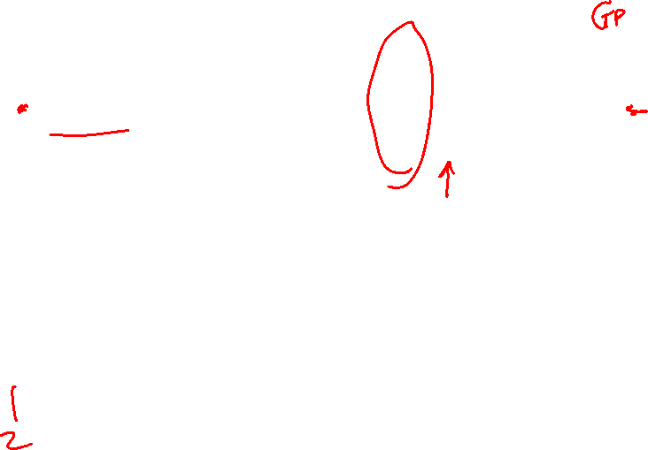
Trade-Off Curve
Truth table
sum-of-products adder, (2, 2⁶⁴)
Performance
#inputs to each gate
# sequential gates
gp adder (3, 33)
Carry Lookahead GP adder (7, 5)
Ripple-Carry
adder (64, 2)
# sequential gates

Slide 20
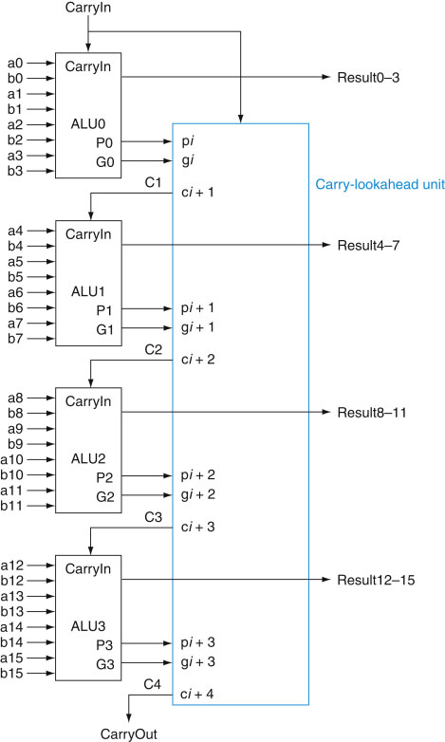
Carry Look-Ahead Adder
16-bit Ripple-carry
takes 32 steps
This design takes
how many steps?
5 sequential steps
Source: H&P textbook

