Slide 1
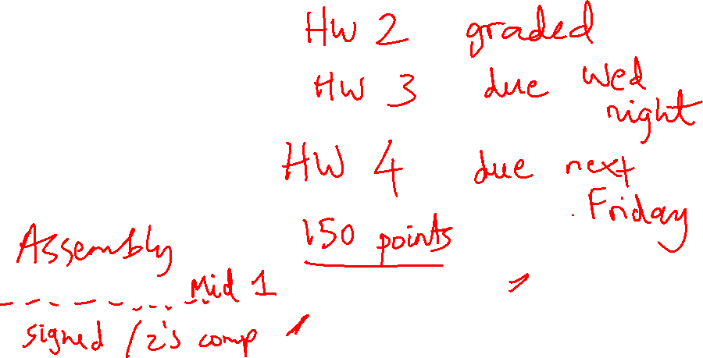
Lecture 9: Addition, Multiplication & Division
Today’s topics:
  Addition
  Multiplication
  Division

Slide 2
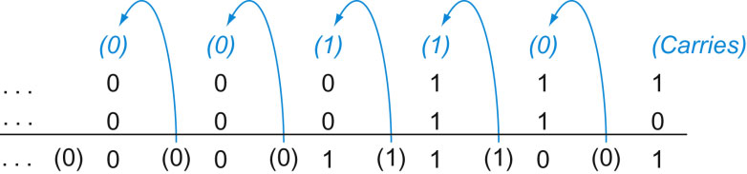
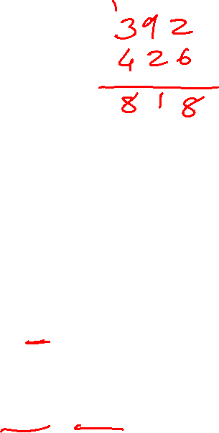
Addition and Subtraction
Addition is similar to decimal arithmetic
For subtraction, simply add the negative number – hence,
subtract A-B involves negating B’s bits, adding 1 and A
Source: H&P textbook

Slide 3

Overflows
For an unsigned number, overflow happens when the last carry (1)
cannot be accommodated
For a signed number, overflow happens when the most significant bit
is not the same as every bit to its left
  when the sum of two positive numbers is a negative result
  when the sum of two negative numbers is a positive result
  The sum of a positive and negative number will never overflow
MIPS allows addu and subu instructions that work with unsigned
integers and never flag an overflow – to detect the overflow, other
instructions will have to be executed

Slide 4
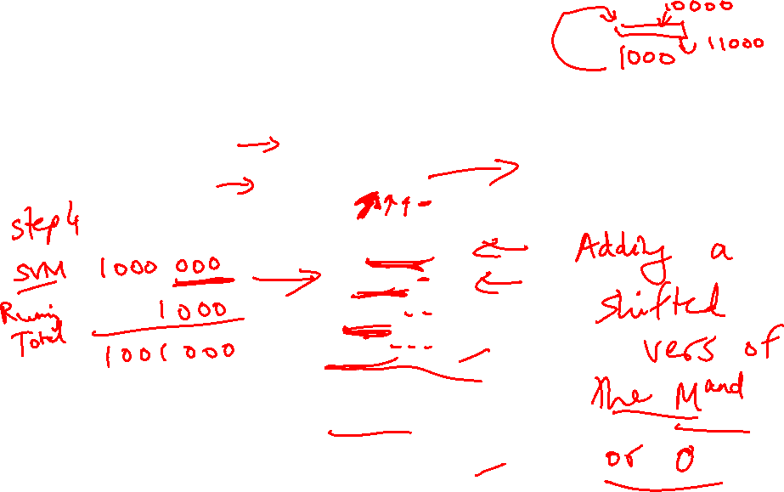
Multiplication Example
Multiplicand 1000_{ten}
Multiplier x 1001_{ten}
---------------
1000
0000
0000
1000
----------------
Product 1001000_{ten}
In every step
  multiplicand is shifted
  next bit of multiplier is examined (also a shifting step)
  if this bit is 1, shifted multiplicand is added to the product

Slide 5
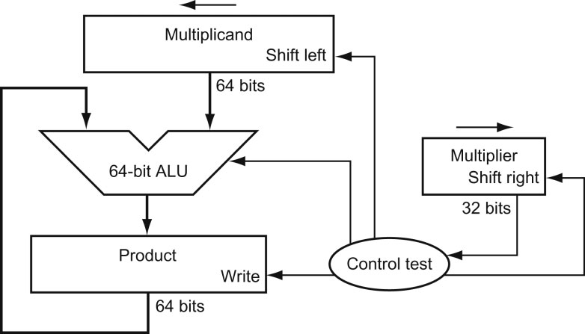
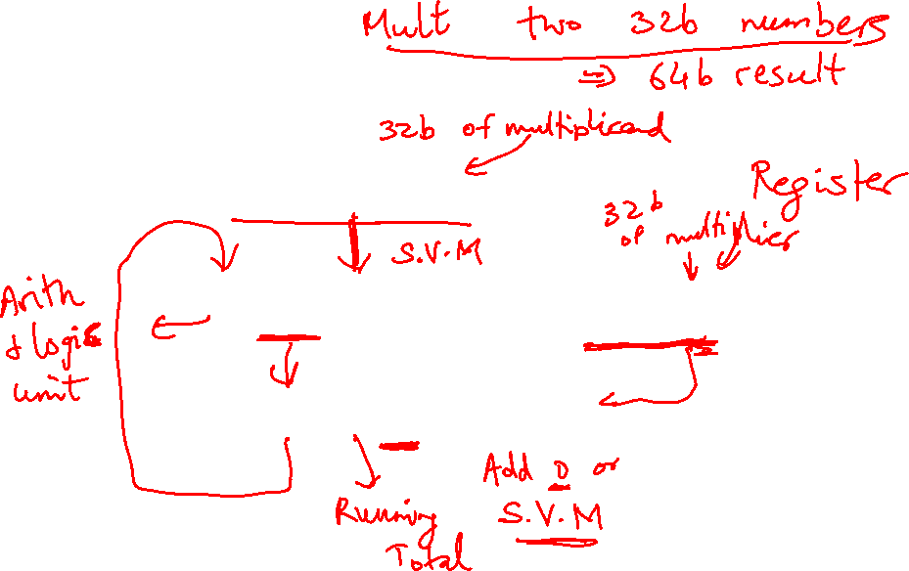
HW Algorithm 1
Source: H&P textbook
In every step
  multiplicand is shifted
  next bit of multiplier is examined (also a shifting step)
  if this bit is 1, shifted multiplicand is added to the product

Slide 6
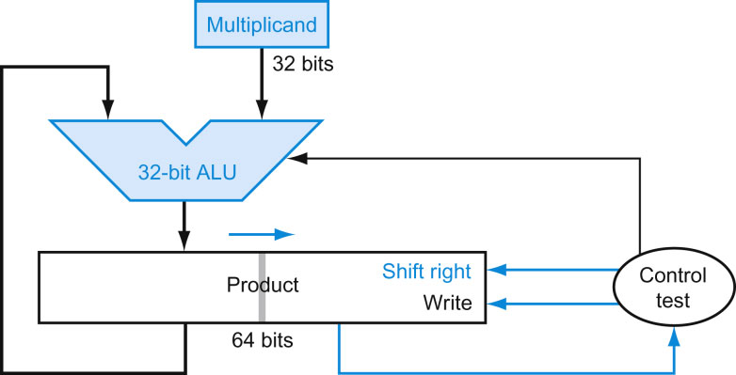
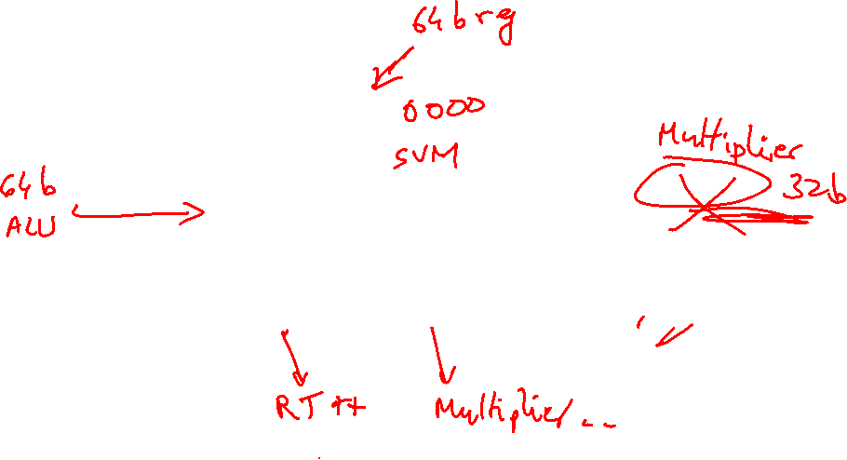
HW Algorithm 2
Source: H&P textbook
  32-bit ALU and multiplicand is untouched
  the sum keeps shifting right
  at every step, number of bits in product + multiplier = 64,
  hence, they share a single 64-bit register

Slide 7

Notes
The previous algorithm also works for signed numbers
(negative numbers in 2’s complement form)
We can also convert negative numbers to positive, multiply
the magnitudes, and convert to negative if signs disagree
The product of two 32-bit numbers can be a 64-bit number
-- hence, in MIPS, the product is saved in two 32-bit
registers

Slide 8
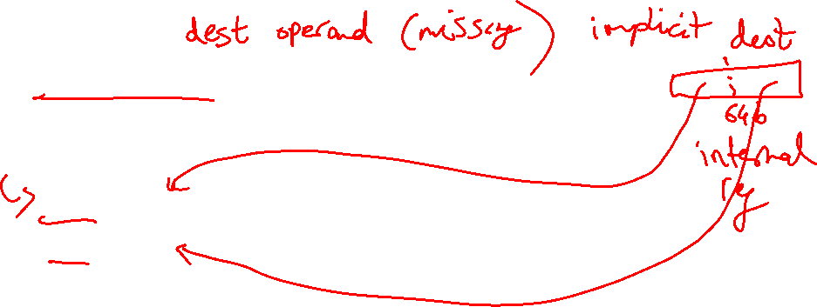
MIPS Instructions
mult $s2, $s3 computes the product and stores
it in two “internal” registers that
can be referred to as hi and lo
mfhi $s0 moves the value in hi into $s0
mflo $s1 moves the value in lo into $s1
Similarly for multu

Slide 9
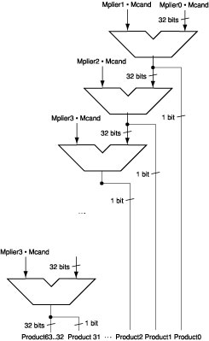

Fast Algorithm
The previous algorithm
requires a clock to ensure that
the earlier addition has
completed before shifting
This algorithm can quickly set
up most inputs – it then has to
wait for the result of each add
to propagate down – faster
because no clock is involved
-- Note: high transistor cost
Source: H&P textbook

Slide 10
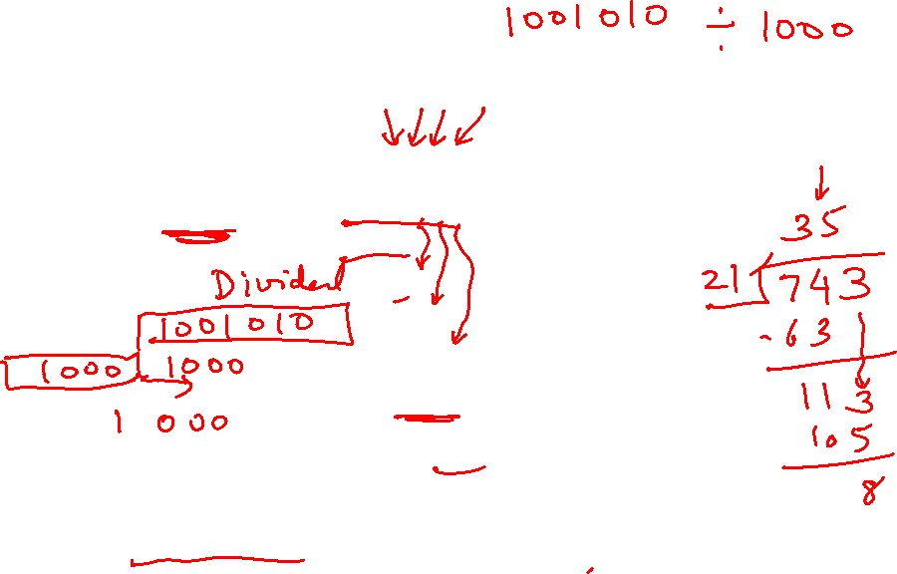
Division
1001_{ten} Quotient
Divisor 1000_{ten} | 1001010_{ten} Dividend
-1000
10
101
1010
-1000
10_{ten} Remainder
At every step,
  shift divisor right and compare it with current dividend
  if divisor is larger, shift 0 as the next bit of the quotient
  if divisor is smaller, subtract to get new dividend and shift 1
  as the next bit of the quotient

Slide 11
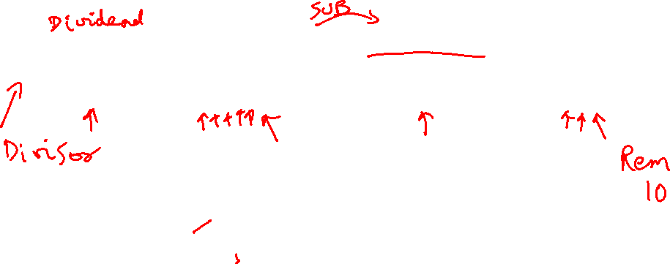
Division
1001_{ten} Quotient
Divisor 1000_{ten} | 1001010_{ten} Dividend
0001001010 0001001010 0000001010 0000001010
100000000000 → 0001000000→ 0000100000→0000001000
Quo: 0 000001 0000010 000001001
At every step,
  shift divisor right and compare it with current dividend
  if divisor is larger, shift 0 as the next bit of the quotient
  if divisor is smaller, subtract to get new dividend and shift 1
  as the next bit of the quotient

Slide 12
Divide Example
Divide 7_{ten} (0000 0111_{two}) by 2_{ten} (0010_{two})
Iter | Step | Quot | Divisor | Remainder
0 | Initial values
1
2
3
4
5

Slide 13

Divide Example
Divide 7_{ten} (0000 0111_{two}) by 2_{ten} (0010_{two})
Iter | Step | Quot | Divisor | Remainder
0 | Initial values | 0000 | 0010 0000 | 0000 0111
1 | Rem = Rem – Div Rem < 0 ➔ +Div, shift 0 into Q Shift Div right | 0000 0000 0000 | 0010 0000 0010 0000 0001 0000 | 1110 0111 0000 0111 0000 0111
2 | Same steps as 1 | 0000 0000 0000 | 0001 0000 0001 0000 0000 1000 | 1111 0111 0000 0111 0000 0111
3 | Same steps as 1 | 0000 | 0000 0100 | 0000 0111
4 | Rem = Rem – Div Rem >= 0 ➔ shift 1 into Q Shift Div right | 0000 0001 0001 | 0000 0100 0000 0100 0000 0010 | 0000 0011 0000 0011 0000 0011
5 | Same steps as 4 | 0011 | 0000 0001 | 0000 0001

Slide 14
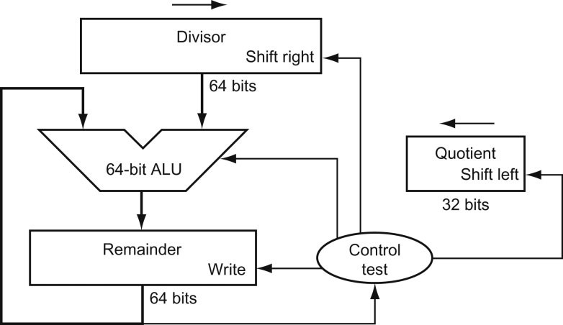

Hardware for Division
Source: H&P textbook
A comparison requires a subtract; the sign of the result is examined;
if the result is negative, the divisor must be added back
Similar to multiply, results are placed in Hi (remainder) and Lo (quotient)

Slide 15
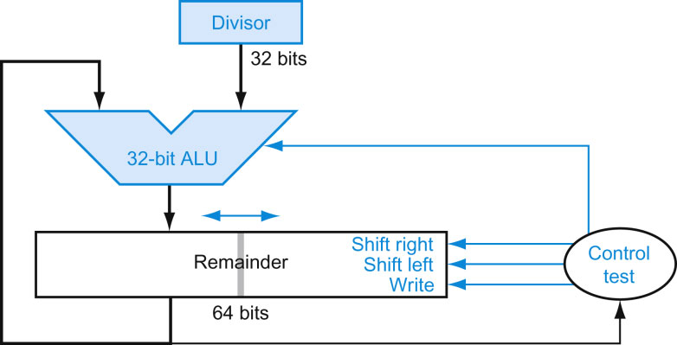

Efficient Division
Source: H&P textbook

Slide 16
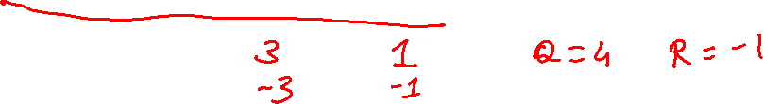
Divisions involving Negatives
Simplest solution: convert to positive and adjust sign later
Note that multiple solutions exist for the equation:
Dividend = Quotient x Divisor + Remainder
+7 div +2 Quo = Rem =
-7 div +2 Quo = Rem =
+7 div -2 Quo = Rem =
-7 div -2 Quo = Rem =

Slide 17

Divisions involving Negatives
Simplest solution: convert to positive and adjust sign later
Note that multiple solutions exist for the equation:
Dividend = Quotient x Divisor + Remainder
+7 div +2 Quo = +3 Rem = +1
-7 div +2 Quo = -3 Rem = -1
+7 div -2 Quo = -3 Rem = +1
-7 div -2 Quo = +3 Rem = -1
Convention: Dividend and remainder have the same sign
Quotient is negative if signs disagree
These rules fulfil the equation above

Slide 18

Take Homes
Grade school algorithms are commonly used – the algorithms are
even easier in binary (mult by 1 and 0)
They can be implemented in hardware with shifts, add, sub, checks
To improve efficiency, look for ineffectuals – are only some bits
changing in every step – allows us to use narrow adders and
registers – allows us to pack more operands in one register
Can also improve speed by throwing more transistors and parallel
computations at the problem

