Slide 1
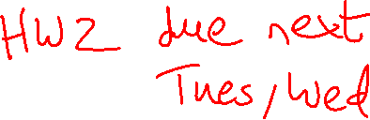
Lecture 5: More Instructions, Control Flow
Today’s topics:
  Load/store instructions
  Numbers, control instructions
  Procedure calls

Slide 2
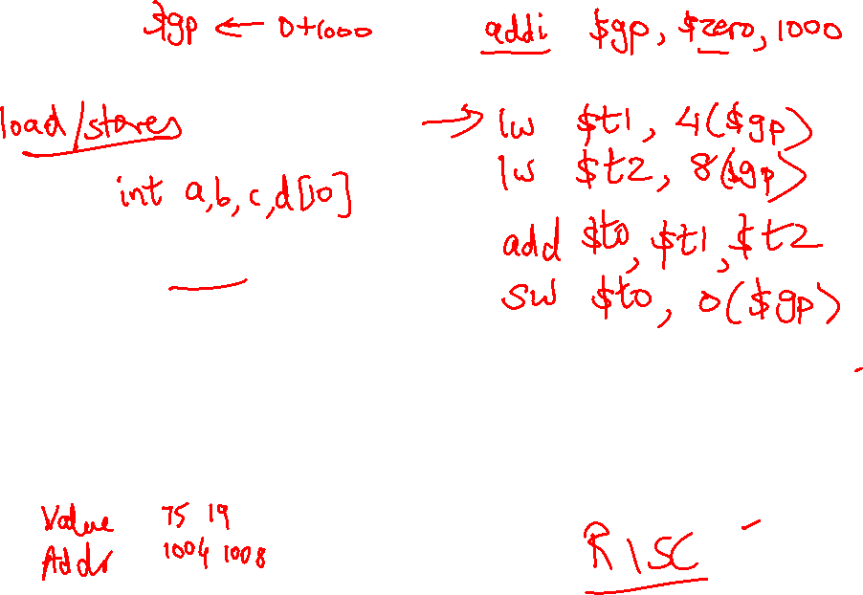
Recap
a = b + c;
int a, b, c, d[10]
…
Memory
Base address

Slide 3
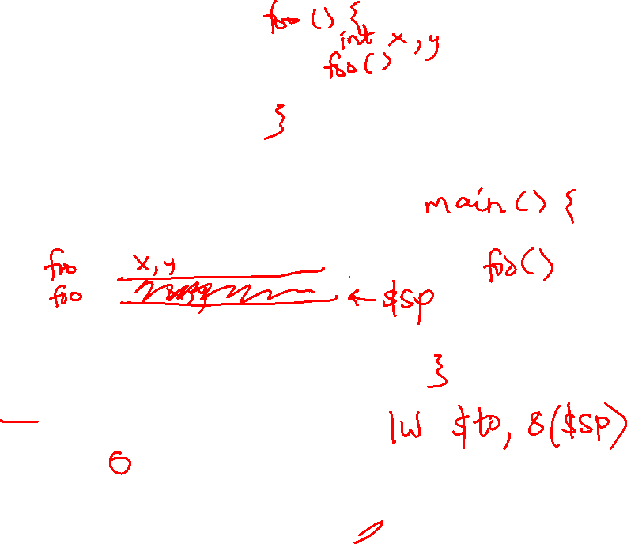
Memory Organization
$gp points to area in memory that saves global variables
Stack
Dynamic data (heap)
Static data (globals)
$gp
Text (instructions)

Slide 4
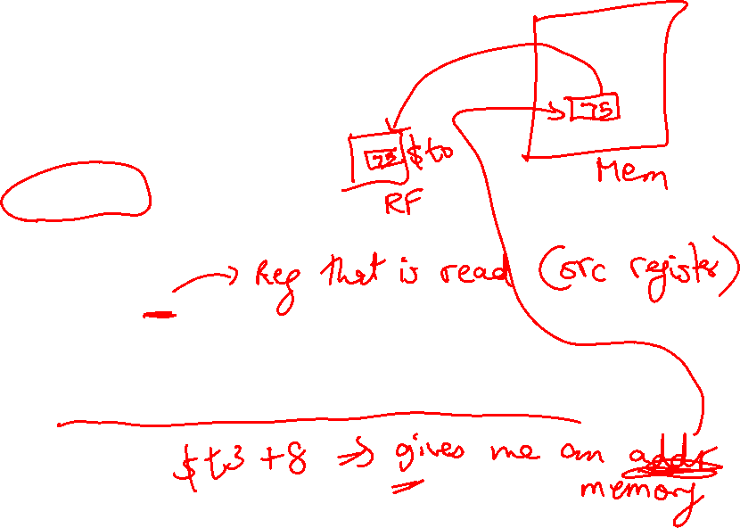
Memory Instruction Format
The format of a load instruction:
destination register
source address
lw $t0, 8($t3)
any register
a constant that is added to the register in parentheses

Slide 5
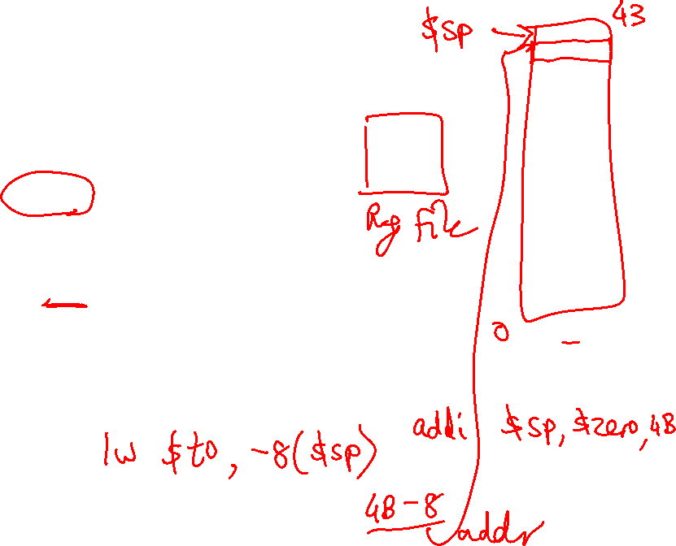
Memory Instruction Format
The format of a store instruction:
source register
destination address
sw $t0, 8($t3)
any register
a constant that is added to the register in parentheses

Slide 6
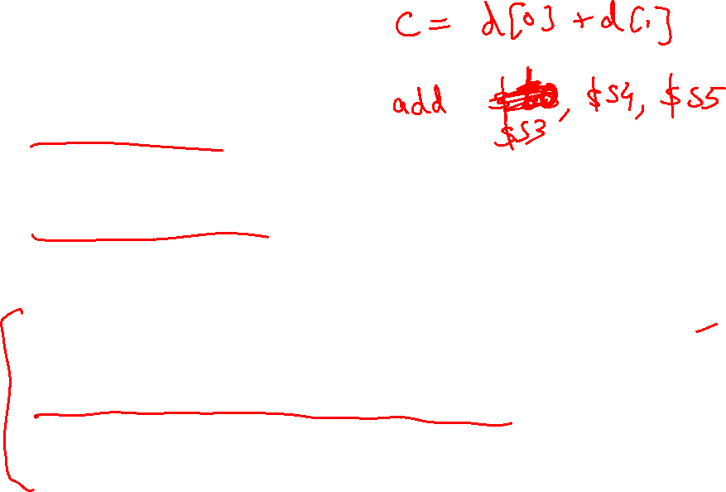
Example
int a, b, c, d[10];
addi $gp, $zero, 1000 # assume that data is stored at
# base address 1000; placed in $gp;
# $zero is a register that always
# equals zero
lw $s1, 0($gp) # brings value of a into register $s1
lw $s2, 4($gp) # brings value of b into register $s2
lw $s3, 8($gp) # brings value of c into register $s3
lw $s4, 12($gp) # brings value of d[0] into register $s4
lw $s5, 16($gp) # brings value of d[1] into register $s5

Slide 7
Example
Convert to assembly:
C code: d[3] = d[2] + a;

Slide 8
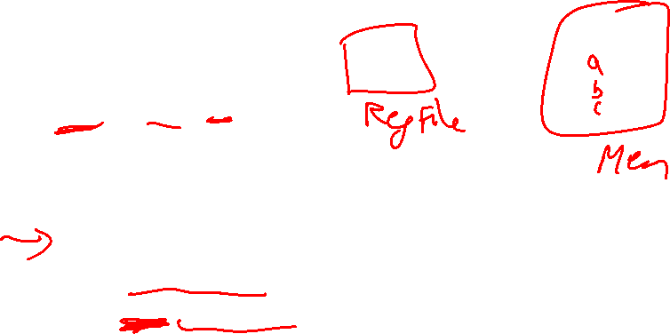
Example
Convert to assembly:
C code: d[3] = d[2] + a;
Assembly (same assumptions as previous example):
lw $s0, 0($gp) # a is brought into $s0
lw $s1, 20($gp) # d[2] is brought into $s1
add $s2, $s0, $s1 # the sum is in $s2
sw $s2, 24($gp) # $s2 is stored into d[3]
Assembly version of the code continues to expand!

Slide 9

Memory Organization
The space allocated on stack by a procedure is termed the activation
record (includes saved values and data local to the procedure) – frame
pointer points to the start of the record and stack pointer points to the
end – variable addresses are specified relative to $fp as $sp may
change during the execution of the procedure
$gp points to area in memory that saves global variables
Dynamically allocated storage (with malloc()) is placed on the heap
Stack
Dynamic data (heap)
Static data (globals)
Text (instructions)

Slide 10
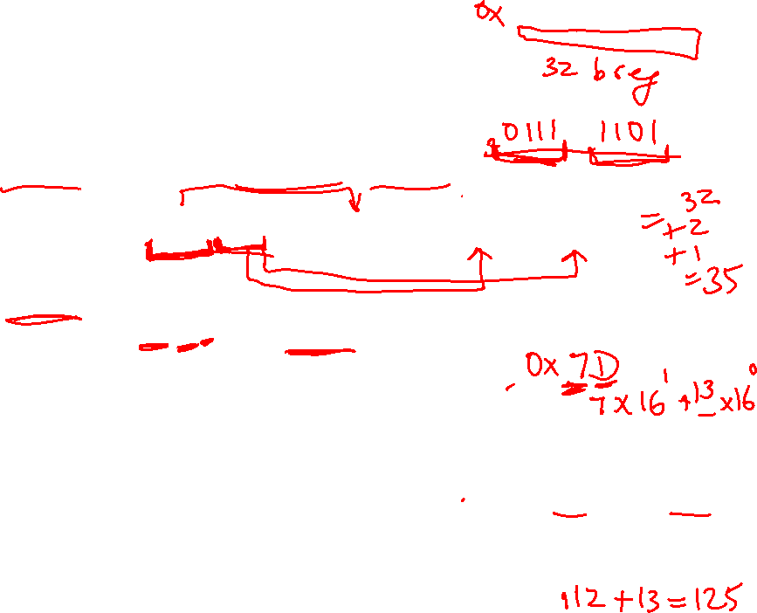
Recap – Numeric Representations
Decimal 35₁₀ = 3 x 10¹ + 5 x 10⁰
Binary 00100011₂ = 1 x 2⁵ + 1 x 2¹ + 1 x 2⁰
Hexadecimal (compact representation)
0x 23 or 23_{hex} = 2 x 16¹ + 3 x 16⁰
0-15 (decimal) → 0-9, a-f (hex)
Dec Binary Hex
0 0000 00
1 0001 01
2 0010 02
3 0011 03
Dec Binary Hex
4 0100 04
5 0101 05
6 0110 06
7 0111 07
Dec Binary Hex
8 1000 08
9 1001 09
10 1010 0a
11 1011 0b
Dec Binary Hex
12 1100 0c
13 1101 0d
14 1110 0e
15 1111 0f

Slide 11
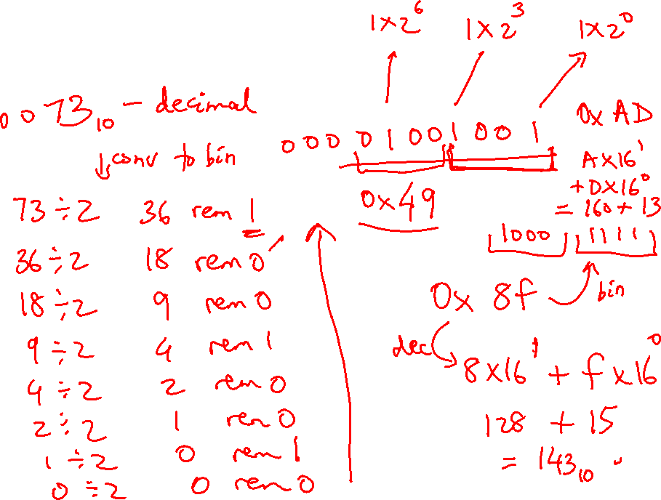
Examples of Conversion

Slide 12
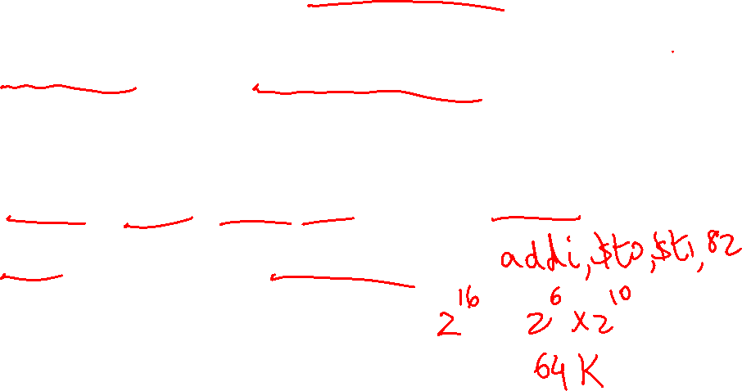
Instruction Formats
Instructions are represented as 32-bit numbers (one word),
broken into 6 fields
R-type instruction add $t0, $s1, $s2
000000 10001 10010 01000 00000 100000
6 bits 5 bits 5 bits 5 bits 5 bits 6 bits
op rs rt rd shamt funct
opcode source source dest shift amt function
I-type instruction lw $t0, 32($s3)
6 bits 5 bits 5 bits 16 bits
opcode rs rt constant
($s3) ($t0)

Slide 13
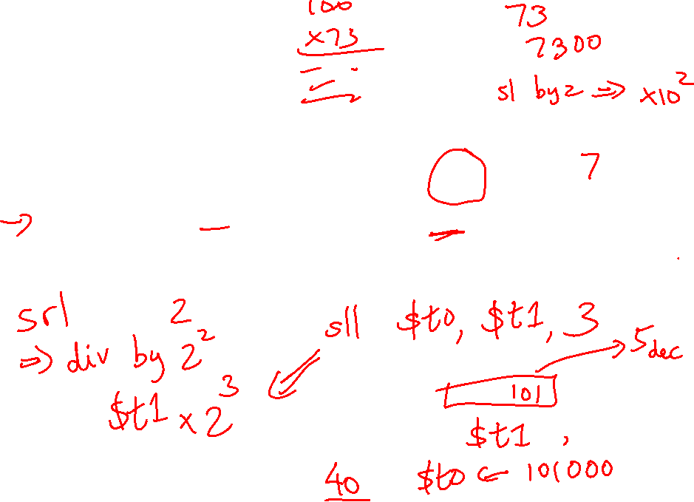
Logical Operations
Logical ops C operators Java operators MIPS instr
Shift Left << << sll
Shift Right >> >>> srl
Bit-by-bit AND & & and, andi
Bit-by-bit OR | | or, ori
Bit-by-bit NOT ~ ~ nor (with $zero)

Slide 14
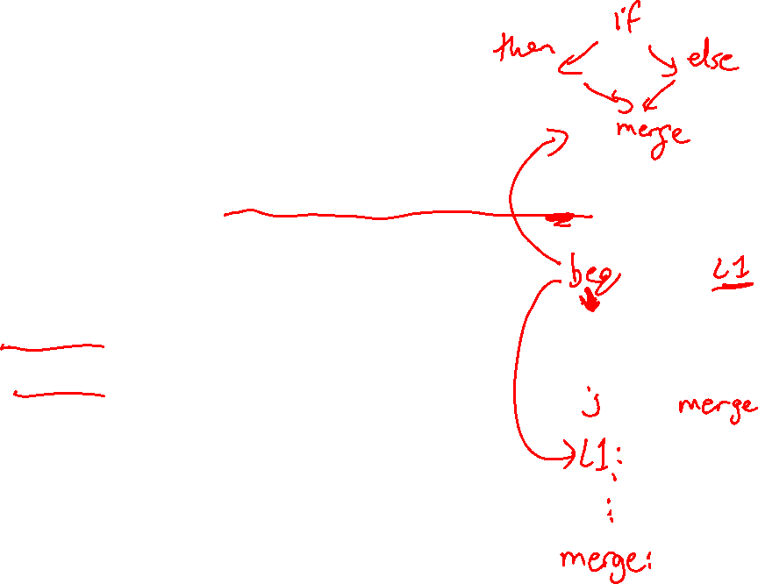
Control Instructions
Conditional branch: Jump to instruction L1 if register1
equals register2: beq register1, register2, L1
Similarly, bne and slt (set-on-less-than)
Unconditional branch:
j L1
jr $s0 (useful for big jumps and procedure returns)
Convert to assembly:
if (i == j)
f = g+h;
else
f = g-h;

Slide 15

Control Instructions
Conditional branch: Jump to instruction L1 if register1
equals register2: beq register1, register2, L1
Similarly, bne and slt (set-on-less-than)
Unconditional branch:
j L1
jr $s0 (useful for big jumps and procedure returns)
Convert to assembly:
if (i == j) bne $s3, $s4, Else
f = g+h; add $s0, $s1, $s2
else j End
f = g-h; Else: sub $s0, $s1, $s2
End:

Slide 16
Example
Convert to assembly:
while (save[i] == k)
i += 1;
Values of i and k are in $s3 and $s5 and base of array save[] is in $s6

Slide 17
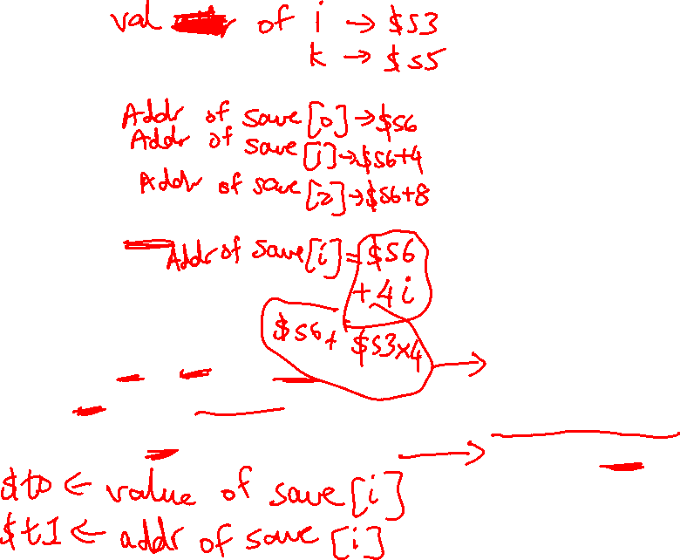
Example
Loop: sll $t1, $s3, 2
add $t1, $t1, $s6
lw $t0, 0($t1)
bne $t0, $s5, Exit
addi $s3, $s3, 1
j Loop
Exit:
Convert to assembly:
while (save[i] == k)
i += 1;
Values of i and k are in $s3
and $s5 and base of array
save[] is in $s6
sll $t1, $s3, 2
add $t1, $t1, $s6
Loop: lw $t0, 0($t1)
bne $t0, $s5, Exit
addi $s3, $s3, 1
addi $t1, $t1, 4
j Loop
Exit:

Slide 18
Registers
The 32 MIPS registers are partitioned as follows:
  Register 0 : $zero always stores the constant 0
  Regs 2-3 : $v0, $v1 return values of a procedure
  Regs 4-7 : $a0-$a3 input arguments to a procedure
  Regs 8-15 : $t0-$t7 temporaries
  Regs 16-23: $s0-$s7 variables
  Regs 24-25: $t8-$t9 more temporaries
  Reg 28 : $gp global pointer
  Reg 29 : $sp stack pointer
  Reg 30 : $fp frame pointer
  Reg 31 : $ra return address

Slide 19
Procedures
Local variables, AR, $fp, $sp
Scratchpad and saves/restores
Arguments and returns
jal and $ra

