Slide 1
Lecture 2: Performance
Today’s topics:
Technology wrap-up
Performance trends and equations
Reminders: YouTube videos, Canvas, Piazza, class webpage:
https://www.cs.utah.edu/~rajeev/cs3810/

Slide 2
Summary
Three roadblocks: power, ideas, technology scaling
Fixed power budget because of cooling constraints; implies that
frequency can’t be increased; discourages complex ideas
End of voltage (Dennard) scaling in early 2010s; the end of
Moore’s Law also imminent
Has led to dark silicon and dim silicon (occasional turbo)
The rise of accelerators

Slide 3
Important Trends
Historical contributions to performance:
Better processes (faster devices) ~20%
Better circuits/pipelines ~15%
Better organization/architecture ~15%
In the future, bullet-2 will help little and bullet-1 will eventually
disappear!
Pentium P-Pro P-II P-III P-4 Itanium Montecito
Year 1993 95 97 99 2000 2002 2005
Transistors 3.1M 5.5M 7.5M 9.5M 42M 300M 1720M
Clock Speed 60M 200M 300M 500M 1500M 800M 1800M
Moore’s Law in action
At this point, adding transistors
to a core yields little benefit

Slide 4
What Does This Mean to a Programmer?
Today, one can expect only a 20% annual improvement;
the improvement is even lower if the program is not
multi-threaded
A program needs many threads
The threads need efficient synchronization and
communication
Data placement in the memory hierarchy is important
Accelerators should be used when possible

Slide 5
Challenges for Hardware Designers
Find efficient ways to
improve single-thread performance and energy
improve data sharing
boost programmer productivity
manage the memory system
build accelerators for important kernels
provide security

Slide 6
The HW/SW Interface
Application software
a[i] = b[i] + c;
Compiler
lw $15, 0($2)
add $16, $15, $14
add $17, $15, $13
lw $18, 0($12)
lw $19, 0($17)
add $20, $18, $19
sw $20, 0($16)
Systems software
(OS, compiler)
Assembler
Hardware
000000101100000
110100000100010
…

Slide 7
Computer Components
Input/output devices
Secondary storage: non-volatile, slower, cheaper (HDD/SSD)
Primary storage: volatile, faster, costlier (RAM)
CPU/processor (datapath and control)

Slide 8
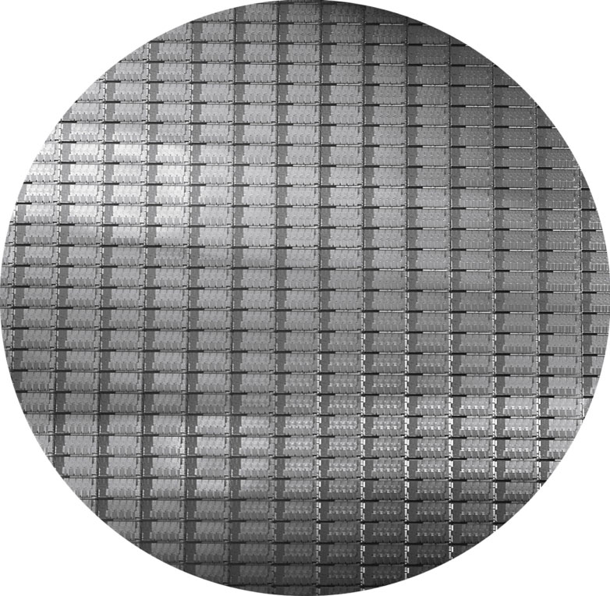
Wafers and Dies
Source: H&P Textbook

Slide 9
Manufacturing Process
Silicon wafers undergo many processing steps so that different
parts of the wafer behave as insulators, conductors, and
transistors (switches)
Multiple metal layers on the silicon enable connections
between transistors
The wafer is chopped into many dies – the size of the die
determines yield and cost

Slide 10
Processor Technology Trends
Shrinking of transistor sizes: 250nm (1997) →
130nm (2002) → 70nm (2008) → 35nm (2014) →
2019 transition to 10nm, now transitioning to 5nm
Transistor density increases by 35% per year and die size
increases by 10-20% per year… functionality improvements!
Transistor speed improves linearly with size (complex
equation involving voltages, resistances, capacitances)
Wire delays do not scale down at the same rate as
transistor delays

Slide 11
Memory and I/O Technology Trends
DRAM density increases by 40-60% per year, latency has
reduced by 33% in 10 years (the memory wall!), bandwidth
improves twice as fast as latency decreases
Disk density improves by 100% every year, latency
improvement similar to DRAM
Networks: primary focus on bandwidth; 10Mb → 100Mb
in 10 years; 100Mb → 1Gb in 5 years

Slide 12
Performance Metrics
Possible measures:
response time – time elapsed between start and end
of a program
throughput – amount of work done in a fixed time
The two measures are usually linked
A faster processor will improve both
More processors will likely only improve throughput
Some policies will improve throughput and worsen
response time (or vice versa)
What influences performance?

Slide 13
Execution Time
Consider a system X executing a fixed workload W
Performance_{X} = 1 / Execution time_{X}
Execution time = response time = wall clock time
- Note that this includes time to execute the workload
as well as time spent by the operating system
co-ordinating various events
The UNIX “time” command breaks up the wall clock time
as user and system time

Slide 14
Speedup and Improvement
System X executes a program in 10 seconds, system Y
executes the same program in 15 seconds
System X is 1.5 times faster than system Y
The speedup of system X over system Y is 1.5 (the ratio)
= perf X / perf Y = exectime Y / exectime X
The performance improvement of X over Y is
1.5 -1 = 0.5 = 50% = (perf X – perf Y) / perf Y = speedup - 1
The execution time reduction for system X, compared to
Y is (15-10) / 15 = 33%
The execution time increase for Y, compared to X is
(15-10) / 10 = 50%

Slide 15
A Primer on Clocks and Cycles

Slide 16
Performance Equation - I
CPU execution time = CPU clock cycles x Clock cycle time
Clock cycle time = 1 / Clock speed
If a processor has a frequency of 3 GHz, the clock ticks
3 billion times in a second – as we’ll soon see, with each
clock tick, one or more/less instructions may complete
If a program runs for 10 seconds on a 3 GHz processor,
how many clock cycles did it run for?
If a program runs for 2 billion clock cycles on a 1.5 GHz
processor, what is the execution time in seconds?

Slide 17
Performance Equation - II
CPU clock cycles = number of instrs x avg clock cycles
per instruction (CPI)
Substituting in previous equation,
Execution time = clock cycle time x number of instrs x avg CPI
If a 2 GHz processor graduates an instruction every third cycle,
how many instructions are there in a program that runs for
10 seconds?

