Slide 1
Lecture 27: Pot-Pourri
Today’s topics:
  Synchronization
  Consistency Models
  Shared memory vs message-passing
  Simultaneous multi-threading (SMT)
  GPUs
  Accelerators
  Disks and reliability

Slide 2

Cache Coherence Protocols
Directory-based: A single location (directory) keeps track
of the sharing status of a block of memory
Snooping: Every cache block is accompanied by the sharing
status of that block – all cache controllers monitor the
shared bus so they can update the sharing status of the
block, if necessary
Write-invalidate: a processor gains exclusive access of
a block before writing by invalidating all other copies
Write-update: when a processor writes, it updates other
shared copies of that block

Slide 3
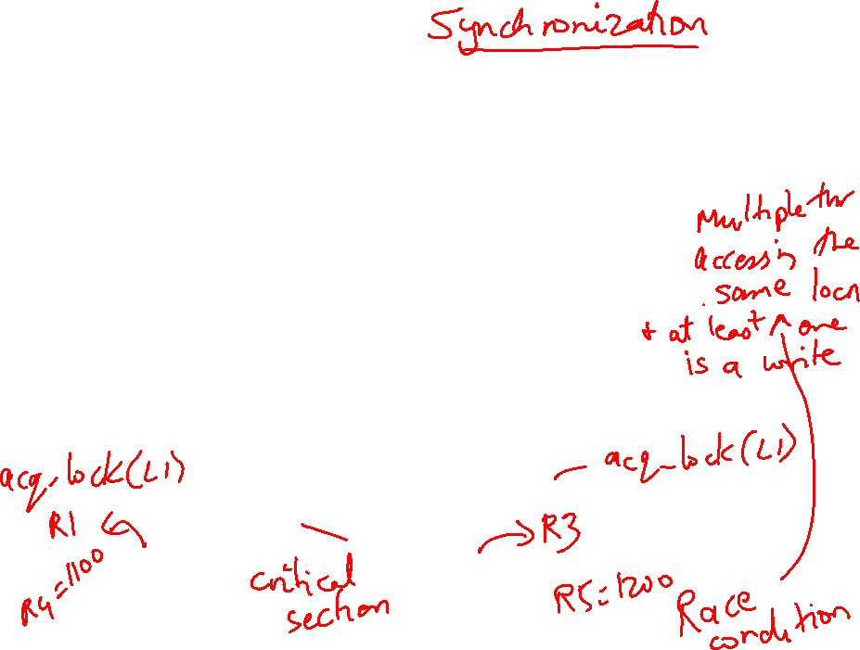
Constructing Locks
Applications have phases (consisting of many instructions)
that must be executed atomically, without other parallel
processes modifying the data
A lock surrounding the data/code ensures that only one
program can be in a critical section at a time
The hardware must provide some basic primitives that
allow us to construct locks with different properties
Bank balance
$1000
Parallel (unlocked) banking transactions
Rd $1000
Add $100
Wr $1100
Rd $1000
Add $200
Wr $1200

Slide 4
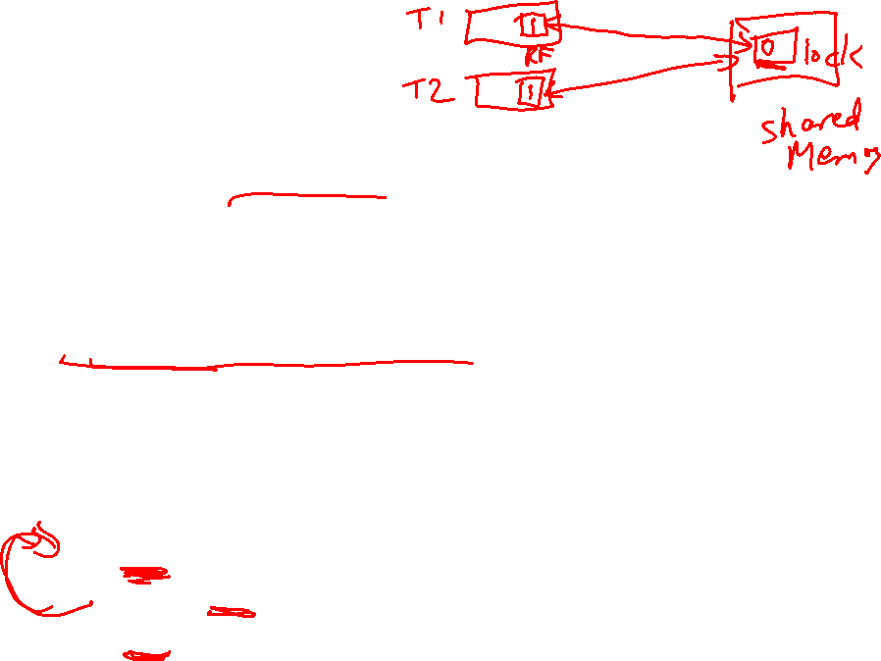
Synchronization
The simplest hardware primitive that greatly facilitates
synchronization implementations (locks, barriers, etc.)
is an atomic read-modify-write
Atomic exchange: swap contents of register and memory
Special case of atomic exchange: test & set: transfer
memory location into register and write 1 into memory
(if memory has 0, lock is free)
lock: t&s register, location
bnz register, lock
CS
st location, #0
When multiple parallel threads
execute this code, only one
will be able to enter CS

Slide 5

Coherence Vs. Consistency
Coherence guarantees (i) write propagation
(a write will eventually be seen by other processors), and
(ii) write serialization (all processors see writes to the
same location in the same order)
The consistency model defines the ordering of writes and
reads to different memory locations – the hardware
guarantees a certain consistency model and the
programmer attempts to write correct programs with
those assumptions

Slide 6
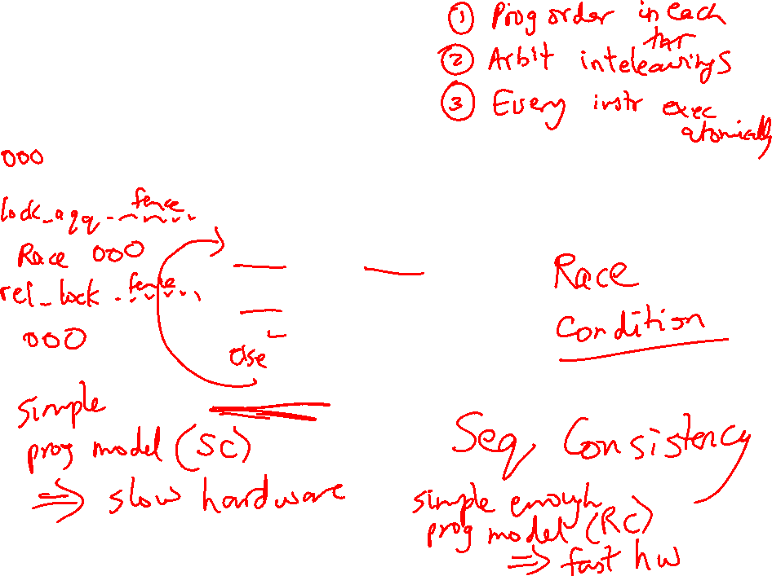
Consistency Example
Consider a multiprocessor with bus-based snooping cache
coherence
Initially A = B = 0
P1 P2
A ← 1 B ← 1
… …
if (B == 0) if (A == 0)
Crit.Section Crit.Section

Slide 7
Consistency Example
Consider a multiprocessor with bus-based snooping cache
coherence
Initially A = B = 0
P1 P2
A ← 1 B ← 1
… …
if (B == 0) if (A == 0)
Crit.Section Crit.Section
The programmer expected the
above code to implement a
lock – because of ooo, both processors
can enter the critical section
The consistency model lets the programmer know what assumptions
they can make about the hardware’s reordering capabilities

Slide 8
Sequential Consistency
A multiprocessor is sequentially consistent if the result
of the execution is achieveable by maintaining program
order within a processor and interleaving accesses by
different processors in an arbitrary fashion
The multiprocessor in the previous example is not
sequentially consistent
Can implement sequential consistency by requiring the
following: program order, write serialization, everyone has
seen an update before a value is read – very intuitive for
the programmer, but extremely slow

Slide 9
Relaxed Consistency
Sequential consistency is very slow
The programming complications/surprises are caused when the
program has race conditions (two threads dealing with same
data and at least one of the threads is modifying the data)
If programmers are disciplined and enforce mutual exclusion
when dealing with shared data, we can allow some re-orderings
and higher performance
This is effective at balancing performance & programming effort

Slide 10
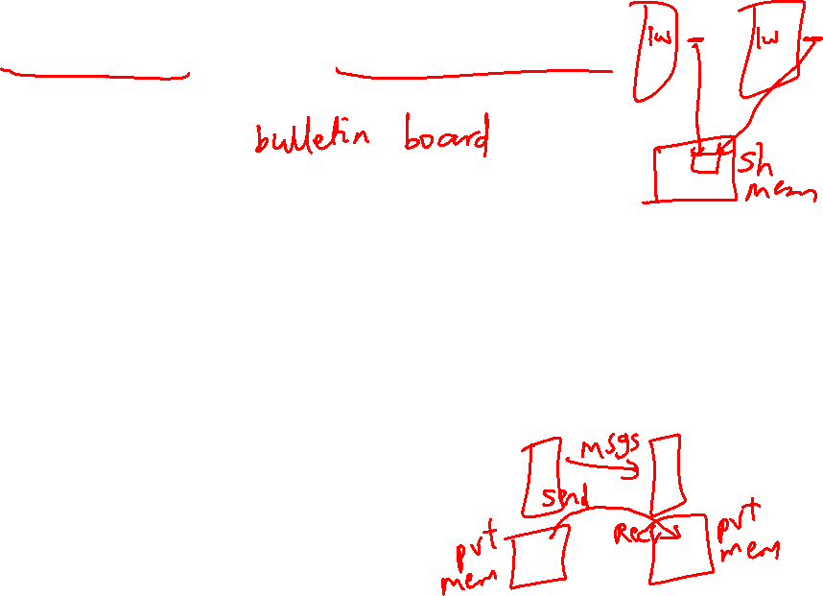
Shared-Memory Vs. Message-Passing
Shared-memory:
Well-understood programming model
Communication is implicit and hardware handles protection
Hardware-controlled caching
Message-passing:
No cache coherence → simpler hardware
Explicit communication → easier for the programmer to
restructure code
Software-controlled caching
Sender can initiate data transfer

Slide 11
Ocean Kernel
.
Procedure Solve(A)
begin
diff = done = 0;
while (!done) do
diff = 0;
for i ← 1 to n do
for j ← 1 to n do
temp = A[i,j];
A[i,j] ← 0.2 * (A[i,j] + neighbors);
diff += abs(A[i,j] – temp);
end for
end for
if (diff < TOL) then done = 1;
end while
end procedure
Row 1
.
Row k
Row 2k
Row 3k
…

Slide 12
Shared Address Space Model
procedure Solve(A)
int i, j, pid, done=0;
float temp, mydiff=0;
int mymin = 1 + (pid * n/procs);
int mymax = mymin + n/nprocs -1;
while (!done) do
mydiff = diff = 0;
BARRIER(bar1,nprocs);
for i ← mymin to mymax
for j ← 1 to n do
…
endfor
endfor
LOCK(diff_lock);
diff += mydiff;
UNLOCK(diff_lock);
BARRIER (bar1, nprocs);
if (diff < TOL) then done = 1;
BARRIER (bar1, nprocs);
endwhile
int n, nprocs;
float **A, diff;
LOCKDEC(diff_lock);
BARDEC(bar1);
main()
begin
read(n); read(nprocs);
A ← G_MALLOC();
initialize (A);
CREATE (nprocs,Solve,A);
WAIT_FOR_END (nprocs);
end main

Slide 13

Message Passing Model
main()
read(n); read(nprocs);
CREATE (nprocs-1, Solve);
Solve();
WAIT_FOR_END (nprocs-1);
procedure Solve()
int i, j, pid, nn = n/nprocs, done=0;
float temp, tempdiff, mydiff = 0;
myA ← malloc(…)
initialize(myA);
while (!done) do
mydiff = 0;
if (pid != 0)
SEND(&myA[1,0], n, pid-1, ROW);
if (pid != nprocs-1)
SEND(&myA[nn,0], n, pid+1, ROW);
if (pid != 0)
RECEIVE(&myA[0,0], n, pid-1, ROW);
if (pid != nprocs-1)
RECEIVE(&myA[nn+1,0], n, pid+1, ROW);
for i ← 1 to nn do
for j ← 1 to n do
…
endfor
endfor
if (pid != 0)
SEND(mydiff, 1, 0, DIFF);
RECEIVE(done, 1, 0, DONE);
else
for i ← 1 to nprocs-1 do
RECEIVE(tempdiff, 1, *, DIFF);
mydiff += tempdiff;
endfor
if (mydiff < TOL) done = 1;
for i ← 1 to nprocs-1 do
SEND(done, 1, I, DONE);
endfor
endif
endwhile

Slide 14

Multithreading Within a Processor
Until now, we have executed multiple threads of an
application on different processors – can multiple
threads execute concurrently on the same processor?
Why is this desireable?
  inexpensive – one CPU, no external interconnects
  no remote or coherence misses (more capacity misses)
Why does this make sense?
  most processors can’t find enough work – peak IPC
  is 6, average IPC is 1.5!
  threads can share resources → we can increase
  threads without a corresponding linear increase in area

Slide 15

How are Resources Shared?
Each box represents an issue slot for a functional unit. Peak thruput is 4 IPC.
Thread 1
Thread 2
Thread 3
Cycles
Thread 4
Idle
Superscalar
Fine-Grained
Multithreading
Simultaneous
Multithreading
Superscalar processor has high under-utilization – not enough work every
cycle, especially when there is a cache miss
Fine-grained multithreading can only issue instructions from a single thread
in a cycle – can not find max work every cycle, but cache misses can be tolerated
Simultaneous multithreading can issue instructions from any thread every
cycle – has the highest probability of finding work for every issue slot

Slide 16
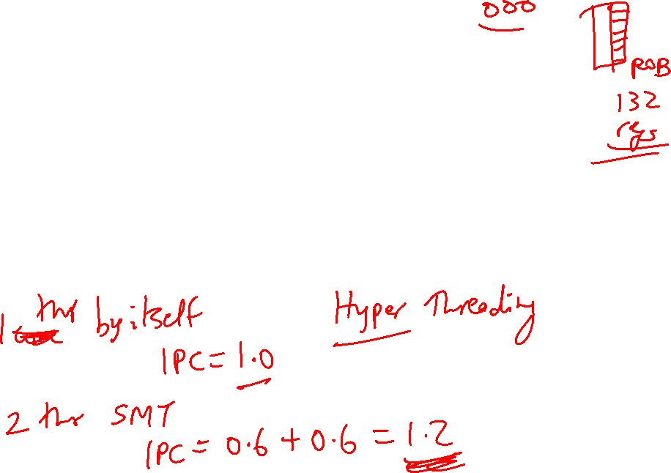
Performance Implications of SMT
Single thread performance is likely to go down (caches,
branch predictors, registers, etc. are shared) – this effect
can be mitigated by trying to prioritize one thread
With eight threads in a processor with many resources,
SMT yields throughput improvements of roughly 2-4

Slide 17
SIMD Processors
Single instruction, multiple data
Such processors offer energy efficiency because a single
instruction fetch can trigger many data operations
Such data parallelism may be useful for many
image/sound and numerical applications

Slide 18

GPUs
Initially developed as graphics accelerators; now viewed
as one of the densest compute engines available
Many on-going efforts to run non-graphics workloads on
GPUs, i.e., use them as general-purpose GPUs or GPGPUs
C/C++ based programming platforms enable wider use
of GPGPUs – CUDA from NVidia and OpenCL from an
industry consortium
A heterogeneous system has a regular host CPU and a
GPU that handles (say) CUDA code (they can both be
on the same chip)

Slide 19
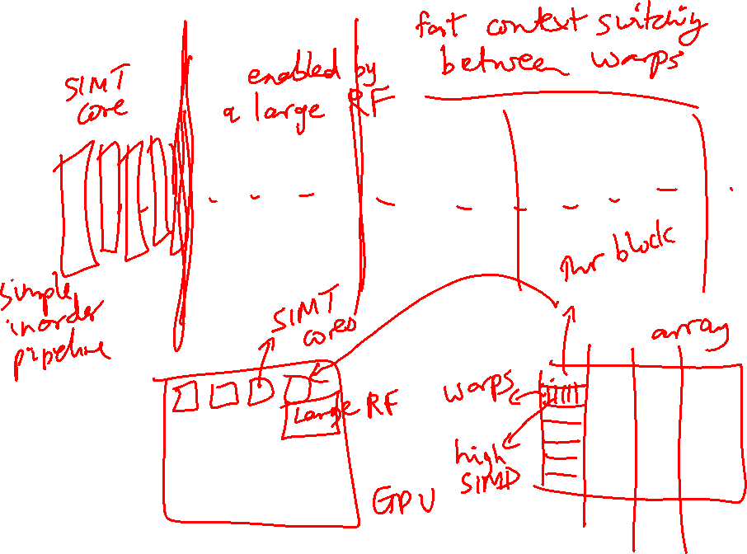
GPUs

Slide 20
The GPU Architecture
SIMT – single instruction, multiple thread; a GPU has
many SIMT cores
A large data-parallel operation is partitioned into many
thread blocks (one per SIMT core); a thread block is
partitioned into many warps (one warp running at a
time in the SIMT core); a warp is partitioned across many
in-order pipelines (each is called a SIMD lane)
A SIMT core can have multiple active warps at a time,
i.e., the SIMT core stores the registers for each warp;
warps can be context-switched at low cost; a warp
scheduler keeps track of runnable warps and schedules
a new warp if the currently running warp stalls

Slide 21
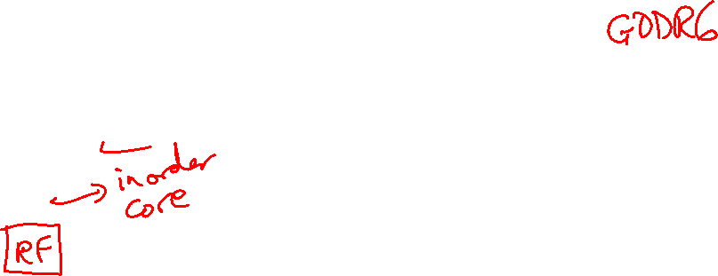
The GPU Architecture

Slide 22

Architecture Features
Simple in-order pipelines that rely on thread-level parallelism
to hide long latencies
Many registers (~1K) per in-order pipeline (lane) to support
many active warps
When a branch is encountered, some of the lanes proceed
along the “then” case depending on their data values;
later, the other lanes evaluate the “else” case; a branch
cuts the data-level parallelism by half (branch divergence)
When a load/store is encountered, the requests from all
lanes are coalesced into a few 128B cache line requests;
each request may return at a different time (mem divergence)

Slide 23
GPU Memory Hierarchy
Each SIMT core has a private L1 cache (shared by the
warps on that core)
A large L2 is shared by all SIMT cores; each L2 bank
services a subset of all addresses
Each L2 partition is connected to its own memory
controller and memory channel
The GDDR5 memory system runs at higher frequencies,
and uses chips with more banks, wide IO, and better
power delivery networks
A portion of GDDR5 memory is private to the GPU and the
rest is accessible to the host CPU (the GPU performs copies)

Slide 24
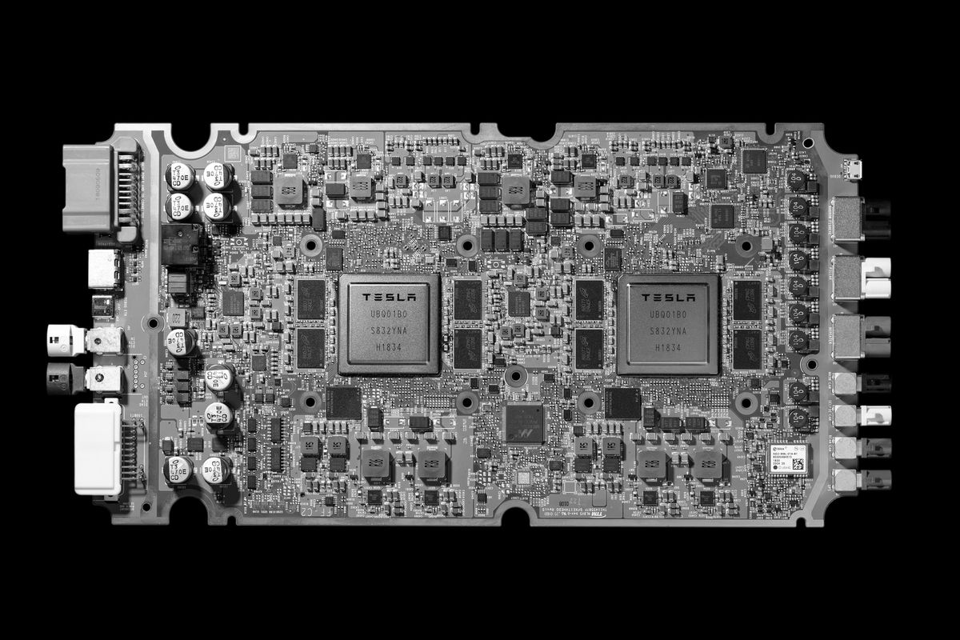
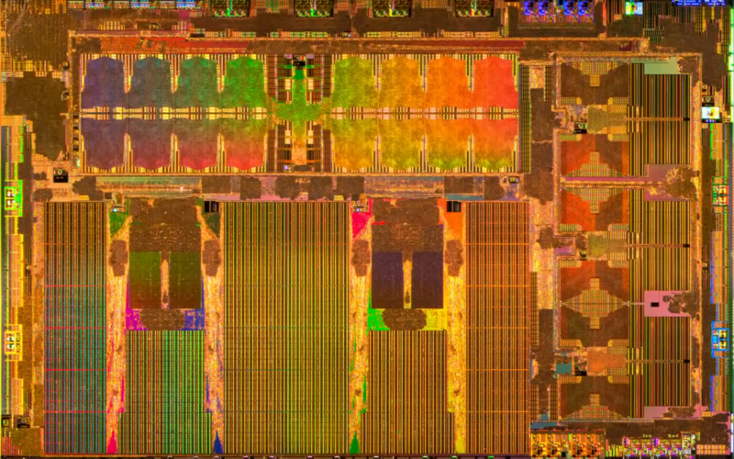
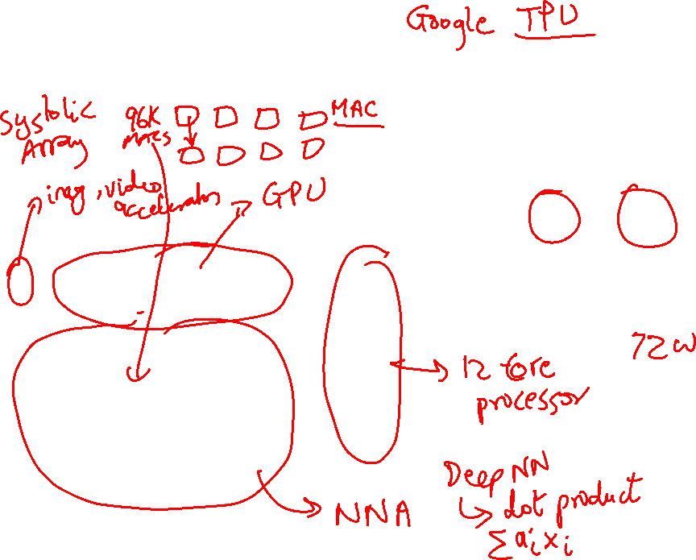
Accelerators - Tesla FSD
Image Source: Tesla

Slide 25

Role of Disks
Activities external to the CPU/memory are typically
orders of magnitude slower
Example: while CPU performance has improved by 50%
per year, disk latencies have improved by 10% every year
Typical strategy on I/O: switch contexts and work on
something else
Other metrics, such as bandwidth, reliability, availability,
and capacity, often receive more attention than performance

Slide 26
Magnetic Disks
A magnetic disk consists of 1-12 platters (metal or glass
disk covered with magnetic recording material on both
sides), with diameters between 1-3.5 inches
Each platter is comprised of concentric tracks (5-30K) and
each track is divided into sectors (100 – 500 per track,
each about 512 bytes)
A movable arm holds the read/write heads for each disk
surface and moves them all in tandem – a cylinder of data
is accessible at a time

Slide 27

Disk Latency
To read/write data, the arm has to be placed on the
correct track – this seek time usually takes 5 to 12 ms
on average – can take less if there is spatial locality
Rotational latency is the time taken to rotate the correct
sector under the head – average is typically more than
2 ms (15,000 RPM)
Transfer time is the time taken to transfer a block of bits
out of the disk and is typically 3 – 65 MB/second
A disk controller maintains a disk cache (spatial locality
can be exploited) and sets up the transfer on the bus
(controller overhead)

Slide 28

Defining Reliability and Availability
A system toggles between
  Service accomplishment: service matches specifications
  Service interruption: service deviates from specs
The toggle is caused by failures and restorations
Reliability measures continuous service accomplishment
and is usually expressed as mean time to failure (MTTF)
Availability measures fraction of time that service matches
specifications, expressed as MTTF / (MTTF + MTTR)

Slide 29

RAID
Reliability and availability are important metrics for disks
RAID: redundant array of inexpensive (independent) disks
Redundancy can deal with one or more failures
Each sector of a disk records check information that allows
it to determine if the disk has an error or not (in other words,
redundancy already exists within a disk)
When the disk read flags an error, we turn elsewhere for
correct data

Slide 30

RAID 0 and RAID 1
RAID 0 has no additional redundancy (misnomer) – it
uses an array of disks and stripes (interleaves) data
across the arrays to improve parallelism and throughput
RAID 1 mirrors or shadows every disk – every write
happens to two disks
Reads to the mirror may happen only when the primary
disk fails – or, you may try to read both together and the
quicker response is accepted
Expensive solution: high reliability at twice the cost

Slide 31
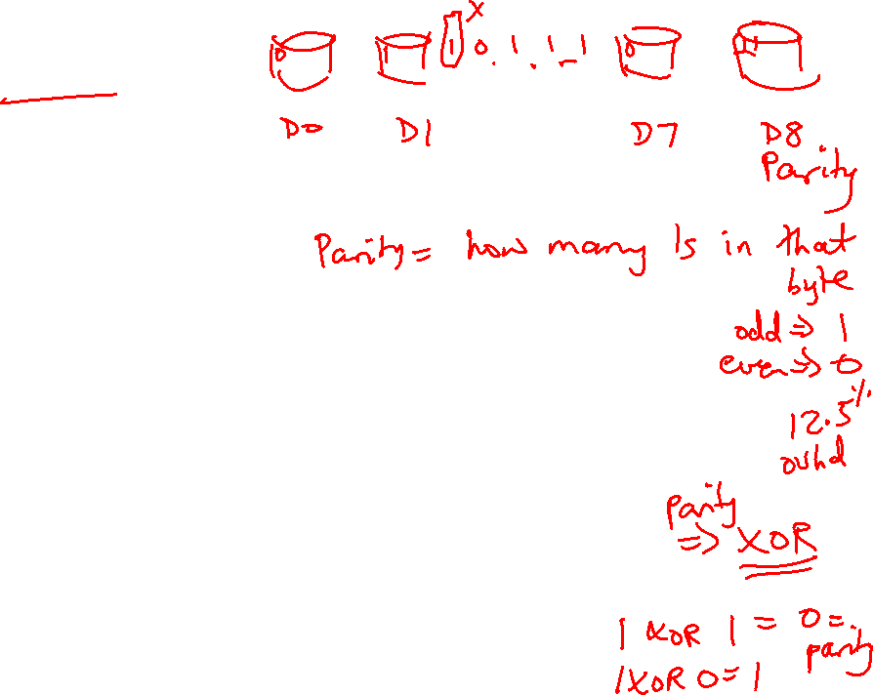
RAID 3
Data is bit-interleaved across several disks and a separate
disk maintains parity information for a set of bits
For example: with 8 disks, bit 0 is in disk-0, bit 1 is in disk-1,
…, bit 7 is in disk-7; disk-8 maintains parity for all 8 bits
For any read, 8 disks must be accessed (as we usually
read more than a byte at a time) and for any write, 9 disks
must be accessed as parity has to be re-calculated
High throughput for a single request, low cost for
redundancy (overhead: 12.5%), low task-level parallelism

Slide 32

RAID 4 and RAID 5
Data is block interleaved – this allows us to get all our
data from a single disk on a read – in case of a disk error,
read all 9 disks
Block interleaving reduces thruput for a single request (as
only a single disk drive is servicing the request), but
improves task-level parallelism as other disk drives are
free to service other requests
On a write, we access the disk that stores the data and the
parity disk – parity information can be updated simply by
checking if the new data differs from the old data

Slide 33
RAID 5
If we have a single disk for parity, multiple writes can not
happen in parallel (as all writes must update parity info)
RAID 5 distributes the parity block to allow simultaneous
writes

Slide 34
RAID Summary
RAID 1-5 can tolerate a single fault – mirroring (RAID 1)
has a 100% overhead, while parity (RAID 3, 4, 5) has
modest overhead
Can tolerate multiple faults by having multiple check
functions – each additional check can cost an additional
disk (RAID 6)
RAID 6 and RAID 2 (memory-style ECC) are not
commercially employed

Slide 35
Memory Protection
Most common approach: SECDED – single error correction,
double error detection – an 8-bit code for every 64-bit word
-- can correct a single error in any 64-bit word – also used
in caches
Extends a 64-bit memory channel to a 72-bit channel and
requires ECC DIMMs (e.g., a word is fetched from 9 chips
instead of 8)
Chipkill is a form of error protection where failures in an
entire memory chip can be corrected

Slide 36
Computation Errors – TMR
Errors in ALUs and cores are typically handled by
performing the computation n times and voting for the
correct answer
n=3 is common and is referred to as triple modular
redundancy

