Slide 1
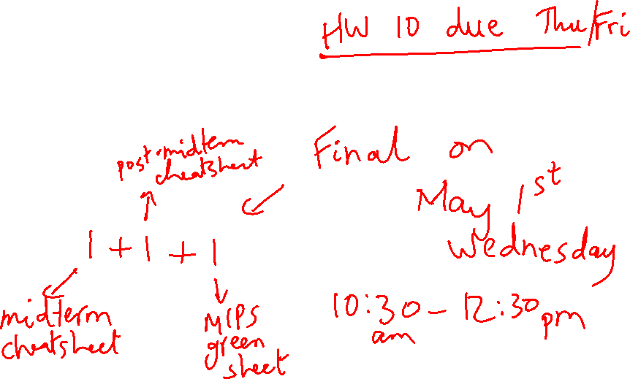
Lecture 26: Multiprocessors
Today’s topics:
  VM wrap-up
  Snooping-based coherence
  Synchronization
  Consistency

Slide 2
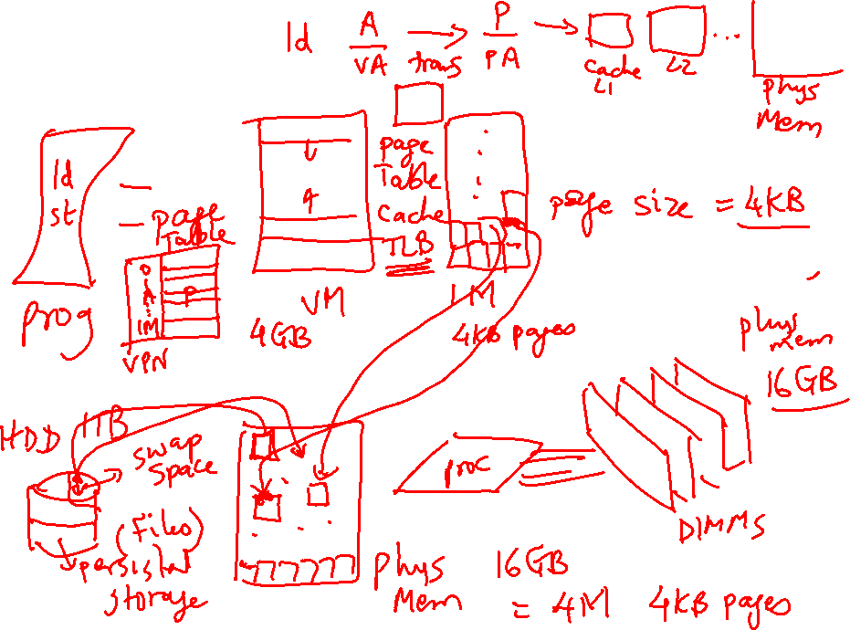
VM Overview

Slide 3
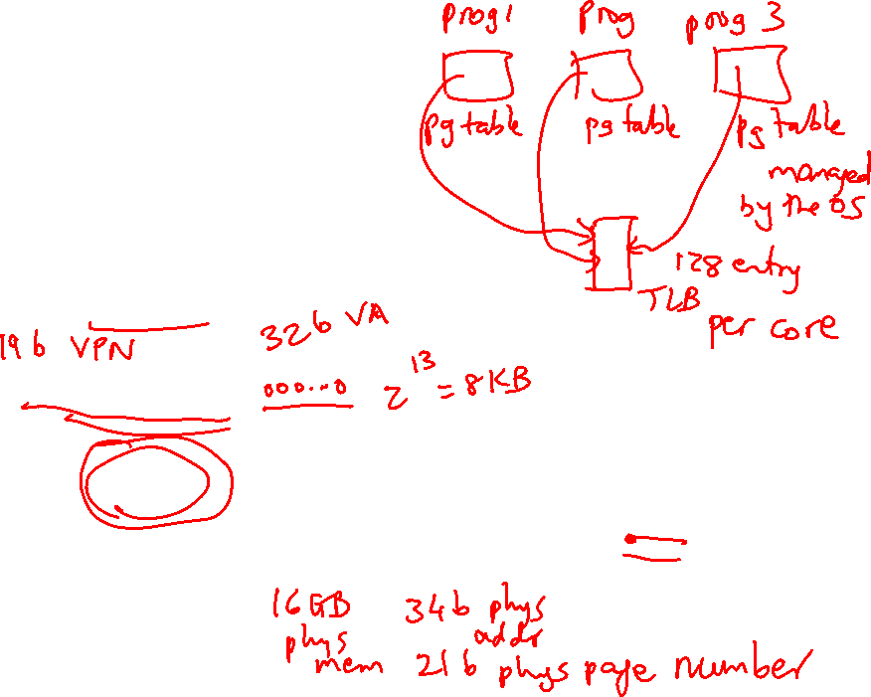
Address Translation
The virtual and physical memory are broken up into pages
8KB page size
Virtual address
13
virtual page
number
page offset
Translated to physical
page number
Physical address

Slide 4
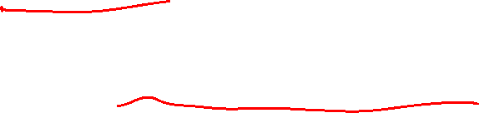
Memory Hierarchy Properties
A virtual memory page can be placed anywhere in physical
memory (fully-associative)
Replacement is usually LRU (since the miss penalty is
huge, we can invest some effort to minimize misses)
A page table (indexed by virtual page number) is used for
translating virtual to physical page number
The page table is itself in memory

Slide 5
TLB
Since the number of pages is very high, the page table
capacity is too large to fit on chip
A translation lookaside buffer (TLB) caches the virtual
to physical page number translation for recent accesses
A TLB miss requires us to access the page table, which
may not even be found in the cache – two expensive
memory look-ups to access one word of data!
A large page size can increase the coverage of the TLB
and reduce the capacity of the page table, but also
increases memory waste

Slide 6
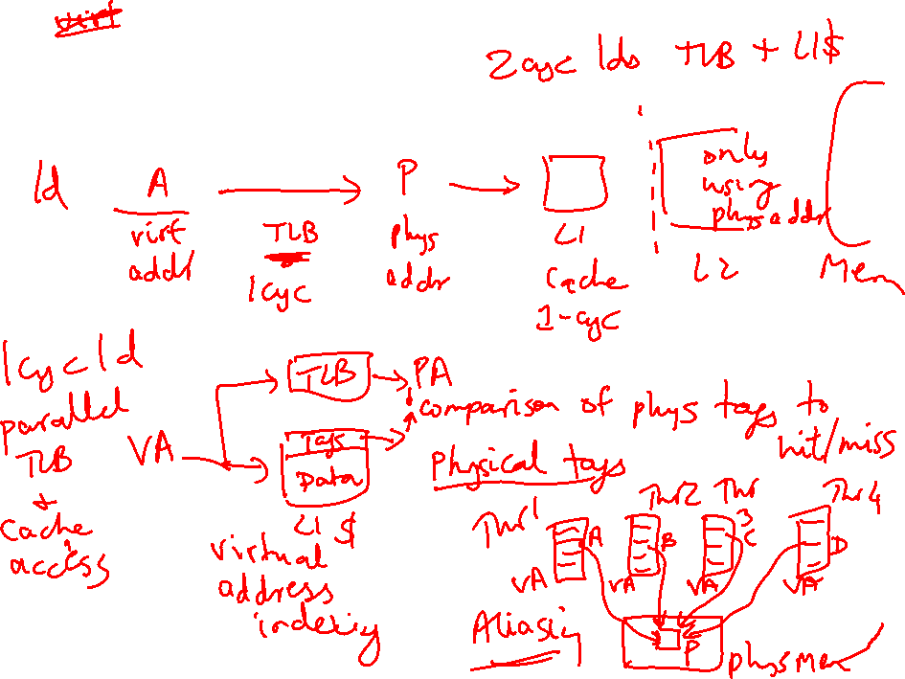
TLB and Cache Access

Slide 7
TLB and Cache
Is the cache indexed with virtual or physical address?
  To index with a physical address, we will have to first
  look up the TLB, then the cache → longer access time
  Multiple virtual addresses can map to the same
  physical address – must ensure that these
  different virtual addresses will map to the same
  location in cache – else, there will be two different
  copies of the same physical memory word
Does the tag array store virtual or physical addresses?
  Since multiple virtual addresses can map to the same
  physical address, a virtual tag comparison can flag a
  miss even if the correct physical memory word is present

Slide 8
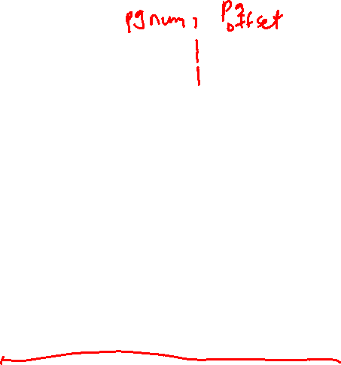
Cache and TLB Pipeline
Virtual address
Offset
Virtual page number
Virtual
index
TLB
Tag array
Data array
Physical page number
Physical tag
Physical tag comparion
Virtually Indexed; Physically Tagged Cache

Slide 9
Bad Events
Consider the longest latency possible for a load instruction:
  TLB miss: must look up page table to find translation for v.page P
  Calculate the virtual memory address for the page table entry
  that has the translation for page P – let’s say, this is v.page Q
  TLB miss for v.page Q: will require navigation of a hierarchical
  page table (let’s ignore this case for now and assume we have
  succeeded in finding the physical memory location (R) for page Q)
  Access memory location R (find this either in L1, L2, or memory)
  We now have the translation for v.page P – put this into the TLB
  We now have a TLB hit and know the physical page number – this
  allows us to do tag comparison and check the L1 cache for a hit
  If there’s a miss in L1, check L2 – if that misses, check in memory
  At any point, if the page table entry claims that the page is on disk,
  flag a page fault – the OS then copies the page from disk to memory
  and the hardware resumes what it was doing before the page fault
  … phew!

Slide 10
Multiprocessor Taxonomy
SISD: single instruction and single data stream: uniprocessor
MISD: no commercial multiprocessor: imagine data going
through a pipeline of execution engines
SIMD: vector architectures: lower flexibility
MIMD: most multiprocessors today: easy to construct with
off-the-shelf computers, most flexibility

Slide 11
Memory Organization - I
Centralized shared-memory multiprocessor or
Symmetric shared-memory multiprocessor (SMP)
Multiple processors connected to a single centralized
memory – since all processors see the same memory
organization → uniform memory access (UMA)
Shared-memory because all processors can access the
entire memory address space
Can centralized memory emerge as a bandwidth
bottleneck? – not if you have large caches and employ
fewer than a dozen processors

Slide 12
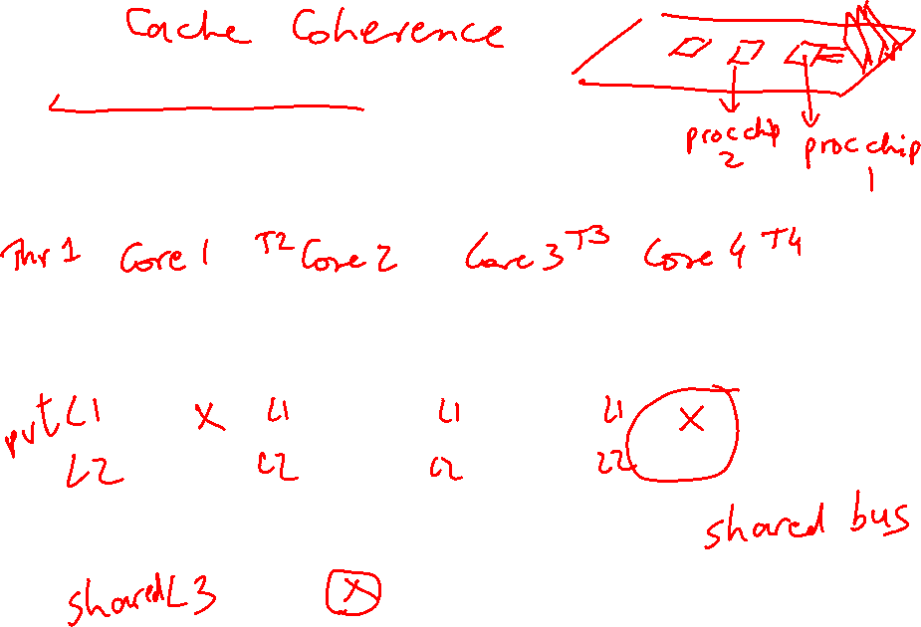
Snooping-Based Protocols
Three states for a block: invalid, shared, modified
A write is placed on the bus and sharers invalidate themselves
The protocols are referred to as MSI, MESI, etc.
Processor
Processor
Processor
Processor
Caches
Caches
Caches
Caches
Main Memory
I/O System

Slide 13
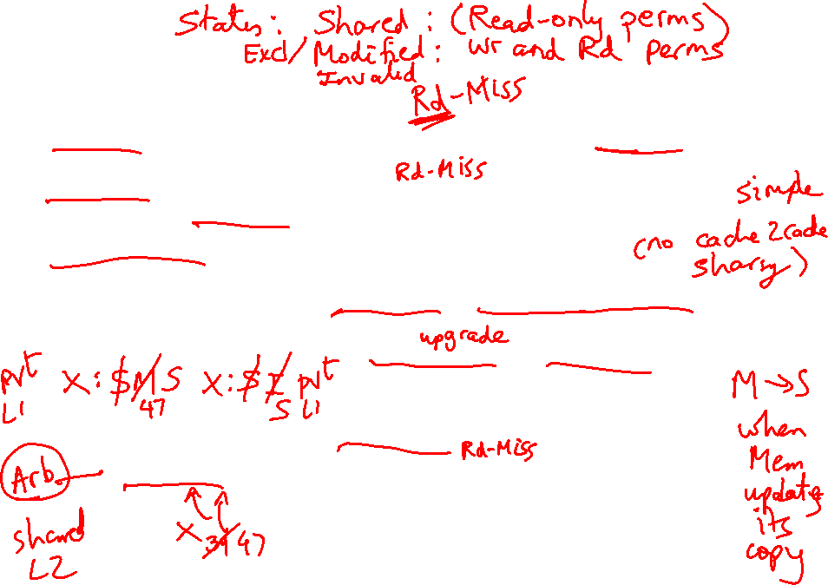
Example
P1 reads X: not found in cache-1, request sent on bus, memory responds,
X is placed in cache-1 in shared state
P2 reads X: not found in cache-2, request sent on bus, everyone snoops
this request, cache-1does nothing because this is just a read request,
memory responds, X is placed in cache-2 in shared state
P1
P2
P1 writes X: cache-1 has data in shared
state (shared only provides read perms),
request sent on bus, cache-2 snoops and
then invalidates its copy of X, cache-1
moves its state to modified
P2 reads X: cache-2 has data in invalid
state, request sent on bus, cache-1 snoops
and realizes it has the only valid copy, so it
downgrades itself to shared state and
responds with data, X is placed in cache-2
in shared state, memory is also updated
Cache-1
Cache-2
Main Memory

Slide 14
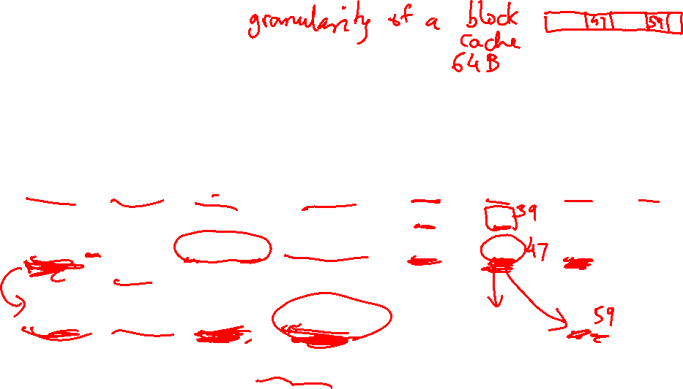
Example
Request | Cache Hit/Miss | Request on the bus | Who responds | State in Cache 1 | State in Cache 2 | State in Cache 3 | State in Cache 4
 |  |  |  | Inv | Inv | Inv | Inv
P1: Rd X | Rd Miss | Rd X | Memory | S | Inv | Inv | Inv
P2: Rd X | Rd Miss | Rd X | Memory | S | S | Inv | Inv
P2: Wr X | Perms Miss | Upgrade X | No response. Other caches invalidate. | Inv | M | Inv | Inv
P3: Wr X | Wr Miss | Wr X | P2 responds | Inv | Inv | M | Inv
P3: Rd X | Rd Hit | - | - | Inv | Inv | M | Inv
P4: Rd X | Rd Miss | Rd X | P3 responds. Mem wrtbk | Inv | Inv | S | S

Slide 15
Cache Coherence Protocols
Directory-based: A single location (directory) keeps track
of the sharing status of a block of memory
Snooping: Every cache block is accompanied by the sharing
status of that block – all cache controllers monitor the
shared bus so they can update the sharing status of the
block, if necessary
Write-invalidate: a processor gains exclusive access of
a block before writing by invalidating all other copies
Write-update: when a processor writes, it updates other
shared copies of that block

Slide 16
Constructing Locks
Applications have phases (consisting of many instructions)
that must be executed atomically, without other parallel
processes modifying the data
A lock surrounding the data/code ensures that only one
program can be in a critical section at a time
The hardware must provide some basic primitives that
allow us to construct locks with different properties
Bank balance
$1000
Parallel (unlocked) banking transactions
Rd $1000
Add $100
Wr $1100
Rd $1000
Add $200
Wr $1200

Slide 17
Synchronization
The simplest hardware primitive that greatly facilitates
synchronization implementations (locks, barriers, etc.)
is an atomic read-modify-write
Atomic exchange: swap contents of register and memory
Special case of atomic exchange: test & set: transfer
memory location into register and write 1 into memory
(if memory has 0, lock is free)
lock: t&s register, location
bnz register, lock
CS
st location, #0
When multiple parallel threads
execute this code, only one
will be able to enter CS

Slide 18
Coherence Vs. Consistency
Coherence guarantees (i) write propagation
(a write will eventually be seen by other processors), and
(ii) write serialization (all processors see writes to the
same location in the same order)
The consistency model defines the ordering of writes and
reads to different memory locations – the hardware
guarantees a certain consistency model and the
programmer attempts to write correct programs with
those assumptions

Slide 19
Consistency Example
Consider a multiprocessor with bus-based snooping cache
coherence
Initially A = B = 0
P1 P2
A ← 1 B ← 1
… …
if (B == 0) if (A == 0)
Crit.Section Crit.Section

Slide 20
Consistency Example
Consider a multiprocessor with bus-based snooping cache
coherence
Initially A = B = 0
P1 P2
A ← 1 B ← 1
… …
if (B == 0) if (A == 0)
Crit.Section Crit.Section
The programmer expected the
above code to implement a
lock – because of ooo, both processors
can enter the critical section
The consistency model lets the programmer know what assumptions
they can make about the hardware’s reordering capabilities

Slide 21
Sequential Consistency
A multiprocessor is sequentially consistent if the result
of the execution is achieveable by maintaining program
order within a processor and interleaving accesses by
different processors in an arbitrary fashion
The multiprocessor in the previous example is not
sequentially consistent
Can implement sequential consistency by requiring the
following: program order, write serialization, everyone has
seen an update before a value is read – very intuitive for
the programmer, but extremely slow

Slide 22
Relaxed Consistency
Sequential consistency is very slow
The programming complications/surprises are caused when the
program has race conditions (two threads dealing with same
data and at least one of the threads is modifying the data)
If programmers are disciplined and enforce mutual exclusion
when dealing with shared data, we can allow some re-orderings
and higher performance
This is effective at balancing performance & programming effort

