Slide 1
Lecture 23: Cache Examples
Today’s topics:
Cache access
Example problems in cache design
Caching policies

Slide 2
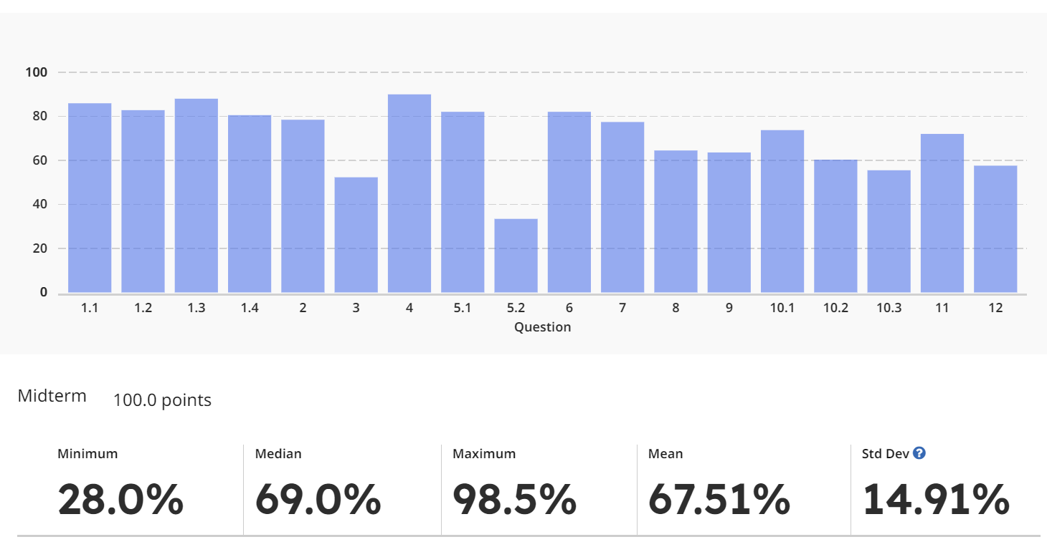
Midterm Stats
 | A | A- | B+ | B | B- | C+/C/C- | D+ or worse
Percentile | Top 16% | 32% | 45% | 58% | 71% | 86%
Rank | 47 | 94 | 133 | 172 | 211 | 256 | 295
Midterm Score | 83.5 | 76.25 | 69.5 | 64 | 57 | 48

Slide 3
Accessing the Cache

Slide 4
Accessing the Cache

Slide 5
Accessing the Cache
Byte address
101000
Offset
8-byte words
8 words: 3 index bits
Direct-mapped cache:
each address maps to
a unique location in cache
Sets
Data array

Slide 6
The Tag Array
Byte address
101000
Tag
8-byte words
Compare
Direct-mapped cache:
each address maps to
a unique address
Tag array
Data array

Slide 7
Example Access Pattern
Byte address
Assume that addresses are 8 bits long
How many of the following address requests
are hits/misses?
4, 7, 10, 13, 16, 68, 73, 78, 83, 88, 4, 7, 10…
101000
Tag
8-byte words
Compare
Direct-mapped cache:
each address maps to
a unique address
Tag array
Data array

Slide 8
Increasing Line Size
Byte address
A large cache line size → smaller tag array,
fewer misses because of spatial locality
10100000
32-byte cache
line size or
block size
Tag
Offset
Tag array
Data array

Slide 9
Associativity
Byte address
Set associativity → fewer conflicts; wasted power
because multiple data and tags are read
10100000
Tag
Way-1
Way-2
Tag array
Data array
Compare

Slide 10
Associativity
How many offset/index/tag bits if the cache has
64 sets,
each set has 64 bytes,
4 ways
Byte address
10100000
Tag
Way-1
Way-2
Tag array
Data array
Compare

Slide 11
Example 1
32 KB 4-way set-associative data cache array with 32
byte line sizes
How many sets?
How many index bits, offset bits, tag bits?
How large is the tag array?
Cache size = #sets x #ways x blocksize
Index bits = log₂(sets)
Offset bits = log₂(blocksize)
Addr width = tag + index + offset

Slide 12
Example 1
32 KB 4-way set-associative data cache array with 32
byte line sizes
cache size = #sets x #ways x block size
How many sets? 256
How many index bits, offset bits, tag bits?
8 5 19
log₂(sets) log₂(blksize) addrsize-index-offset
How large is the tag array?
tag array size = #sets x #ways x tag size
= 19 Kb = 2.375 KB

Slide 13
Example 2
Show how the following addresses map to the cache and yield hits or misses.
The cache is direct-mapped, has 16 sets, and a 64-byte block size.
Addresses: 8, 96, 32, 480, 976, 1040, 1096
Offset = address % 64 (address modulo 64, extract last 6)
Index = address/64 % 16 (shift right by 6, extract last 4)
Tag = address/1024 (shift address right by 10)
32-bit address
22 bits tag 4 bits index 6 bits offset
8: 0 0 8 M
96: 0 1 32 M
32: 0 0 32 H
480: 0 7 32 M
976: 0 15 16 M
1040: 1 0 16 M
1096: 1 1 8 M
.
.
.

Slide 14
Example 3
A pipeline has CPI 1 if all loads/stores are L1 cache hits
40% of all instructions are loads/stores
85% of all loads/stores hit in 1-cycle L1
50% of all (10-cycle) L2 accesses are misses
Memory access takes 100 cycles
What is the CPI?

Slide 15
Example 3
A pipeline has CPI 1 if all loads/stores are L1 cache hits
40% of all instructions are loads/stores
85% of all loads/stores hit in 1-cycle L1
50% of all (10-cycle) L2 accesses are misses
Memory access takes 100 cycles
What is the CPI?
Start with 1000 instructions
1000 cycles (includes all 400 L1 accesses)
+ 400 (ld/st) x 15% x 10 cycles (the L2 accesses)
+ 400 x 15% x 50% x 100 cycles (the mem accesses)
= 4,600 cycles
CPI = 4.6

Slide 16
Example 4
Assume that addresses are 8 bits long
How many of the following address requests
are hits/misses?
4, 7, 10, 13, 16, 24, 36, 4, 48, 64, 4, 36, 64, 4
Byte address
00010000
Tag
Way-1
Way-2
8-byte blocks
Tag array
Data array

Slide 17
Example 4
Assume that addresses are 8 bits long
How many of the following address requests
are hits/misses?
4, 7, 10, 13, 16, 24, 36, 4, 48, 64, 4, 36, 64, 4
M H M H M M M H M M H M M M
Byte address
00010000
Tag
Way-1
Way-2
8-byte blocks
Tag array
Data array

Slide 18
Cache Misses
On a write miss, you may either choose to bring the block
into the cache (write-allocate) or not (write-no-allocate)
On a read miss, you always bring the block in (spatial and
temporal locality) – but which block do you replace?
no choice for a direct-mapped cache
randomly pick one of the ways to replace
replace the way that was least-recently used (LRU)
FIFO replacement (round-robin)

Slide 19
Writes
When you write into a block, do you also update the
copy in L2?
write-through: every write to L1 → write to L2
write-back: mark the block as dirty, when the block
gets replaced from L1, write it to L2
Writeback coalesces multiple writes to an L1 block into one
L2 write
Writethrough simplifies coherency protocols in a
multiprocessor system as the L2 always has a current
copy of data

Slide 20
Types of Cache Misses
Compulsory misses: happens the first time a memory
word is accessed – the misses for an infinite cache
Capacity misses: happens because the program touched
many other words before re-touching the same word – the
misses for a fully-associative cache
Conflict misses: happens because two words map to the
same location in the cache – the misses generated while
moving from a fully-associative to a direct-mapped cache

