Slide 1
Lecture 21: BPred, OOO, Memory Hierarchy
Today’s topics:
Branch Predictors
Out-of-order execution
Cache intro

Slide 2
Pipeline with Branch Predictor
PC
IF (br)
Reg Read
Compare
Br-target
Branch
Predictor

Slide 3
Bimodal Predictor
Table of
16K entries
of 2-bit
saturating
counters
14 bits
Branch PC

Slide 4
2-Bit Prediction
For each branch, maintain a 2-bit saturating counter:
if the branch is taken: counter = min(3,counter+1)
if the branch is not taken: counter = max(0,counter-1)
… sound familiar?
If (counter >= 2), predict taken, else predict not taken
The counter attempts to capture the common case for
each branch
Indexing functions
Multiple branch predictors
History, trade-offs

Slide 5
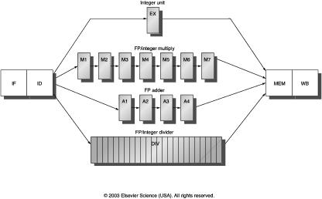
Multicycle Instructions
Multiple parallel pipelines – each pipeline can have a different
number of stages
Instructions can now complete out of order – must make sure
that writes to a register happen in the correct order

Slide 6
An Out-of-Order Processor Implementation
Reorder Buffer (ROB)
Branch prediction
and instr fetch
Instr 1
Instr 2
Instr 3
Instr 4
Instr 5
Instr 6
T1
T2
T3
T4
T5
T6
Register File
R1-R32
R1 ← R1+R2
R2 ← R1+R3
BEQZ R2
R3 ← R1+R2
R1 ← R3+R2
Decode &
Rename
T1 ← R1+R2
T2 ← T1+R3
BEQZ T2
T4 ← T1+T2
T5 ← T4+T2
ALU
ALU
ALU
Instr Fetch Queue
Results written to
ROB and tags
broadcast to IQ
Issue Queue (IQ)

Slide 7
Example Code
Completion times with in-order with ooo
ADD R1, R2, R3 5 5
ADD R4, R1, R2 6 6
LW R5, 8(R4) 7 7
ADD R7, R6, R5 9 9
ADD R8, R7, R5 10 10
LW R9, 16(R4) 11 7
ADD R10, R6, R9 13 9
ADD R11, R10, R9 14 10

Slide 8
Cache Hierarchies
Data and instructions are stored on DRAM chips – DRAM
is a technology that has high bit density, but relatively poor
latency – an access to data in memory can take as many
as 300 cycles today!
Hence, some data is stored on the processor in a structure
called the cache – caches employ SRAM technology, which
is faster, but has lower bit density
Internet browsers also cache web pages – same concept

Slide 9
Memory Hierarchy
As you go further, capacity and latency increase
Disk
1 TB
10M cycles
Memory
16GB
300 cycles
L2 cache
2MB
15 cycles
L1 data or
instruction
Cache
32KB
2 cycles
Registers
1KB
1 cycle

Slide 10
Locality
Why do caches work?
Temporal locality: if you used some data recently, you
will likely use it again
Spatial locality: if you used some data recently, you
will likely access its neighbors
No hierarchy: average access time for data = 300 cycles
32KB 1-cycle L1 cache that has a hit rate of 95%:
average access time = 0.95 x 1 + 0.05 x (301)
= 16 cycles

