Slide 1

Lecture 16: Basic Pipelining
Today’s topics:
5-stage pipeline
Hazards

Slide 2

Midterm Prep
In-class midterm 2 weeks away
Prep: homework, notes/slides/examples, videos, sample midterm
80% homeworks, 10% brief concept questions, 10% difficult/new
Time constrained
MIPS assembly questions
Single sheet of notes (both sides) – green sheet allowed
Phone/calculator allowed for calculations
90 minute test – 10:40 – 12:10

Slide 3
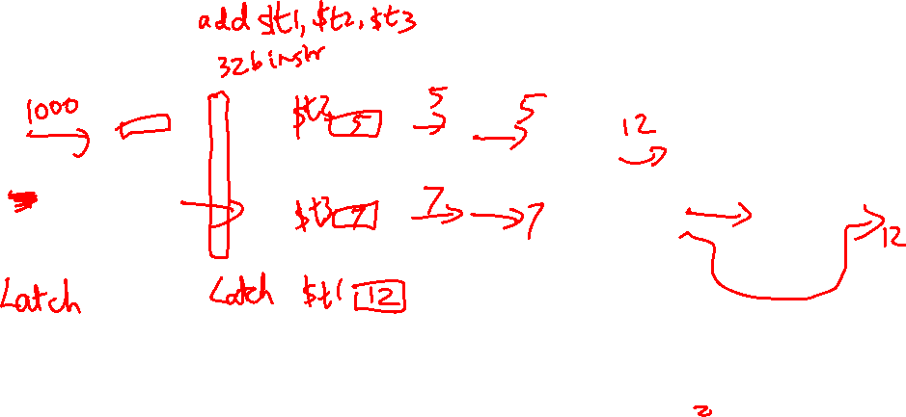
Multi-Stage Circuit
Instead of executing the entire instruction in a single
cycle (a single stage), let’s break up the execution into
multiple stages, each separated by a latch
PC
Instr
Mem
L2
Reg
File
L3
ALU
L4
Data
Memory
L5
Reg
File

Slide 4
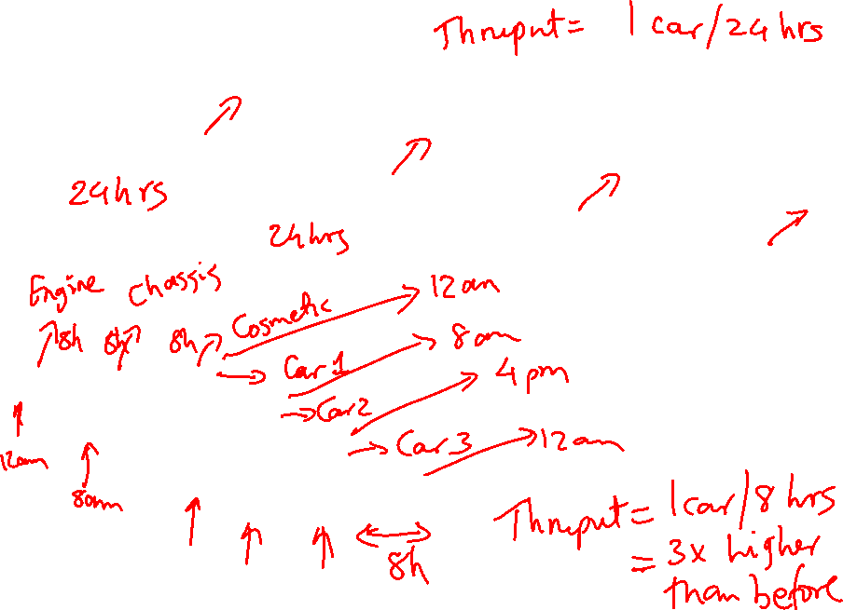
The Assembly Line
Unpipelined
Start and finish a job before moving to the next
Jobs
Time
A
B
C
A
B
C
Break the job into smaller stages
A
B
C
A
B
C
Pipelined

Slide 5
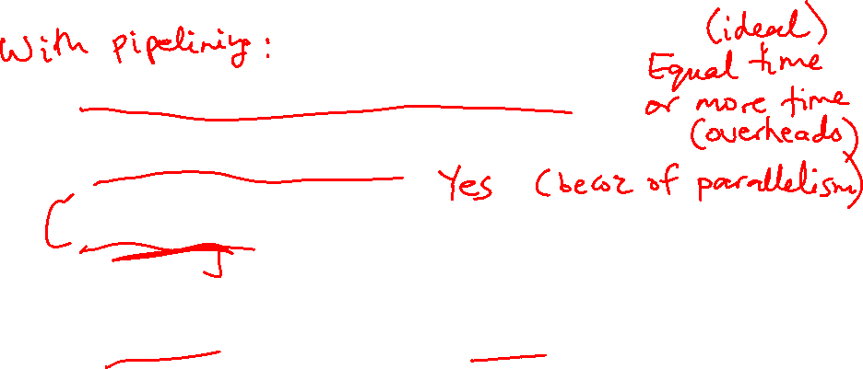
Performance Improvements?
Does it take longer to finish each individual job?
Does it take shorter to finish a series of jobs?
What assumptions were made while answering these
questions?
Is a 10-stage pipeline better than a 5-stage pipeline?

Slide 6
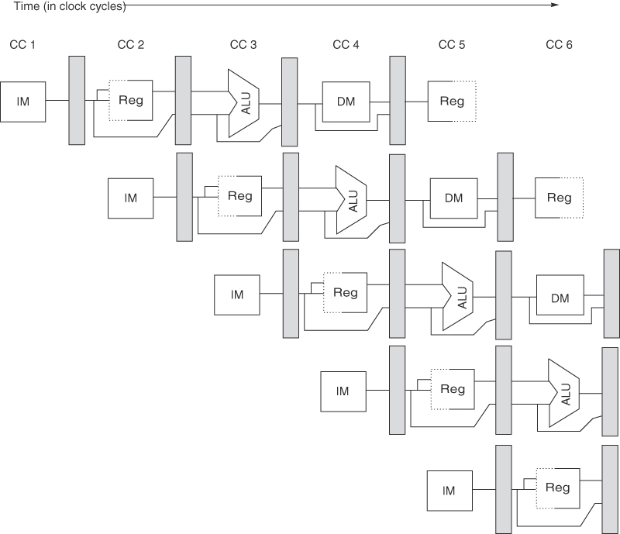
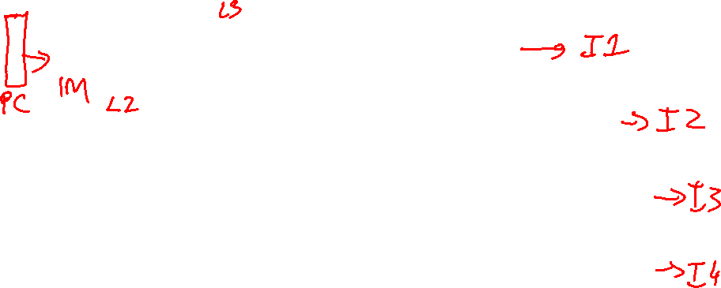
A 5-Stage Pipeline
Source: H&P textbook

Slide 7
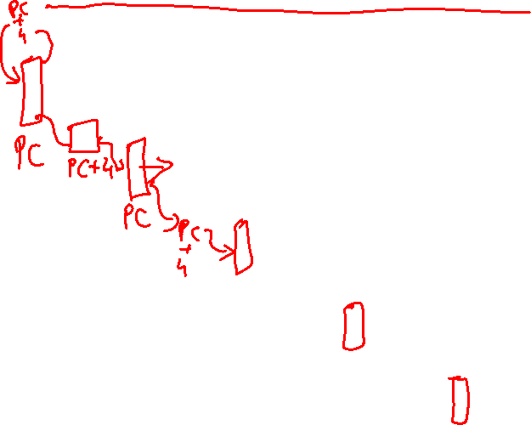
A 5-Stage Pipeline
Use the PC to access the I-cache and increment PC by 4

Slide 8
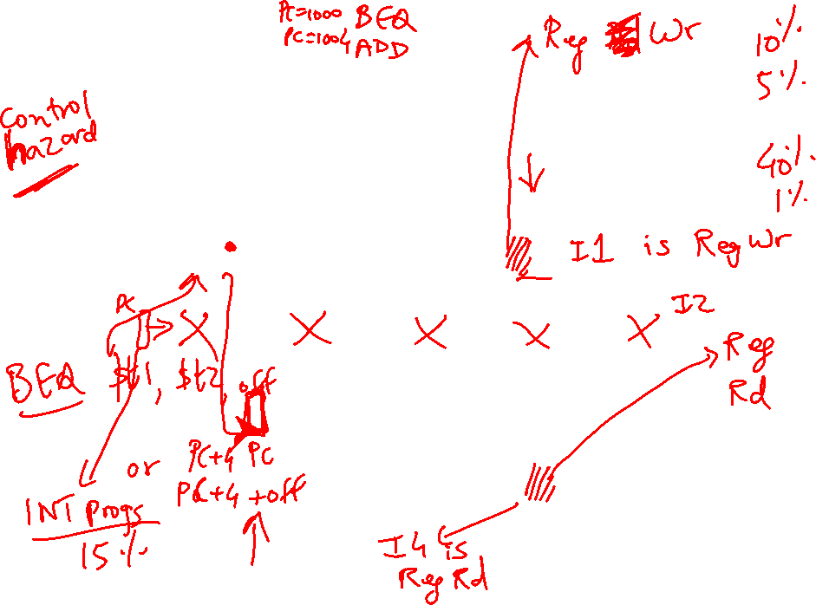
A 5-Stage Pipeline
Read registers, compare registers, compute branch target; for now, assume
branches take 2 cyc (there is enough work that branches can easily take more)

Slide 9
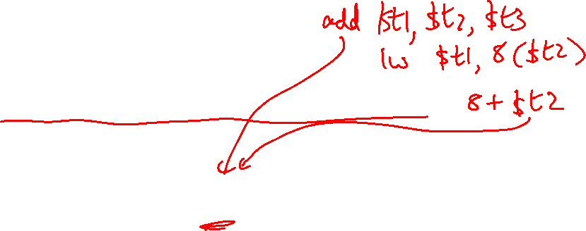
A 5-Stage Pipeline
ALU computation, effective address computation for load/store

Slide 10
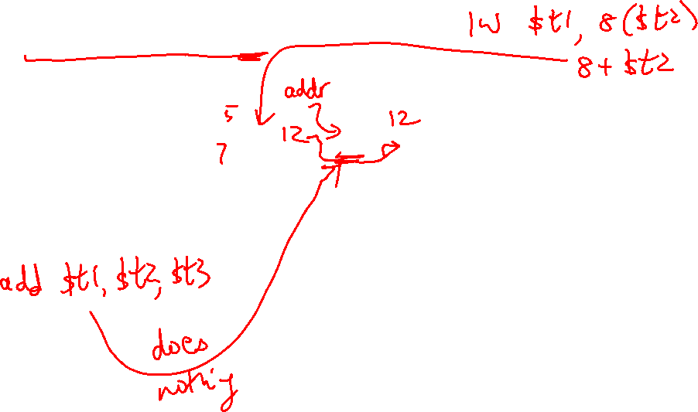
A 5-Stage Pipeline
Memory access to/from data cache, stores finish in 4 cycles

Slide 11

A 5-Stage Pipeline
Write result of ALU computation or load into register file

Slide 12

Pipeline Summary
RR ALU DM RW
ADD R1, R2, → R3 Rd R1,R2 R1+R2 -- Wr R3
BEQ R1, R2, 100 Rd R1, R2 -- -- --
Compare, Set PC
LD 8[R3] → R6 Rd R3 R3+8 Get data Wr R6
ST 8[R3] ← R6 Rd R3,R6 R3+8 Wr data --

Slide 13
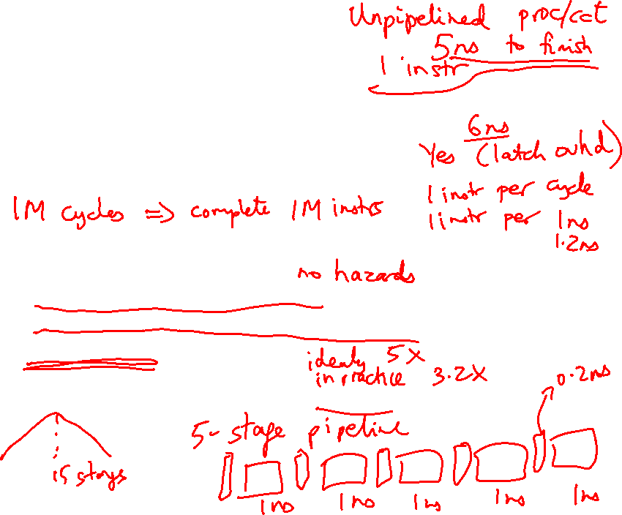
Performance Improvements?
Does it take longer to finish each individual job?
Does it take shorter to finish a series of jobs?
What assumptions were made while answering these
questions?
No dependences between instructions
Easy to partition circuits into uniform pipeline stages
No latch overhead
Is a 10-stage pipeline better than a 5-stage pipeline?

Slide 14
Quantitative Effects
As a result of pipelining:
Time in ns per instruction goes up
Each instruction takes more cycles to execute
But… average CPI remains roughly the same
Clock speed goes up
Total execution time goes down, resulting in lower
average time per instruction
Under ideal conditions, speedup
= ratio of elapsed times between successive instruction
completions
= number of pipeline stages = increase in clock speed

Slide 15
Conflicts/Problems
I-cache and D-cache are accessed in the same cycle – it
helps to implement them separately
Registers are read and written in the same cycle – easy to
deal with if register read/write time equals cycle time/2
Branch target changes only at the end of the second stage
-- what do you do in the meantime?

Slide 16
Hazards
Structural hazards: different instructions in different stages
(or the same stage) conflicting for the same resource
Data hazards: an instruction cannot continue because it
needs a value that has not yet been generated by an
earlier instruction
Control hazard: fetch cannot continue because it does
not know the outcome of an earlier branch – special case
of a data hazard – separate category because they are
treated in different ways

