Slide 1
Lecture 15: Basic CPU Design
Today’s topics:
  FSM examples
  Single-cycle CPU
  Multi-cycle CPU

Slide 2
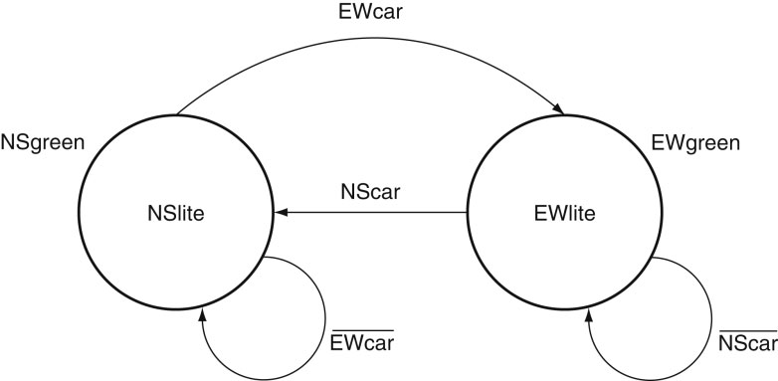
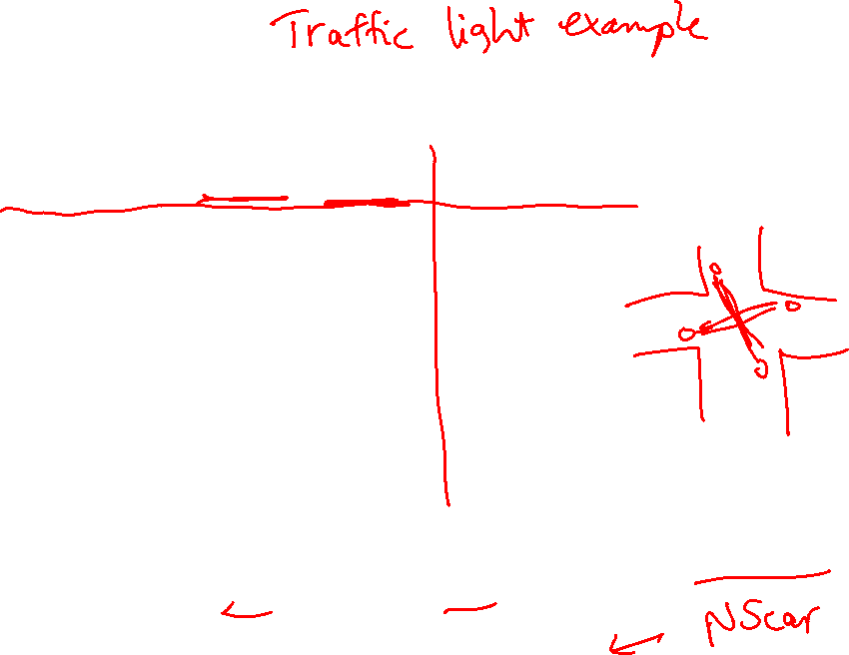
State Diagram
State Transition Table:
CurrState InputEW InputNS NextState=Output
N 0 0 N
N 0 1 N
N 1 0 E
N 1 1 E
E 0 0 E
E 0 1 N
E 1 0 E
E 1 1 N
Source: H&P textbook

Slide 3

Tackling FSM Problems
Three questions worth asking:
  What are the possible output states? Draw a
  bubble for each.
  What are inputs? What values can those inputs take?
  For each state, what do I do for each possible
  input value? Draw an arc out of every bubble for
  every input value.

Slide 4
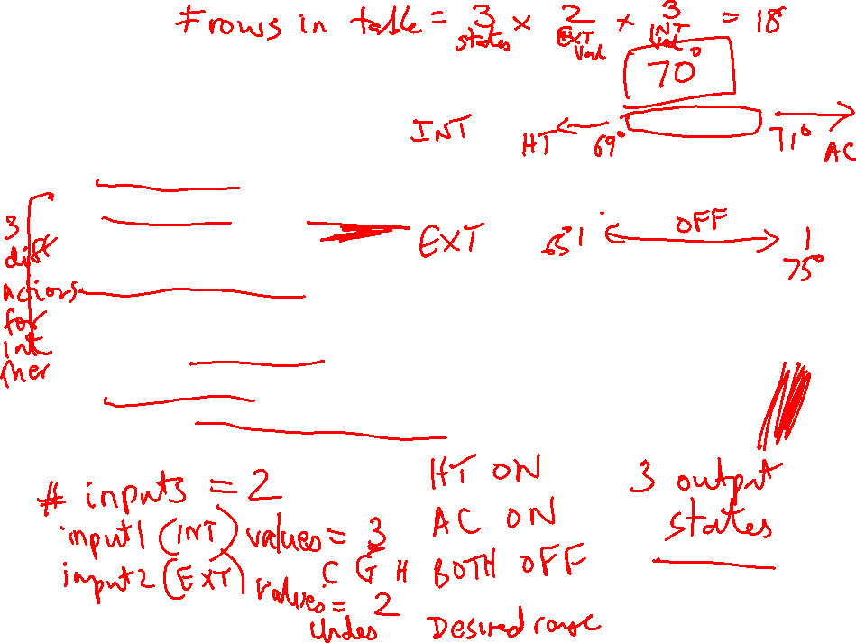
Example – Residential Thermostat
Two temp sensors: internal and external
If internal temp is within 1 degree of desired, don’t
change setting
If internal temp is > 1 degree higher than desired, turn
AC on; if internal temp is < 1 degree lower than
desired, turn heater on
If external temp and desired temp are within 5
degrees, disregard the internal temp, and turn both AC
and heater off

Slide 5
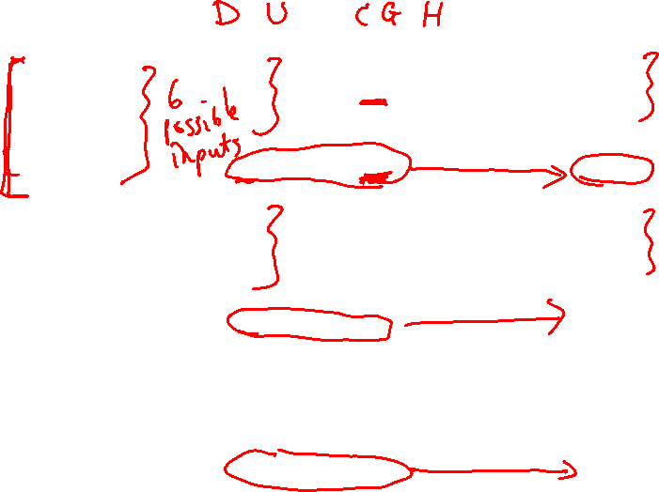
Finite State Machine Table

Slide 6
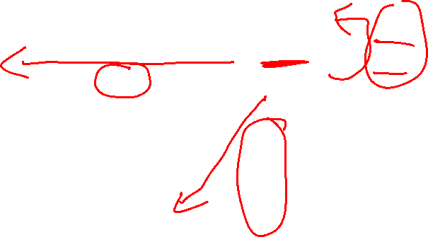
Finite State Diagram
HEAT
U-H
COOL
U-C,
U-G
U-H,
U-G
U-C
D-C,
D-G,
D-H
U-C
U-H
D-C,
D-G,
D-H
OFF
Int temp settings:
C – cold
G – goldilocks
H – hot
Ext temp settings:
D – desired zone
U – undesired zone
D-C, D-G, D-H, U-G

Slide 7
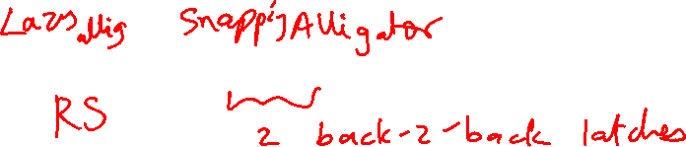
Latch vs. Flip-Flop
Recall that we want a circuit to have stable inputs for
an entire cycle – so I want my new inputs to arrive at
the start of a cycle and be fixed for an entire cycle
A flip-flop provides the above semantics (a door that
swings open and shut at the start of a cycle)
But a flip-flop needs two back-to-back D-latches, i.e.,
more transistors, delay, power
You can reduce these overheads with just a single
D-latch (a door that is open for half a cycle) as long as
you can tolerate stable inputs for just half a cycle

Slide 8
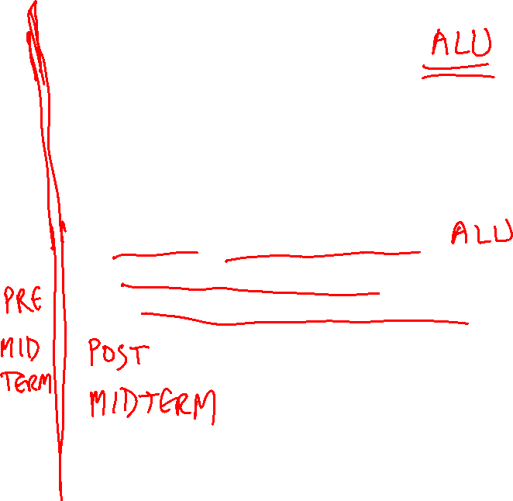
Basic MIPS Architecture
Now that we understand clocks and storage of states,
we’ll design a simple CPU that executes:
  basic math (add, sub, and, or, slt)
  memory access (lw and sw)
  branch and jump instructions (beq and j)

Slide 9
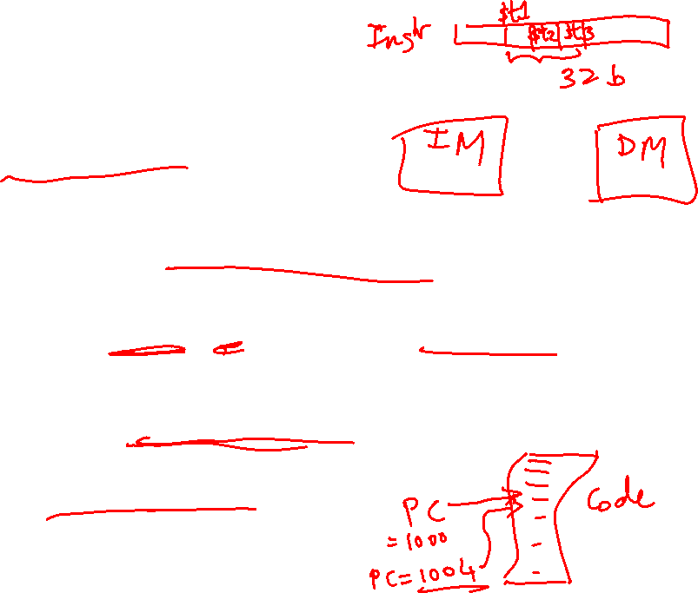
Implementation Overview
We need memory
  to store instructions
  to store data
  for now, let’s make them separate units
We need registers, ALU, and a whole lot of control logic
CPU operations common to all instructions:
  use the program counter (PC) to pull instruction out
  of instruction memory
  read register values

Slide 10
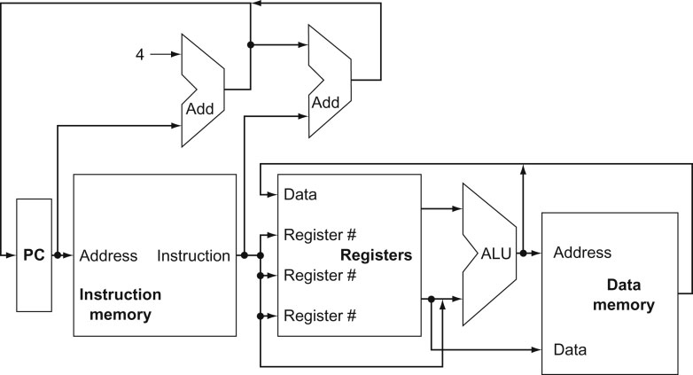
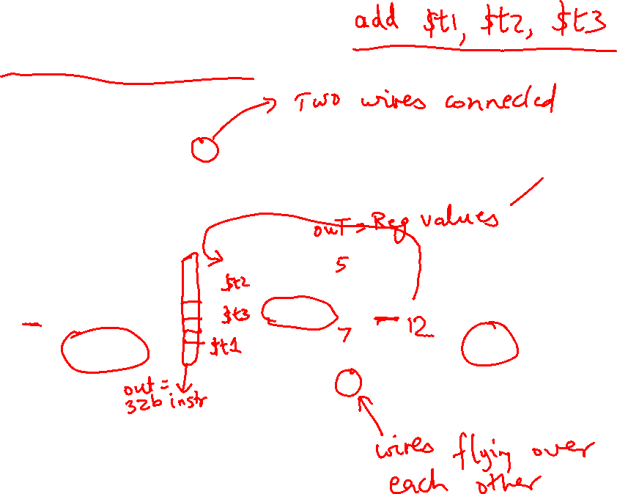
View from 30,000 Feet
Note: we haven’t bothered
showing multiplexors
What is the role of the Add units?
Explain the inputs to the data memory unit
Explain the inputs to the ALU
Explain the inputs to the register unit
Source: H&P textbook

Slide 11
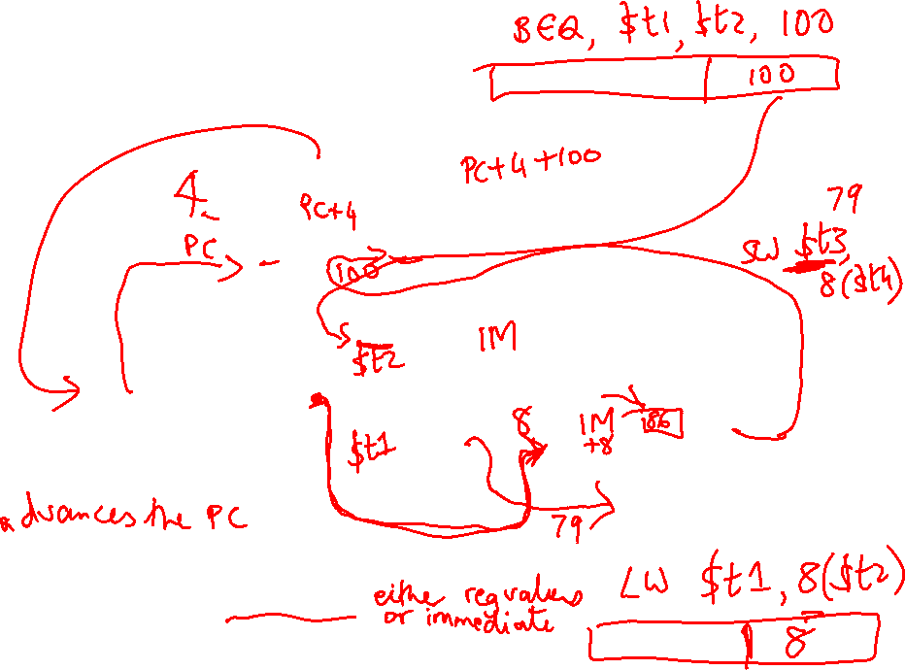
View from 30,000 Feet
Note: we haven’t bothered
showing multiplexors
What is the role of the Add units?
Explain the inputs to the data memory unit
Explain the inputs to the ALU
Explain the inputs to the register unit
Source: H&P textbook

Slide 12
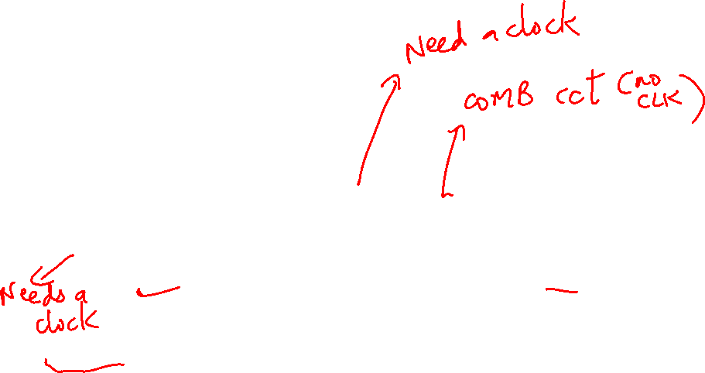
Clocking Methodology
Source: H&P textbook
Which of the above units need a clock?
What is being saved (latched) on the rising edge of the clock?
Keep in mind that the latched value remains there for an entire cycle

Slide 13
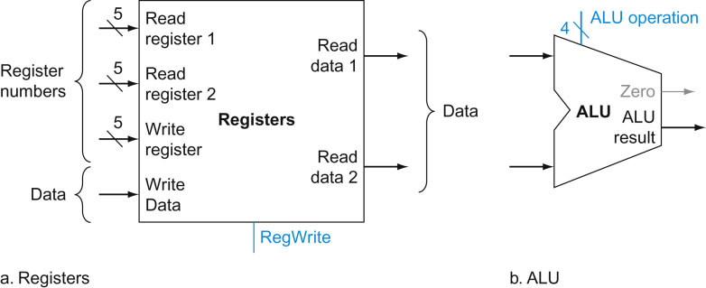
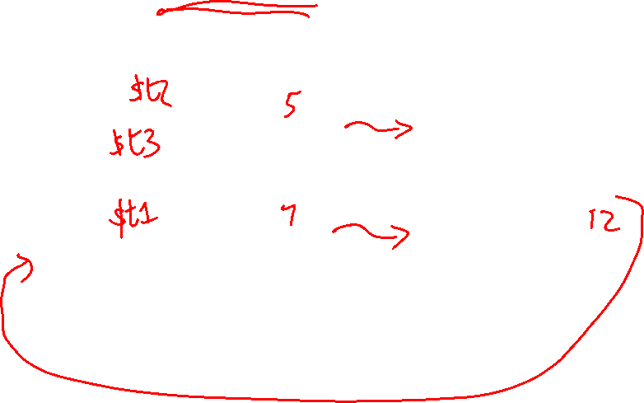
Implementing R-type Instructions
Instructions of the form add $t1, $t2, $t3
Explain the role of each signal
Source: H&P textbook

Slide 14
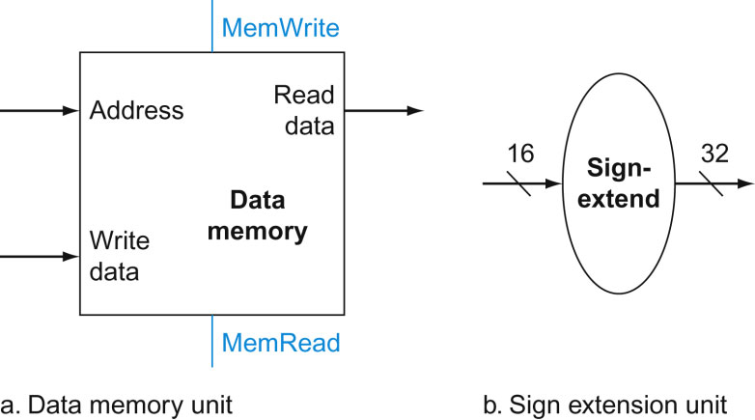
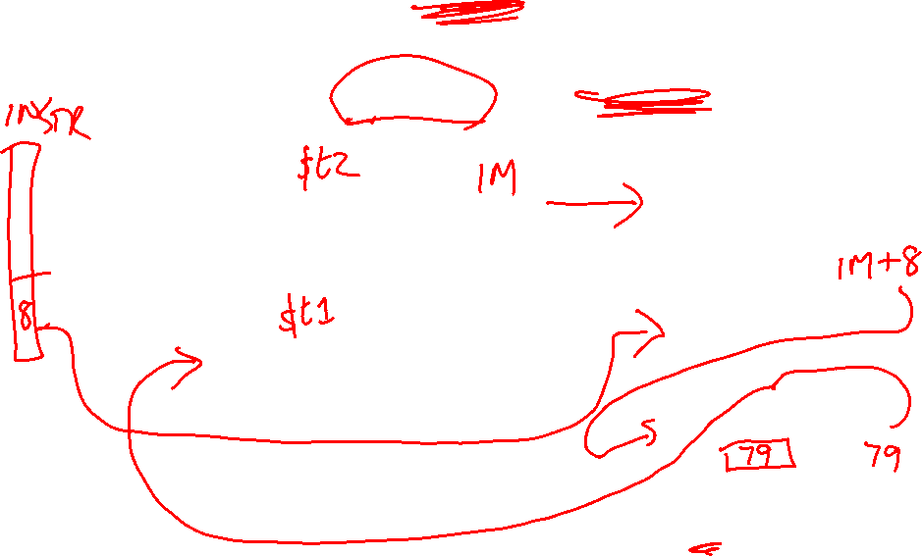
Implementing Loads/Stores
Instructions of the form lw $t1, 8($t2) and sw $t1, 8($t2)
Where does this input come from?
Source: H&P textbook

Slide 15
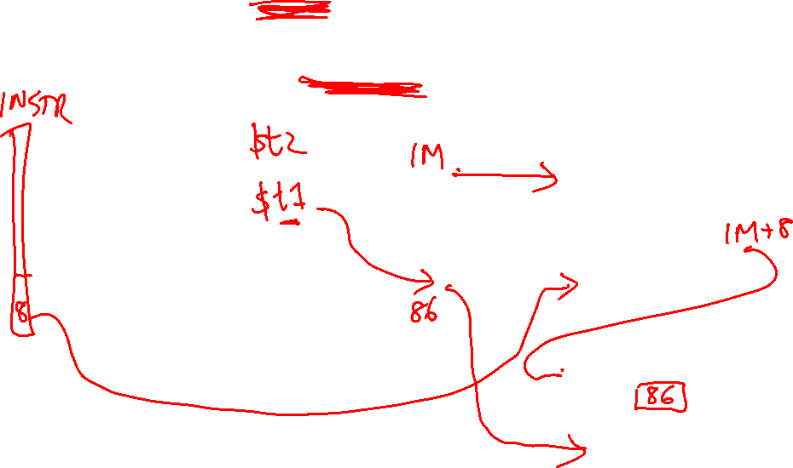
Implementing Loads/Stores
Instructions of the form lw $t1, 8($t2) and sw $t1, 8($t2)
Where does this input come from?
Source: H&P textbook

Slide 16
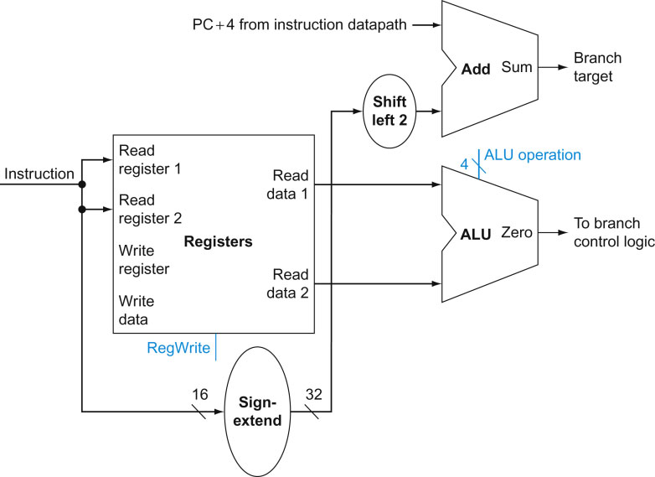
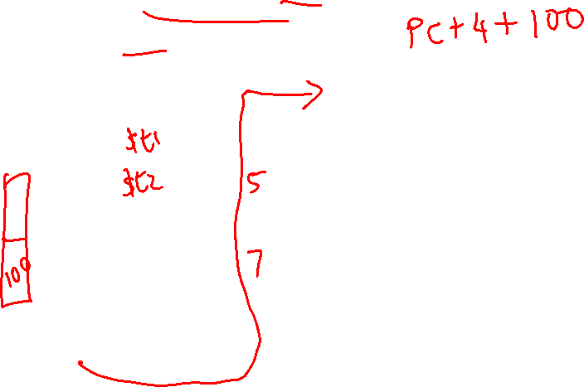
Implementing J-type Instructions
Instructions of the form beq $t1, $t2, offset
Source: H&P textbook

Slide 17
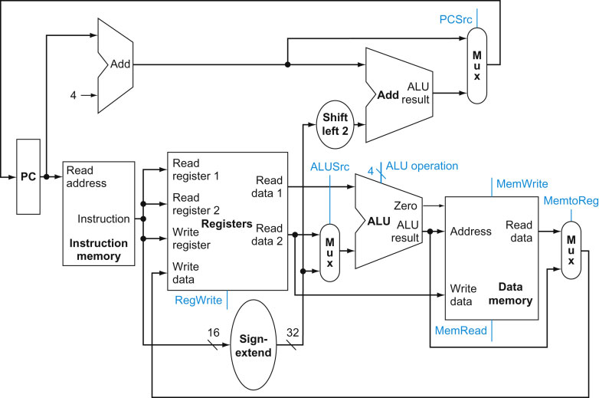
View from 10,000 Feet
Source: H&P textbook

Slide 18
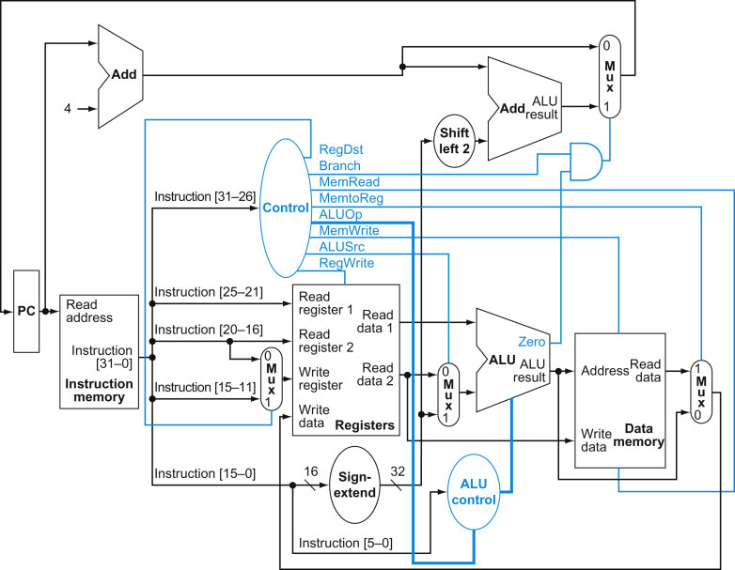
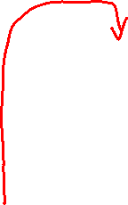
View from 5,000 Feet
Source: H&P textbook

Slide 19
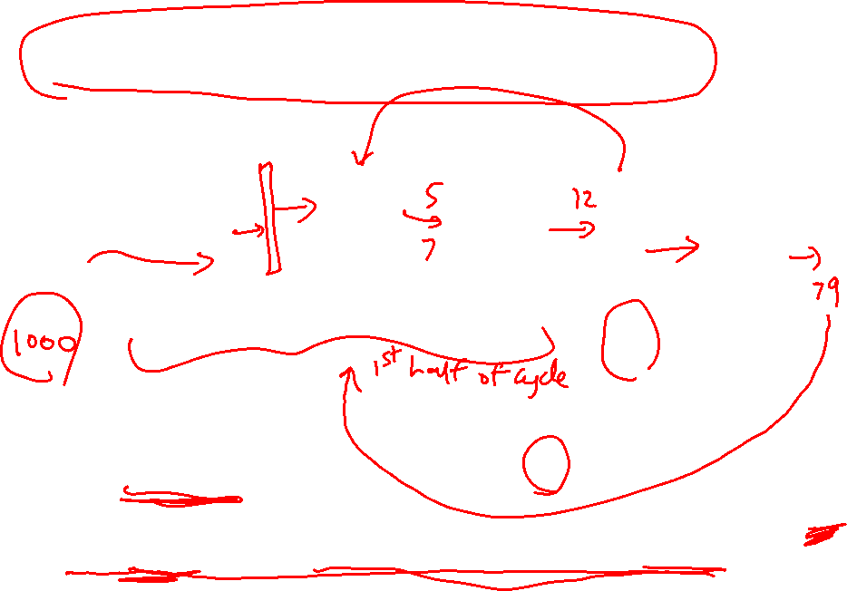
Latches and Clocks in a Single-Cycle Design
PC
Instr
Mem
Reg
File
ALU
Addr
Data
Memory
The entire instruction executes in a single cycle
Green blocks are latches
At the rising edge, a new PC is recorded
At the rising edge, the result of the previous cycle is recorded
At the falling edge, the address of LW/SW is recorded so
we can access the data memory in the 2nd half of the cycle

