Slide 1
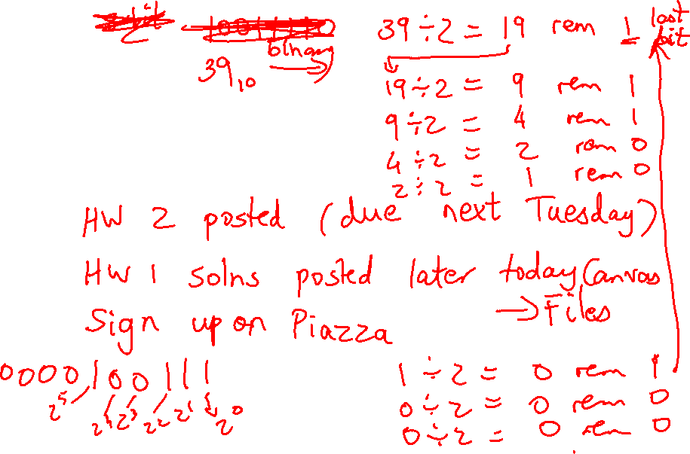
Lecture 5: More Instructions, Procedure Calls
Today’s topics:
  Examples
  Numbers, control instructions
  Procedure calls

Slide 2
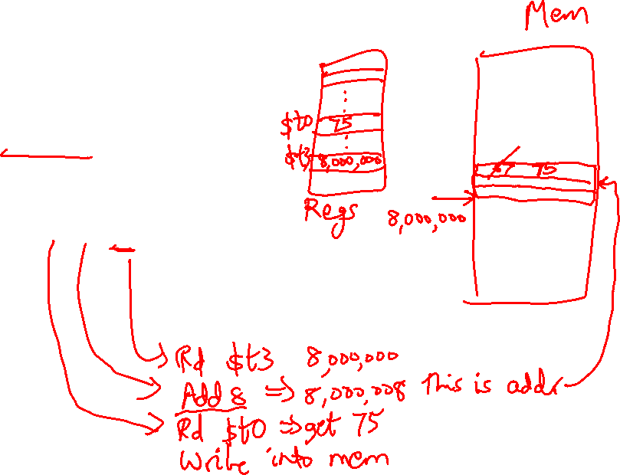
Memory Instruction Format
The format of a store instruction:
source register
destination address
sw $t0, 8($t3)
any register
a constant that is added to the register in parentheses

Slide 3
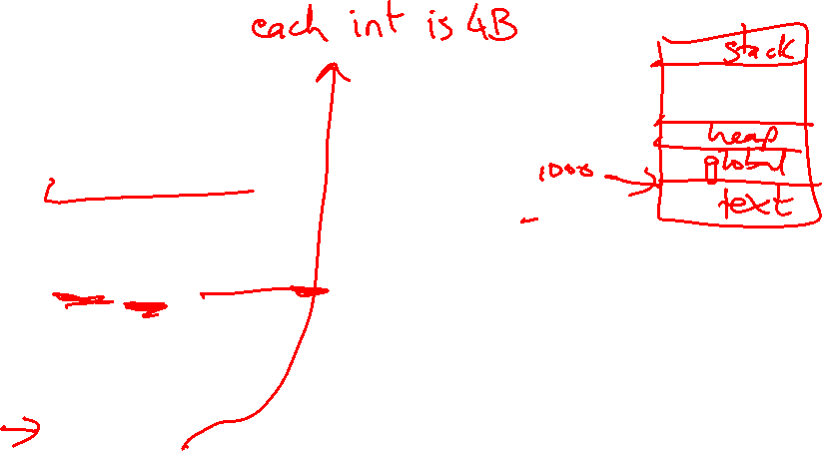
Example
int a, b, c, d[10];
addi $gp, $zero, 1000 # assume that data is stored at
# base address 1000; placed in $gp;
# $zero is a register that always
# equals zero
lw $s1, 0($gp) # brings value of a into register $s1
lw $s2, 4($gp) # brings value of b into register $s2
lw $s3, 8($gp) # brings value of c into register $s3
lw $s4, 12($gp) # brings value of d[0] into register $s4
lw $s5, 16($gp) # brings value of d[1] into register $s5

Slide 4
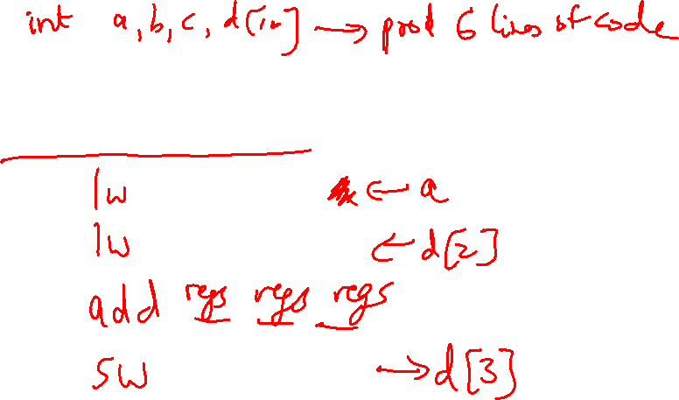
Example
Convert to assembly:
C code: d[3] = d[2] + a;

Slide 5
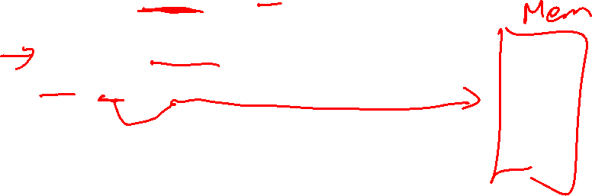
Example
Convert to assembly:
C code: d[3] = d[2] + a;
Assembly (same assumptions as previous example):
lw $s0, 0($gp) # a is brought into $s0
lw $s1, 20($gp) # d[2] is brought into $s1
add $s2, $s0, $s1 # the sum is in $s2
sw $s2, 24($gp) # $s2 is stored into d[3]
Assembly version of the code continues to expand!

Slide 6
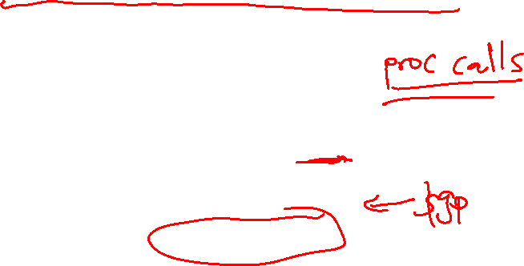
Memory Organization
The space allocated on stack by a procedure is termed the activation
record (includes saved values and data local to the procedure) – frame
pointer points to the start of the record and stack pointer points to the
end – variable addresses are specified relative to $fp as $sp may
change during the execution of the procedure
$gp points to area in memory that saves global variables
Dynamically allocated storage (with malloc()) is placed on the heap
Stack
Dynamic data (heap)
Static data (globals)
Text (instructions)

Slide 7
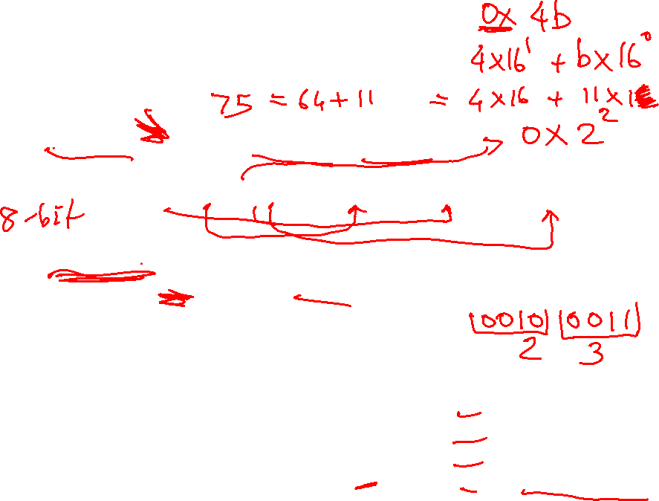
Recap – Numeric Representations
Decimal 35₁₀ = 3 x 10¹ + 5 x 10⁰
Binary 00100011₂ = 1 x 2⁵ + 1 x 2¹ + 1 x 2⁰
Hexadecimal (compact representation)
0x 23 or 23_{hex} = 2 x 16¹ + 3 x 16⁰
0-15 (decimal) → 0-9, a-f (hex)
Dec Binary Hex
0 0000 00
1 0001 01
2 0010 02
3 0011 03
Dec Binary Hex
4 0100 04
5 0101 05
6 0110 06
7 0111 07
Dec Binary Hex
8 1000 08
9 1001 09
10 1010 0a
11 1011 0b
Dec Binary Hex
12 1100 0c
13 1101 0d
14 1110 0e
15 1111 0f

Slide 8
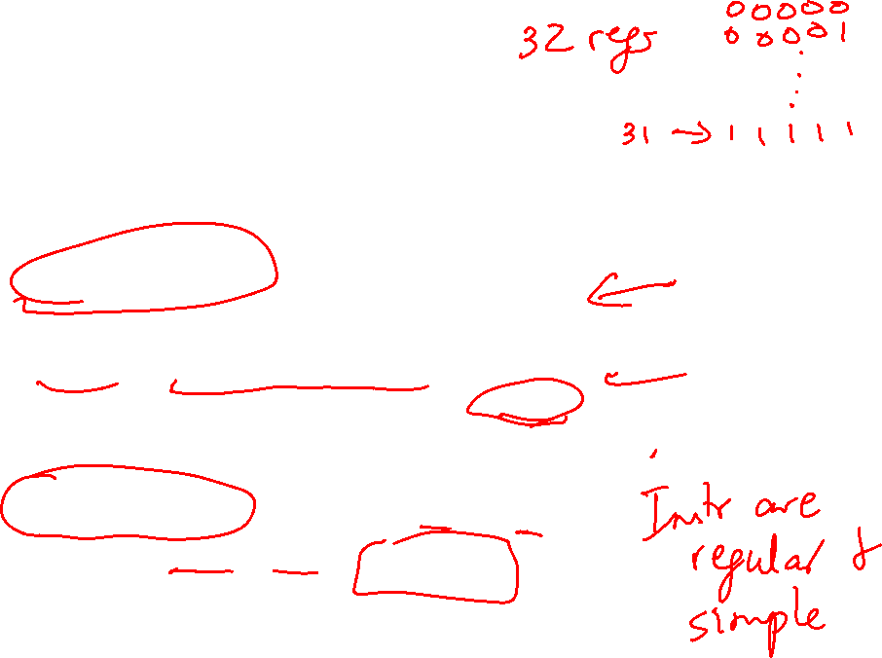
Instruction Formats
Instructions are represented as 32-bit numbers (one word),
broken into 6 fields
R-type instruction add $t0, $s1, $s2
000000 10001 10010 01000 00000 100000
6 bits 5 bits 5 bits 5 bits 5 bits 6 bits
op rs rt rd shamt funct
opcode source source dest shift amt function
I-type instruction lw $t0, 32($s3)
6 bits 5 bits 5 bits 16 bits
opcode rs rt constant
($s3) ($t0)

Slide 9
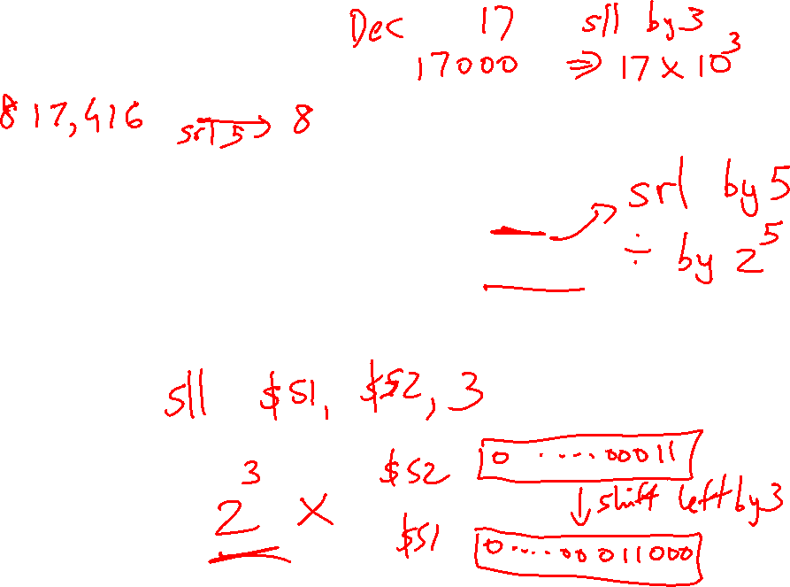
Logical Operations
Logical ops C operators Java operators MIPS instr
Shift Left << << sll
Shift Right >> >>> srl
Bit-by-bit AND & & and, andi
Bit-by-bit OR | | or, ori
Bit-by-bit NOT ~ ~ nor (with $zero)

Slide 10
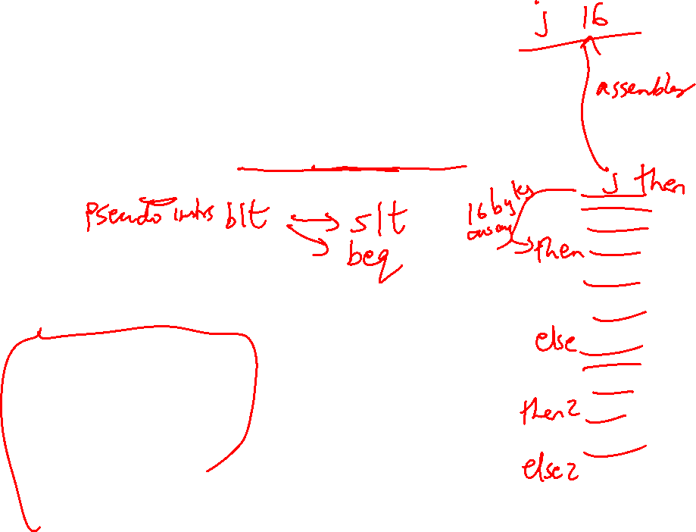
Control Instructions
Conditional branch: Jump to instruction L1 if register1
equals register2: beq register1, register2, L1
Similarly, bne and slt (set-on-less-than)
Unconditional branch:
j L1
jr $s0 (useful for big jumps and procedure returns)
Convert to assembly:
if (i == j)
f = g+h;
else
f = g-h;

Slide 11
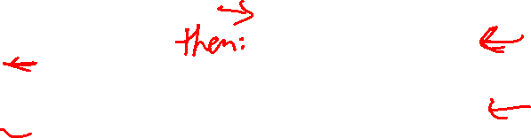
Control Instructions
Conditional branch: Jump to instruction L1 if register1
equals register2: beq register1, register2, L1
Similarly, bne and slt (set-on-less-than)
Unconditional branch:
j L1
jr $s0 (useful for big jumps and procedure returns)
Convert to assembly:
if (i == j) bne $s3, $s4, Else
f = g+h; add $s0, $s1, $s2
else j End
f = g-h; Else: sub $s0, $s1, $s2
End:

Slide 12
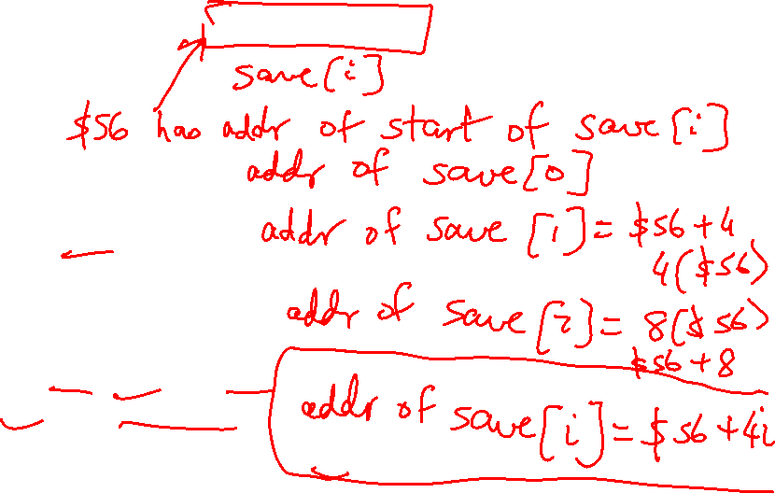
Example
Convert to assembly:
while (save[i] == k)
i += 1;
Values of i and k are in $s3 and $s5 and base of array save[] is in $s6

Slide 13
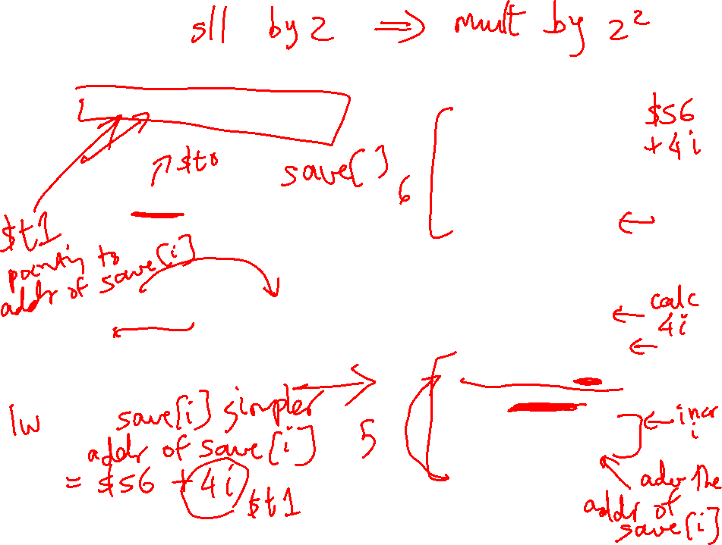
Example
Loop: sll $t1, $s3, 2
add $t1, $t1, $s6
lw $t0, 0($t1)
bne $t0, $s5, Exit
addi $s3, $s3, 1
j Loop
Exit:
Convert to assembly:
while (save[i] == k)
i += 1;
Values of i and k are in $s3
and $s5 and base of array
save[] is in $s6
sll $t1, $s3, 2
add $t1, $t1, $s6
Loop: lw $t0, 0($t1)
bne $t0, $s5, Exit
addi $s3, $s3, 1
addi $t1, $t1, 4
j Loop
Exit:

Slide 14
Registers
The 32 MIPS registers are partitioned as follows:
  Register 0 : $zero always stores the constant 0
  Regs 2-3 : $v0, $v1 return values of a procedure
  Regs 4-7 : $a0-$a3 input arguments to a procedure
  Regs 8-15 : $t0-$t7 temporaries
  Regs 16-23: $s0-$s7 variables
  Regs 24-25: $t8-$t9 more temporaries
  Reg 28 : $gp global pointer
  Reg 29 : $sp stack pointer
  Reg 30 : $fp frame pointer
  Reg 31 : $ra return address

Slide 15
Procedures
Local variables, AR, $fp, $sp
Scratchpad and saves/restores
Arguments and returns
jal and $ra

