Slide 1
Lecture 4: MIPS Instruction Set
Today’s topics:
  Chapter 1 wrap-up
  MIPS instructions
  Code examples
  HW 1 due today/tomorrow!
  HW 2 posted later today
  Piazza signup link

Slide 2

Common Principles
Amdahl’s Law
Energy: performance improvements typically also result
in energy improvements – less leakage
90-10 rule: 10% of the program accounts for 90% of
execution time
Principle of locality: the same data/code will be used
again (temporal locality), nearby data/code will be
touched next (spatial locality)

Slide 3
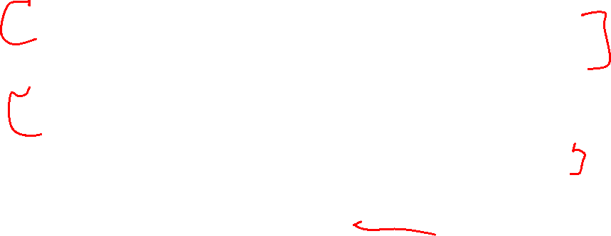
Recap
Knowledge of hardware improves software quality:
compilers, OS, threaded programs, memory management
Important trends: growing transistors, move to multi-core
and accelerators, slowing rate of performance improvement,
power/thermal constraints, long memory/disk latencies
Reasoning about performance: clock speeds, CPI,
benchmark suites, performance and power equations
Next: assembly instructions

Slide 4
Instruction Set
Understanding the language of the hardware is key to understanding
the hardware/software interface
A program (in say, C) is compiled into an executable that is composed
of machine instructions – this executable must also run on future
machines – for example, each Intel processor reads in the same x86
instructions, but each processor handles instructions differently
Java programs are converted into portable bytecode that is converted
into machine instructions during execution (just-in-time compilation)
What are important design principles when defining the instruction
set architecture (ISA)?

Slide 5
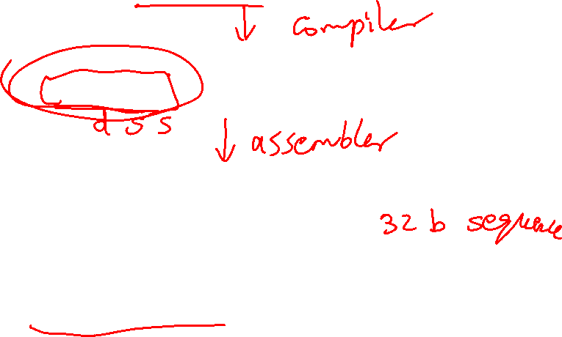
A Basic MIPS Instruction
C code: a = b + c ;
Assembly code: (human-friendly machine instructions)
add a, b, c # a is the sum of b and c
Machine code: (hardware-friendly machine instructions)
00000010001100100100000000100000
Translate the following C code into assembly code:
a = b + c + d + e;

Slide 6
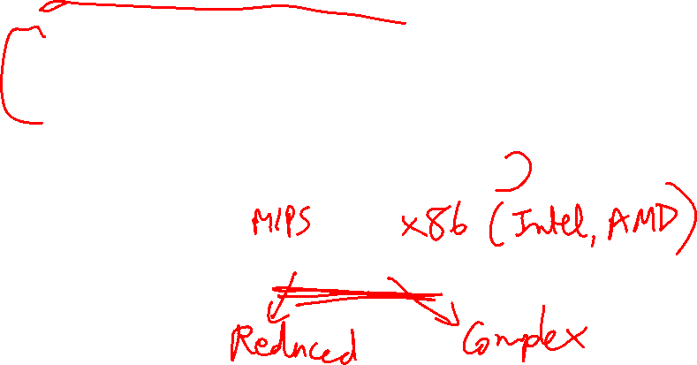
Instruction Set
Important design principles when defining the
instruction set architecture (ISA):
  keep the hardware simple – the chip must only
  implement basic primitives and run fast
  keep the instructions regular – simplifies the
  decoding/scheduling of instructions
  We will later discuss RISC vs CISC

Slide 7
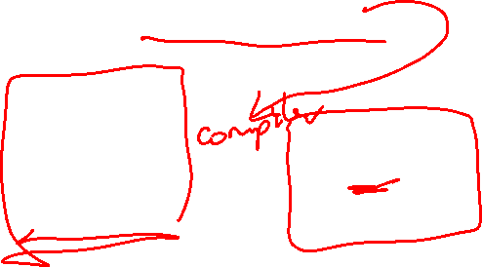
Example
C code a = b + c + d + e;
translates into the following assembly code:
add a, b, c add a, b, c
add a, a, d or add f, d, e
add a, a, e add a, a, f
Instructions are simple: fixed number of operands (unlike C)
A single line of C code is converted into multiple lines of
assembly code
Some sequences are better than others… the second
sequence needs one more (temporary) variable f

Slide 8

Subtract Example
C code f = (g + h) – (i + j);
translates into the following assembly code:
add t0, g, h add f, g, h
add t1, i, j or sub f, f, i
sub f, t0, t1 sub f, f, j
Each version may produce a different result because
floating-point operations are not necessarily
associative and commutative… more on this later

Slide 9
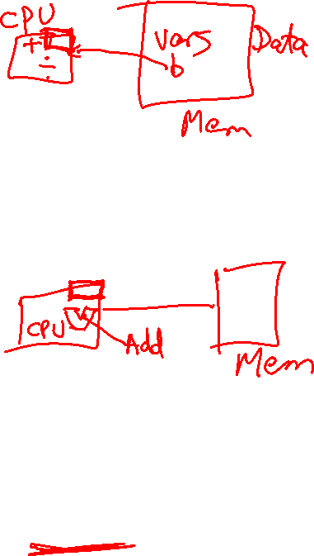
Operands
In C, each “variable” is a location in memory
In hardware, each memory access is expensive – if
variable a is accessed repeatedly, it helps to bring the
variable into an on-chip scratchpad and operate on the
scratchpad (registers)
To simplify the instructions, we require that each
instruction (add, sub) only operate on registers
Note: the number of operands (variables) in a C program is
very large; the number of operands in assembly is fixed…
there can be only so many scratchpad registers

Slide 10
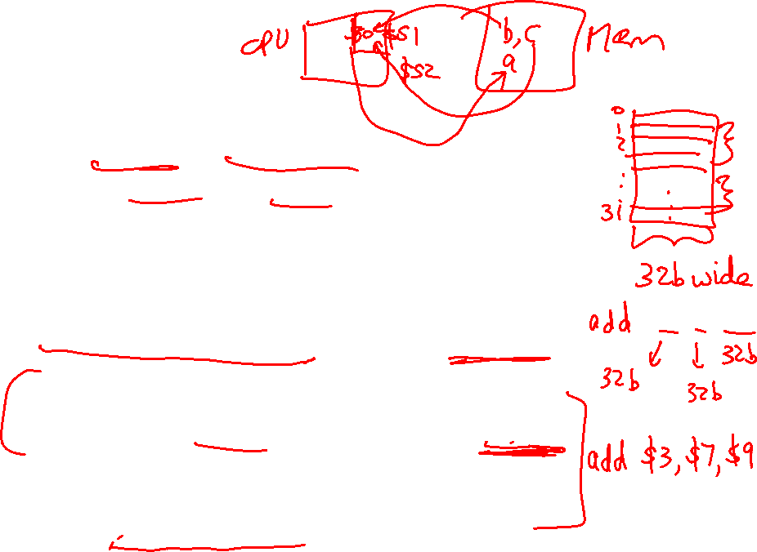
Registers
The MIPS ISA has 32 registers (x86 has 8 registers) –
Why not more? Why not less?
Each register is 32 bits wide (modern 64-bit architectures
have 64-bit wide registers)
A 32-bit entity (4 bytes) is referred to as a word
To make the code more readable, registers are
partitioned as $s0-$s7 (C/Java variables), $t0-$t9
(temporary variables)…
add $s0, $s1, $s2

Slide 11
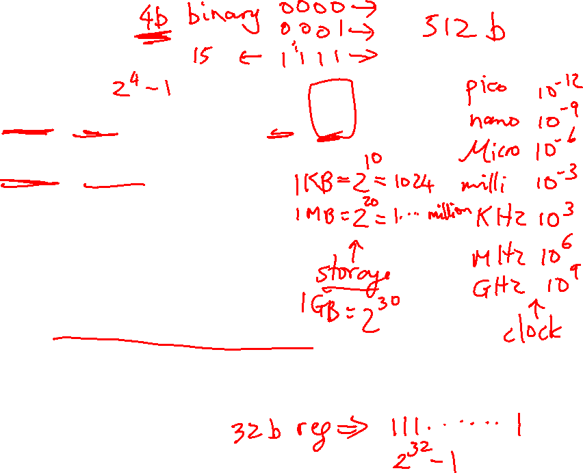
Binary Stuff
8 bits = 1 Byte, also written as 8b = 1B
1 word = 32 bits = 4B
1KB = 1024 B = 2¹⁰ B
1MB = 1024 x 1024 B = 2²⁰ B
1GB = 1024 x 1024 x 1024 B = 2³⁰ B
A 32-bit memory address refers to a number between
0 and 2³² – 1, i.e., it identifies a byte in a 4GB memory

Slide 12
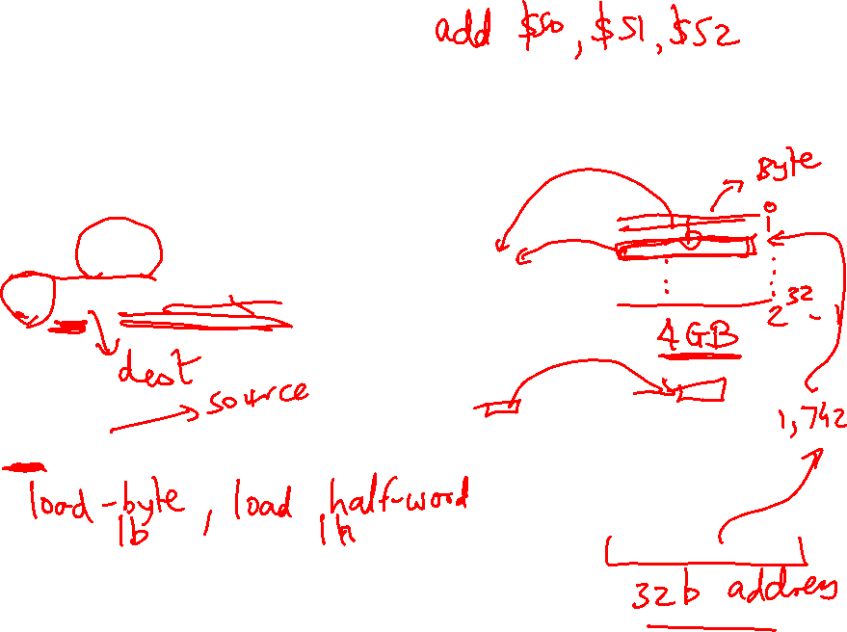
Memory Operands
Values must be fetched from memory before (add and sub)
instructions can operate on them
Load word
lw $t0, memory-address
Store word
sw $t0, memory-address
How is memory-address determined?
Memory
Register
Memory
Register

Slide 13
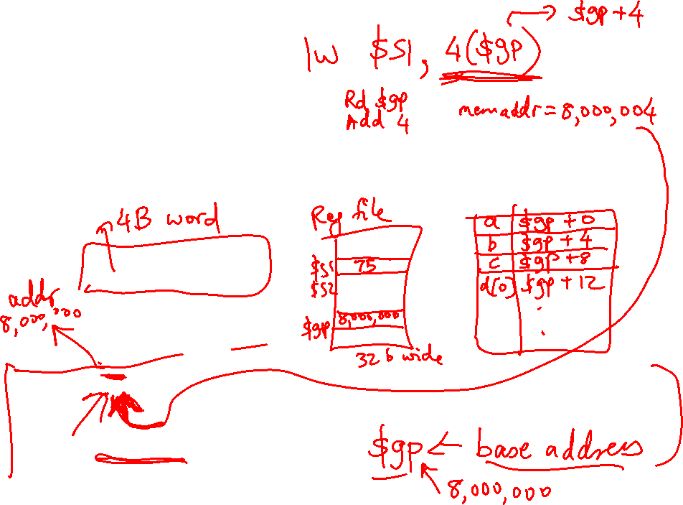
Memory Address
The compiler organizes data in memory… it knows the
location of every variable (saved in a table)… it can fill
in the appropriate mem-address for load-store instructions
int a, b, c, d[10]
…
Memory
Base address

Slide 14

Memory Organization
$gp points to area in memory that saves global variables
Stack
Dynamic data (heap)
Static data (globals)
$gp
Text (instructions)

Slide 15
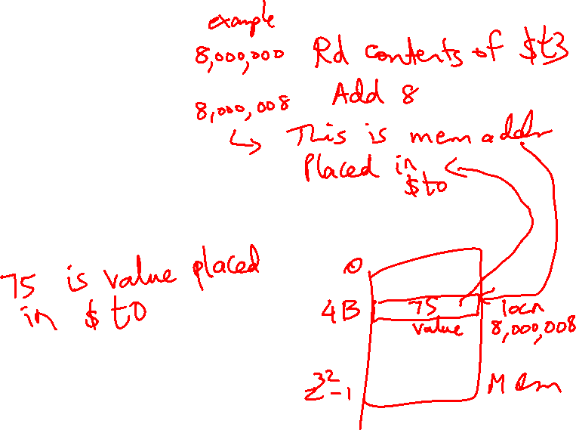
Memory Instruction Format
The format of a load instruction:
destination register
source address
lw $t0, 8($t3)
any register
a constant that is added to the register in parentheses

Slide 16
Memory Instruction Format
The format of a store instruction:
source register
destination address
sw $t0, 8($t3)
any register
a constant that is added to the register in parentheses

Slide 17
Example
int a, b, c, d[10];
addi $gp, $zero, 1000 # assume that data is stored at
# base address 1000; placed in $gp;
# $zero is a register that always
# equals zero
lw $s1, 0($gp) # brings value of a into register $s1
lw $s2, 4($gp) # brings value of b into register $s2
lw $s3, 8($gp) # brings value of c into register $s3
lw $s4, 12($gp) # brings value of d[0] into register $s4
lw $s5, 16($gp) # brings value of d[1] into register $s5

Slide 18
Example
Convert to assembly:
C code: d[3] = d[2] + a;

Slide 19
Example
Convert to assembly:
C code: d[3] = d[2] + a;
Assembly (same assumptions as previous example):
lw $s0, 0($gp) # a is brought into $s0
lw $s1, 20($gp) # d[2] is brought into $s1
add $s2, $s0, $s1 # the sum is in $s2
sw $s2, 24($gp) # $s2 is stored into d[3]
Assembly version of the code continues to expand!

