Slide 1

Lecture 1: CS/ECE 3810 Introduction
Today’s topics:
  Why computer organization is important
  Logistics
  Modern trends

Slide 2
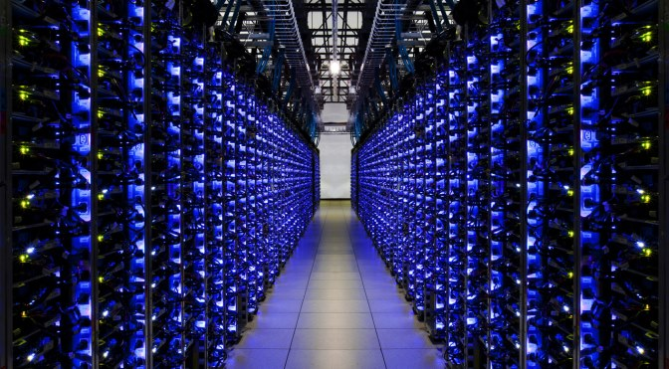
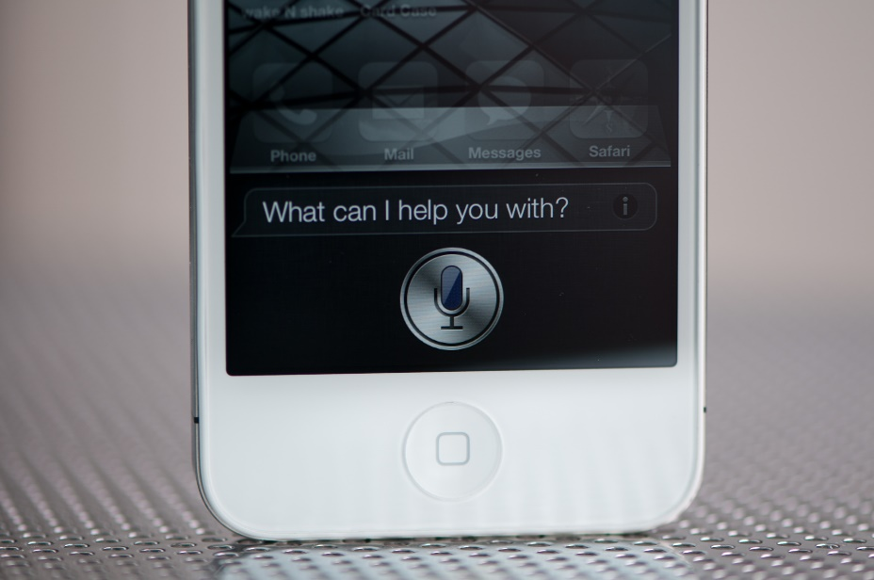
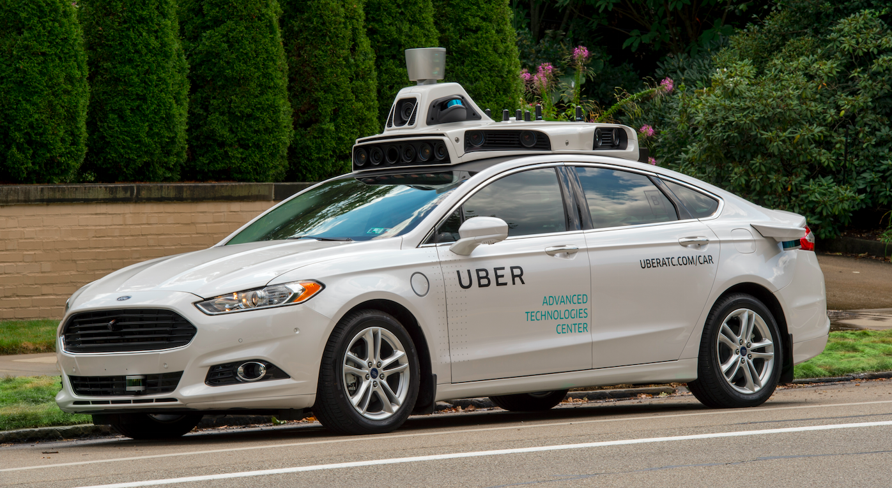
Why Computer Organization
Image credits: uber, extremetech, anandtech

Slide 3


Why Computer Organization
Image credits: gizmodo

Slide 4
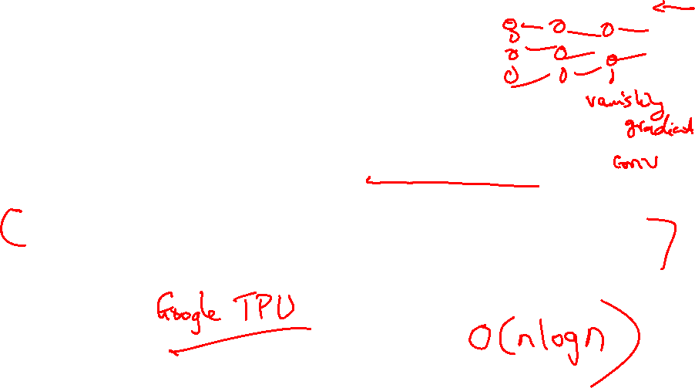
Why Computer Organization
Efficiency is important! You learn about big-O notation in
Algorithms, you learn about the constants in this class
The AI revolution owes a lot to fast hardware; a complete
CS/CE education includes a deep understanding of hardware

Slide 5

Why Computer Organization
Embarrassing if you are a BS in CS/CE and can’t make sense of
the following terms: DRAM, pipelining, cache hierarchies, I/O,
virtual memory, …
Embarrassing if you are a BS in CS/CE and can’t decide which
processor to buy: 4.4 GHz Intel Core i9 or
4.7 GHz AMD Ryzen 9 (reason about performance/power)
Obvious first step for chip designers, compiler/OS writers
Will knowledge of the hardware help you write better and
more secure programs?

Slide 6
Must a Programmer Care About Hardware?
Must know how to reason about program performance
and energy and security
Memory management: if we understand how/where data
is placed, we can help ensure that relevant data is nearby
Thread management: if we understand how threads
interact, we can write smarter multi-threaded programs
→ Why do we care about multi-threaded programs?

Slide 7

Example
200x speedup for matrix vector multiplication
Data level parallelism: 3.8x
Loop unrolling and out-of-order execution: 2.3x
Cache blocking: 2.5x
Thread level parallelism: 14x
Further, can use accelerators to get an additional 100x.

Slide 8
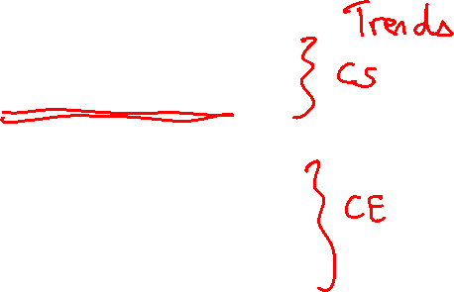
Key Topics
Moore’s Law, power wall
Use of abstractions
Assembly language
Computer arithmetic
Pipelining
Using predictions
Memory hierarchies
Accelerators
Reliability and Security

Slide 9
Logistics
See class web-page for syllabus/resources
https://www.cs.utah.edu/~rajeev/cs3810
TAs and office hours: on the class webpage
Most communication on Canvas; email me directly to set
up meetings, or meet me in office hours right before class
Textbook: Computer Organization – HW/SW Interface,
Patterson and Hennessy, 5th or 6th edition

Slide 10
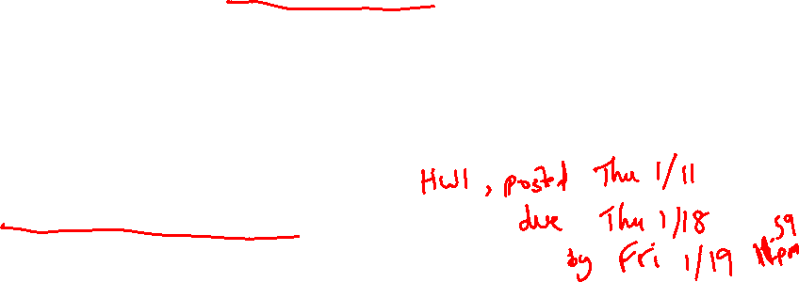
Course Organization
30% midterm, 40% final, 30% assignments
~10 assignments – you may skip two; automatic 1.5 day
extension until Wed/Fri late night; upload on Canvas
Co-operation policy: you may discuss – you may not see
someone else’s written matter when writing your solution
Exams are open-notes (1 page)
Print slides just before class
Screencast YouTube videos

Slide 11
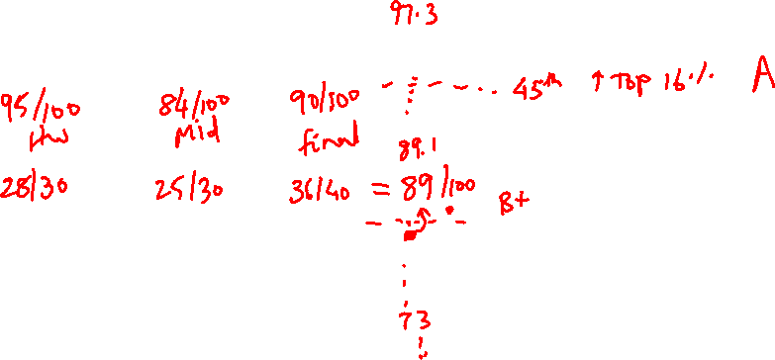
Grading Policy
Grading by rank (32% receive A or A-, 40% receive B+/B/B-)
About 13% receive D+ or lower, scores below 70
No tolerance for cheating (see class webpage)
Rank in exams matters more than rank in homeworks

Slide 12
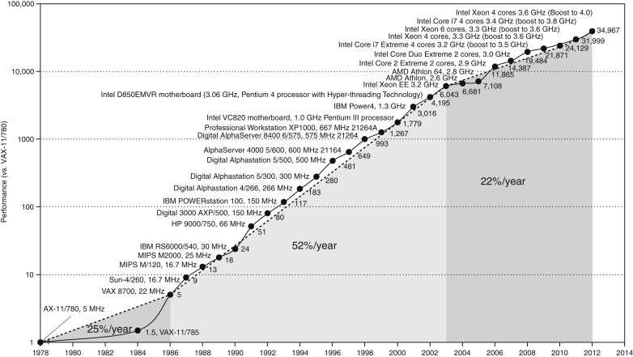
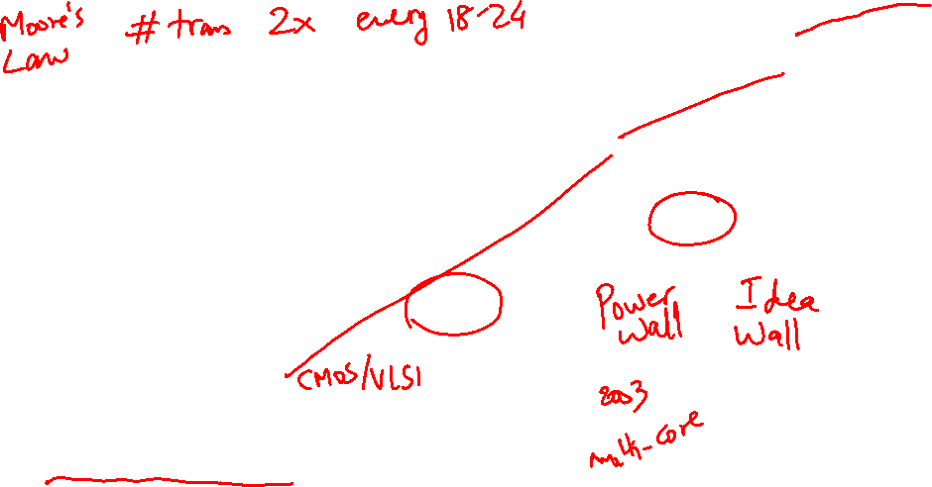
Microprocessor Performance
50% improvement every year!!
What contributes to this improvement?
Why the lower improvement?
Source: H&P Textbook

Slide 13
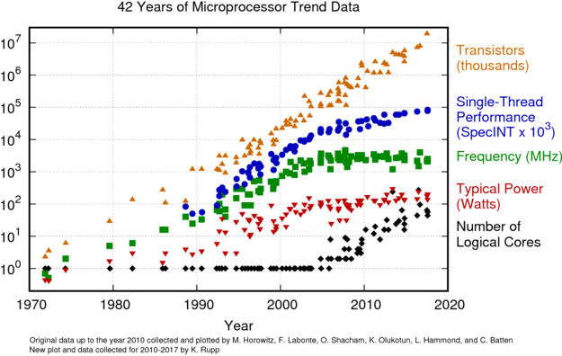
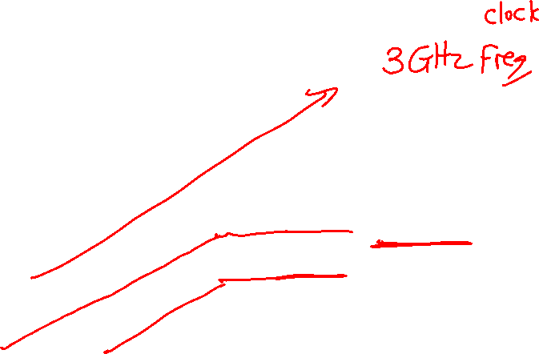
Microprocessor Performance
Source: karlrupp.net

Slide 14
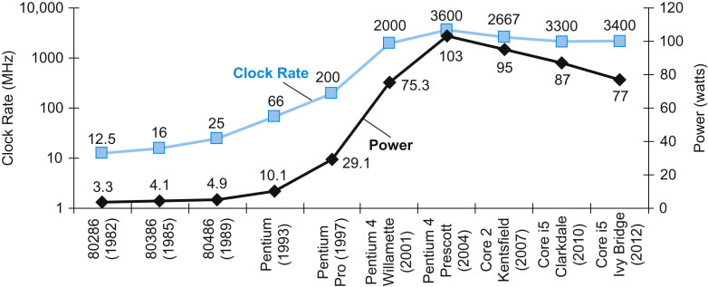

Power Consumption Trends
Dyn power α activity x capacitance x voltage² x frequency
Voltage and frequency are somewhat constant now,
while capacitance per transistor is decreasing and number
of transistors (activity) is increasing
Leakage power is also rising (function of #trans and voltage)
Source: H&P Textbook

Slide 15
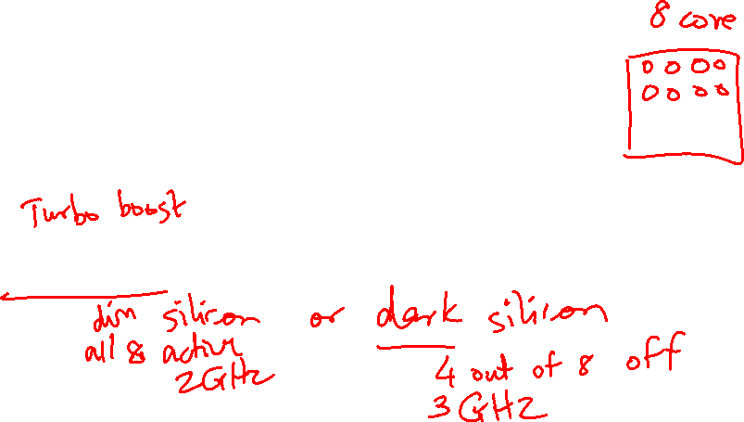
Important Trends
Running out of ideas to improve single thread performance
Power wall makes it harder to add complex features
Power wall makes it harder to increase frequency
Technology scaling likely to end soon
Additional performance provided by: more cores, occasional
spikes in frequency, accelerators

Slide 16
Summary
Three roadblocks: power, ideas, technology scaling
Fixed power budget because of cooling constraints; implies that
frequency can’t be increased; discourages complex ideas
End of voltage (Dennard) scaling in early 2010s; the end of
Moore’s Law also imminent
Has led to dark silicon and dim silicon (occasional turbo)

Slide 17
Next Class
Topics: Trends, Performance, MIPS instruction set
architecture (Chapter 2)
Visit the class web-page
https://www.cs.utah.edu/~rajeev/cs3810

