Slide 1
3810 Review Session
Spring 2023
Hit Record!
Reminders:
Practice exam, annotated slides, class notes, homework solutions
Friday April 28, 8-10am. Room assignments: Last names A-R in
WEB L104. Last names S-Z in WEB 2230.
80-20 post-pre midterm material
Office hours: today until 11:30am, Wed and Thurs 9-11am
No laptops/textbooks. 6 sheets + green sheet. Calculators ok.
SoC code of conduct

Slide 2
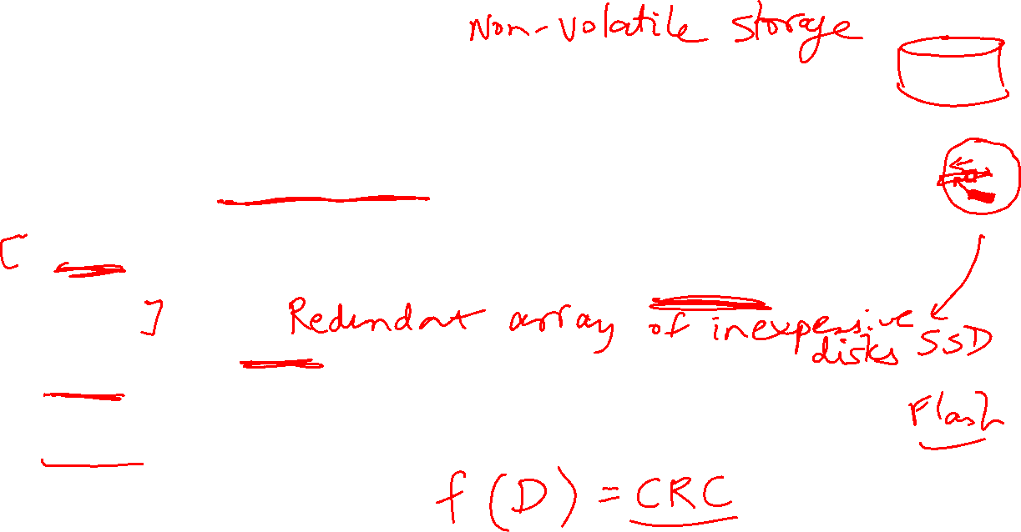
Disks Basics
Disk access remains very slow – mechanical head that has to move to the correct “ring” of data – order of milli-seconds – high enough that a context-switch is best
Focus on other metrics, especially reliability
A sector on the disk is associated with a cyclic redundancy code (CRC) – a hash that tells us if the read data is correct or not – it is simply an error detector, not an error corrector
To correct the error, RAID is commonly used
Reliability measures continuous service accomplishment and is usually expressed as mean time to failure (MTTF)
Availability is measured as MTTF/(MTTF+MTTRecovery)

Slide 3
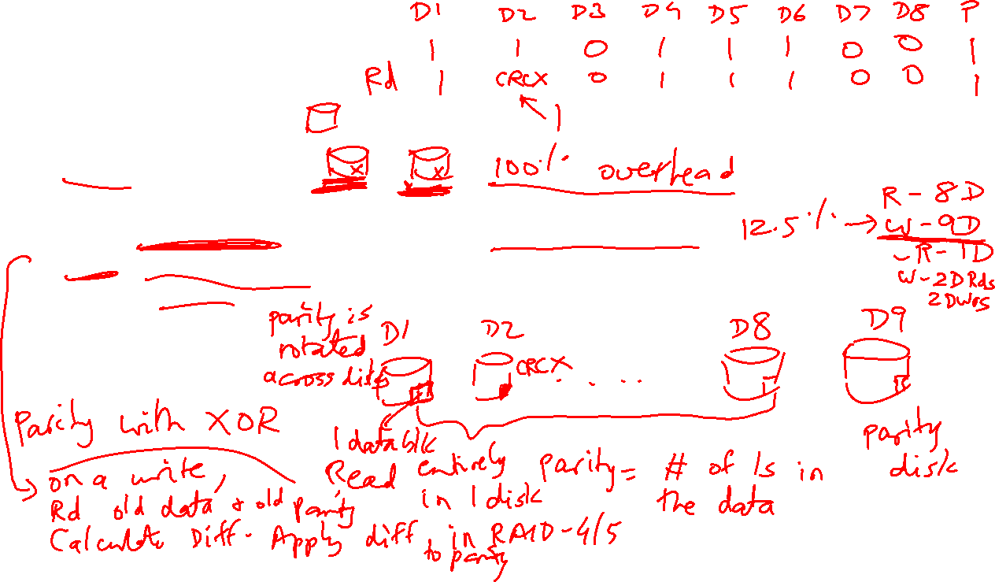
RAID
RAID 0: no redundancy
RAID 1: mirroring
RAID 2 and 6: memory-style ECC and rarely deployed
RAID 3: bit-interleaved, lower cost, but no query-level parallelism
RAID 4: block-interleaved, lower cost, query-level parallelism, but write bottleneck
RAID 5: block-interleaved, lower cost, query-level parallelism, write parallelism
Parity and XOR!

Slide 4
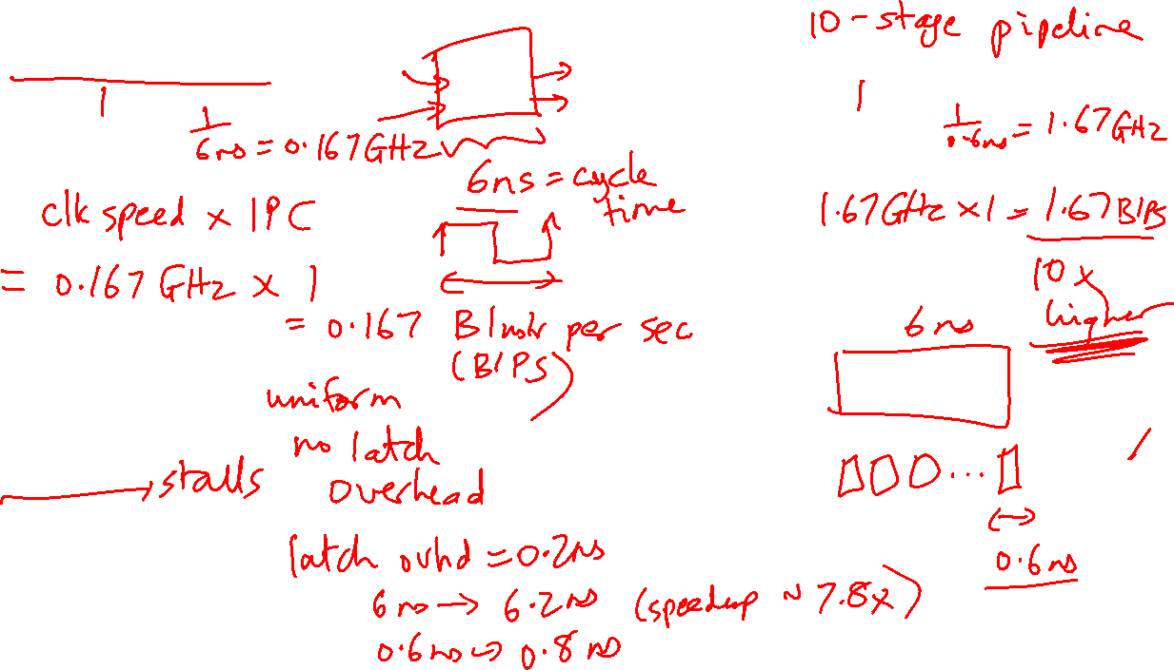
Unpipelined processor
CPI:
Clock speed:
Throughput:
Pipelined processor
CPI:
Clock speed:
Throughput:
Circuit Assumptions
Length of full circuit:
Length of each stage:
No hazards
Pipeline Performance

Slide 5
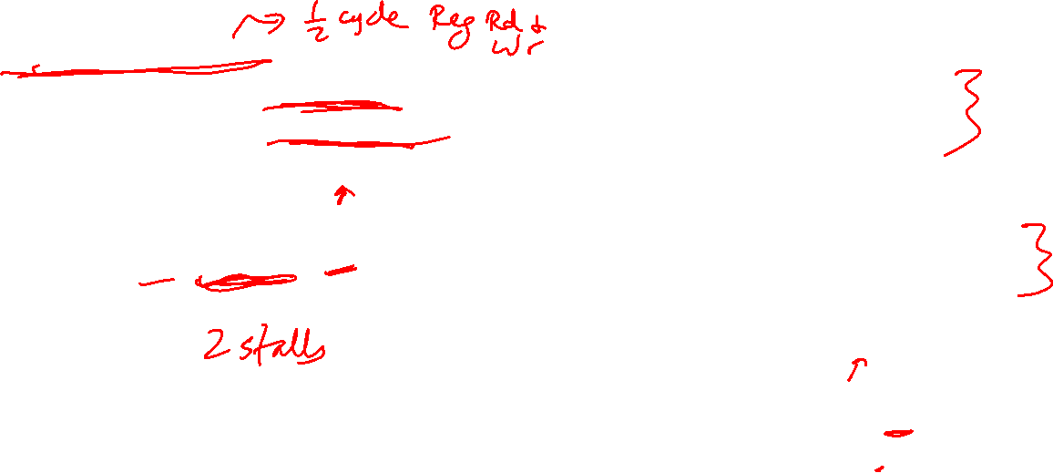
No Bypassing
(for the 5-stage pipeline)
Point of production: always RW middle
Point of consumption: always D/R middle
Bypassing
Point of production:
add, sub, etc.: end of ALU
lw: end of DM
Point of consumption:
add, sub, lw: start of ALU
sw $1, 8($2): start of ALU for $2,
start of DM for $1
* PoP
I1 add: IF DR AL DM RW
I2 add: IF DR DR DR AL DM RW
* PoC
* PoP
I1 add: IF DR AL DM RW
I2 add: IF DR AL DM RW
* PoC
Data Hazards

Slide 6
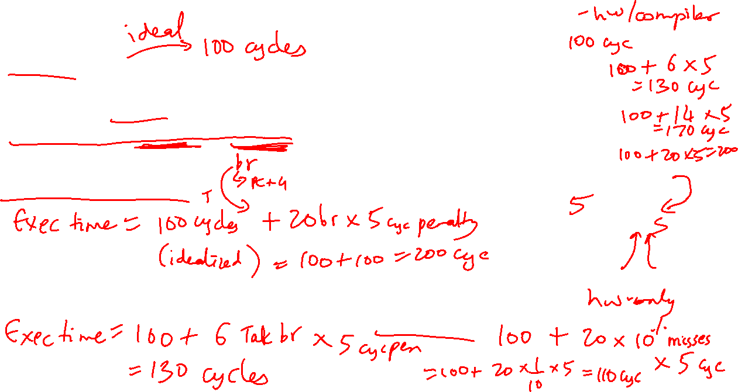
Assumptions
100 instructions
20 branches
14 Not-Taken, 6 Taken
Branch resolved in 6th cycle (penalty of 5)
Approach 3: Branch Delay Slot
Option A: always useful
Option B: useful when the branch
goes along common fork
Option C: useful when the branch
goes along uncommon fork
Option D: no-op, always non-useful
Approach 1: Panic and wait
Option A
Branch
Slot
NTaken Taken
Option B Option C
Approach 2: Fetch-next-instr
Approach 4: Branch predictor
Accuracy of 90%
Control Hazards

Slide 7
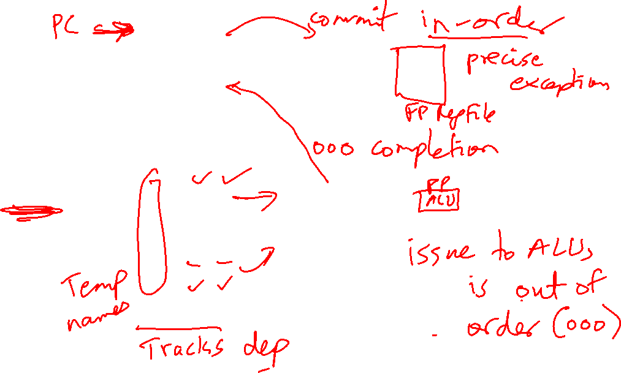
Reorder Buffer (ROB)
Branch prediction
and instr fetch
Instr 1
Instr 2
Instr 3
Instr 4
Instr 5
Instr 6
T1
T2
T3
T4
T5
T6
Register File
R1-R32
R1 ← R1+R2
R2 ← R1+R3
BEQZ R2
R3 ← R1+R2
R1 ← R3+R2
Decode &
Rename
T1 ← R1+R2
T2 ← T1+R3
BEQZ T2
T4 ← T1+T2
T5 ← T4+T2
ALU
ALU
ALU
Instr Fetch Queue
Results written to
ROB and tags
broadcast to IQ
Issue Queue (IQ)
Out of Order Processor

Slide 8
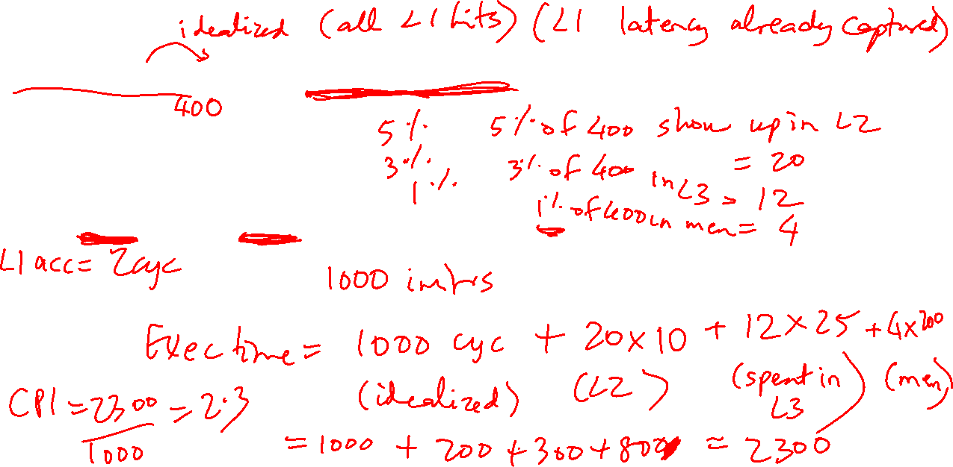
Assumptions
1000 instructions, 1000 cycles, no stalls with L1 hits
# loads/stores:
% of loads/stores that show up at L2:
% of loads/stores that show up at L3:
% of loads/stores that show up at mem:
L2 acc = 10 cyc, L3 acc = 25 cyc, mem acc = 200 cyc
Cache Latency

Slide 9
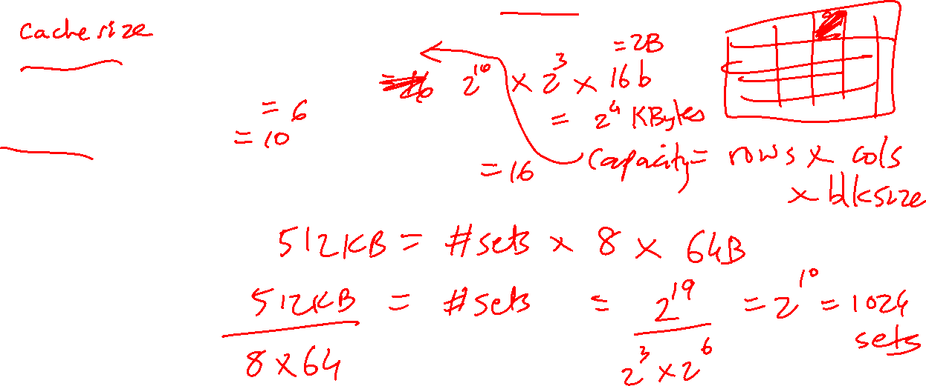
Assumptions
512KB cache, 8-way set-associative, 64-byte blocks, 32-bit addresses
Data array size = #sets x #ways x blocksize
Tag array size = #sets x #ways x tagsize
Offset bits = log(blocksize)
Index bits = log(#sets)
Tag bits + index bits + offset bits = addresswidth
Cache Size

Slide 10
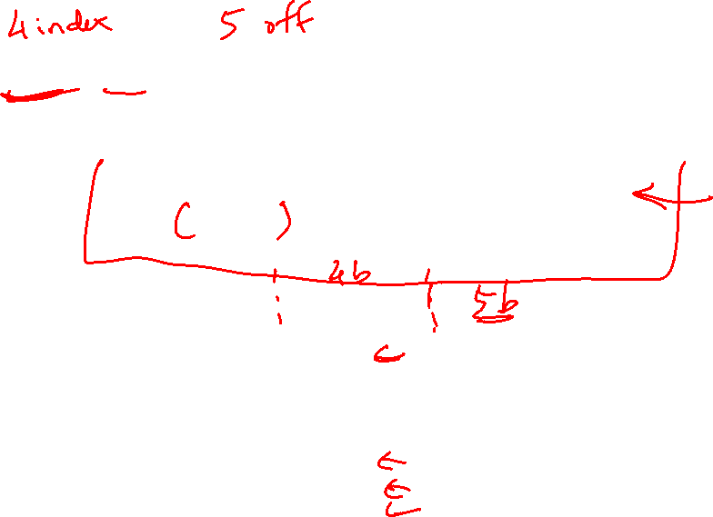
Assumptions
16 sets, 1 way, 32-byte blocks
Access pattern: 4 40 400 480 512 520 1032 1540
Offset = address % 32 (address modulo 32, extract last 5)
Index = address/32 % 16 (shift right by 5, extract last 4)
Tag = address/512 (shift address right by 9)
32-bit address
23 bits tag 4 bits index 5 bits offset H/M Evicted address
4: 0 0 4 M Inv
40: 0 1 8 M Inv
400: 0 12 16 M Inv
480: 0 15 0 M Inv
512: 1 0 0 M 0
520: 1 0 8 H -
1032: 2 0 8 M 512
1540: 3 0 4 M 1024
Cache Hits/Misses

Slide 11
Example 0b
Show how the following addresses map to the cache and yield hits or misses.
The cache is direct-mapped, has 16 sets, and a 64-byte block size.
Addresses: 8, 96, 32, 480, 976, 1040, 1096
Offset = address % 64 (address modulo 64, extract last 6)
Index = address/64 % 16 (shift right by 6, extract last 4)
Tag = address/1024 (shift address right by 10)
32-bit address
22 bits tag 4 bits index 6 bits offset
8: 0 0 8 M
96: 0 1 32 M
32: 0 0 32 H
480: 0 7 32 M
976: 0 15 16 M
1040: 1 0 16 M
1096: 1 1 8 M
.
.
.

Slide 12
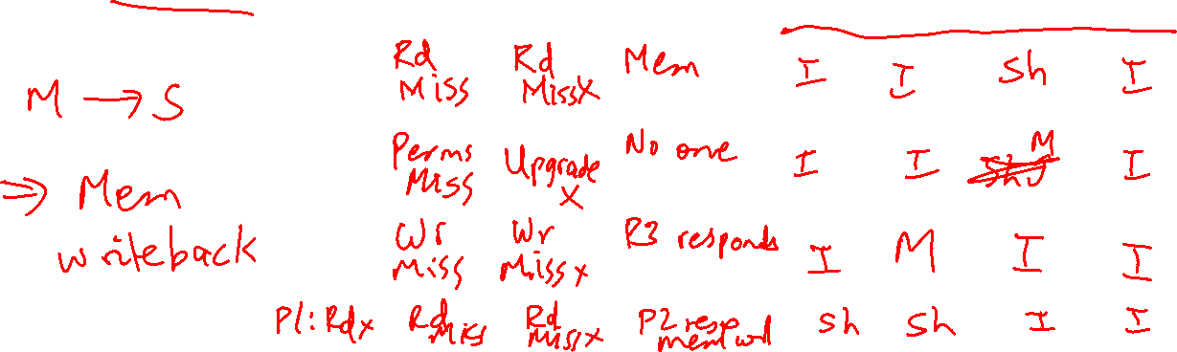

Slide 13
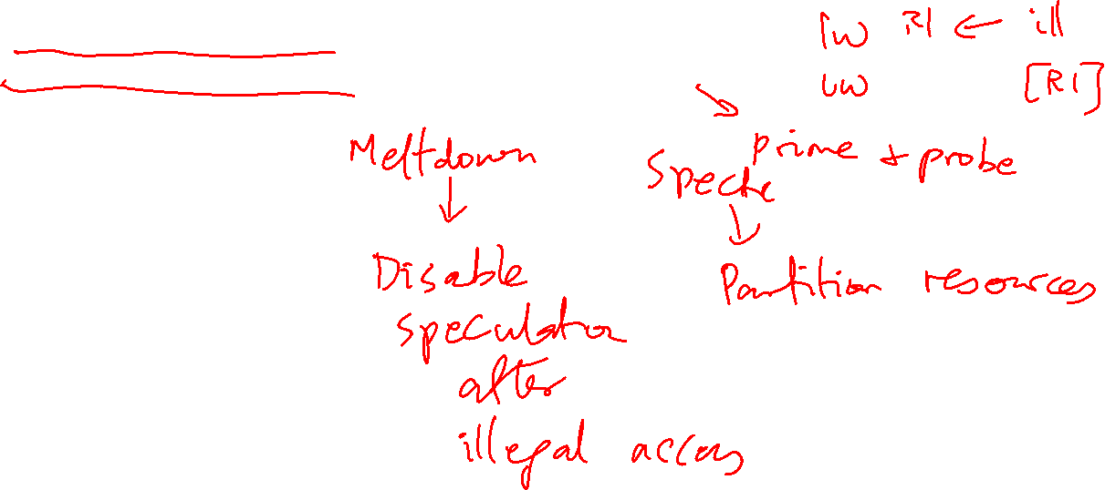
Questions to ask yourself:
How does Meltdown work?
How does Spectre work?
How can you force a footprint? (the relevant code sequence)
How can you examine footprints? (exploiting the side channel)
How can you defend against these attacks?
Security

Slide 14

Questions to ask yourself:
What does the programmer/compiler deal with?
What does the OS deal with?
How is translation done efficiently?
Virtual Memory

Slide 15
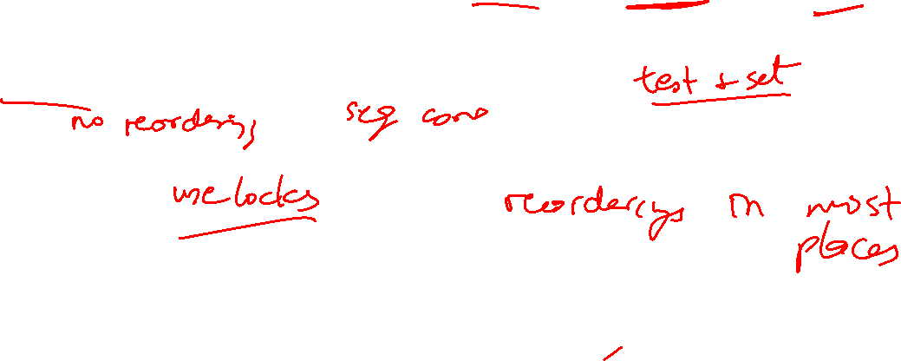
Questions to ask yourself:
Why do multiprocs need to deal with prog. models, coherence, synchronization, consistency?
What are race conditions?
What is an example synchronization primitive and how is it implemented?
What consistency model is assumed by a programmer?
Why is it slow?
How do I make life easier for the programmer and provide high performance?
Synchronization, Consistency

Slide 16
Questions to ask yourself:
What are the central philosophies in a GPU?
In what ways does the GPU design differ from a CPU?
What are the different ways that disks provide high reliability?
Can you explain how parity is used to recover lost data?
GPUs, Disks

