Slide 1
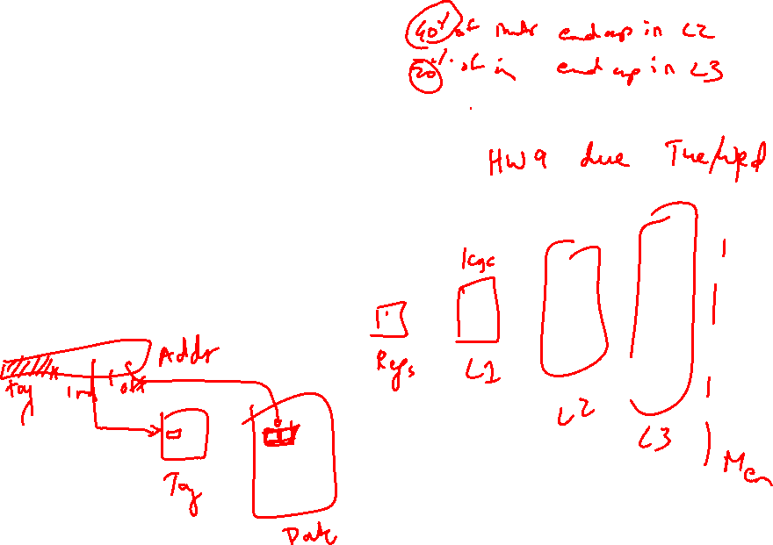
Lecture 23: Cache, Memory
Today’s topics:
  Example problems in cache design
  Caching policies
  Main memory system

Slide 2
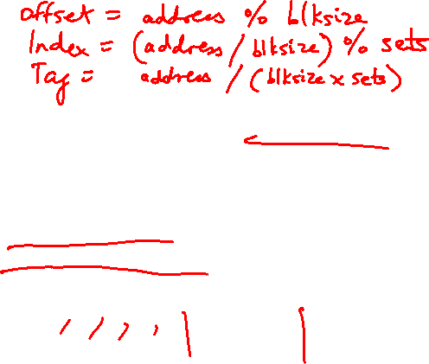
Example 2
Show how the following addresses map to the cache and yield hits or misses.
The cache is direct-mapped, has 16 sets, and a 64-byte block size.
Addresses: 8, 96, 32, 480, 976, 1040, 1096
Offset = address % 64 (address modulo 64, extract last 6)
Index = address/64 % 16 (shift right by 6, extract last 4)
Tag = address/1024 (shift address right by 10)
32-bit address
22 bits tag 4 bits index 6 bits offset
8: 0 0 8 M
96: 0 1 32 M
32: 0 0 32 H
480: 0 7 32 M
976: 0 15 16 M
1040: 1 0 16 M
1096: 1 1 8 M
.
.
.

Slide 3
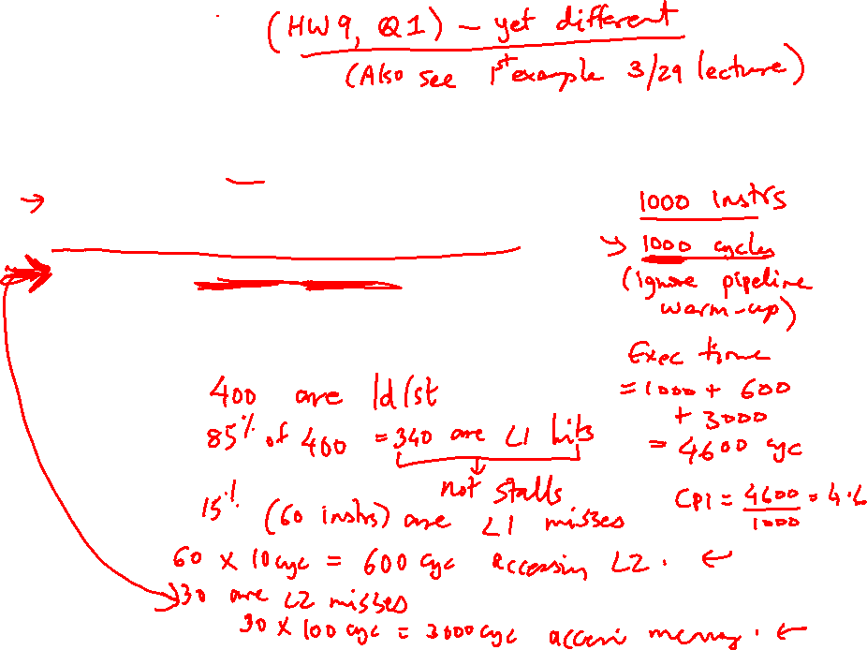
Example 3
A pipeline has CPI 1 if all loads/stores are L1 cache hits
40% of all instructions are loads/stores
85% of all loads/stores hit in 1-cycle L1
50% of all (10-cycle) L2 accesses are misses
Memory access takes 100 cycles
What is the CPI?

Slide 4
Example 3
A pipeline has CPI 1 if all loads/stores are L1 cache hits
40% of all instructions are loads/stores
85% of all loads/stores hit in 1-cycle L1
50% of all (10-cycle) L2 accesses are misses
Memory access takes 100 cycles
What is the CPI?
Start with 1000 instructions
1000 cycles (includes all 400 L1 accesses)
+ 400 (ld/st) x 15% x 10 cycles (the L2 accesses)
+ 400 x 15% x 50% x 100 cycles (the mem accesses)
= 4,600 cycles
CPI = 4.6

Slide 5
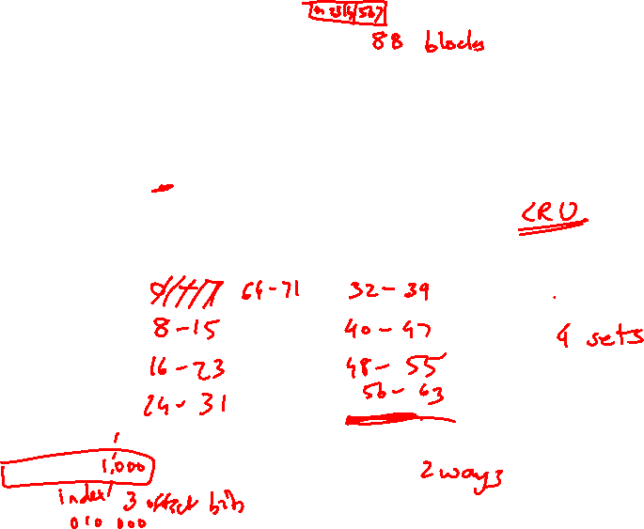
Example 4
Assume that addresses are 8 bits long
How many of the following address requests
are hits/misses?
4, 7, 10, 13, 16, 24, 36, 4, 48, 64, 4, 36, 64, 4
Byte address
00010000
Tag
Way-1
Way-2
8-byte blocks
Tag array
Data array

Slide 6
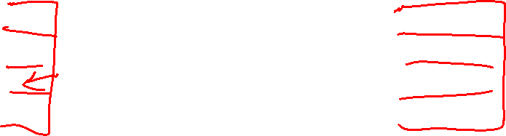
Example 4
Assume that addresses are 8 bits long
How many of the following address requests
are hits/misses?
4, 7, 10, 13, 16, 24, 36, 4, 48, 64, 4, 36, 64, 4
M H M H M M M H M M H M M M
Byte address
00010000
Tag
Way-1
Way-2
8-byte blocks
Tag array
Data array

Slide 7
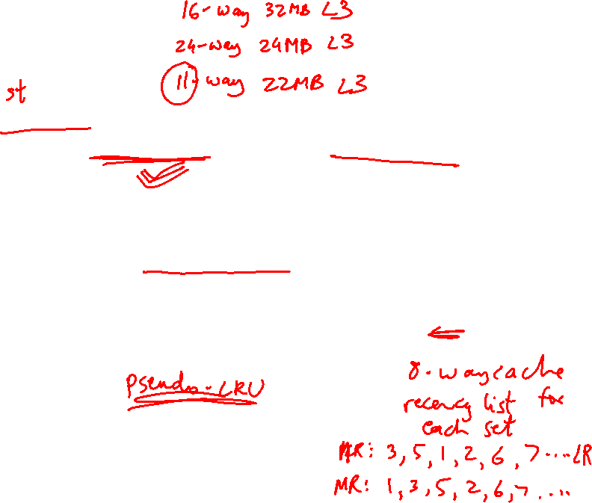
Cache Misses
On a write miss, you may either choose to bring the block
into the cache (write-allocate) or not (write-no-allocate)
On a read miss, you always bring the block in (spatial and
temporal locality) – but which block do you replace?
  no choice for a direct-mapped cache
  randomly pick one of the ways to replace
  replace the way that was least-recently used (LRU)
  FIFO replacement (round-robin)

Slide 8
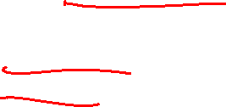
Writes
When you write into a block, do you also update the
copy in L2?
  write-through: every write to L1 → write to L2
  write-back: mark the block as dirty, when the block
  gets replaced from L1, write it to L2
Writeback coalesces multiple writes to an L1 block into one
L2 write
Writethrough simplifies coherency protocols in a
multiprocessor system as the L2 always has a current
copy of data

Slide 9
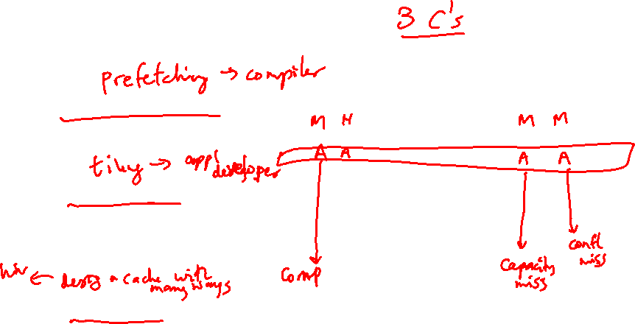
Types of Cache Misses
Compulsory misses: happens the first time a memory
word is accessed – the misses for an infinite cache
Capacity misses: happens because the program touched
many other words before re-touching the same word – the
misses for a fully-associative cache
Conflict misses: happens because two words map to the
same location in the cache – the misses generated while
moving from a fully-associative to a direct-mapped cache

Slide 10
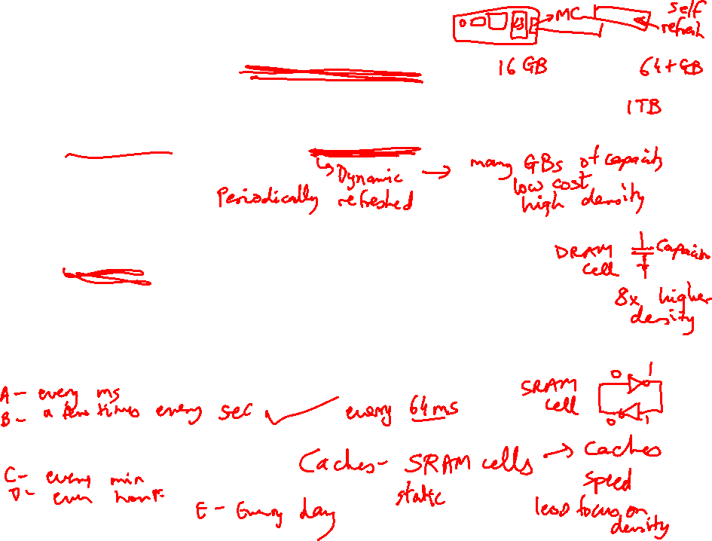
Off-Chip DRAM Main Memory
Main memory is stored in DRAM cells that have much
higher storage density
DRAM cells lose their state over time – must be refreshed
periodically, hence the name Dynamic
A number of DRAM chips are aggregated on a DIMM to
provide high capacity – a DIMM is a module that plugs
into a bus on the motherboard
DRAM access suffers from long access time and high
energy overhead

Slide 11
Memory Architecture
Processor
Bank
Row Buffer
Memory Controller
Address/Cmd
DIMM
Data
DIMM: a PCB with DRAM chips on the back and front
The memory system is itself organized into ranks and banks; each
bank can process a transaction in parallel
Each bank has a row buffer that retains the last row touched in a bank
(it’s like a cache in the memory system that exploits spatial locality)
(row buffer hits have a lower latency than a row buffer miss)

