Slide 1

Lecture 19: Pipelining
Today’s topics:
  Data hazards and instruction scheduling
  Control hazards

Slide 2
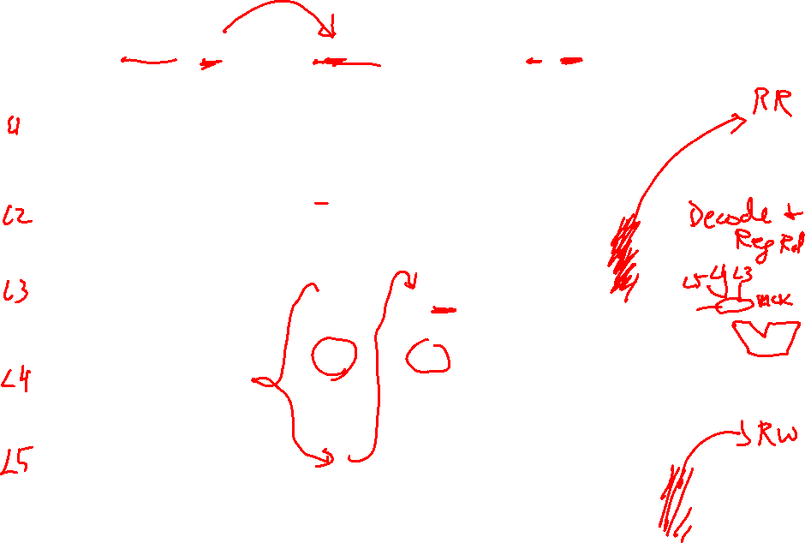
Example 2 – Bypassing
Show the instruction occupying each stage in each cycle (with bypassing)
if I1 is R1+R2→R3 and I2 is R3+R4→R5 and I3 is R3+R8→R9.
Identify the input latch for each input operand.
CYC-1
CYC-2
CYC-3
CYC-4
CYC-5
CYC-6
CYC-7
CYC-8
IF
I1
IF
I2
IF
I3
IF
I4
IF
I5
IF
IF
IF
D/R
D/R
I1
D/R
I2
D/R
I3
D/R
I4
D/R
D/R
D/R
L3 L3 L4 L3 L5 L3
ALU
ALU
ALU
I1
ALU
I2
ALU
I3
ALU
ALU
ALU
DM
DM
DM
DM
I1
DM
I2
DM
I3
DM
DM
RW
RW
RW
RW
RW
I1
RW
I2
RW
I3
RW

Slide 3
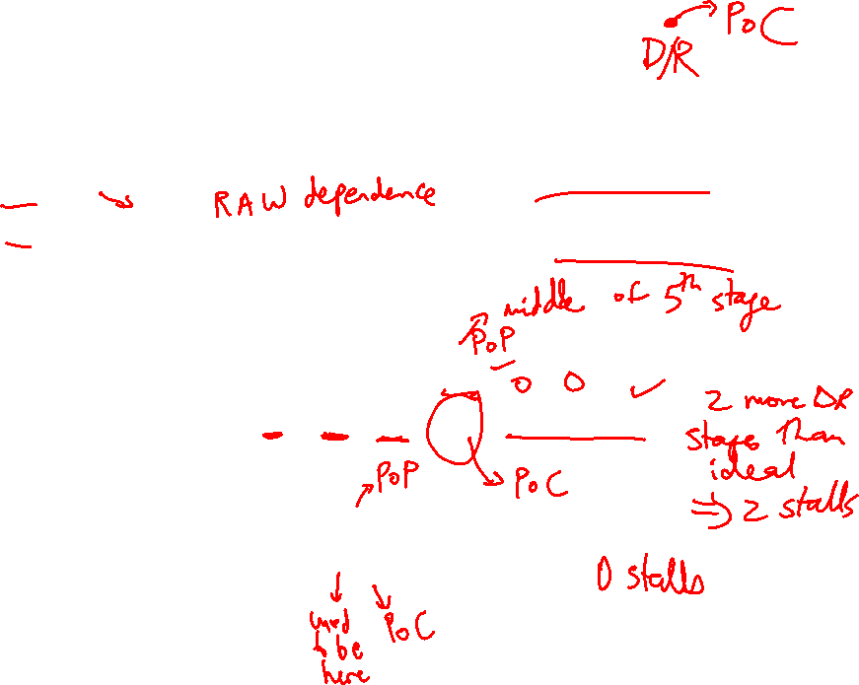
Problem 0
Point of Production
add $1, $2, $3
add $5, $1, $4
Without bypassing:
add $1, $2, $3: IF DR AL DM RW
add $5, $1, $4: IF DR DR DR AL DM RW
With bypassing:
add $1, $2, $3: IF DR AL DM RW
add $5, $1, $4: IF DR AL DM RW
Point of Consumption

Slide 4
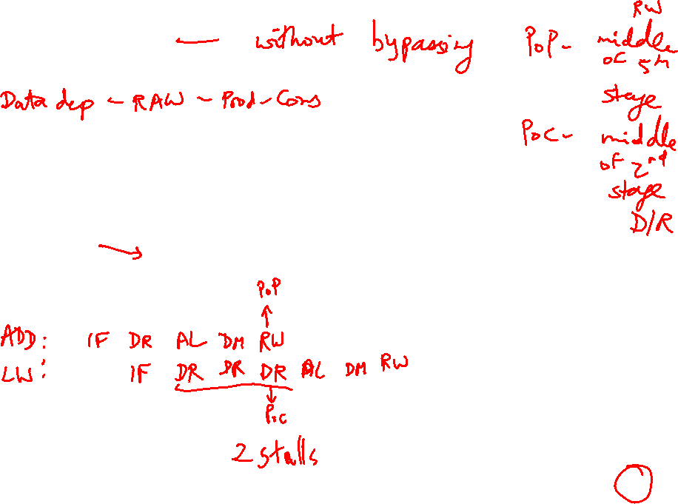
Problem 1
IF
D/R
ALU
DM
RW
add $1, $2, $3
lw $4, 8($1)
IF
D/R
ALU
DM
RW
IF
D/R
ALU
DM
RW
IF
D/R
ALU
DM
RW

Slide 5
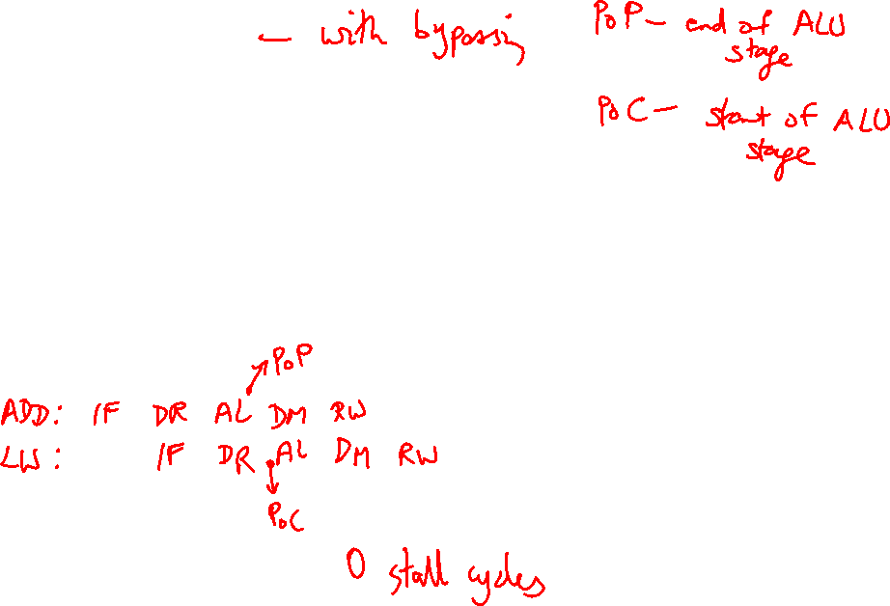
Problem 1
IF
D/R
ALU
DM
RW
add $1, $2, $3
lw $4, 8($1)
IF
D/R
ALU
DM
RW
IF
D/R
ALU
DM
RW
IF
D/R
ALU
DM
RW

Slide 6
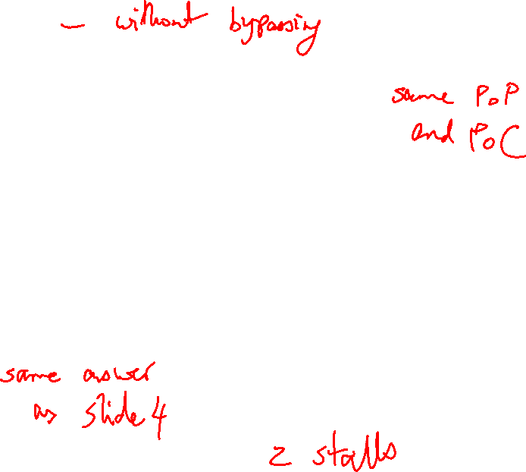
Problem 2
IF
D/R
ALU
DM
RW
lw $1, 8($2)
lw $4, 8($1)
IF
D/R
ALU
DM
RW
IF
D/R
ALU
DM
RW
IF
D/R
ALU
DM
RW

Slide 7
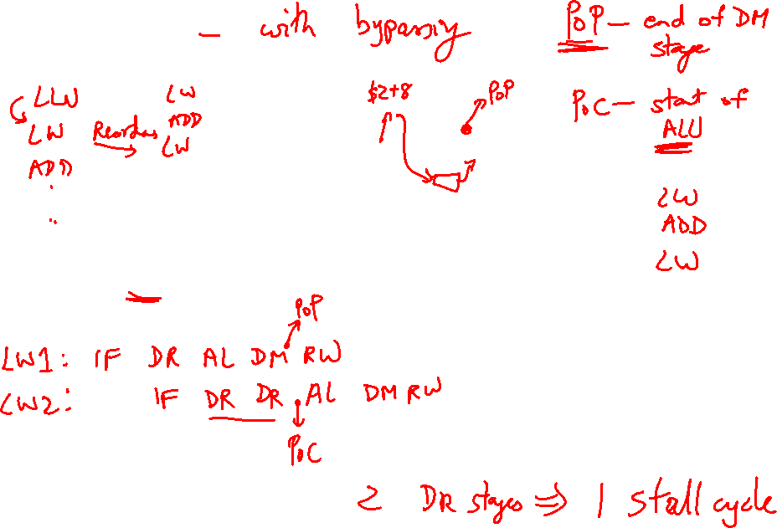
Problem 2
IF
D/R
ALU
DM
RW
lw $1, 8($2)
lw $4, 8($1)
IF
D/R
ALU
DM
RW
IF
D/R
ALU
DM
RW
IF
D/R
ALU
DM
RW

Slide 8
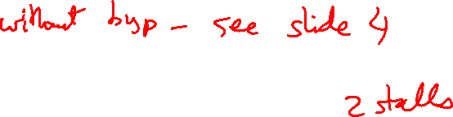
Problem 3
IF
D/R
ALU
DM
RW
lw $1, 8($2)
sw $1, 8($3)
IF
D/R
ALU
DM
RW
IF
D/R
ALU
DM
RW
IF
D/R
ALU
DM
RW

Slide 9
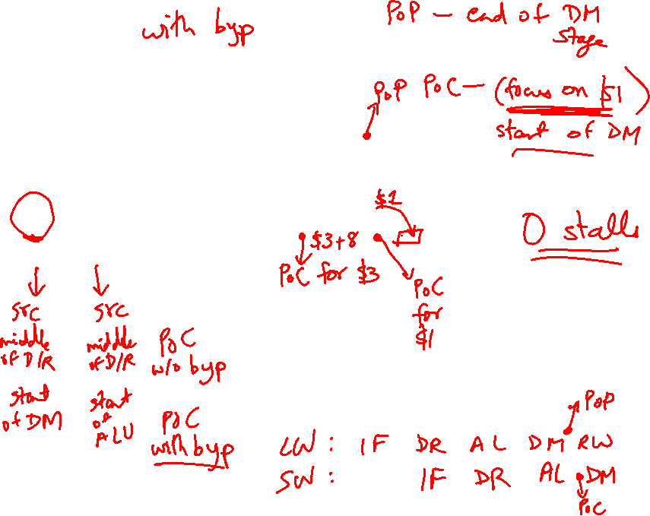
Problem 3
IF
D/R
ALU
DM
RW
lw $1, 8($2)
sw $1, 8($3)
IF
D/R
ALU
DM
RW
IF
D/R
ALU
DM
RW
IF
D/R
ALU
DM
RW

Slide 10
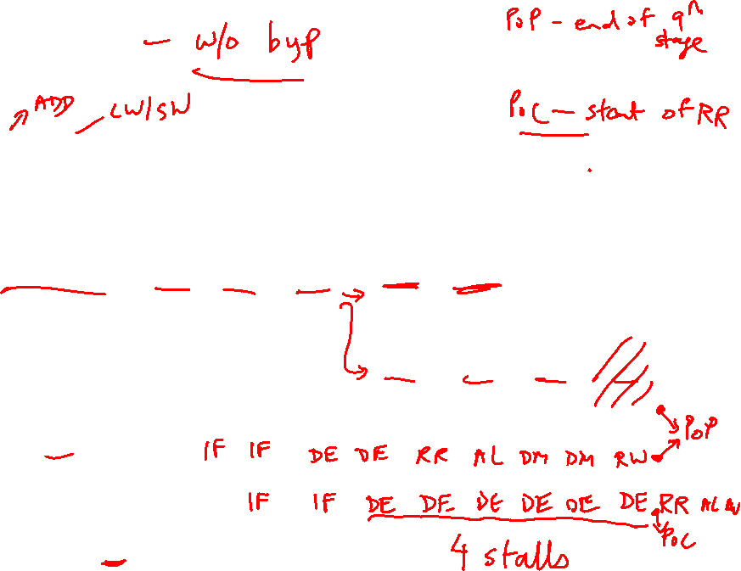
Problem 4
A 7 or 9 stage pipeline, RR and RW take an entire stage
IF
IF
Dec
Dec
RR
ALU
RW
ALU
DM
DM
RW
lw $1, 8($2)
add $4, $1, $3

Slide 11
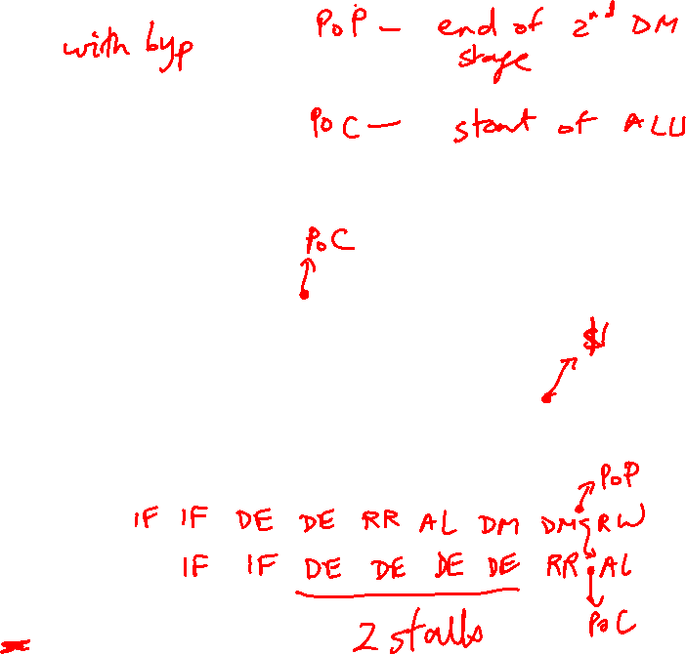
Problem 4
A 7 or 9 stage pipeline, RR and RW take an entire stage
IF
IF
Dec
Dec
RR
ALU
RW
ALU
DM
DM
RW
lw $1, 8($2)
add $4, $1, $3

Slide 12
Problem 4
Without bypassing: 4 stalls
IF:IF:DE:DE:RR:AL:DM:DM:RW
IF: IF :DE:DE:DE:DE: DE :DE:RR:AL:RW
With bypassing: 2 stalls
IF:IF:DE:DE:RR:AL:DM:DM:RW
IF: IF :DE:DE:DE:DE: RR :AL:RW
lw $1, 8($2)
add $4, $1, $3
IF
IF
Dec
Dec
RR
ALU
RW
ALU
DM
DM
RW

Slide 13
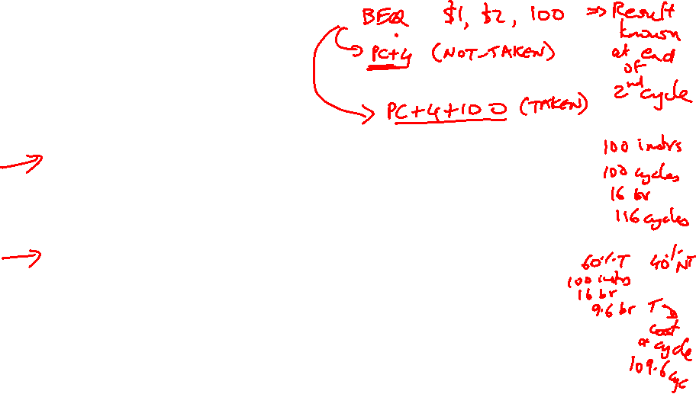
Control Hazards
Simple techniques to handle control hazard stalls:
  for every branch, introduce a stall cycle (note: every
  6th instruction is a branch!)
  assume the branch is not taken and start fetching the
  next instruction – if the branch is taken, need hardware
  to cancel the effect of the wrong-path instruction
  fetch the next instruction (branch delay slot) and
  execute it anyway – if the instruction turns out to be
  on the correct path, useful work was done – if the
  instruction turns out to be on the wrong path,
  hopefully program state is not lost
  make a smarter guess and fetch instructions from the
  expected target

Slide 14
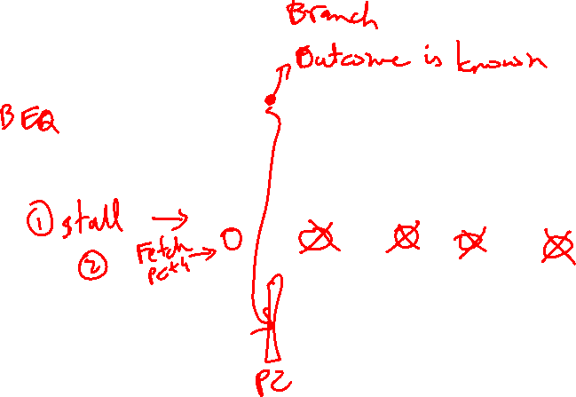
Control Hazards
IF
D/R
ALU
DM
RW
IF
D/R
ALU
DM
RW
IF
D/R
ALU
DM
RW
IF
D/R
ALU
DM
RW

Slide 15
Branch Delay Slots
Source: H&P textbook

