Slide 1
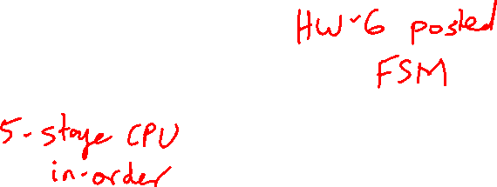
Lecture 16: Basic CPU Design
Today’s topics:
  Single-cycle CPU
  Multi-cycle CPU

Slide 2
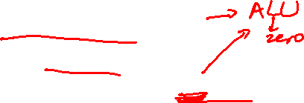
Basic MIPS Architecture
Now that we understand clocks and storage of states,
we’ll design a simple CPU that executes:
  basic math (add, sub, and, or, slt)
  memory access (lw and sw)
  branch and jump instructions (beq and j)

Slide 3
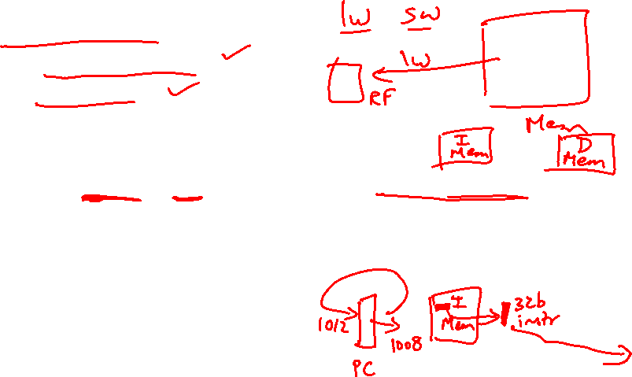
Implementation Overview
We need memory
  to store instructions
  to store data
  for now, let’s make them separate units
We need registers, ALU, and a whole lot of control logic
CPU operations common to all instructions:
  use the program counter (PC) to pull instruction out
  of instruction memory
  read register values

Slide 4
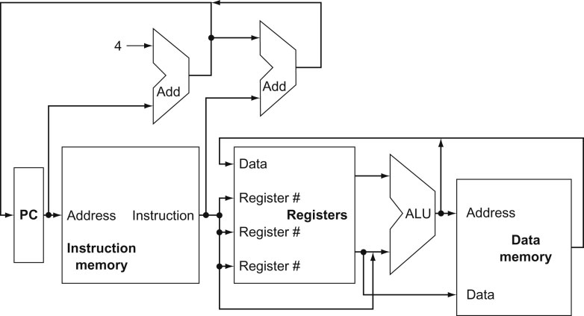
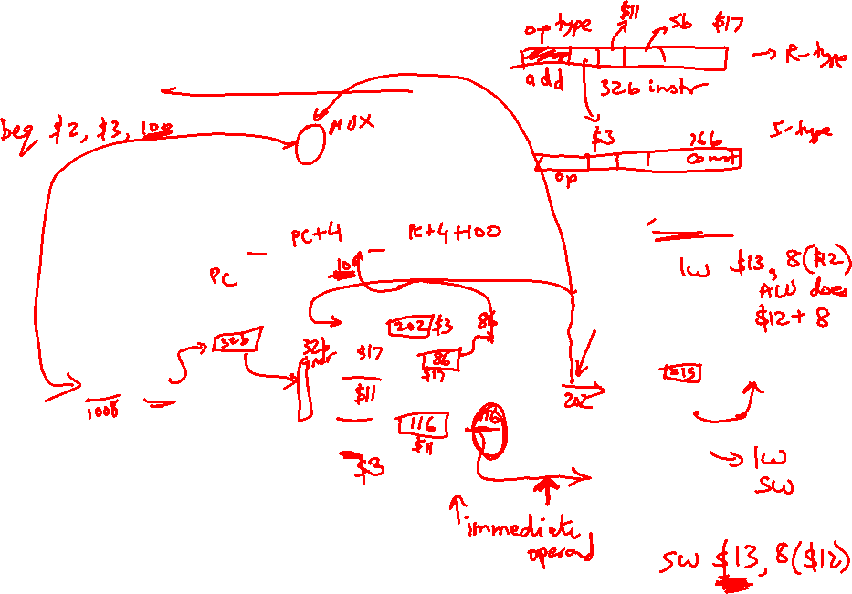
View from 30,000 Feet
Note: we haven’t bothered
showing multiplexors
What is the role of the Add units?
Explain the inputs to the data memory unit
Explain the inputs to the ALU
Explain the inputs to the register unit
Source: H&P textbook

Slide 5
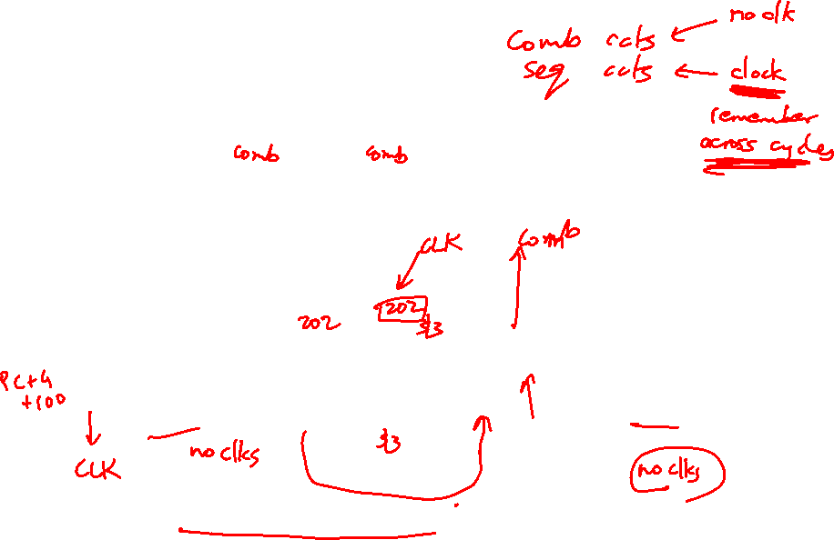
Clocking Methodology
Source: H&P textbook
Which of the above units need a clock?
What is being saved (latched) on the rising edge of the clock?
Keep in mind that the latched value remains there for an entire cycle

Slide 6
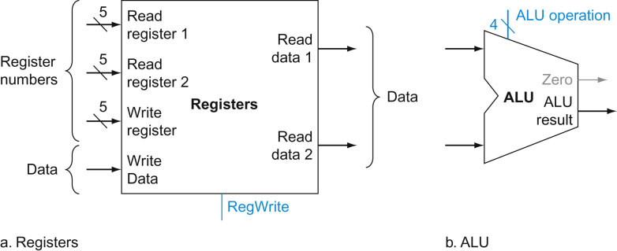
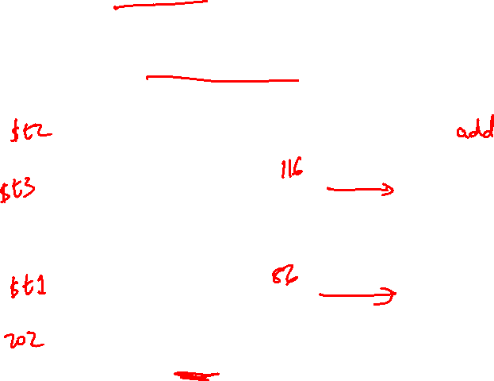
Implementing R-type Instructions
Instructions of the form add $t1, $t2, $t3
Explain the role of each signal
Source: H&P textbook

Slide 7
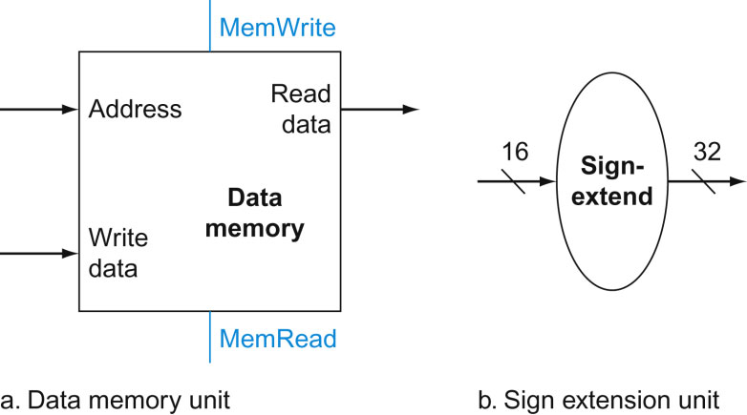
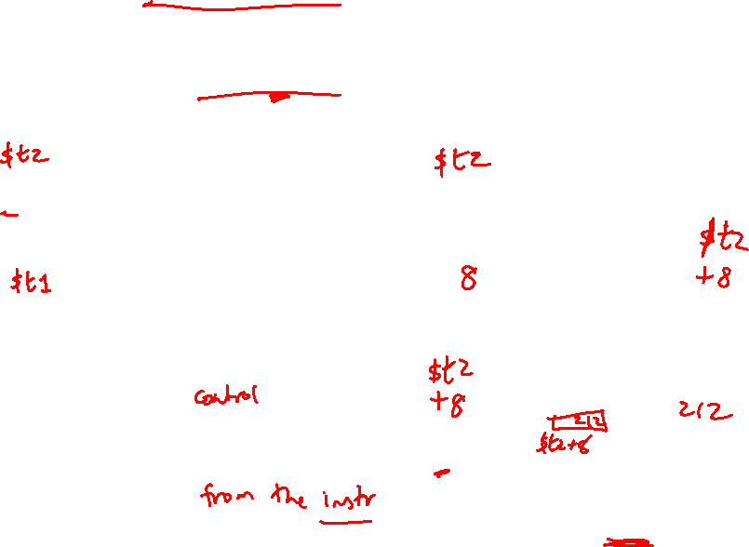
Implementing Loads/Stores
Instructions of the form lw $t1, 8($t2) and sw $t1, 8($t2)
Where does this input come from?
Source: H&P textbook

Slide 8
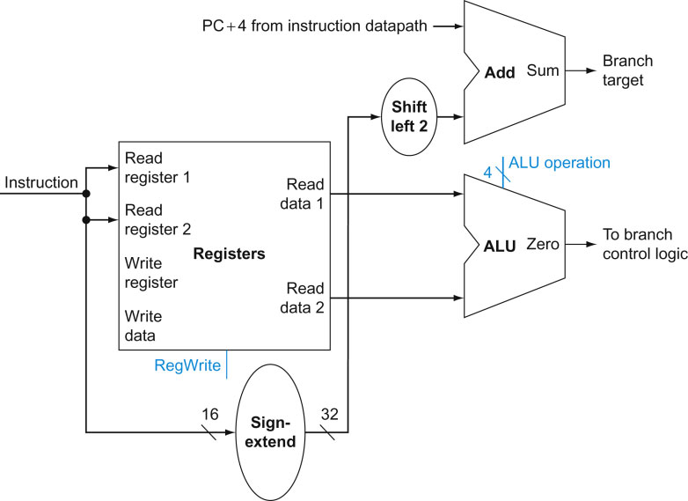
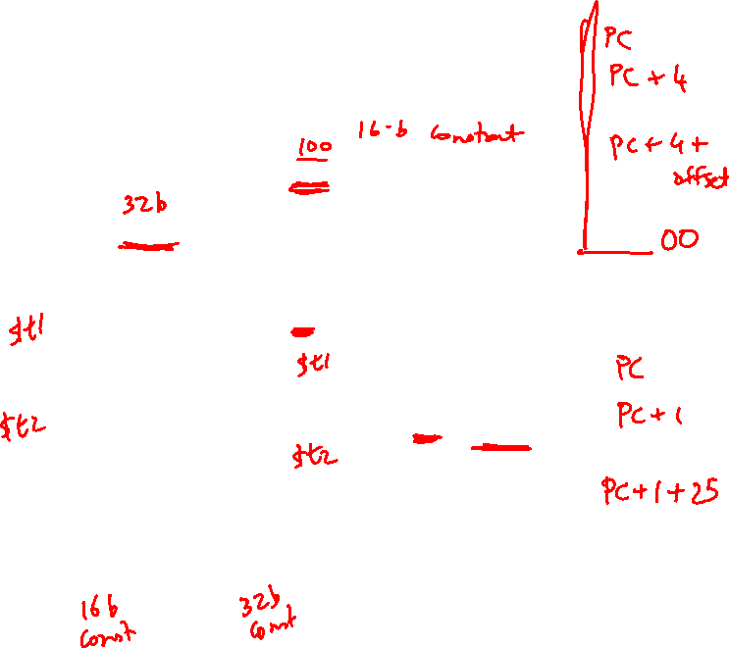
Implementing J-type Instructions
Instructions of the form beq $t1, $t2, offset
Source: H&P textbook

Slide 9
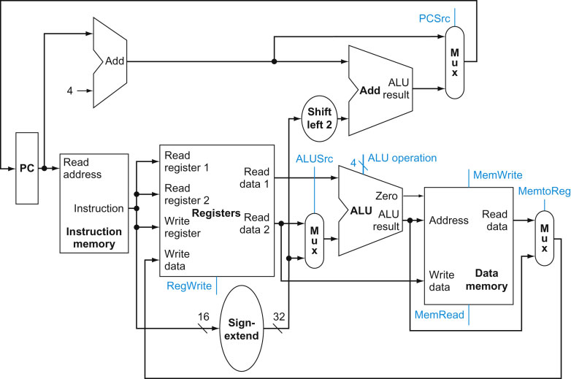
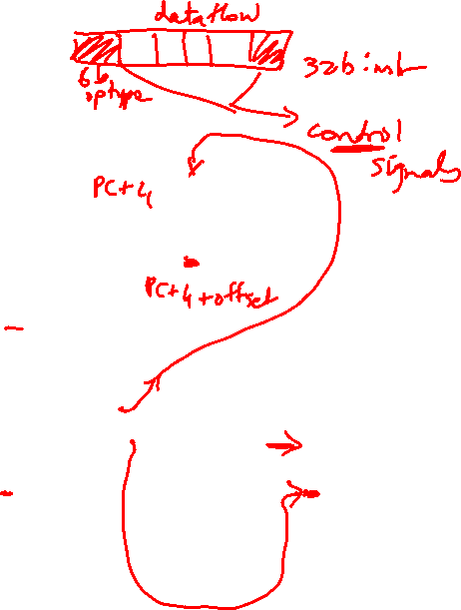
View from 10,000 Feet
Source: H&P textbook

Slide 10
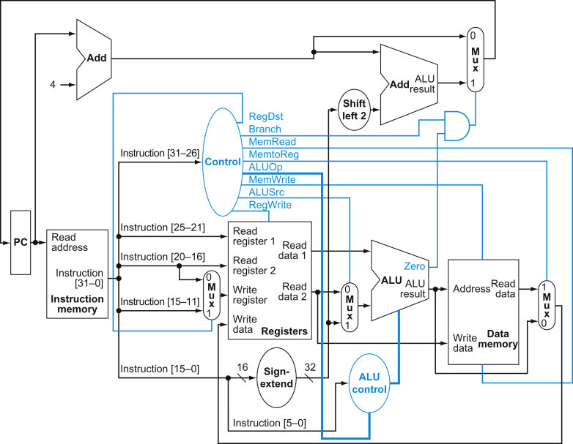
View from 5,000 Feet
Source: H&P textbook

Slide 11
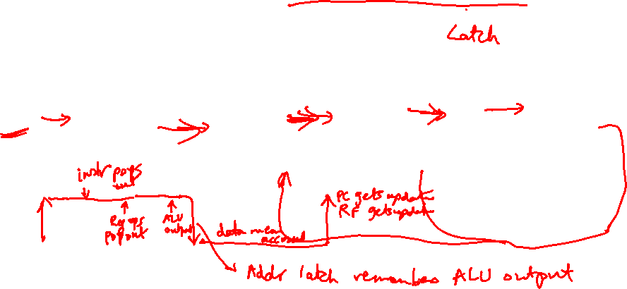
Latches and Clocks in a Single-Cycle Design
PC
Instr
Mem
Reg
File
ALU
Addr
Data
Memory
The entire instruction executes in a single cycle
Green blocks are latches
At the rising edge, a new PC is recorded
At the rising edge, the result of the previous cycle is recorded
At the falling edge, the address of LW/SW is recorded so
we can access the data memory in the 2nd half of the cycle

Slide 12
Multi-Stage Circuit
Instead of executing the entire instruction in a single
cycle (a single stage), let’s break up the execution into
multiple stages, each separated by a latch
PC
Instr
Mem
L2
Reg
File
L3
ALU
L4
Data
Memory
L5
Reg
File

Slide 13
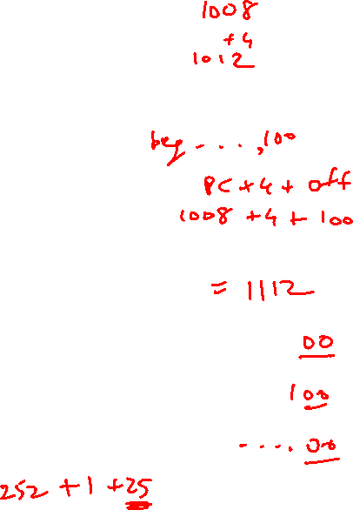
The Assembly Line
Unpipelined
Start and finish a job before moving to the next
Jobs
Time
A
B
C
A
B
C
Break the job into smaller stages
A
B
C
A
B
C
Pipelined

