Slide 1
Lecture 8: Number Crunching
Today’s topics:
  MARS wrap-up
  RISC vs. CISC
  Numerical representations
  Signed/Unsigned

Slide 2
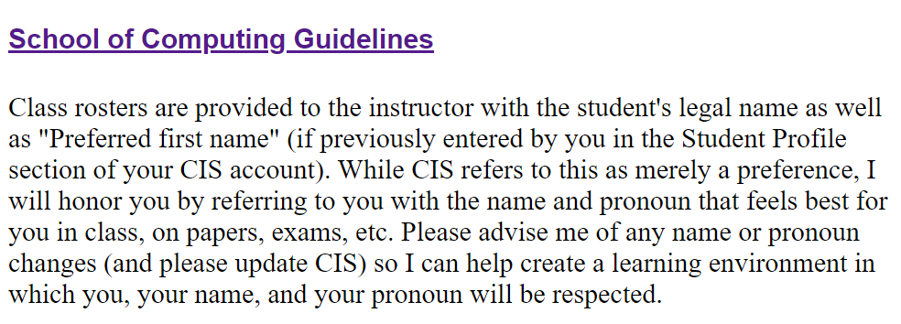
Syllabus Reminders

Slide 3
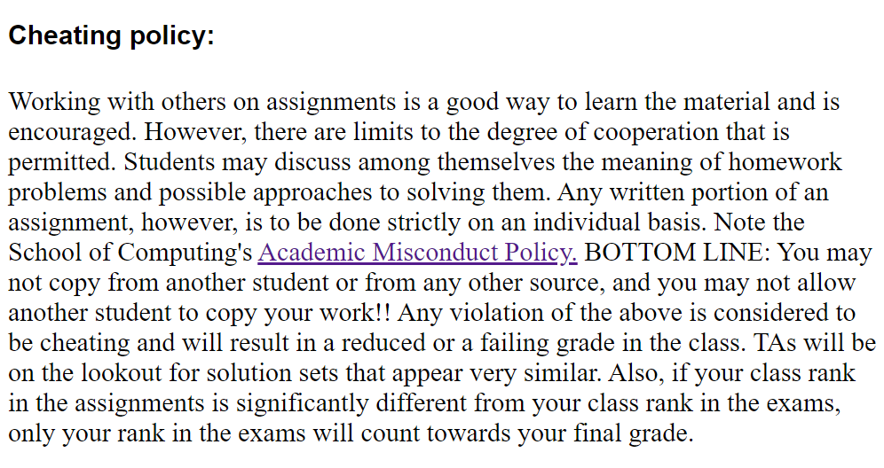
Syllabus Reminders

Slide 4
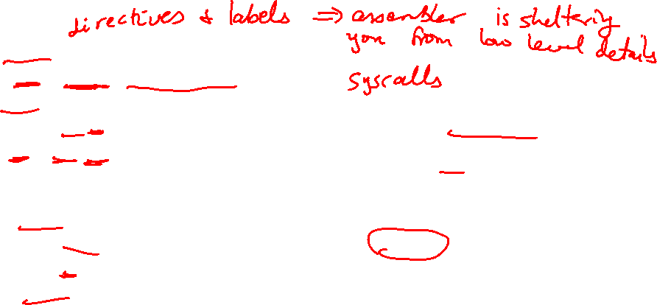
Example Print Routine
.data
str: .asciiz “the answer is ”
.text
li $v0, 4 # load immediate; 4 is the code for print_string
la $a0, str # the print_string syscall expects the string
# address as the argument; la is the instruction
# to load the address of the operand (str)
syscall # MARS will now invoke syscall-4
li $v0, 1 # syscall-1 corresponds to print_int
li $a0, 5 # print_int expects the integer as its argument
syscall # MARS will now invoke syscall-1

Slide 5
Example
Write an assembly program to prompt the user for two
numbers and print the sum of the two numbers

Slide 6
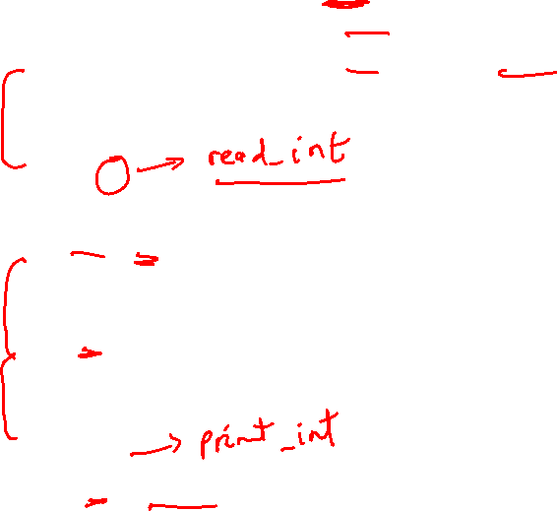
Example
.data
str1: .asciiz “Enter 2 numbers:”
.text str2: .asciiz “The sum is ”
li $v0, 4
la $a0, str1
syscall
li $v0, 5
syscall
add $t0, $v0, $zero
li $v0, 5
syscall
add $t1, $v0, $zero
li $v0, 4
la $a0, str2
syscall
li $v0, 1
add $a0, $t1, $t0
syscall

Slide 7
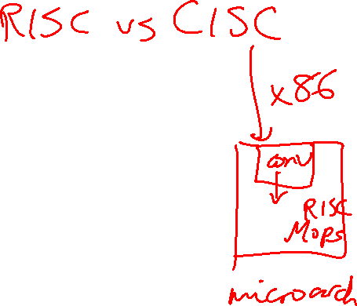
IA-32 Instruction Set
Intel’s IA-32 instruction set has evolved over 20 years –
old features are preserved for software compatibility
Numerous complex instructions – complicates hardware
design (Complex Instruction Set Computer – CISC)
Instructions have different sizes, operands can be in
registers or memory, only 8 general-purpose registers,
one of the operands is over-written
RISC instructions are more amenable to high performance
(clock speed and parallelism) – modern Intel processors
convert IA-32 instructions into simpler micro-operations

Slide 8
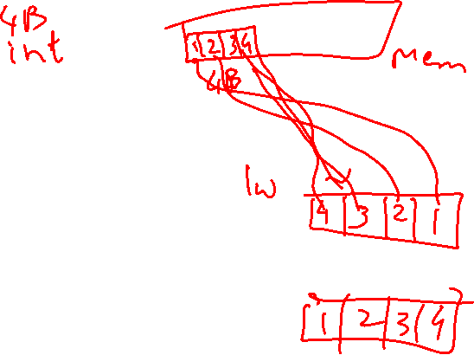
Endian-ness
Two major formats for transferring values between registers and memory
Memory: low address 45 7b 87 7f high address
Little-endian register: the first byte read goes in the low end of the register
Register: 7f 87 7b 45
Most-significant bit Least-significant bit (x86)
Big-endian register: the first byte read goes in the big end of the register
Register: 45 7b 87 7f
Most-significant bit Least-significant bit (MIPS, IBM)

Slide 9
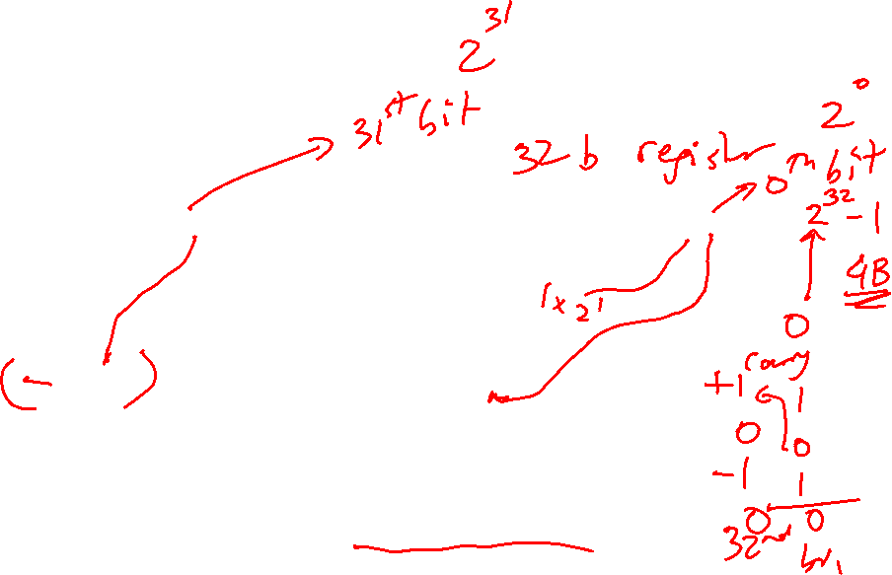
Binary Representation
The binary number
01011000 00010101 00101110 11100111
represents the quantity
0 x 2³¹ + 1 x 2³⁰ + 0 x 2²⁹ + … + 1 x 2⁰
A 32-bit word can represent 2³² numbers between
0 and 2³²-1
… this is known as the unsigned representation as
we’re assuming that numbers are always positive
Most significant bit
Least significant bit

Slide 10
ASCII Vs. Binary
Does it make more sense to represent a decimal number
in ASCII?
Hardware to implement arithmetic would be difficult
What are the storage needs? How many bits does it
take to represent the decimal number 1,000,000,000 in
ASCII and in binary?

Slide 11
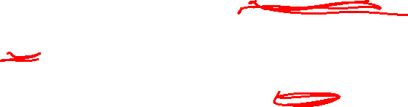
ASCII Vs. Binary
Does it make more sense to represent a decimal number
in ASCII?
Hardware to implement arithmetic would be difficult
What are the storage needs? How many bits does it
take to represent the decimal number 1,000,000,000 in
ASCII and in binary?
In binary: 30 bits (2³⁰ > 1 billion)
In ASCII: 10 characters, 8 bits per char = 80 bits

Slide 12
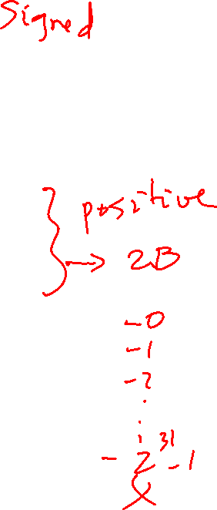
Negative Numbers
32 bits can only represent 2³² numbers – if we wish to also represent
negative numbers, we can represent 2³¹ positive numbers (incl zero)
and 2³¹ negative numbers
0000 0000 0000 0000 0000 0000 0000 0000_{two} = 0_{ten}
0000 0000 0000 0000 0000 0000 0000 0001_{two} = 1_{ten}
…
0111 1111 1111 1111 1111 1111 1111 1111_{two} = 2³¹-1
1000 0000 0000 0000 0000 0000 0000 0000_{two} = -2³¹
1000 0000 0000 0000 0000 0000 0000 0001_{two} = -(2³¹ – 1)
1000 0000 0000 0000 0000 0000 0000 0010_{two} = -(2³¹ – 2)
…
1111 1111 1111 1111 1111 1111 1111 1110_{two} = -2
1111 1111 1111 1111 1111 1111 1111 1111_{two} = -1

Slide 13
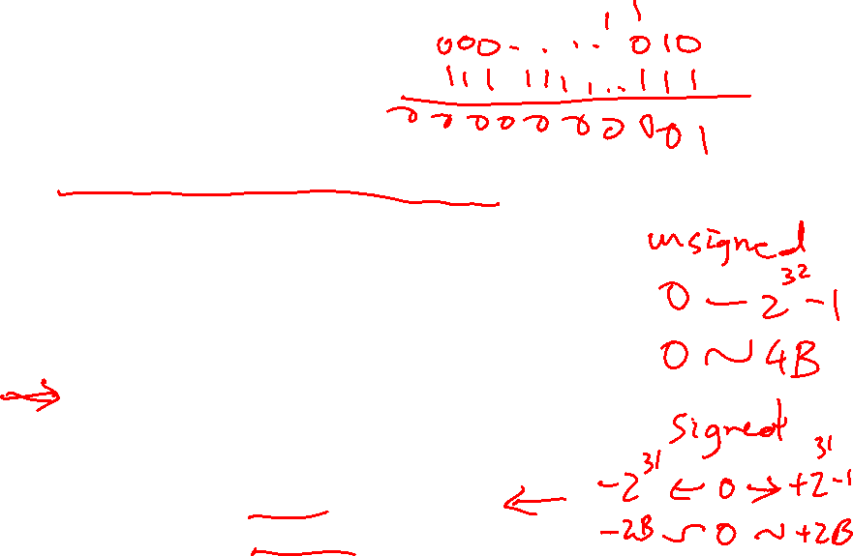
2’s Complement
0000 0000 0000 0000 0000 0000 0000 0000_{two} = 0_{ten}
0000 0000 0000 0000 0000 0000 0000 0001_{two} = 1_{ten}
…
0111 1111 1111 1111 1111 1111 1111 1111_{two} = 2³¹-1
1000 0000 0000 0000 0000 0000 0000 0000_{two} = -2³¹
1000 0000 0000 0000 0000 0000 0000 0001_{two} = -(2³¹ – 1)
1000 0000 0000 0000 0000 0000 0000 0010_{two} = -(2³¹ – 2)
…
1111 1111 1111 1111 1111 1111 1111 1110_{two} = -2
1111 1111 1111 1111 1111 1111 1111 1111_{two} = -1
Why is this representation favorable?
Consider the sum of 1 and -2 …. we get -1
Consider the sum of 2 and -1 …. we get +1
This format can directly undergo addition without any conversions!
Each number represents the quantity
x₃₁ -2³¹ + x₃₀ 2³⁰ + x₂₉ 2²⁹ + … + x₁ 2¹ + x₀ 2⁰

Slide 14
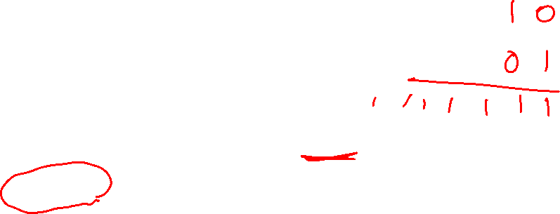
2’s Complement
0000 0000 0000 0000 0000 0000 0000 0000_{two} = 0_{ten}
0000 0000 0000 0000 0000 0000 0000 0001_{two} = 1_{ten}
…
0111 1111 1111 1111 1111 1111 1111 1111_{two} = 2³¹-1
1000 0000 0000 0000 0000 0000 0000 0000_{two} = -2³¹
1000 0000 0000 0000 0000 0000 0000 0001_{two} = -(2³¹ – 1)
1000 0000 0000 0000 0000 0000 0000 0010_{two} = -(2³¹ – 2)
…
1111 1111 1111 1111 1111 1111 1111 1110_{two} = -2
1111 1111 1111 1111 1111 1111 1111 1111_{two} = -1
Note that the sum of a number x and its inverted representation x’ always
equals a string of 1s (-1).
x + x’ = -1
x’ + 1 = -x … hence, can compute the negative of a number by
-x = x’ + 1 inverting all bits and adding 1
Similarly, the sum of x and –x gives us all zeroes, with a carry of 1
In reality, x + (-x) = 2^{n} … hence the name 2’s complement

Slide 15
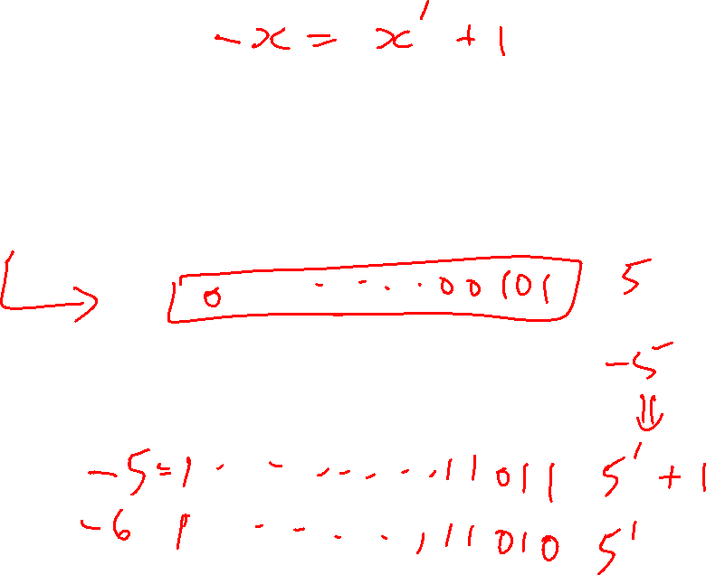
Example
Compute the 32-bit 2’s complement representations
for the following decimal numbers:
5, -5, -6

Slide 16
Example
Compute the 32-bit 2’s complement representations
for the following decimal numbers:
5, -5, -6
5: 0000 0000 0000 0000 0000 0000 0000 0101
-5: 1111 1111 1111 1111 1111 1111 1111 1011
-6: 1111 1111 1111 1111 1111 1111 1111 1010
Given -5, verify that inverting and adding 1 yields the
number 5

Slide 17
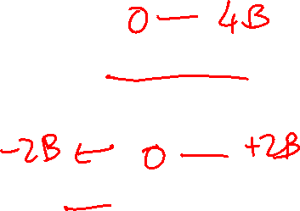
Signed / Unsigned
The hardware recognizes two formats:
unsigned (corresponding to the C declaration unsigned int)
-- all numbers are positive, a 1 in the most significant bit
just means it is a really large number
signed (C declaration is signed int or just int)
-- numbers can be +/- , a 1 in the MSB means the number
is negative
This distinction enables us to represent twice as many
numbers when we’re sure that we don’t need negatives

Slide 18
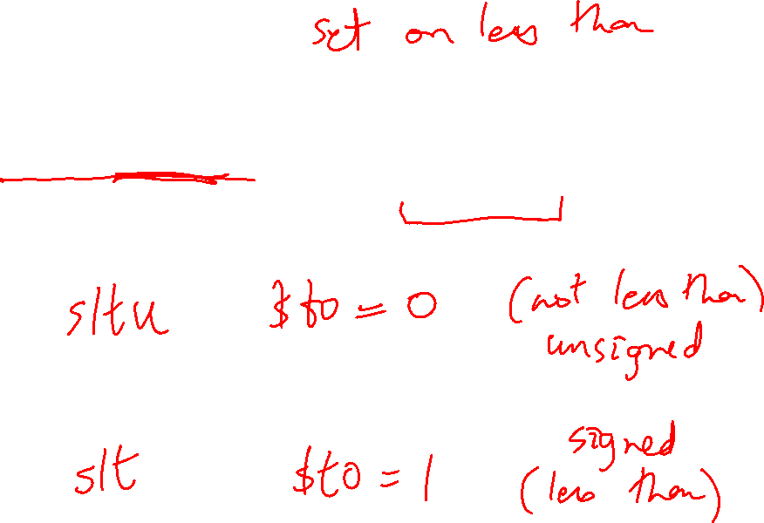
MIPS Instructions
Consider a comparison instruction:
slt $t0, $t1, $zero
and $t1 contains the 32-bit number 1111 01…01
What gets stored in $t0?

Slide 19
MIPS Instructions
Consider a comparison instruction:
slt $t0, $t1, $zero
and $t1 contains the 32-bit number 1111 01…01
What gets stored in $t0?
The result depends on whether $t1 is a signed or unsigned
number – the compiler/programmer must track this and
accordingly use either slt or sltu
slt $t0, $t1, $zero stores 1 in $t0
sltu $t0, $t1, $zero stores 0 in $t0

Slide 20
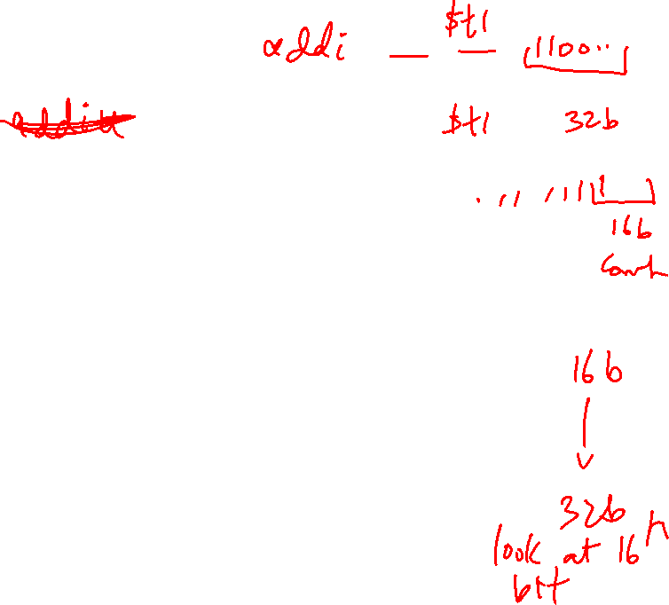
Sign Extension
Occasionally, 16-bit signed numbers must be converted
into 32-bit signed numbers – for example, when doing an
add with an immediate operand
The conversion is simple: take the most significant bit and
use it to fill up the additional bits on the left – known as
sign extension
So 2₁₀ goes from 0000 0000 0000 0010 to
0000 0000 0000 0000 0000 0000 0000 0010
and -2₁₀ goes from 1111 1111 1111 1110 to
1111 1111 1111 1111 1111 1111 1111 1110

Slide 21
Alternative Representations
The following two (intuitive) representations were discarded
because they required additional conversion steps before
arithmetic could be performed on the numbers
  sign-and-magnitude: the most significant bit represents
  +/- and the remaining bits express the magnitude
  one’s complement: -x is represented by inverting all
  the bits of x
  Both representations above suffer from two zeroes

