Slide 1
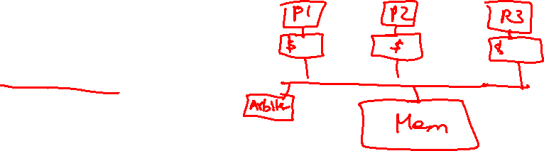
Lecture 26: Multiprocessors
Today’s topics:
  Snooping-based coherence
  Synchronization
  Consistency

Slide 2
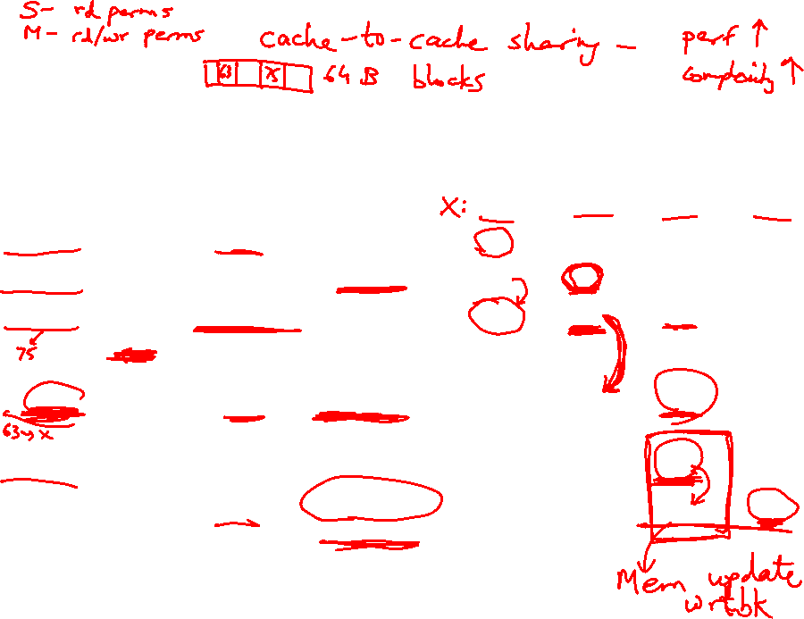
Example
Request | Cache Hit/Miss | Request on the bus | Who responds | State in Cache 1 | State in Cache 2 | State in Cache 3 | State in Cache 4
 |  |  |  | Inv | Inv | Inv | Inv
P1: Rd X | Miss | Rd X | Memory | S | Inv | Inv | Inv
P2: Rd X | Miss | Rd X | Memory | S | S | Inv | Inv
P2: Wr X | Perms Miss | Upgrade X | No response. Other caches invalidate. | Inv | M | Inv | Inv
P3: Wr X | Write Miss | Wr X | P2 responds | Inv | Inv | M | Inv
P3: Rd X | Read Hit | - | - | Inv | Inv | M | Inv
P4: Rd X | Read Miss | Rd X | P3 responds. Mem wrtbk | Inv | Inv | S | S

Slide 3
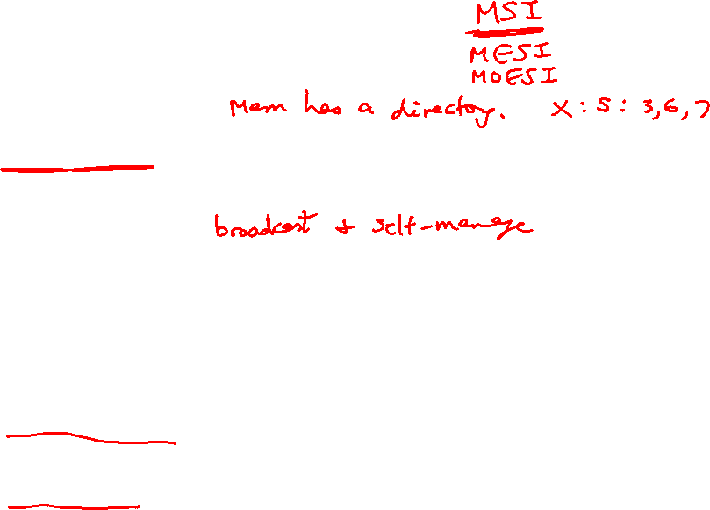
Cache Coherence Protocols
Directory-based: A single location (directory) keeps track
of the sharing status of a block of memory
Snooping: Every cache block is accompanied by the sharing
status of that block – all cache controllers monitor the
shared bus so they can update the sharing status of the
block, if necessary
Write-invalidate: a processor gains exclusive access of
a block before writing by invalidating all other copies
Write-update: when a processor writes, it updates other
shared copies of that block

Slide 4
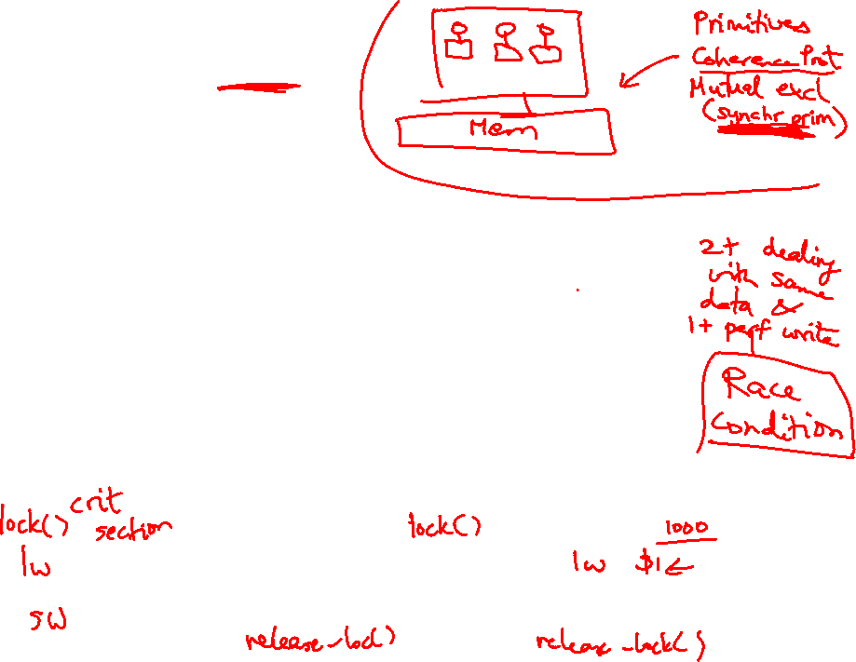
Constructing Locks
Applications have phases (consisting of many instructions)
that must be executed atomically, without other parallel
processes modifying the data
A lock surrounding the data/code ensures that only one
program can be in a critical section at a time
The hardware must provide some basic primitives that
allow us to construct locks with different properties
Bank balance
$1000
Parallel (unlocked) banking transactions
Rd $1000
Add $100
Wr $1100
Rd $1000
Add $200
Wr $1200

Slide 5
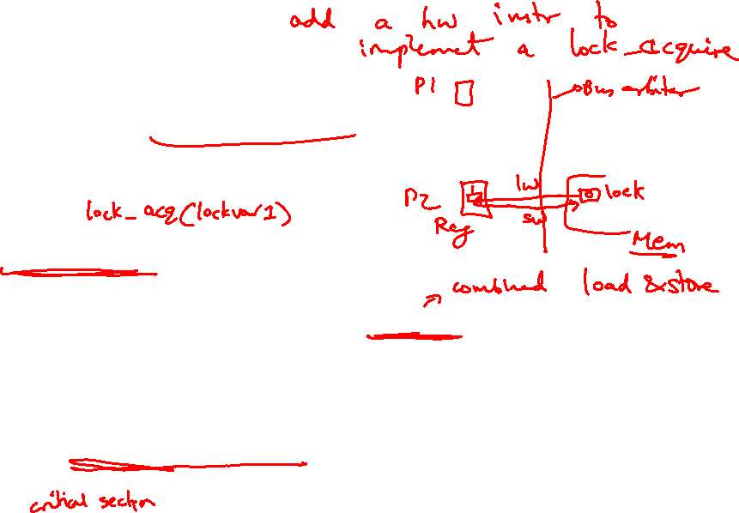
Synchronization
The simplest hardware primitive that greatly facilitates
synchronization implementations (locks, barriers, etc.)
is an atomic read-modify-write
Atomic exchange: swap contents of register and memory
Special case of atomic exchange: test & set: transfer
memory location into register and write 1 into memory
(if memory has 0, lock is free)
lock: t&s register, location
bnz register, lock
CS
st location, #0
When multiple parallel threads
execute this code, only one
will be able to enter CS

Slide 6
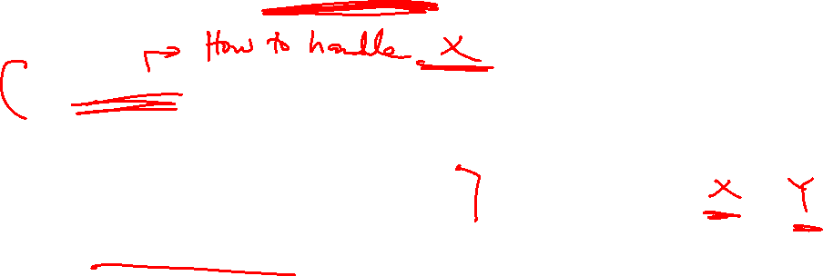
Coherence Vs. Consistency
Coherence guarantees (i) write propagation
(a write will eventually be seen by other processors), and
(ii) write serialization (all processors see writes to the
same location in the same order)
The consistency model defines the ordering of writes and
reads to different memory locations – the hardware
guarantees a certain consistency model and the
programmer attempts to write correct programs with
those assumptions

Slide 7
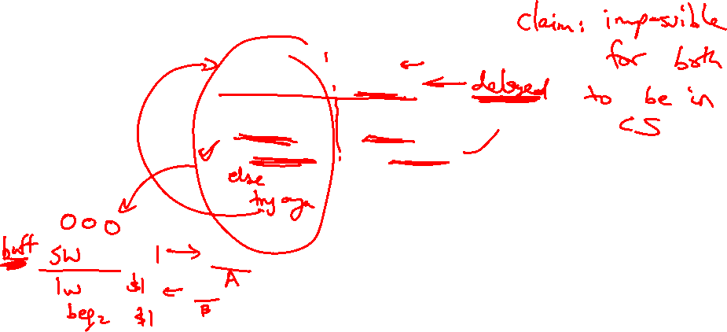
Consistency Example
Consider a multiprocessor with bus-based snooping cache
coherence
Initially A = B = 0
P1 P2
A ← 1 B ← 1
… …
if (B == 0) if (A == 0)
Crit.Section Crit.Section

Slide 8
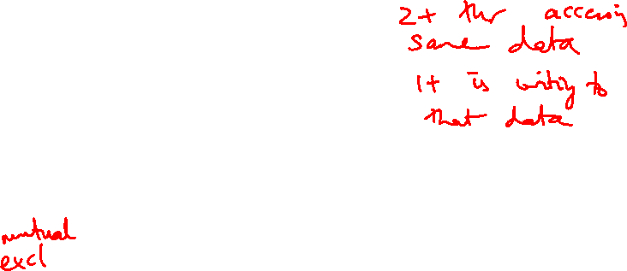
Consistency Example
Consider a multiprocessor with bus-based snooping cache
coherence
Initially A = B = 0
P1 P2
A ← 1 B ← 1
… …
if (B == 0) if (A == 0)
Crit.Section Crit.Section
The programmer expected the
above code to implement a
lock – because of ooo, both processors
can enter the critical section
The consistency model lets the programmer know what assumptions
they can make about the hardware’s reordering capabilities

Slide 9
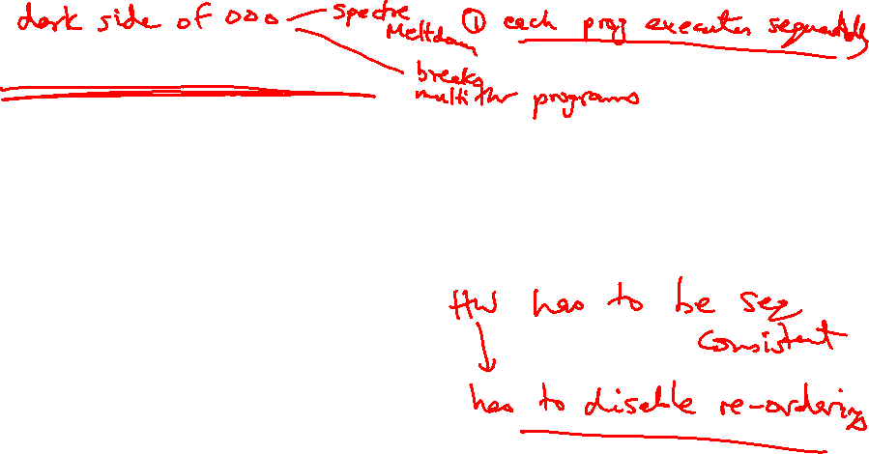
Sequential Consistency
A multiprocessor is sequentially consistent if the result
of the execution is achieveable by maintaining program
order within a processor and interleaving accesses by
different processors in an arbitrary fashion
The multiprocessor in the previous example is not
sequentially consistent
Can implement sequential consistency by requiring the
following: program order, write serialization, everyone has
seen an update before a value is read – very intuitive for
the programmer, but extremely slow

Slide 10
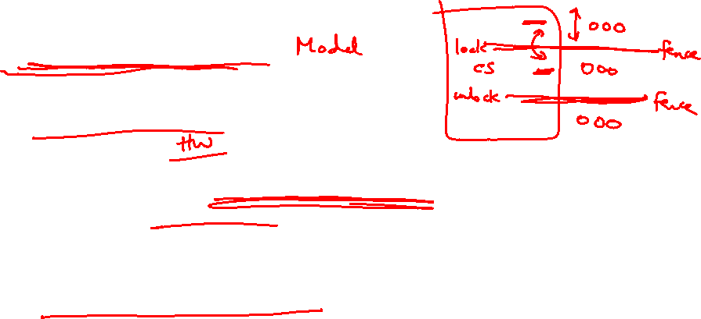
Relaxed Consistency
Sequential consistency is very slow
The programming complications/surprises are caused when the
program has race conditions (two threads dealing with same
data and at least one of the threads is modifying the data)
If programmers are disciplined and enforce mutual exclusion
when dealing with shared data, we can allow some re-orderings
and higher performance
This is effective at balancing performance & programming effort

