Slide 1

Lecture 25: Security, VM, Multiproc
Today’s topics:
  Security wrap-up
  Virtual memory
  Multiprocessors, cache coherence
Homework Ranks
Top 20% 99.4
Top 40% 98.4
Top 60% 96.6
Top 80% 94.5
Top 95% 88.3

Slide 2
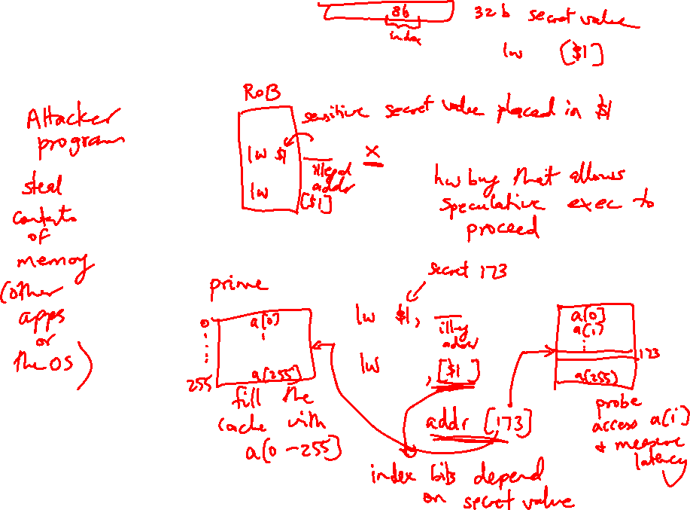
Meltdown

Slide 3
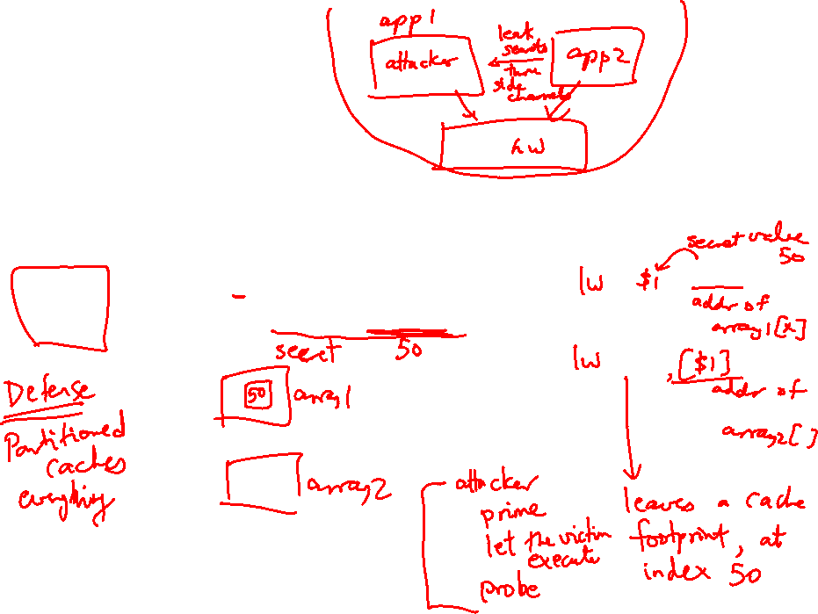
Spectre: Variant 1
x is controlled by attacker
Thanks to bpred, x can be anything
array1[ ] is the secret
Victim Code
if (x < array1_size)
y = array2[ array1[x] ];
Access pattern of array2[ ] betrays the secret

Slide 4
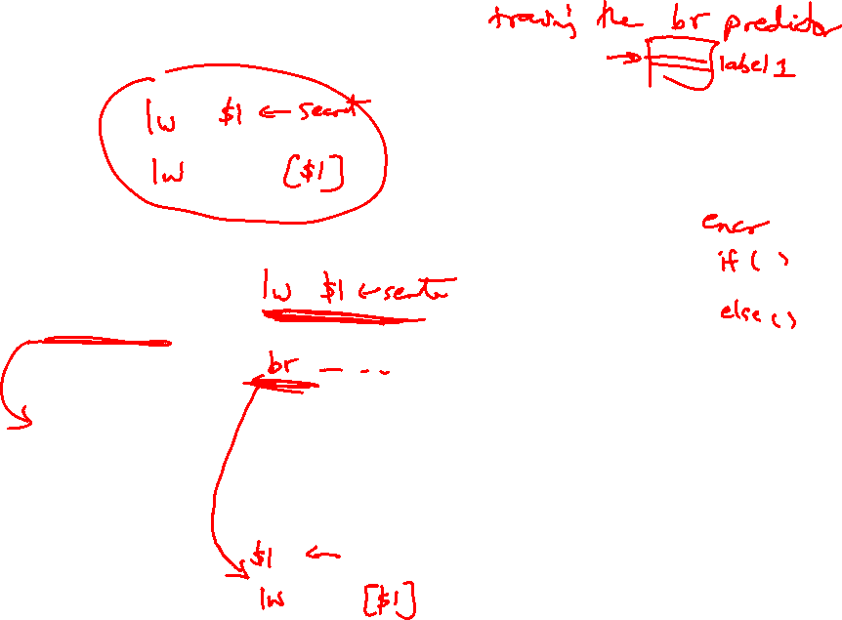
Spectre: Variant 2
Victim code
R1 ← (from attacker)
R2 ← some secret
Label0: if (…)
Attacker code
Label0: if (1)
Label1: …
…
…
Victim code
Label1:
lw [R2]

Slide 5
Virtual Memory
Processes deal with virtual memory – they have the
illusion that a very large address space is available to
them
There is only a limited amount of physical memory that is
shared by all processes – a process places part of its
virtual memory in this physical memory and the rest is
stored on disk (called swap space)
Thanks to locality, disk access is likely to be uncommon
The hardware ensures that one process cannot access
the memory of a different process

Slide 6
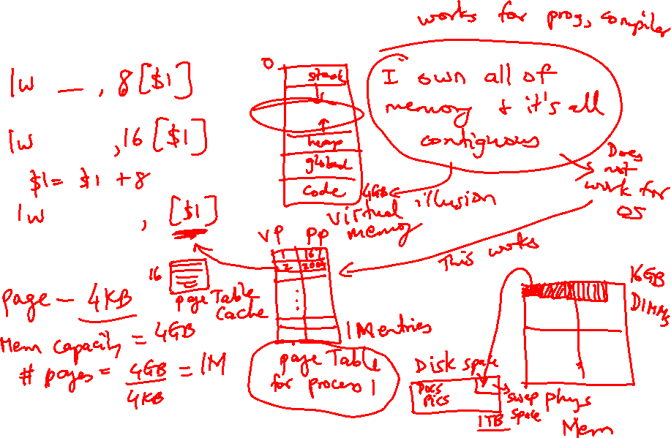
Virtual Memory

Slide 7
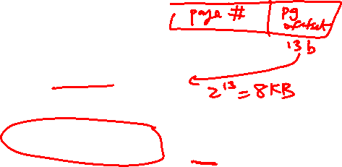
Address Translation
The virtual and physical memory are broken up into pages
8KB page size
Virtual address
13
virtual page
number
page offset
Translated to physical
page number
Physical address

Slide 8

Memory Hierarchy Properties
A virtual memory page can be placed anywhere in physical
memory (fully-associative)
Replacement is usually LRU (since the miss penalty is
huge, we can invest some effort to minimize misses)
A page table (indexed by virtual page number) is used for
translating virtual to physical page number
The page table is itself in memory

Slide 9

TLB
Since the number of pages is very high, the page table
capacity is too large to fit on chip
A translation lookaside buffer (TLB) caches the virtual
to physical page number translation for recent accesses
A TLB miss requires us to access the page table, which
may not even be found in the cache – two expensive
memory look-ups to access one word of data!
A large page size can increase the coverage of the TLB
and reduce the capacity of the page table, but also
increases memory waste

Slide 10
TLB and Cache
Is the cache indexed with virtual or physical address?
  To index with a physical address, we will have to first
  look up the TLB, then the cache → longer access time
  Multiple virtual addresses can map to the same
  physical address – must ensure that these
  different virtual addresses will map to the same
  location in cache – else, there will be two different
  copies of the same physical memory word
Does the tag array store virtual or physical addresses?
  Since multiple virtual addresses can map to the same
  physical address, a virtual tag comparison can flag a
  miss even if the correct physical memory word is present

Slide 11

Cache and TLB Pipeline
Virtual address
Offset
Virtual page number
Virtual
index
TLB
Tag array
Data array
Physical page number
Physical tag
Physical tag comparion
Virtually Indexed; Physically Tagged Cache

Slide 12
Bad Events
Consider the longest latency possible for a load instruction:
  TLB miss: must look up page table to find translation for v.page P
  Calculate the virtual memory address for the page table entry
  that has the translation for page P – let’s say, this is v.page Q
  TLB miss for v.page Q: will require navigation of a hierarchical
  page table (let’s ignore this case for now and assume we have
  succeeded in finding the physical memory location (R) for page Q)
  Access memory location R (find this either in L1, L2, or memory)
  We now have the translation for v.page P – put this into the TLB
  We now have a TLB hit and know the physical page number – this
  allows us to do tag comparison and check the L1 cache for a hit
  If there’s a miss in L1, check L2 – if that misses, check in memory
  At any point, if the page table entry claims that the page is on disk,
  flag a page fault – the OS then copies the page from disk to memory
  and the hardware resumes what it was doing before the page fault
  … phew!

Slide 13
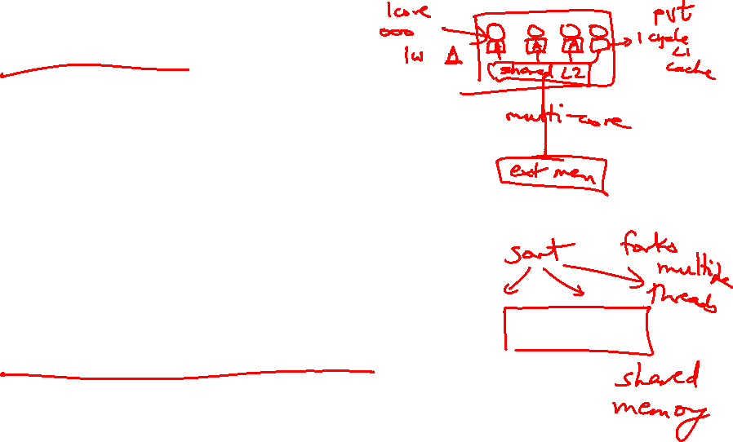
Multiprocessor Taxonomy
SISD: single instruction and single data stream: uniprocessor
MISD: no commercial multiprocessor: imagine data going
through a pipeline of execution engines
SIMD: vector architectures: lower flexibility
MIMD: most multiprocessors today: easy to construct with
off-the-shelf computers, most flexibility

Slide 14
Memory Organization - I
Centralized shared-memory multiprocessor or
Symmetric shared-memory multiprocessor (SMP)
Multiple processors connected to a single centralized
memory – since all processors see the same memory
organization → uniform memory access (UMA)
Shared-memory because all processors can access the
entire memory address space
Can centralized memory emerge as a bandwidth
bottleneck? – not if you have large caches and employ
fewer than a dozen processors

Slide 15
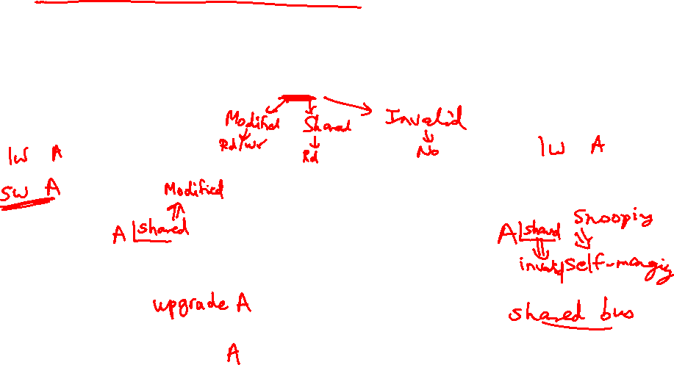
Snooping-Based Protocols
Three states for a block: invalid, shared, modified
A write is placed on the bus and sharers invalidate themselves
The protocols are referred to as MSI, MESI, etc.
Processor
Processor
Processor
Processor
Caches
Caches
Caches
Caches
Main Memory
I/O System

Slide 16
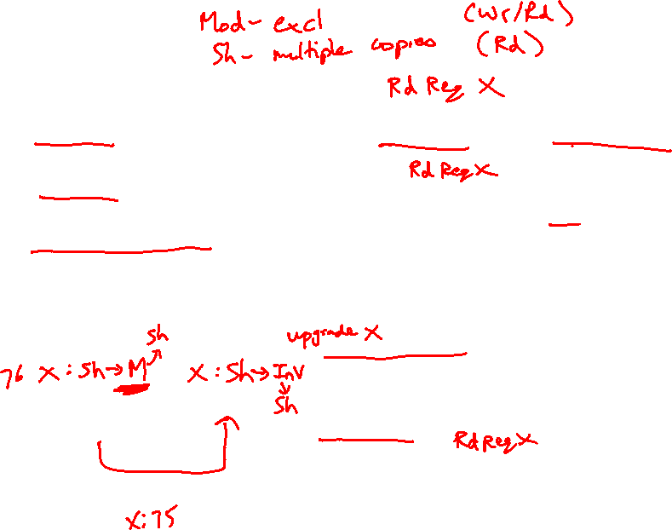
Example
P1 reads X: not found in cache-1, request sent on bus, memory responds,
X is placed in cache-1 in shared state
P2 reads X: not found in cache-2, request sent on bus, everyone snoops
this request, cache-1does nothing because this is just a read request,
memory responds, X is placed in cache-2 in shared state
P1
P2
P1 writes X: cache-1 has data in shared
state (shared only provides read perms),
request sent on bus, cache-2 snoops and
then invalidates its copy of X, cache-1
moves its state to modified
P2 reads X: cache-2 has data in invalid
state, request sent on bus, cache-1 snoops
and realizes it has the only valid copy, so it
downgrades itself to shared state and
responds with data, X is placed in cache-2
in shared state, memory is also updated
Cache-1
Cache-2
Main Memory

Slide 17
Example
Request | Cache Hit/Miss | Request on the bus | Who responds | State in Cache 1 | State in Cache 2 | State in Cache 3 | State in Cache 4
 |  |  |  | Inv | Inv | Inv | Inv
P1: Rd X | Miss | Rd X | Memory | S | Inv | Inv | Inv
P2: Rd X | Miss | Rd X | Memory | S | S | Inv | Inv
P2: Wr X | Perms Miss | Upgrade X | No response. Other caches invalidate. | Inv | M | Inv | Inv
P3: Wr X | Write Miss | Wr X | P2 responds | Inv | Inv | M | Inv
P3: Rd X | Read Hit | - | - | Inv | Inv | M | Inv
P4: Rd X | Read Miss | Rd X | P3 responds. Mem wrtbk | Inv | Inv | S | S

