Slide 1
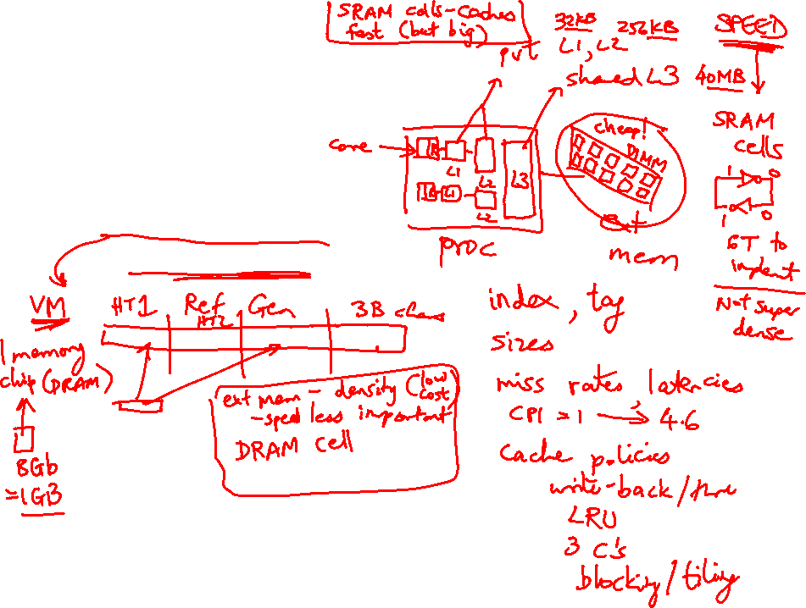
Lecture 24: Memory, Security
Today’s topics:
  Main memory system
  Hardware security intro

Slide 2
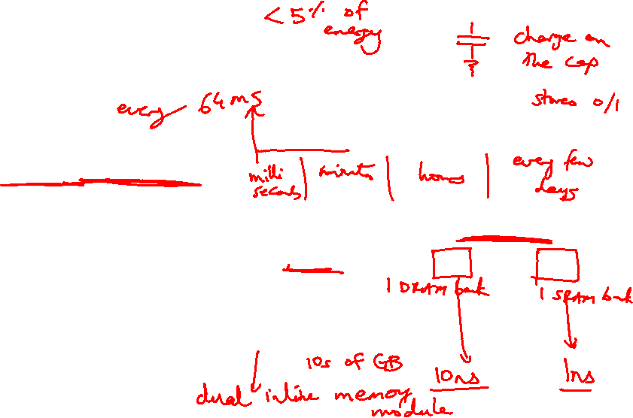
Off-Chip DRAM Main Memory
Main memory is stored in DRAM cells that have much
higher storage density
DRAM cells lose their state over time – must be refreshed
periodically, hence the name Dynamic
A number of DRAM chips are aggregated on a DIMM to
provide high capacity – a DIMM is a module that plugs
into a bus on the motherboard
DRAM access suffers from long access time and high
energy overhead

Slide 3
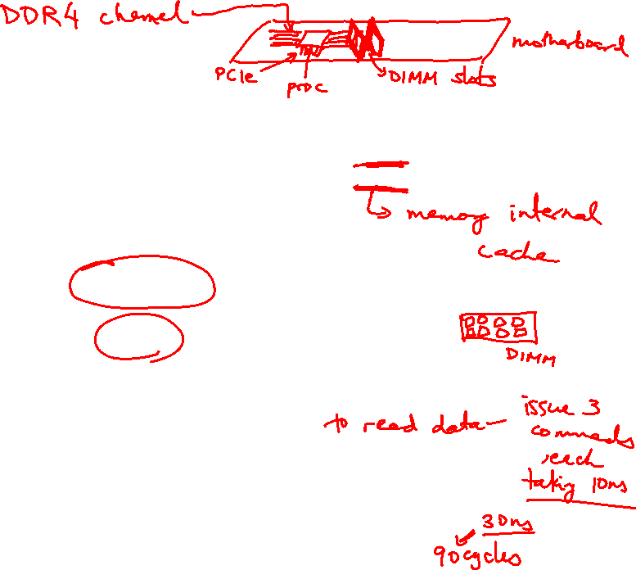
Memory Architecture
Processor
Bank
Row Buffer
Memory Controller
Address/Cmd
DIMM
Data
DIMM: a PCB with DRAM chips on the back and front
The memory system is itself organized into ranks and banks; each
bank can process a transaction in parallel
Each bank has a row buffer that retains the last row touched in a bank
(it’s like a cache in the memory system that exploits spatial locality)
(row buffer hits have a lower latency than a row buffer miss)

Slide 4
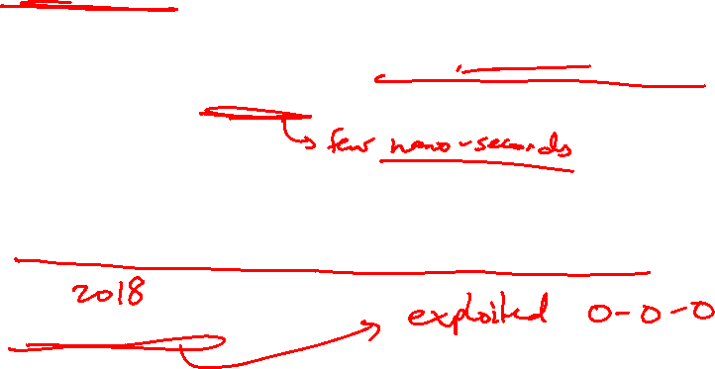
Hardware Security
Software security: key management, buffer overflow, etc.
Hardware security: hardware-enforced permission checks,
authentication/encryption, etc.
Security vs. Privacy
Information leakage, side channels, timing channels
Meltdown, Spectre, SGX

Slide 5
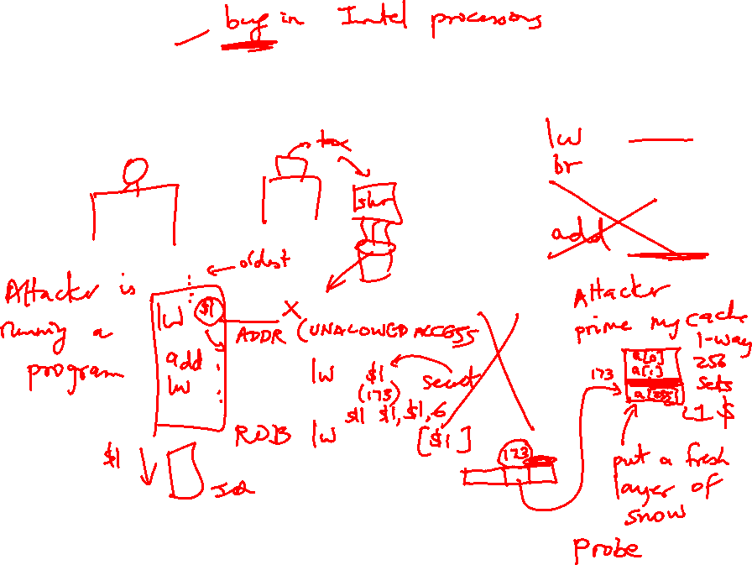
Meltdown

Slide 6
Spectre: Variant 1
x is controlled by attacker
Thanks to bpred, x can be anything
array1[ ] is the secret
Victim Code
if (x < array1_size)
y = array2[ array1[x] ];
Access pattern of array2[ ] betrays the secret

Slide 7
Spectre: Variant 2
Victim code
R1 ← (from attacker)
R2 ← some secret
Label0: if (…)
Attacker code
Label0: if (1)
Label1: …
…
…
Victim code
Label1:
lw [R2]

