Slide 1
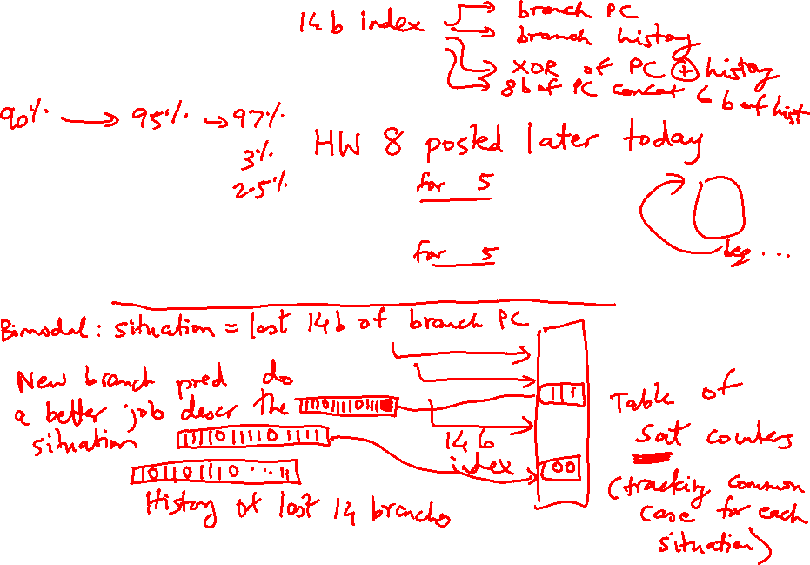
Lecture 20: Branches, OOO
Today’s topics:
  Branch prediction
  Out-of-order execution
  (Also see class notes on pipelining, hazards, etc.)

Slide 2
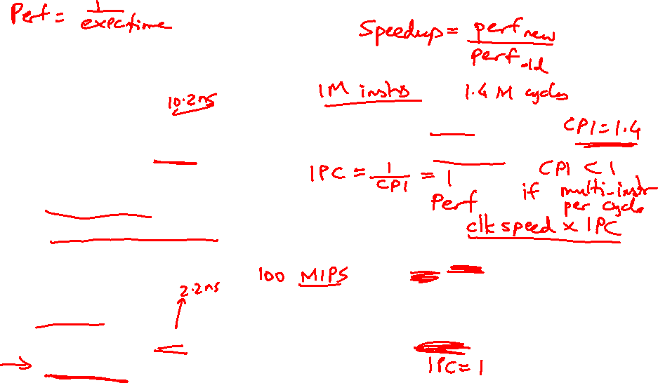
Pipelining Example (Recap)
Unpipelined design: the entire circuit takes 10ns to finish
Cycle time = 10ns; Clock speed = 1/10ns = 100 MHz
CPI = 1 (assuming no stalls)
Throughput in instructions per second =
#cycles in a second x instructions-per-cycle =
100 M x 1 = 100 M instrs per second = 0.1 BIPS (billion instrs per sec)
5-stage pipeline: under ideal conditions, each stage takes 2ns
Cycle time = 2ns; Clock speed = 1/2ns = 500 MHz (5x higher)
CPI = 1 (continuing to assume no stalls)
Throughput = # cycles in a second x instrs-per-cycle
= 500 M x 1 = 500 MIPS = 0.5 BIPS
Under ideal conditions, a 5-stage pipeline gives a 5x speedup.

Slide 3
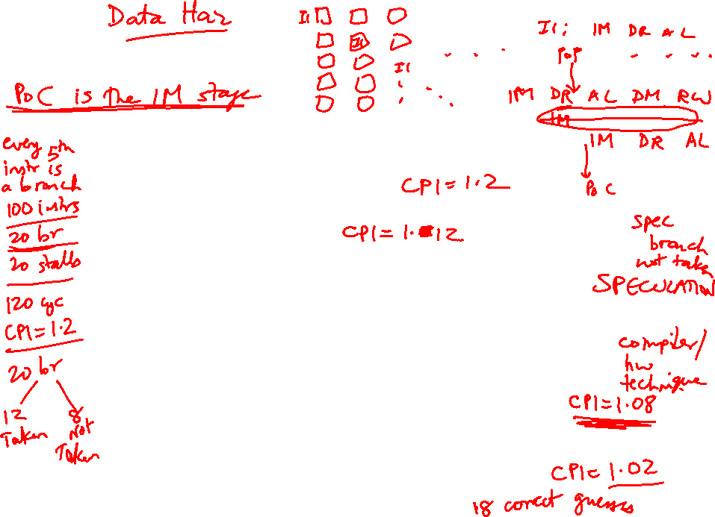
Control Hazards
Simple techniques to handle control hazard stalls:
  for every branch, introduce a stall cycle (note: every
  6th instruction is a branch!)
  assume the branch is not taken and start fetching the
  next instruction – if the branch is taken, need hardware
  to cancel the effect of the wrong-path instruction
  fetch the next instruction (branch delay slot) and
  execute it anyway – if the instruction turns out to be
  on the correct path, useful work was done – if the
  instruction turns out to be on the wrong path,
  hopefully program state is not lost
  make a smarter guess and fetch instructions from the
  expected target

Slide 4
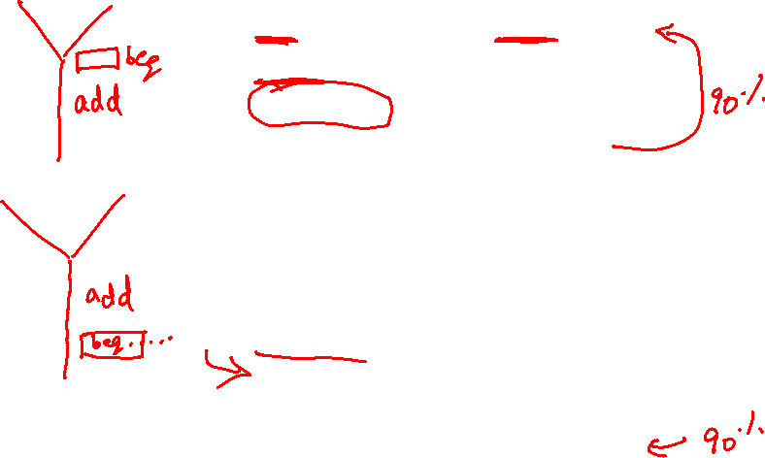
Branch Delay Slots
Source: H&P textbook

Slide 5

Pipeline without Branch Predictor
PC
IF (br)
Reg Read
Compare
Br-target
PC + 4

Slide 6
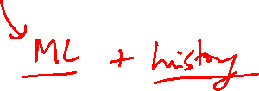
Pipeline with Branch Predictor
PC
IF (br)
Reg Read
Compare
Br-target
Branch
Predictor

Slide 7
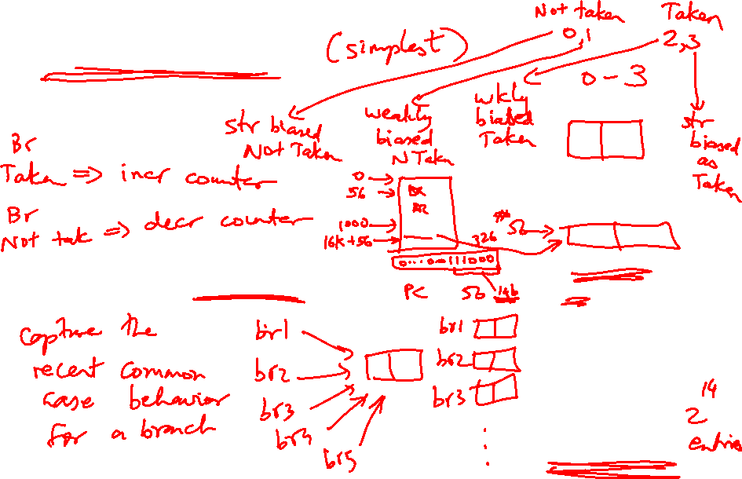
Bimodal Predictor
Table of
16K entries
of 2-bit
saturating
counters
14 bits
Branch PC

Slide 8
2-Bit Prediction
For each branch, maintain a 2-bit saturating counter:
if the branch is taken: counter = min(3,counter+1)
if the branch is not taken: counter = max(0,counter-1)
… sound familiar?
If (counter >= 2), predict taken, else predict not taken
The counter attempts to capture the common case for
each branch
Indexing functions
Multiple branch predictors
History, trade-offs

Slide 9
Slowdowns from Stalls
Perfect pipelining with no hazards → an instruction
completes every cycle (total cycles ~ num instructions)
→ speedup = increase in clock speed = num pipeline stages
With hazards and stalls, some cycles (= stall time) go by
during which no instruction completes, and then the stalled
instruction completes
Total cycles = number of instructions + stall cycles

Slide 10
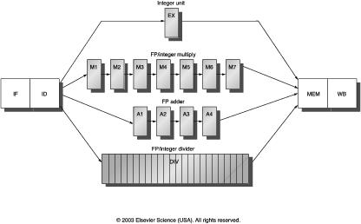
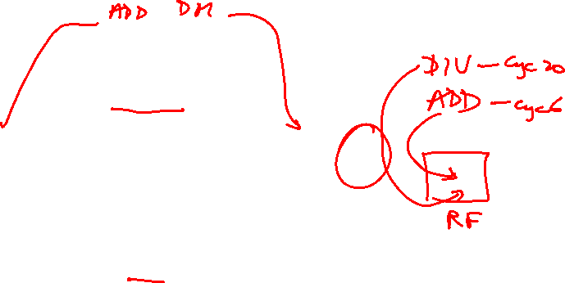
Multicycle Instructions
Multiple parallel pipelines – each pipeline can have a different
number of stages
Instructions can now complete out of order – must make sure
that writes to a register happen in the correct order

Slide 11
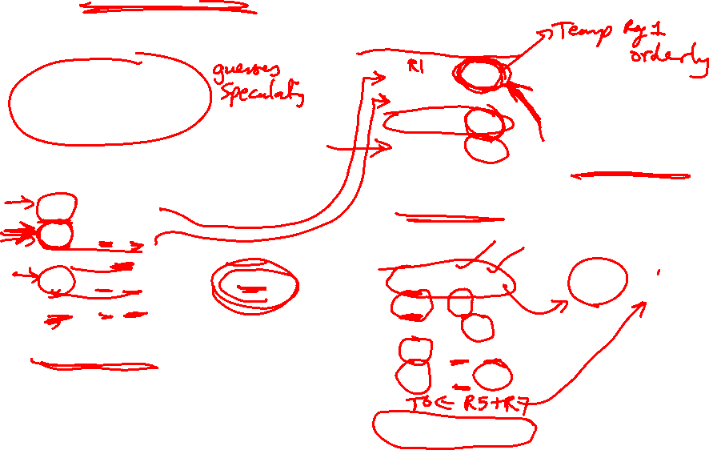
An Out-of-Order Processor Implementation
Reorder Buffer (ROB)
Branch prediction
and instr fetch
Instr 1
Instr 2
Instr 3
Instr 4
Instr 5
Instr 6
T1
T2
T3
T4
T5
T6
Register File
R1-R32
R1 ← R1+R2
R2 ← R1+R3
BEQZ R2
R3 ← R1+R2
R1 ← R3+R2
Decode &
Rename
T1 ← R1+R2
T2 ← T1+R3
BEQZ T2
T4 ← T1+T2
T5 ← T4+T2
ALU
ALU
ALU
Instr Fetch Queue
Results written to
ROB and tags
broadcast to IQ
Issue Queue (IQ)

Slide 12
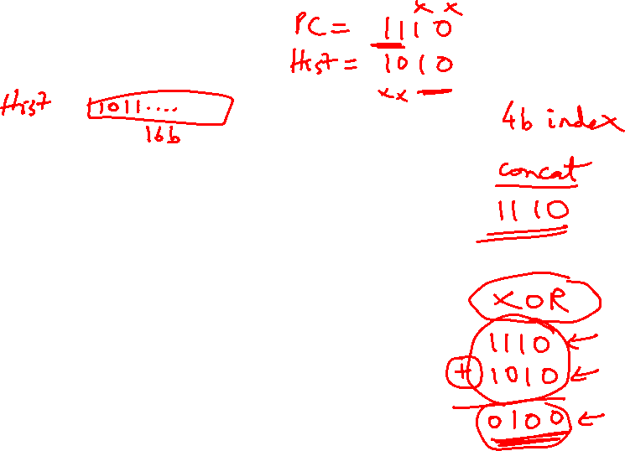
Example Code
Completion times with in-order with ooo
ADD R1, R2, R3 5 5
ADD R4, R1, R2 6 6
LW R5, 8(R4) 7 7
ADD R7, R6, R5 9 9
ADD R8, R7, R5 10 10
LW R9, 16(R4) 11 7
ADD R10, R6, R9 13 9
ADD R11, R10, R9 14 10

