Slide 1
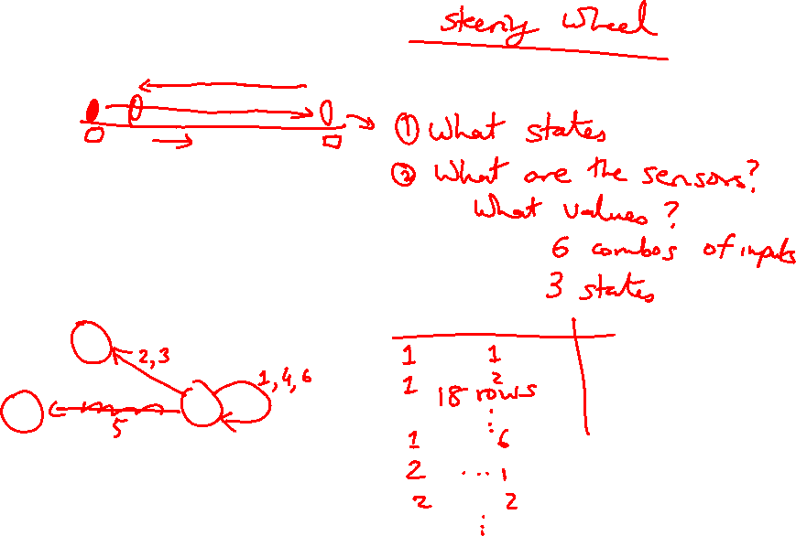
Lecture 19: Pipelining
Today’s topics:
  Hazards and instruction scheduling
  Branch prediction
  Out-of-order execution

Slide 2
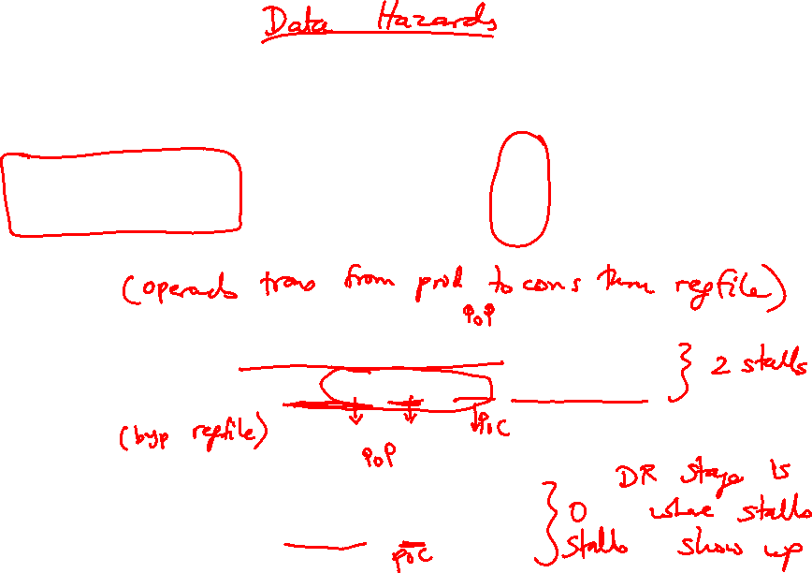
Problem 0
Point of Production
add $1, $2, $3
add $5, $1, $4
Without bypassing:
add $1, $2, $3: IF DR AL DM RW
add $5, $1, $4: IF DR DR DR AL DM RW
With bypassing:
add $1, $2, $3: IF DR AL DM RW
add $5, $1, $4: IF DR AL DM RW
Point of Consumption

Slide 3
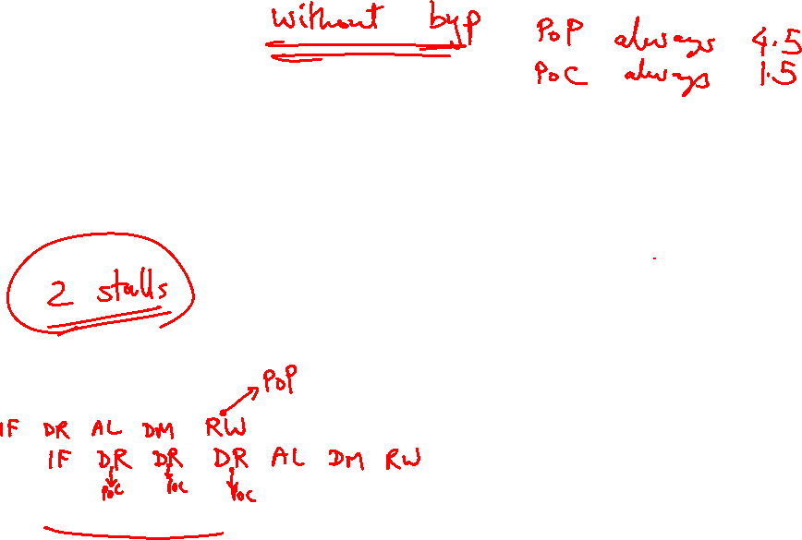
Problem 1
IF
D/R
ALU
DM
RW
IF
D/R
ALU
DM
RW
IF
D/R
ALU
DM
RW
add $1, $2, $3
lw $4, 8($1)
IF
D/R
ALU
DM
RW

Slide 4
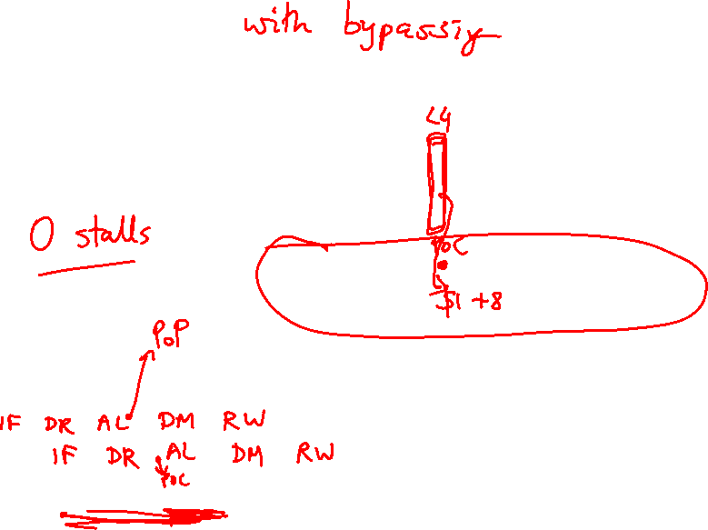
Problem 1
IF
D/R
ALU
DM
RW
IF
D/R
ALU
DM
RW
IF
D/R
ALU
DM
RW
add $1, $2, $3
lw $4, 8($1)
IF
D/R
ALU
DM
RW

Slide 5
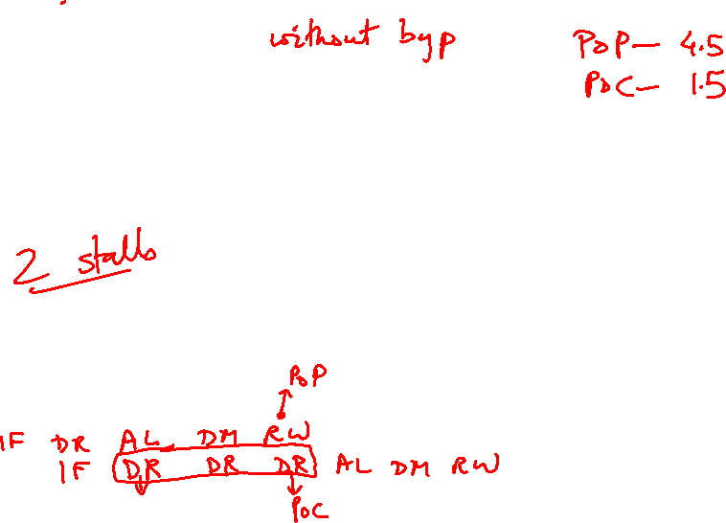
Problem 2
IF
D/R
ALU
DM
RW
IF
D/R
ALU
DM
RW
lw $1, 8($2)
lw $4, 8($1)
IF
D/R
ALU
DM
RW
IF
D/R
ALU
DM
RW

Slide 6
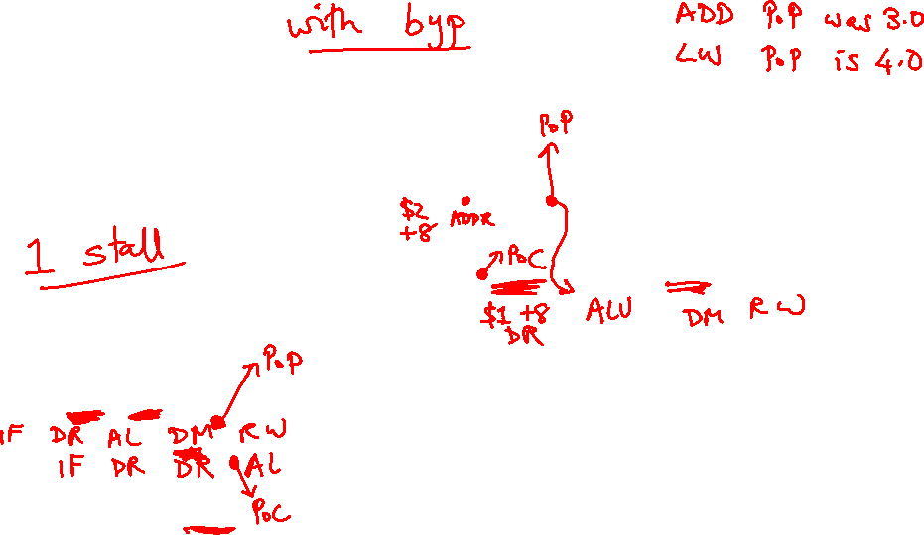
Problem 2
IF
D/R
ALU
DM
RW
IF
D/R
ALU
DM
RW
lw $1, 8($2)
lw $4, 8($1)
IF
D/R
ALU
DM
RW
IF
D/R
ALU
DM
RW

Slide 7
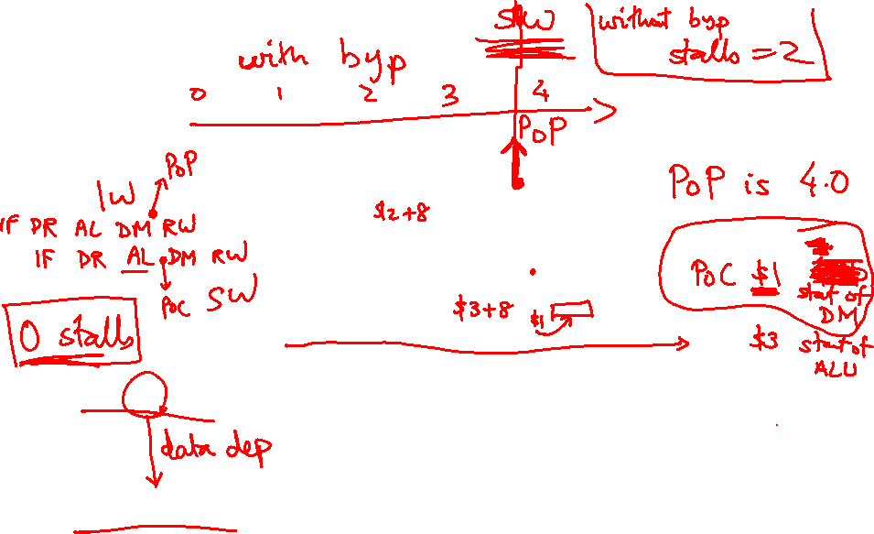
Problem 3
IF
D/R
ALU
DM
RW
IF
D/R
ALU
DM
RW
IF
D/R
ALU
DM
RW
lw $1, 8($2)
sw $1, 8($3)
IF
D/R
ALU
DM
RW

Slide 8
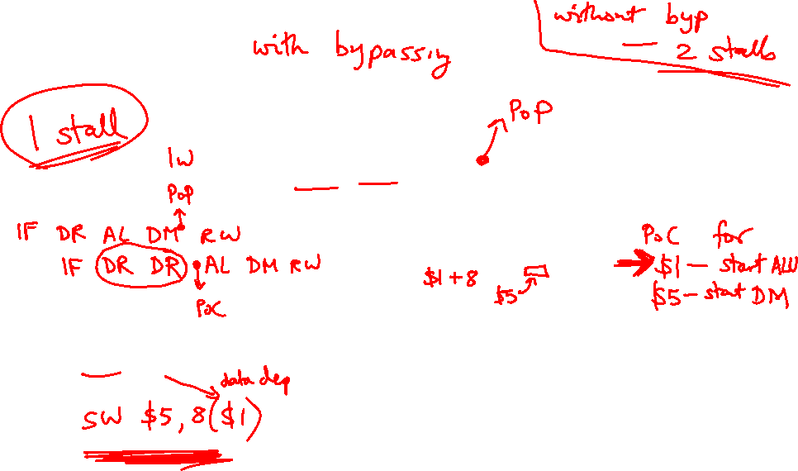
Problem 3
IF
D/R
ALU
DM
RW
IF
D/R
ALU
DM
RW
IF
D/R
ALU
DM
RW
lw $1, 8($2)
sw $1, 8($3)
IF
D/R
ALU
DM
RW

Slide 9
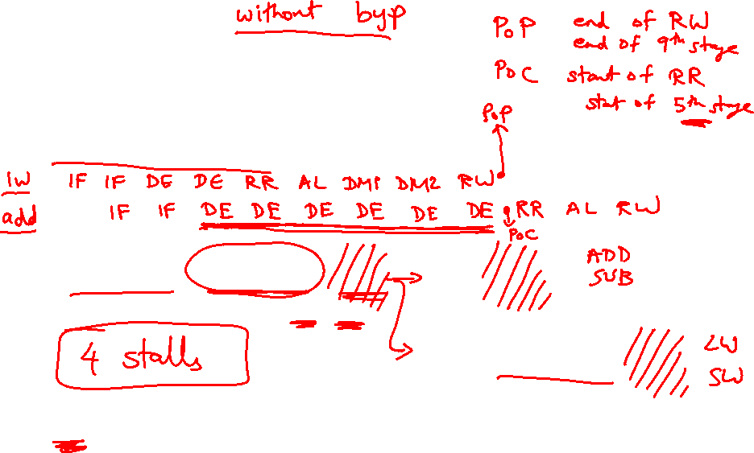
Problem 4
A 7 or 9 stage pipeline, RR and RW take an entire stage
IF
IF
Dec
Dec
RR
ALU
RW
ALU
DM
DM
RW
lw $1, 8($2)
add $4, $1, $3

Slide 10
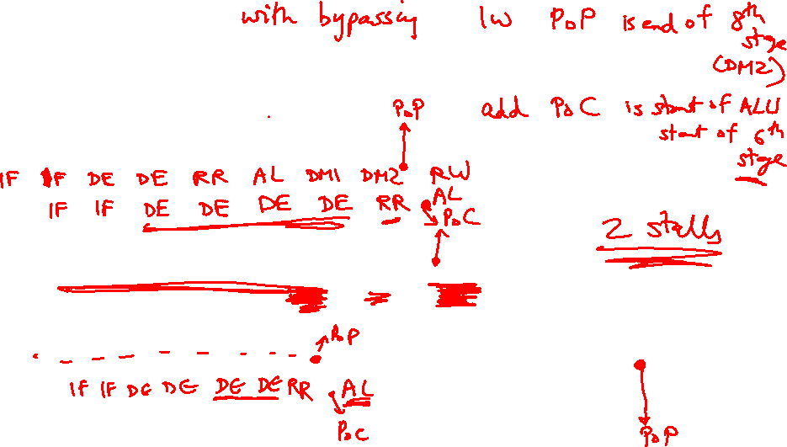
Problem 4
A 7 or 9 stage pipeline, RR and RW take an entire stage
IF
IF
Dec
Dec
RR
ALU
RW
ALU
DM
DM
RW
lw $1, 8($2)
add $4, $1, $3

Slide 11
Problem 4
Without bypassing: 4 stalls
IF:IF:DE:DE:RR:AL:DM:DM:RW
IF: IF :DE:DE:DE:DE: DE :DE:RR:AL:RW
With bypassing: 2 stalls
IF:IF:DE:DE:RR:AL:DM:DM:RW
IF: IF :DE:DE:DE:DE: RR :AL:RW
lw $1, 8($2)
add $4, $1, $3
IF
IF
Dec
Dec
RR
ALU
RW
ALU
DM
DM
RW

Slide 12
Control Hazards
Simple techniques to handle control hazard stalls:
  for every branch, introduce a stall cycle (note: every
  6th instruction is a branch!)
  assume the branch is not taken and start fetching the
  next instruction – if the branch is taken, need hardware
  to cancel the effect of the wrong-path instruction
  fetch the next instruction (branch delay slot) and
  execute it anyway – if the instruction turns out to be
  on the correct path, useful work was done – if the
  instruction turns out to be on the wrong path,
  hopefully program state is not lost
  make a smarter guess and fetch instructions from the
  expected target

Slide 13
Branch Delay Slots
Source: H&P textbook

Slide 14
Pipeline without Branch Predictor
PC
IF (br)
Reg Read
Compare
Br-target
PC + 4

Slide 15
Pipeline with Branch Predictor
PC
IF (br)
Reg Read
Compare
Br-target
Branch
Predictor

Slide 16
2-Bit Prediction
For each branch, maintain a 2-bit saturating counter:
if the branch is taken: counter = min(3,counter+1)
if the branch is not taken: counter = max(0,counter-1)
… sound familiar?
If (counter >= 2), predict taken, else predict not taken
The counter attempts to capture the common case for
each branch

