Slide 1

Lecture 18: Pipelining
Today’s topics:
  5-stage pipeline
  Hazards
  Data dependence handling with bypassing
  Data dependence examples

Slide 2
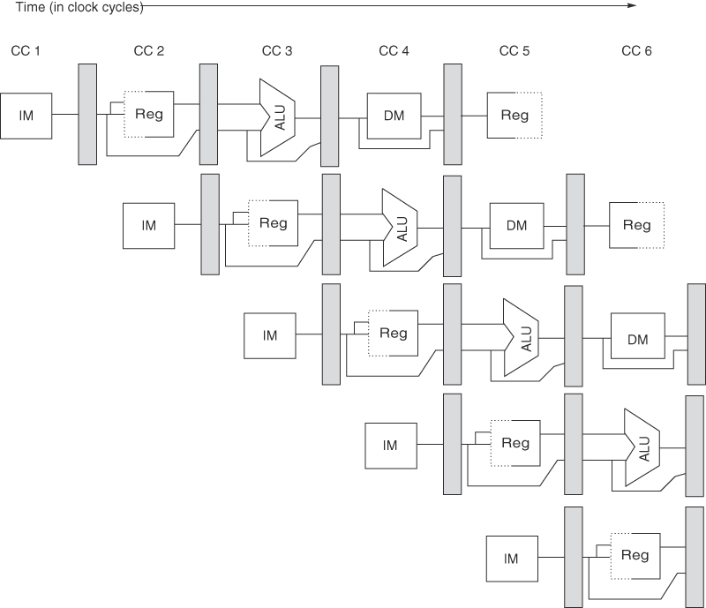
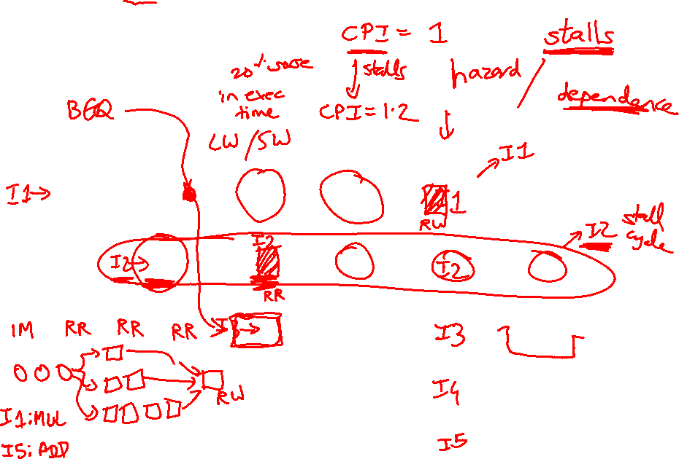
A 5-Stage Pipeline
Source: H&P textbook

Slide 3
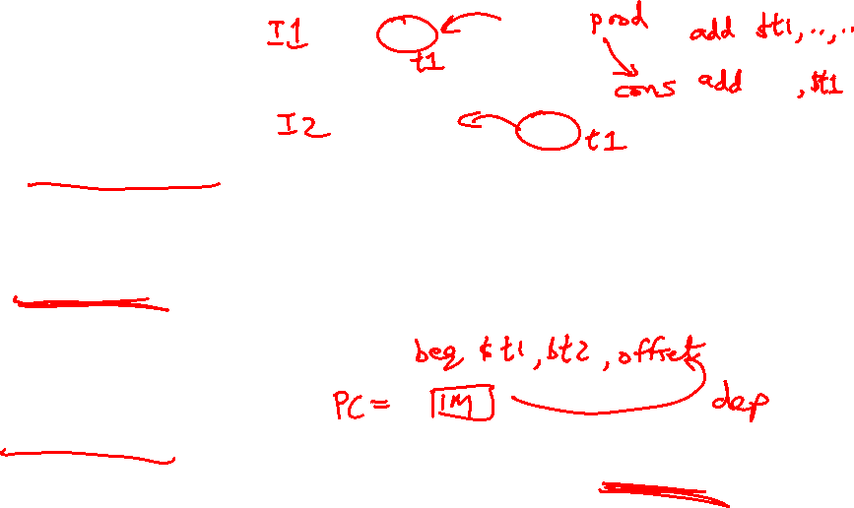
Hazards
Structural hazards: different instructions in different stages
(or the same stage) conflicting for the same resource
Data hazards: an instruction cannot continue because it
needs a value that has not yet been generated by an
earlier instruction
Control hazard: fetch cannot continue because it does
not know the outcome of an earlier branch – special case
of a data hazard – separate category because they are
treated in different ways

Slide 4

Conflicts/Problems
I-cache and D-cache are accessed in the same cycle – it
helps to implement them separately
Registers are read and written in the same cycle – easy to
deal with if register read/write time equals cycle time/2
Instructions can’t skip the DM stage, else conflict for RW
Consuming instruction may have to wait for producer
Branch target changes only at the end of the second stage
-- what do you do in the meantime?

Slide 5
Structural Hazards
Example: a unified instruction and data cache →
stage 4 (MEM) and stage 1 (IF) can never coincide
The later instruction and all its successors are delayed
until a cycle is found when the resource is free → these
are pipeline bubbles
Structural hazards are easy to eliminate – increase the
number of resources (for example, implement a separate
instruction and data cache, add more register ports)

Slide 6
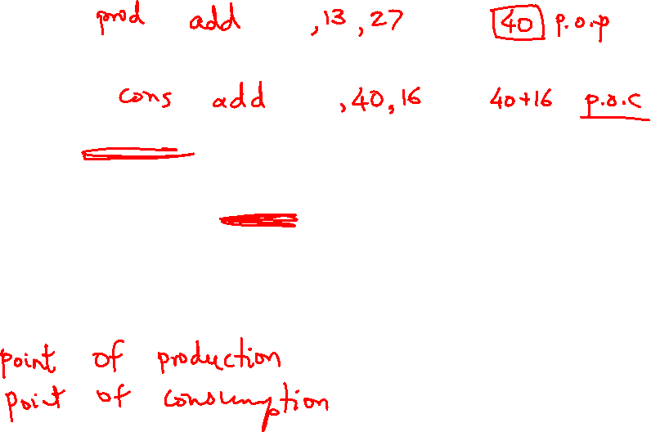
Data Hazards
An instruction produces a value in a given pipeline stage
A subsequent instruction consumes that value in a pipeline
stage
The consumer may have to be delayed so that the time
of consumption is later than the time of production

Slide 7
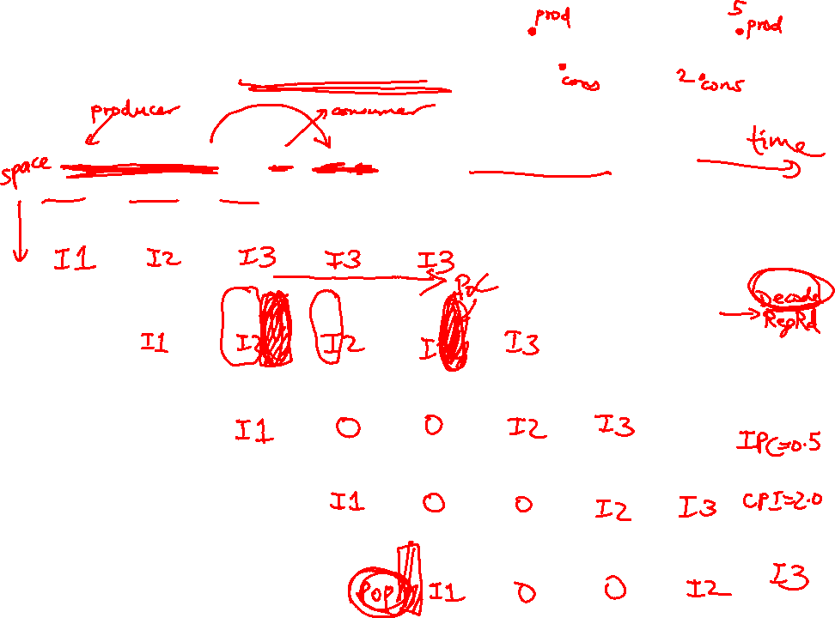
Example 1 – No Bypassing
Show the instruction occupying each stage in each cycle (no bypassing)
if I1 is R1+R2→R3 and I2 is R3+R4→R5 and I3 is R7+R8→R9
CYC-1
CYC-2
CYC-3
CYC-4
CYC-5
CYC-6
CYC-7
CYC-8
IF
IF
IF
IF
IF
IF
IF
IF
D/R
D/R
D/R
D/R
D/R
D/R
D/R
D/R
ALU
ALU
ALU
ALU
ALU
ALU
ALU
ALU
DM
DM
DM
DM
DM
DM
DM
DM
RW
RW
RW
RW
RW
RW
RW
RW

Slide 8
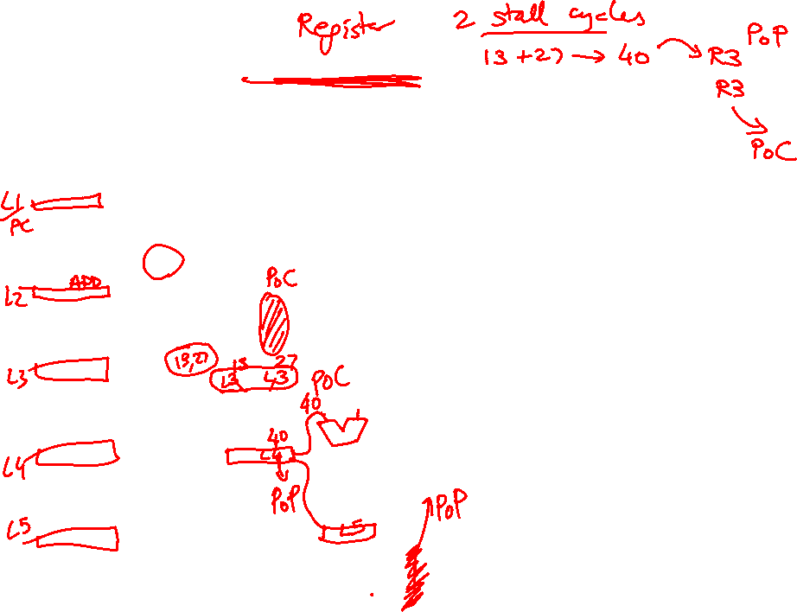
Example 1 – No Bypassing
Show the instruction occupying each stage in each cycle (no bypassing)
if I1 is R1+R2→R3 and I2 is R3+R4→R5 and I3 is R7+R8→R9
CYC-1
CYC-2
CYC-3
CYC-4
CYC-5
CYC-6
CYC-7
CYC-8
IF
I1
IF
I2
IF
I3
IF
I3
IF
I3
IF
I4
IF
I5
IF
D/R
D/R
I1
D/R
I2
D/R
I2
D/R
I2
D/R
I3
D/R
I4
D/R
ALU
ALU
ALU
I1
ALU
ALU
ALU
I2
ALU
I3
ALU
DM
DM
DM
DM
I1
DM
DM
DM
I2
DM
I3
RW
RW
RW
RW
RW
I1
RW
RW
RW
I2

Slide 9
Example 2 – Bypassing
Show the instruction occupying each stage in each cycle (with bypassing)
if I1 is R1+R2→R3 and I2 is R3+R4→R5 and I3 is R3+R8→R9.
Identify the input latch for each input operand.
CYC-1
CYC-2
CYC-3
CYC-4
CYC-5
CYC-6
CYC-7
CYC-8
IF
IF
IF
IF
IF
IF
IF
IF
D/R
D/R
D/R
D/R
D/R
D/R
D/R
D/R
ALU
ALU
ALU
ALU
ALU
ALU
ALU
ALU
DM
DM
DM
DM
DM
DM
DM
DM
RW
RW
RW
RW
RW
RW
RW
RW

Slide 10
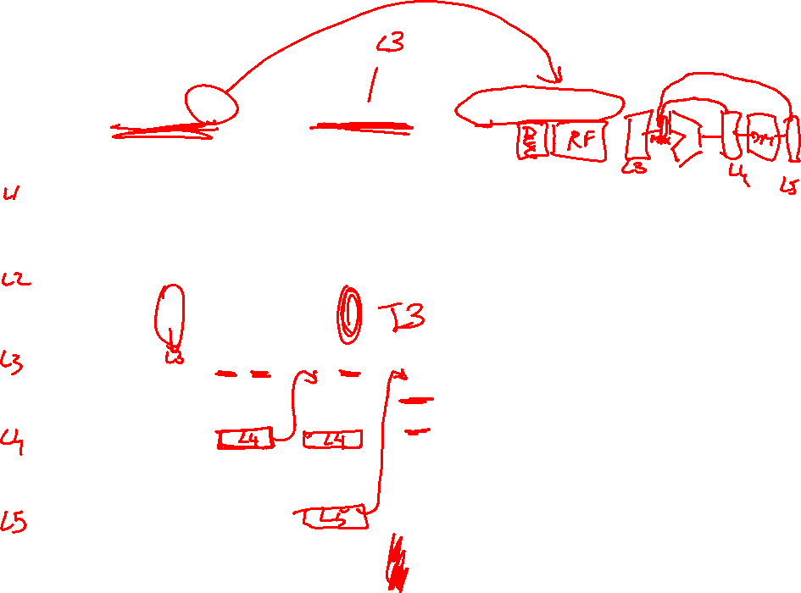
Example 2 – Bypassing
Show the instruction occupying each stage in each cycle (with bypassing)
if I1 is R1+R2→R3 and I2 is R3+R4→R5 and I3 is R3+R8→R9.
Identify the input latch for each input operand.
CYC-1
CYC-2
CYC-3
CYC-4
CYC-5
CYC-6
CYC-7
CYC-8
IF
I1
IF
I2
IF
I3
IF
I4
IF
I5
IF
IF
IF
D/R
D/R
I1
D/R
I2
D/R
I3
D/R
I4
D/R
D/R
D/R
L3 L3 L4 L3 L5 L3
ALU
ALU
ALU
I1
ALU
I2
ALU
I3
ALU
ALU
ALU
DM
DM
DM
DM
I1
DM
I2
DM
I3
DM
DM
RW
RW
RW
RW
RW
I1
RW
I2
RW
I3
RW

Slide 11
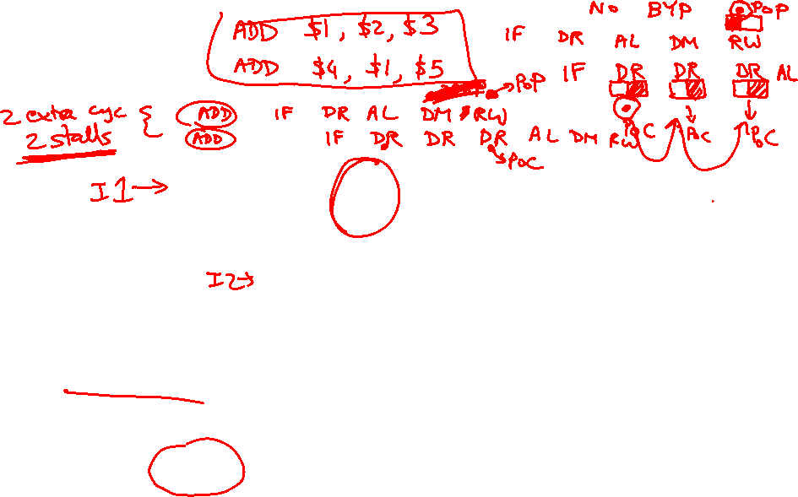
Problem 1
IF
D/R
ALU
DM
RW
IF
D/R
ALU
DM
RW
IF
D/R
ALU
DM
RW
add $1, $2, $3
lw $4, 8($1)
IF
D/R
ALU
DM
RW

Slide 12
Problem 2
IF
D/R
ALU
DM
RW
IF
D/R
ALU
DM
RW
lw $1, 8($2)
lw $4, 8($1)
IF
D/R
ALU
DM
RW
IF
D/R
ALU
DM
RW

Slide 13
Problem 3
IF
D/R
ALU
DM
RW
IF
D/R
ALU
DM
RW
IF
D/R
ALU
DM
RW
lw $1, 8($2)
sw $1, 8($3)
IF
D/R
ALU
DM
RW

Slide 14
