Slide 1
Lecture 15: Review Session
Today’s topics:
  FSM examples
  Midterm review session
  Midterm rules:
  Students are allowed to bring 3 A4/letter-sized sheets of paper with anything written/printed on both sides. In addition, you may bring the ``green sheet''. You may also bring a phone/calculator that can be used for any numeric calculations (but it's also ok to write a mathematical term, say 1.4/2.2 GHz without doing the calculation). You may of course not use your phone to surf the web or consult with others during the test. You may also not use the MARS simulator or other calculators/tools for numeric conversions. If necessary, make reasonable assumptions and clearly state them. The only clarifications you may ask for during the exam are definitions of terms. You will receive partial credit if you show your steps and explain your line of thinking, so attempt every question even if you can't fully solve it. Complete your answers in the space provided (including the back-side of each page). Confirm that you have 14 questions on 8 pages, followed by a blank page. Turn in your answer sheets before 10:35am. The test is worth 100 points and you have about 90 minutes, so allocate time accordingly.

Slide 2
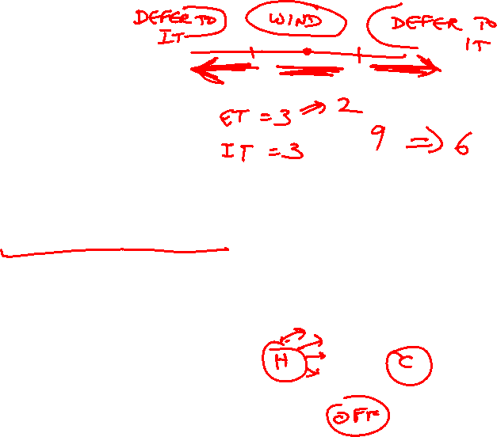
Tackling FSM Problems
Three questions worth asking:
  What are the possible output states? Draw a
  bubble for each.
  What are inputs? What values can those inputs take?
  For each state, what do I do for each possible
  input value? Draw an arc out of every bubble for
  every input value.

Slide 3
Example – Residential Thermostat
Two temp sensors: internal and external
If internal temp is within 1 degree of desired, don’t
change setting
If internal temp is > 1 degree higher than desired, turn
AC on; if internal temp is < 1 degree lower than
desired, turn heater on
If external temp and desired temp are within 5
degrees, disregard the internal temp, and turn both AC
and heater off

Slide 4

Finite State Machine Table

Slide 5
Finite State Diagram
HEAT
U-H
COOL
U-C,
U-G
U-H,
U-G
U-C
D-C,
D-G,
D-H
U-C
U-H
D-C,
D-G,
D-H
OFF
Int temp settings:
C – cold
G – goldilocks
H – hot
Ext temp settings:
D – desired zone
U – undesired zone
D-C, D-G, D-H, U-G

Slide 6
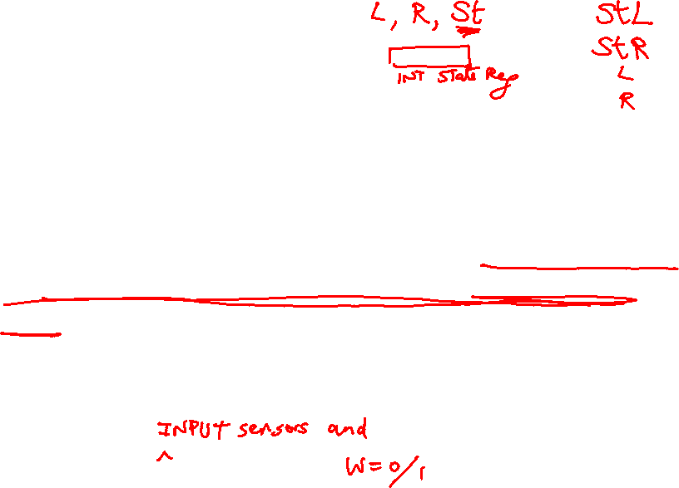
Vacuum Robot Example
Consider the following sequential circuit for an automated vacuum cleaning device. The circuit decides if the steering should be kept straight, or if it should be moved right, or moved left. The device has a sensor that determines if the device has hit a wall. If a wall hasn't been hit, the steering is kept straight. If a wall has been hit, the steering is turned to the opposite of its last non-straight position, i.e., if the steering's last non-straight position was right, the steering is now moved to left.
What are the output states for this finite state machine?
What are the different input values being received by the finite state machine?
Construct the finite state transition table for this circuit.

Slide 7
Vacuum Robot Example
At first, the output of the circuit appears to be LEFT, RIGHT, STRAIGHT. But the circuit also needs to remember if the steering's last non-straight setting was LEFT or RIGHT. I could either do this with an internal variable that remembers this state, or I could make this part of the output state. I'll go with the latter approach, so the output states now become LEFT, RIGHT, LSTRAIGHT, RSTRAIGHT.
There's only 1 input, which is the wall-detecting sensor, which is either 1 (wall detected) or 0 (wall not detected).
The finite state table will therefore have 8 entries (4 states, each receiving 2 possible input values).

Slide 8
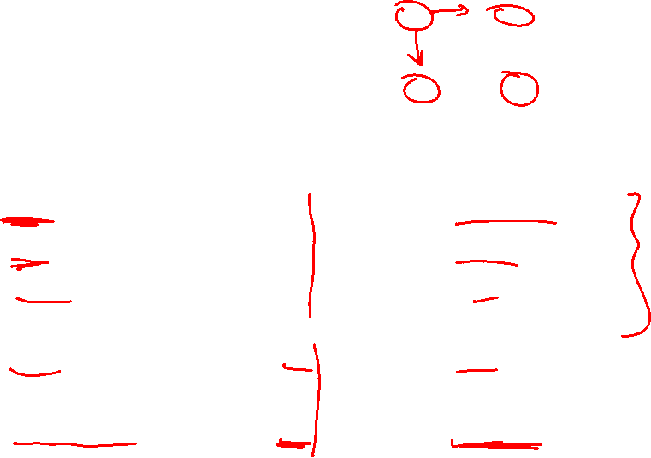
Vacuum Robot Example

Slide 9
Modern Trends
Historical contributions to performance:
  Better processes (faster devices) ~20%
  Better circuits/pipelines ~15%
  Better organization/architecture ~15%
Today, annual improvement is closer to 20%; this is primarily
because of slowly increasing transistor count and more cores.
Need multi-thread parallelism and accelerators to boost
performance every year.

Slide 10

Performance Measures
Performance = 1 / execution time
Speedup = ratio of performance
Performance improvement = speedup -1
Execution time = clock cycle time x CPI x number of instrs
Program takes 100 seconds on ProcA and 150 seconds on ProcB
Speedup of A over B = 150/100 = 1.5
Performance improvement of A over B = 1.5 – 1 = 0.5 = 50%
Speedup of B over A = 100/150 = 0.66 (speedup less than 1 means
performance went down)
Performance improvement of B over A = 0.66 – 1 = -0.33 = -33%
or Performance degradation of B, relative to A = 33%
If multiple programs are executed, the execution times are combined
into a single number using AM, weighted AM, or GM

Slide 11
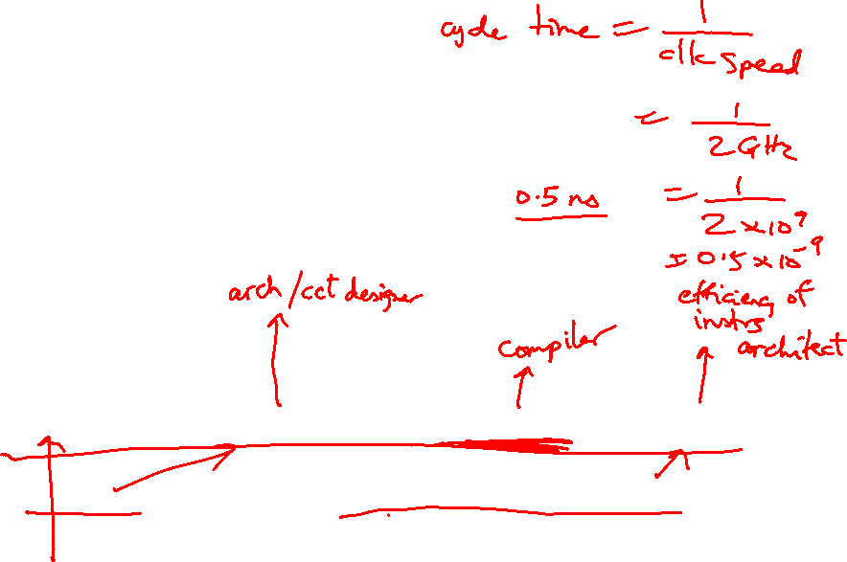
Performance Equations
CPU execution time = CPU clock cycles x Clock cycle time
CPU clock cycles = number of instrs x avg clock cycles
per instruction (CPI)
Substituting in previous equation,
Execution time = clock cycle time x number of instrs x avg CPI
If a 2 GHz processor graduates an instruction every third cycle,
how many instructions are there in a program that runs for
10 seconds?

Slide 12
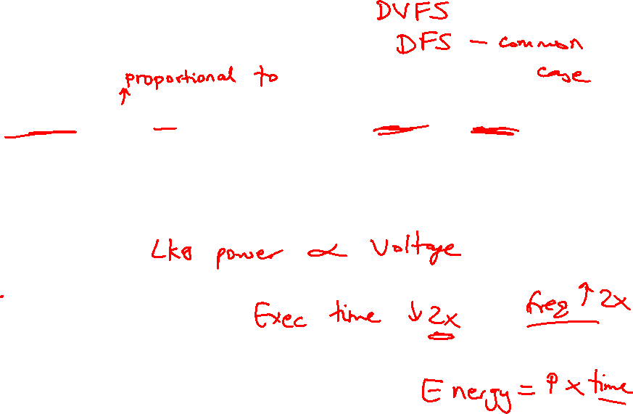
Power Consumption
Dyn power α activity x capacitance x voltage² x frequency
Capacitance per transistor and voltage are decreasing,
but number of transistors and frequency are increasing at
a faster rate
Leakage power is also rising and will soon match dynamic
power
Power consumption is already around 100W in
some high-performance processors today

Slide 13
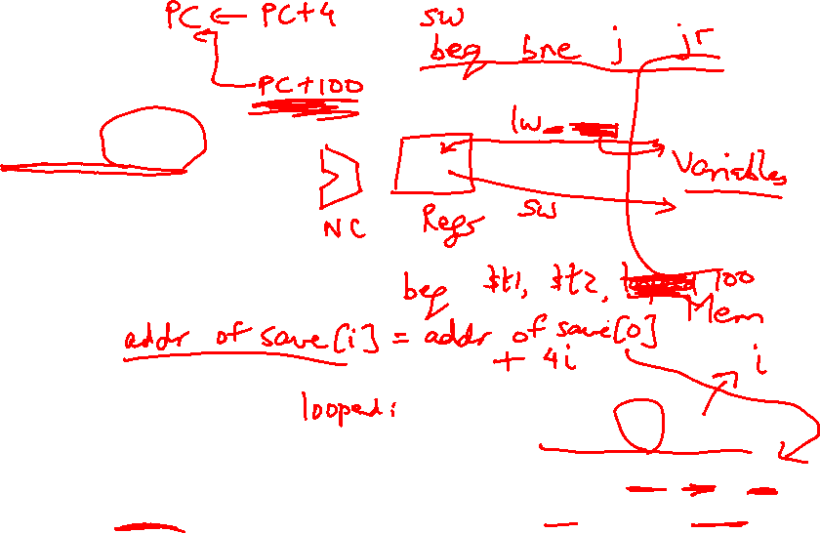
Basic MIPS Instructions
lw $t1, 16($t2)
add $t3, $t1, $t2
addi $t3, $t3, 16
sw $t3, 16($t2)
beq $t1, $t2, 16
blt is implemented as slt and bne
j 64
jr $t1
sll $t1, $t1, 2
Loop: sll $t1, $s3, 2
add $t1, $t1, $s6
lw $t0, 0($t1)
bne $t0, $s5, Exit
addi $s3, $s3, 1
j Loop
Exit:
Convert to assembly:
while (save[i] == k)
i += 1;
i and k are in $s3 and $s5 and
base of array save[] is in $s6

Slide 14
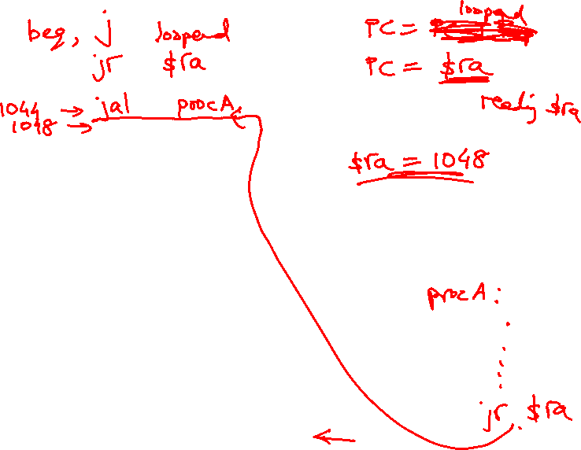
Registers
The 32 MIPS registers are partitioned as follows:
  Register 0 : $zero always stores the constant 0
  Regs 2-3 : $v0, $v1 return values of a procedure
  Regs 4-7 : $a0-$a3 input arguments to a procedure
  Regs 8-15 : $t0-$t7 temporaries
  Regs 16-23: $s0-$s7 variables
  Regs 24-25: $t8-$t9 more temporaries
  Reg 28 : $gp global pointer
  Reg 29 : $sp stack pointer
  Reg 30 : $fp frame pointer
  Reg 31 : $ra return address

Slide 15

Memory Organization
High address
Stack
Dynamic data (heap)
Proc A’s values
Proc B’s values
Static data (globals)
$fp
$gp
Proc C’s values
Text (instructions)
…
$sp
Stack grows
this way
Low address

Slide 16
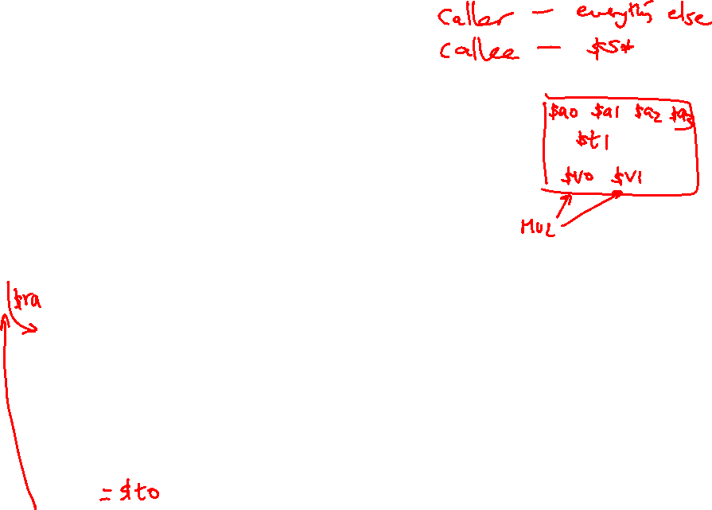
Procedure Calls/Returns
procA (int i)
{
int j;
j = …;
i = call procB(j);
… = i;
}
procB (int j)
{
int k;
… = j;
k = …;
return k;
}
procA:
$s0 = … # value of j
$t0 = … # some tempval
$a0 = $s0 # the argument
…
jal procB
…
… = $v0
procB:
$t0 = … # some tempval
… = $a0 # using the argument
$s0 = … # value of k
$v0 = $s0;
jr $ra

Slide 17
Saves and Restores
Caller saves:
  $ra, $a0, $t0, $fp (if reqd)
Callee saves:
  $s0
As every element is saved on stack,
the stack pointer is decremented
procA:
$s0 = … # value of j
$t0 = … # some tempval
$a0 = $s0 # the argument
…
jal procB
…
… = $v0
procB:
$t0 = … # some tempval
… = $a0 # using the argument
$s0 = … # value of k
$v0 = $s0;
jr $ra

Slide 18
Example 2
int fact (int n)
{
if (n < 1) return (1);
else return (n * fact(n-1));
}
fact:
addi $sp, $sp, -8
sw $ra, 4($sp)
sw $a0, 0($sp)
slti $t0, $a0, 1
beq $t0, $zero, L1
addi $v0, $zero, 1
addi $sp, $sp, 8
jr $ra
L1:
addi $a0, $a0, -1
jal fact
lw $a0, 0($sp)
lw $ra, 4($sp)
addi $sp, $sp, 8
mul $v0, $a0, $v0
jr $ra
Notes:
The caller saves $a0 and $ra
in its stack space.
Temps are never saved.

Slide 19
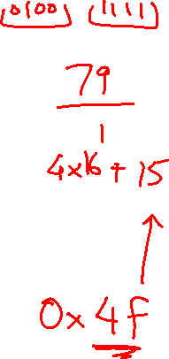
Recap – Numeric Representations
Decimal 35₁₀ = 3 x 10¹ + 5 x 10⁰
Binary 00100011₂ = 1 x 2⁵ + 1 x 2¹ + 1 x 2⁰
Hexadecimal (compact representation)
0x 23 or 23_{hex} = 2 x 16¹ + 3 x 16⁰
0-15 (decimal) → 0-9, a-f (hex)
Dec Binary Hex
0 0000 00
1 0001 01
2 0010 02
3 0011 03
Dec Binary Hex
4 0100 04
5 0101 05
6 0110 06
7 0111 07
Dec Binary Hex
8 1000 08
9 1001 09
10 1010 0a
11 1011 0b
Dec Binary Hex
12 1100 0c
13 1101 0d
14 1110 0e
15 1111 0f

Slide 20
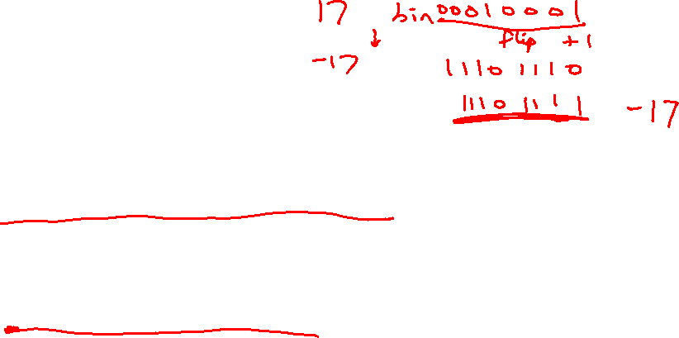
2’s Complement
0000 0000 0000 0000 0000 0000 0000 0000_{two} = 0_{ten}
0000 0000 0000 0000 0000 0000 0000 0001_{two} = 1_{ten}
…
0111 1111 1111 1111 1111 1111 1111 1111_{two} = 2³¹-1
1000 0000 0000 0000 0000 0000 0000 0000_{two} = -2³¹
1000 0000 0000 0000 0000 0000 0000 0001_{two} = -(2³¹ – 1)
1000 0000 0000 0000 0000 0000 0000 0010_{two} = -(2³¹ – 2)
…
1111 1111 1111 1111 1111 1111 1111 1110_{two} = -2
1111 1111 1111 1111 1111 1111 1111 1111_{two} = -1
Note that the sum of a number x and its inverted representation x’ always
equals a string of 1s (-1).
x + x’ = -1
x’ + 1 = -x … hence, can compute the negative of a number by
-x = x’ + 1 inverting all bits and adding 1
This format can directly undergo addition without any conversions!
Each number represents the quantity
x₃₁ -2³¹ + x₃₀ 2³⁰ + x₂₉ 2²⁹ + … + x₁ 2¹ + x₀ 2⁰

Slide 21
Multiplication Example
Multiplicand 1000_{ten}
Multiplier x 1001_{ten}
---------------
1000
0000
0000
1000
----------------
Product 1001000_{ten}
In every step
  multiplicand is shifted
  next bit of multiplier is examined (also a shifting step)
  if this bit is 1, shifted multiplicand is added to the product

Slide 22
Division
1001_{ten} Quotient
Divisor 1000_{ten} | 1001010_{ten} Dividend
-1000
10
101
1010
-1000
10_{ten} Remainder
At every step,
  shift divisor right and compare it with current dividend
  if divisor is larger, shift 0 as the next bit of the quotient
  if divisor is smaller, subtract to get new dividend and shift 1
  as the next bit of the quotient

Slide 23
Division
1001_{ten} Quotient
Divisor 1000_{ten} | 1001010_{ten} Dividend
0001001010 0001001010 0000001010 0000001010
100000000000 → 0001000000→ 0000100000→0000001000
Quo: 0 000001 0000010 000001001
At every step,
  shift divisor right and compare it with current dividend
  if divisor is larger, shift 0 as the next bit of the quotient
  if divisor is smaller, subtract to get new dividend and shift 1
  as the next bit of the quotient

Slide 24
Divide Example
Divide 7_{ten} (0000 0111_{two}) by 2_{ten} (0010_{two})
Iter | Step | Quot | Divisor | Remainder
0 | Initial values | 0000 | 0010 0000 | 0000 0111
1 | Rem = Rem – Div Rem < 0 ➔ +Div, shift 0 into Q Shift Div right | 0000 0000 0000 | 0010 0000 0010 0000 0001 0000 | 1110 0111 0000 0111 0000 0111
2 | Same steps as 1 | 0000 0000 0000 | 0001 0000 0001 0000 0000 1000 | 1111 0111 0000 0111 0000 0111
3 | Same steps as 1 | 0000 | 0000 0100 | 0000 0111
4 | Rem = Rem – Div Rem >= 0 ➔ shift 1 into Q Shift Div right | 0000 0001 0001 | 0000 0100 0000 0100 0000 0010 | 0000 0011 0000 0011 0000 0011
5 | Same steps as 4 | 0011 | 0000 0001 | 0000 0001

Slide 25
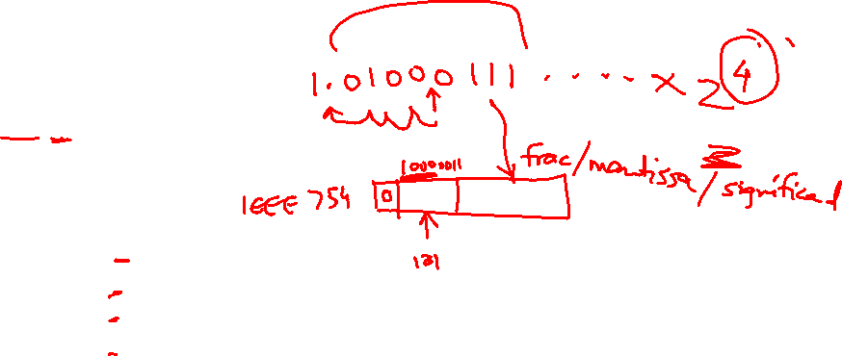
Binary FP Numbers
20.45 decimal = ? Binary
20 decimal = 10100 binary
0.45 x 2 = 0.9 (not greater than 1, first bit after binary point is 0)
0.90 x 2 = 1.8 (greater than 1, second bit is 1, subtract 1 from 1.8)
0.80 x 2 = 1.6 (greater than 1, third bit is 1, subtract 1 from 1.6)
0.60 x 2 = 1.2 (greater than 1, fourth bit is 1, subtract 1 from 1.2)
0.20 x 2 = 0.4 (less than 1, fifth bit is 0)
0.40 x 2 = 0.8 (less than 1, sixth bit is 0)
0.80 x 2 = 1.6 (greater than 1, seventh bit is 1, subtract 1 from 1.6)
… and the pattern repeats
10100.011100110011001100…
Normalized form = 1.0100011100110011… x 2⁴

Slide 26
Examples
Final representation: (-1)^{S} x (1 + Fraction) x 2^{(Exponent – Bias)}
Represent -0.75_{ten} in single and double-precision formats
Single: (1 + 8 + 23)
Double: (1 + 11 + 52)
What decimal number is represented by the following
single-precision number?
1 1000 0001 01000…0000
Remember:
True exponent Exponent in register
+127
-127

Slide 27
Examples
Final representation: (-1)^{S} x (1 + Fraction) x 2^{(Exponent – Bias)}
Represent -0.75_{ten} in single and double-precision formats
Single: (1 + 8 + 23)
1 0111 1110 1000…000
Double: (1 + 11 + 52)
1 0111 1111 110 1000…000
What decimal number is represented by the following
single-precision number?
1 1000 0001 01000…0000
-5.0

Slide 28
Example 2
Final representation: (-1)^{S} x (1 + Fraction) x 2^{(Exponent – Bias)}
Represent 36.90625_{ten} in single-precision format
36 / 2 = 18 rem 0
18 / 2 = 9 rem 0
9 / 2 = 4 rem 1
4 / 2 = 2 rem 0
2 / 2 = 1 rem 0
1 / 2 = 0 rem 1
0.90625 x 2 = 1.81250
0.8125 x 2 = 1.6250
0.625 x 2 = 1.250
0.25 x 2 = 0.50
0.5 x 2 = 1.00
0.0 x 2 = 0.0
36 is 100100
0.90625 is 0.1110100…0

Slide 29
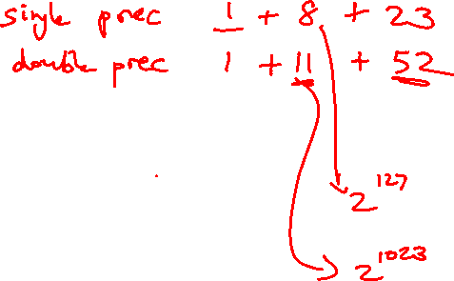
Example 2
Final representation: (-1)^{S} x (1 + Fraction) x 2^{(Exponent – Bias)}
We’ve calculated that 36.90625_{ten} = 100100.1110100…0 in binary
Normalized form = 1.001001110100…0 x 2⁵
(had to shift 5 places to get only one bit left of the point)
The sign bit is 0 (positive number)
The fraction field is 001001110100…0 (the 23 bits after the point)
The exponent field is 5 + 127 (have to add the bias) = 132,
which in binary is 10000100
The IEEE 754 format is 0 10000100 001001110100…..0
sign exponent 23 fraction bits

Slide 30

Value inf
Value NAN
Highest value ~2 x 2¹²⁷
2 special cases up top that use the
reserved exponent field of 255
0 255 00…0
0 255 xx….x
0 254 11….1
Value 1
0 127 00…0
Exponent field < 127, i.e., after
subtracting bias, they are negative
exponents, representing numbers < 1
Smallest Norm ~2 x 2⁻¹²⁶
Largest Denorm ~1 x 2⁻¹²⁶
Smallest Denorm ~2⁻¹⁴⁹
0 0..01 00…0
0 0..00 11…1
0 0..00 00…1
Special case with exponent field 0, used to
represent denorms, that help us gradually approach 0
Value 0
0 00..0 00…0
Same rules as above, but the sign bit is 1
Same magnitudes as above, but negative numbers

Slide 31
FP Addition – Binary Example
Consider the following binary example
1.010 x 2¹ + 1.100 x 2³
Convert to the larger exponent:
0.0101 x 2³ + 1.1000 x 2³
Add
1.1101 x 2³
Normalize
1.1101 x 2³
Check for overflow/underflow
Round
Re-normalize
IEEE 754 format: 0 10000010 11010000000000000000000

Slide 32
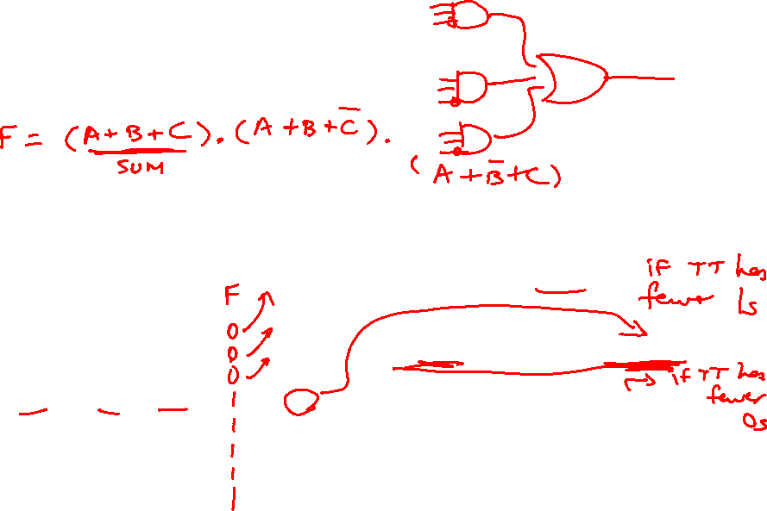
Boolean Algebra
A + B = A . B
A . B = A + B
Any truth table can be expressed
as a sum of products
A B C E
0 0 0 0
0 0 1 0
0 1 0 0
0 1 1 1
1 0 0 0
1 0 1 1
1 1 0 1
1 1 1 0
(A . B . C) + (A . C . B) + (C . B . A)
Can also use “product of sums”
Any equation can be implemented
with an array of ANDs, followed by
an array of ORs

Slide 33
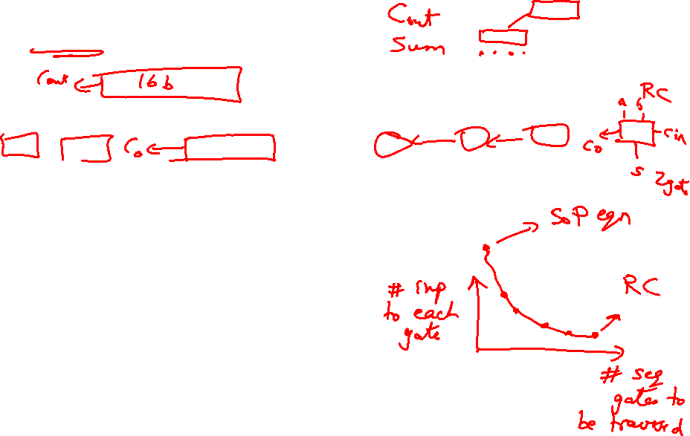
Adder Implementations
Ripple-Carry adder – each 1-bit adder feeds its carry-out to next stage –
simple design, but we must wait for the carry to propagate thru all bits
Carry-Lookahead adder – each bit can be represented by an equation
that only involves input bits (a_{i}, b_{i}) and initial carry-in (c₀) -- this is a
complex equation, so it’s broken into sub-parts
For bits a_{i}, b_{i,}, and c_{i}, a carry is generated if a_{i}.b_{i} = 1 and a carry is
propagated if a_{i} + b_{i} = 1
C_{i+1} = g_{i} + p_{i} . C_{i}
Similarly, compute these values for a block of 4 bits, then for a block
of 16 bits, then for a block of 64 bits….Finally, the carry-out for the
64th bit is represented by an equation such as this:
C₄ = G₃+ G₂.P₃ + G₁.P₂.P₃ + G₀.P₁.P₂.P₃ + C₀.P₀.P₁.P₂.P₃
Each of the sub-terms is also a similar expression

Slide 34
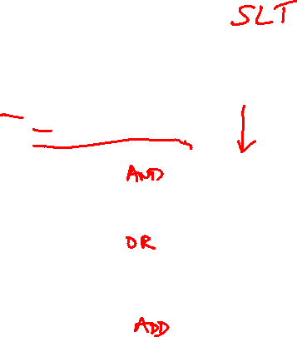
32-bit ALU
Source: H&P textbook

Slide 35

Control Lines
What are the values
of the control lines
and what operations
do they correspond to?
Ai Bn Op
AND 0 0 00
OR 0 0 01
Add 0 0 10
Sub 0 1 10
NOR 1 1 00
NAND 1 1 01
SLT 0 1 11
BEQ 0 1 10 (xx)
Source: H&P textbook

