Slide 1
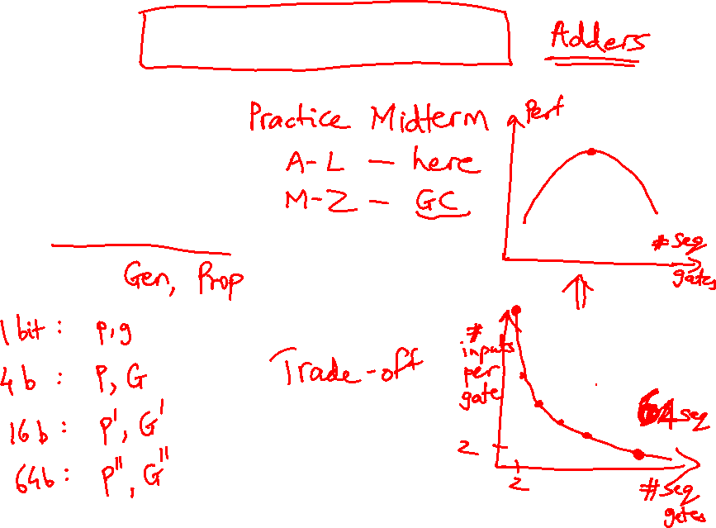
Lecture 14: Sequential Circuits, FSM
Today’s topics:
  Sequential circuits
  Finite state machines

Slide 2
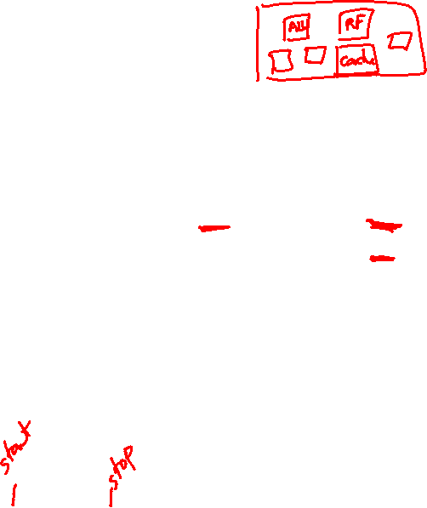
Clocks
A microprocessor is composed of many different circuits
that are operating simultaneously – if each circuit X takes in
inputs at time TI_{X}, takes time TE_{X} to execute the logic,
and produces outputs at time TO_{X}, imagine the
complications in co-ordinating the tasks of every circuit
A major school of thought (used in most processors built
today): all circuits on the chip share a clock signal (a
square wave) that tells every circuit when to accept
inputs, how much time they have to execute the logic, and
when they must produce outputs

Slide 3
Clock Terminology
Rising clock edge
Cycle time
Falling clock edge
4 GHz = clock speed = 1 = 1 .
cycle time 250 ps

Slide 4
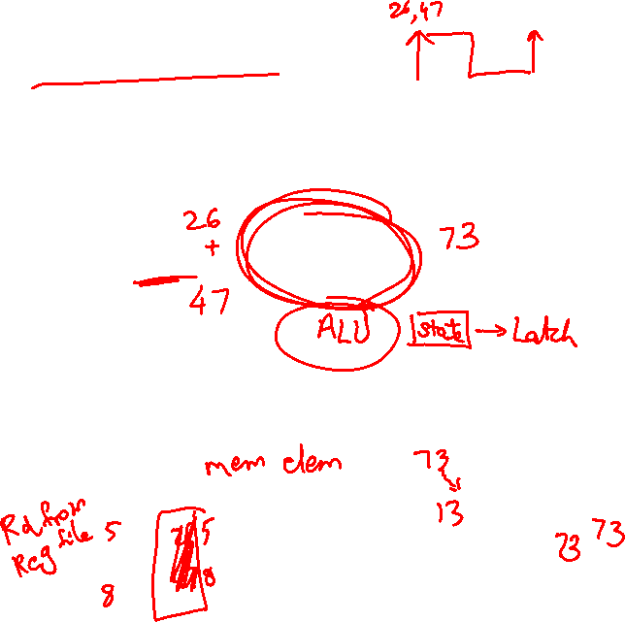
Sequential Circuits
Until now, circuits were combinational – when inputs change, the
outputs change after a while (time = logic delay thru circuit)
Combinational
Circuit
Combinational
Circuit
Inputs
Outputs
We want the clock to act like a start and stop signal – a “latch” is
a storage device that separates these circuits – it ensures that
the inputs to the circuit do not change during a clock cycle
Clock
Clock
Combinational
Circuit
Outputs
Combinational
Circuit
Inputs
Latch
Latch

Slide 5
Sequential Circuits
Sequential circuit: consists
of combinational circuit and
a storage element
At the start of the clock
cycle, the rising edge
causes the “state” storage
to store some input values
This state will not change for an entire cycle (until next rising edge)
The combinational circuit has some time to accept the value
of “state” and “inputs” and produce “outputs”
Some of the outputs (for example, the value of next “state”) may feed
back (but through the latch so they’re only seen in the next cycle)
Inputs
State
Clock
Inputs
Outputs
Combinational Cct

Slide 6
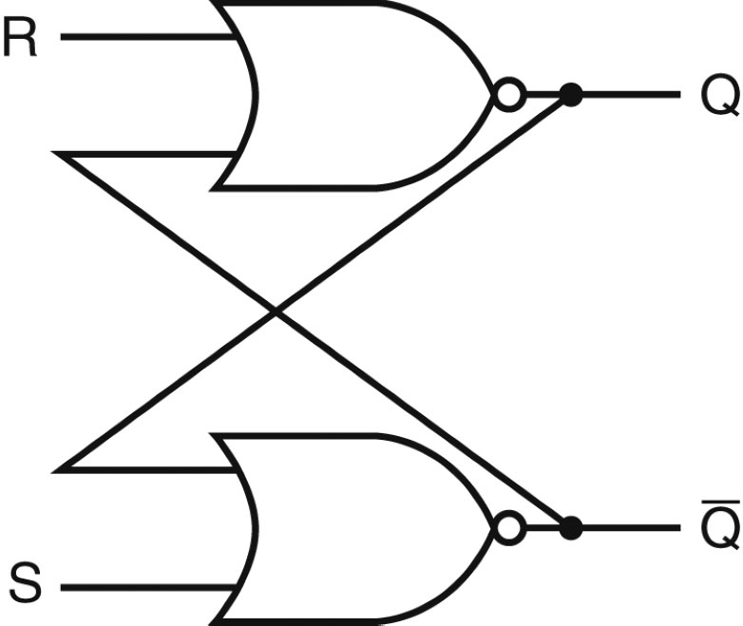
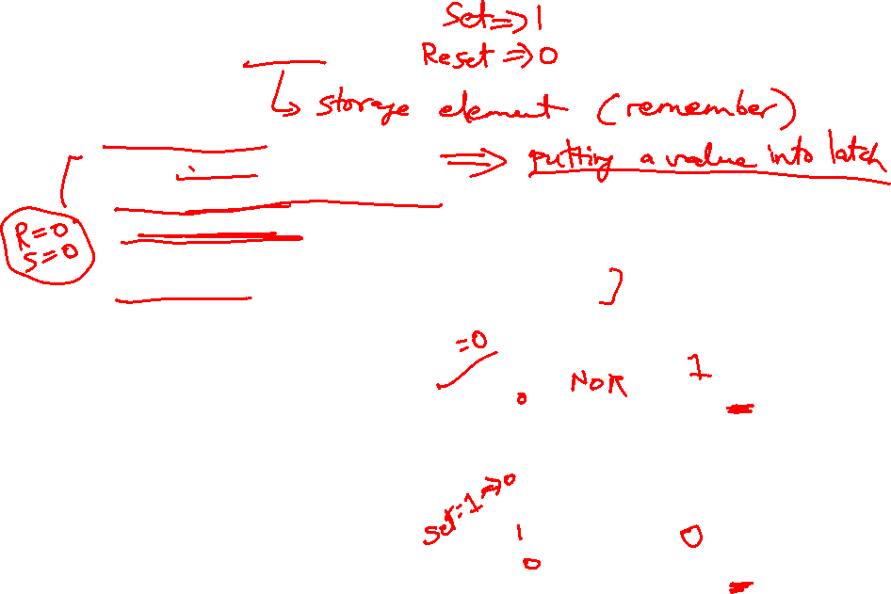
Designing a Latch
An S-R latch: set-reset latch
  When Set is high, a 1 is stored
  When Reset is high, a 0 is stored
  When both are low, the previous state is preserved (hence,
  known as a storage or memory element)
  Both are high – this set of inputs is not allowed
  Verify the above behavior!
Source: H&P textbook

Slide 7
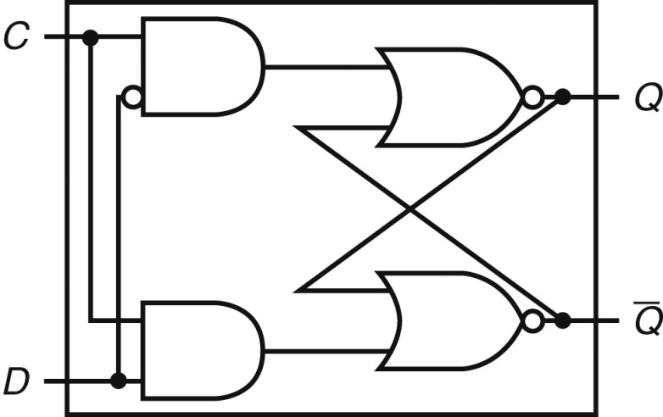
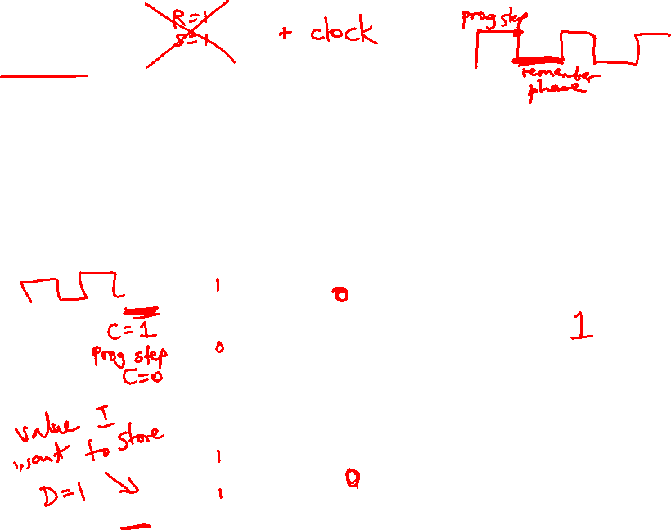
D Latch
Incorporates a clock
The value of the input D signal (data) is stored only when the clock
is high – the previous state is preserved when the clock is low
Source: H&P textbook

Slide 8
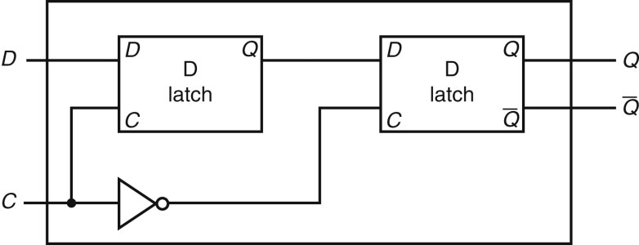
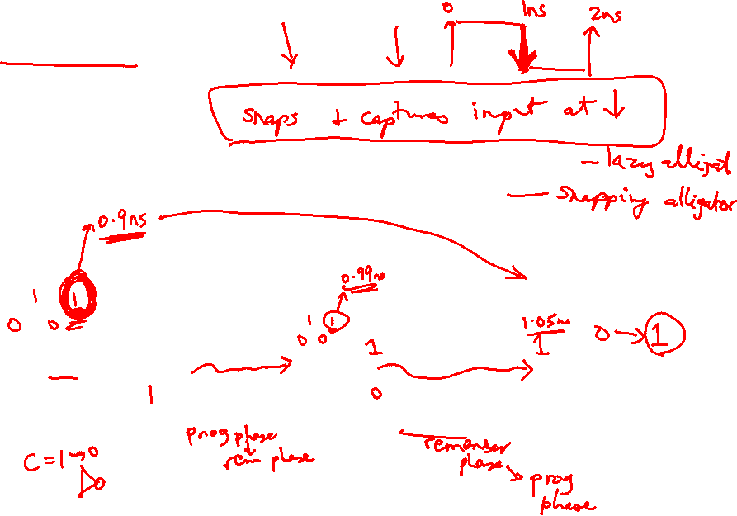
D Flip Flop
Terminology:
Latch: outputs can change any time the clock is high (asserted)
Flip flop: outputs can change only on a clock edge
Two D latches in series – ensures that a value is stored only on
the falling edge of the clock
Source: H&P textbook

Slide 9
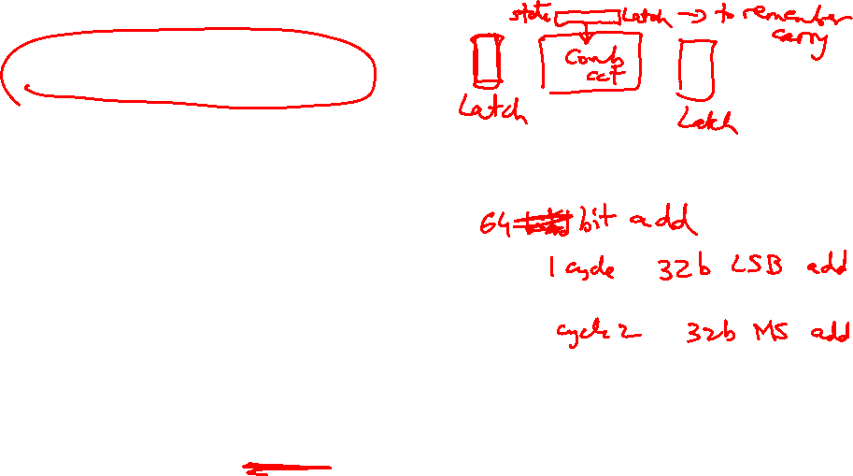
Finite State Machine
A sequential circuit is described by a variation of a truth
table – a finite state diagram (hence, the circuit is also
called a finite state machine)
Note that state is updated only on a clock edge
Next-state
Function
Next
state
Clock
Current
State
Output
Function
Outputs
Inputs

Slide 10
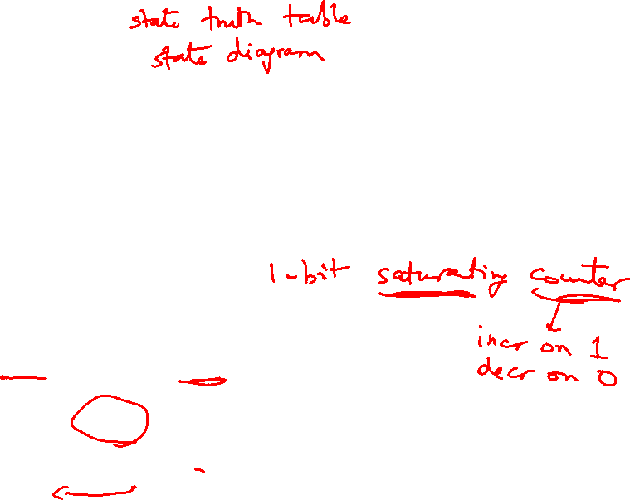
State Diagrams
Each state is shown with a circle, labeled with the state
value – the contents of the circle are the outputs
An arc represents a transition to a different state, with the
inputs indicated on the label
D = 0
D = 1
This is a state diagram for ___?
D = 1
0
0
1
1
D = 0

Slide 11

3-Bit Counter
Consider a circuit that stores a number and increments the value on
every clock edge – on reaching the largest value, it starts again from 0
Draw the state diagram:
  How many states?
  How many inputs?

Slide 12

3-Bit Counter
Consider a circuit that stores a number and increments the value on
every clock edge – on reaching the largest value, it starts again from 0
Draw the state diagram:
  How many states?
  How many inputs?
000
001
010
011
100
101
110
111
000
001
010
011
100
101
110
111

Slide 13
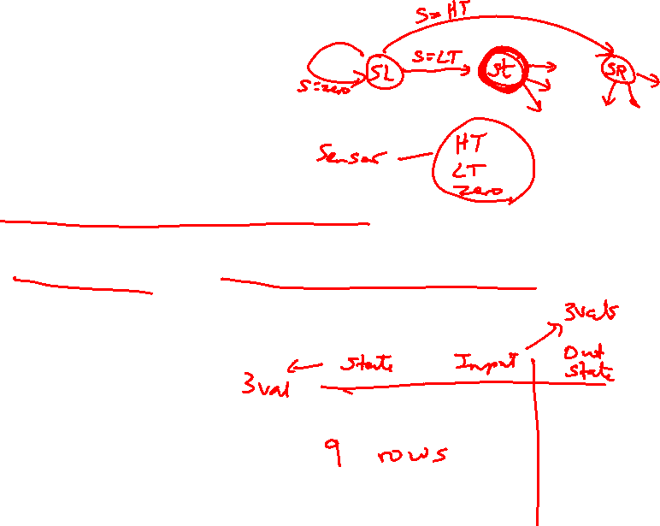
Tackling FSM Problems
Three questions worth asking:
  What are the possible output states? Draw a
  bubble for each.
  What are inputs? What values can those inputs take?
  For each state, what do I do for each possible
  input value? Draw an arc out of every bubble for
  every input value.

Slide 14
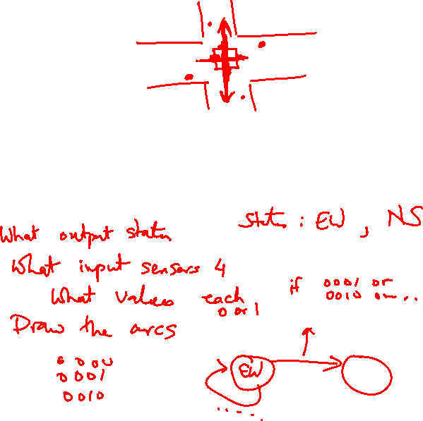
Traffic Light Controller
Problem description: A traffic light with only green and red; either the
North-South road has green or the East-West road has green (both
can’t be red); there are detectors on the roads to indicate if a car is
on the road; the lights are updated every 30 seconds; a light need
change only if a car is waiting on the other road
State Transition Table:
How many states?
How many inputs?
How many outputs?

Slide 15
State Transition Table
Problem description: A traffic light with only green and red; either the
North-South road has green or the East-West road has green (both
can’t be red); there are detectors on the roads to indicate if a car is
on the road; the lights are updated every 30 seconds; a light must
change only if a car is waiting on the other road
State Transition Table:
CurrState InputEW InputNS NextState=Output
N 0 0 N
N 0 1 N
N 1 0 E
N 1 1 E
E 0 0 E
E 0 1 N
E 1 0 E
E 1 1 N

Slide 16
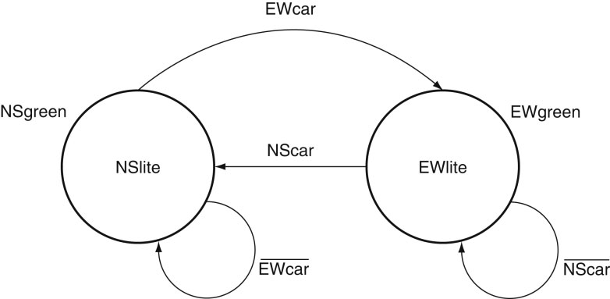
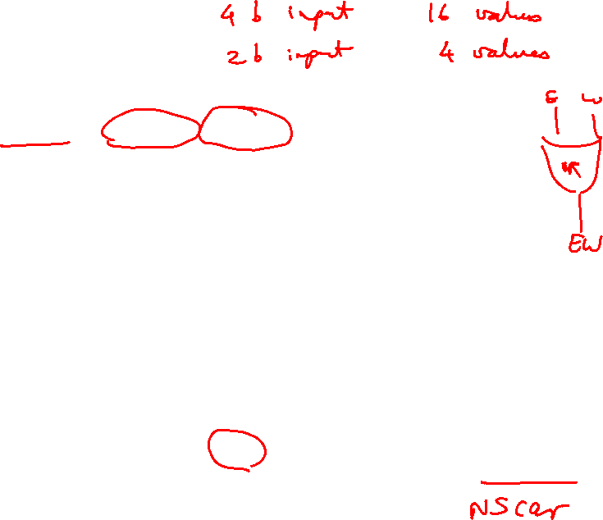
State Diagram
State Transition Table:
CurrState InputEW InputNS NextState=Output
N 0 0 N
N 0 1 N
N 1 0 E
N 1 1 E
E 0 0 E
E 0 1 N
E 1 0 E
E 1 1 N
Source: H&P textbook

Slide 17
Tackling FSM Problems
Three questions worth asking:
  What are the possible output states? Draw a
  bubble for each.
  What are inputs? What values can those inputs take?
  For each state, what do I do for each possible
  input value? Draw an arc out of every bubble for
  every input value.

Slide 18
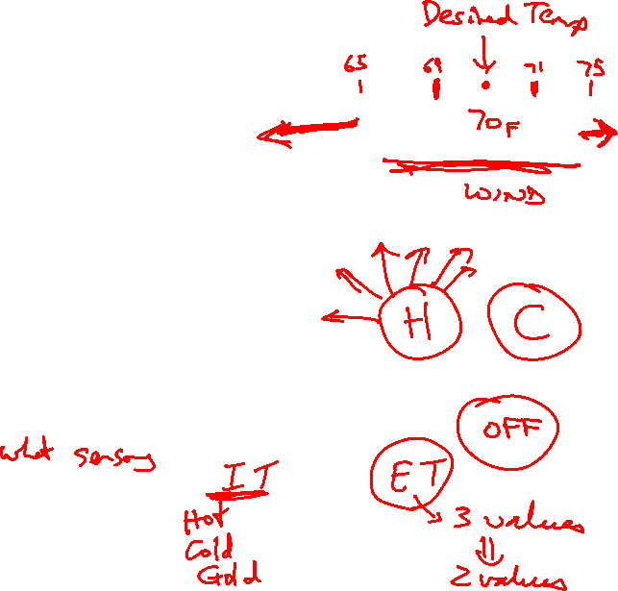
Example – Residential Thermostat
Two temp sensors: internal and external
If internal temp is within 1 degree of desired, don’t
change setting
If internal temp is > 1 degree higher than desired, turn
AC on; if internal temp is < 1 degree lower than
desired, turn heater on
If external temp and desired temp are within 5
degrees, disregard the internal temp, and turn both AC
and heater off

Slide 19
Finite State Machine Table

Slide 20
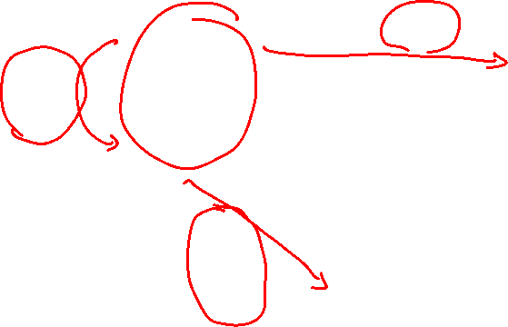
Finite State Diagram
HEAT
U-H
COOL
U-C,
U-G
U-H,
U-G
U-C
D-C,
D-G,
D-H
U-C
U-H
D-C,
D-G,
D-H
OFF
Int temp settings:
C – cold
G – goldilocks
H – hot
Ext temp settings:
D – desired zone
U – undesired zone
D-C, D-G, D-H, U-G

Slide 21
Latch vs. Flip-Flop
Recall that we want a circuit to have stable inputs for
an entire cycle – so I want my new inputs to arrive at
the start of a cycle and be fixed for an entire cycle
A flip-flop provides the above semantics (a door that
swings open and shut at the start of a cycle)
But a flip-flop needs two back-to-back D-latches, i.e.,
more transistors, delay, power
You can reduce these overheads with just a single
D-latch (a door that is open for half a cycle) as long as
you can tolerate stable inputs for just half a cycle

